Slide 1
Genetic Nurture and Family Data:
The Effects of the Parental Genotypes
Augustine Kong
University of Oxford

Slide 2
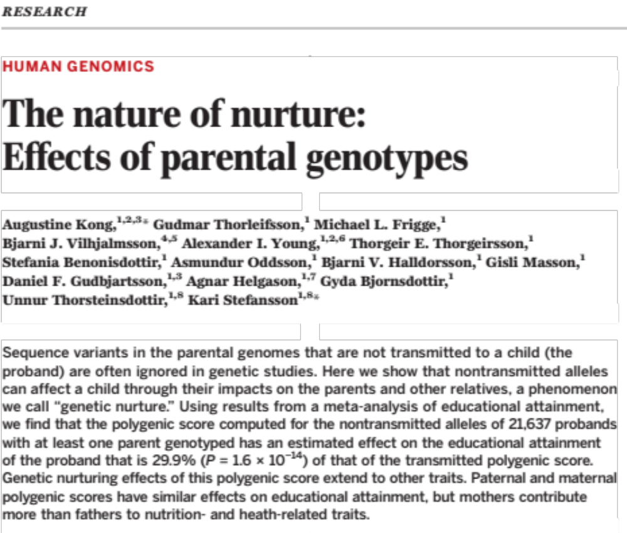
Science, Jan 2018

Slide 3
NT_{P}
T_{P}
T_{M}
NT_{M}
genetic nurturing
path
T_{P}
T_{M}
genetic
nurturing
path
Y_{P}
Y_{M}
direct
effect
path
X_{O}
NT alleles only have nurturing effects and T alleles have both direct and nurturing effects

Slide 4
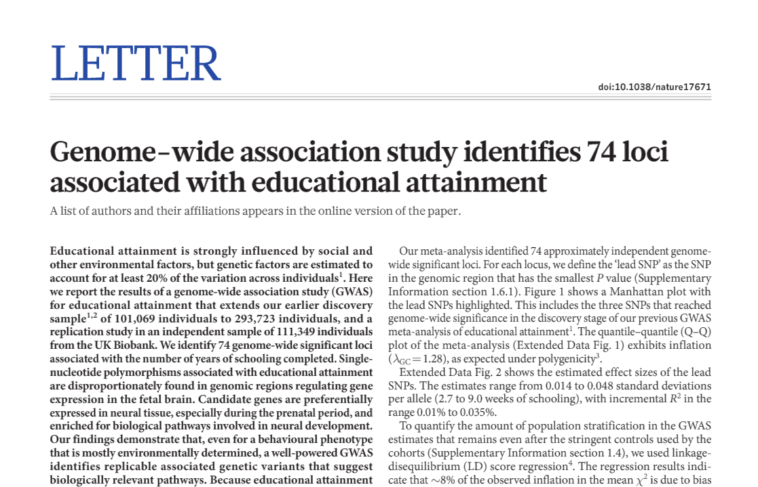
EA2
Nature 2016

Slide 5
Some special properties of the Icelandic data
Among the the over 150,000 chip-typed individuals:
56% of their mothers are chip-typed
45% of their fathers are chip-typed
37% both parents are chip-typed
For Educational Attainment (EA), there are 21,637 probands with at least one parent genotyped
Because of our work on parent-of-origin (Nature 2009), for a genotyped parent/offspring pair, we know which is the transmitted allele and which is the non-transmitted allele.

Slide 6
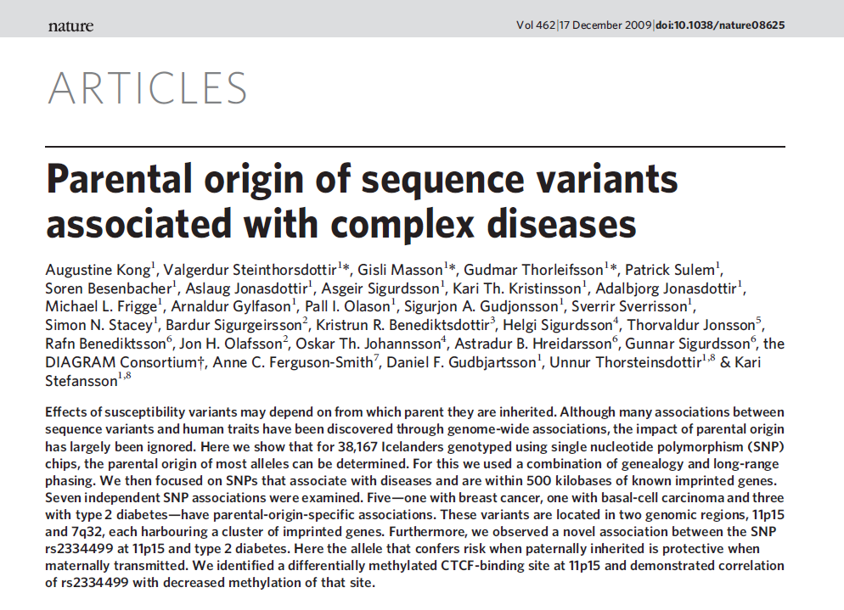
2009

Slide 7
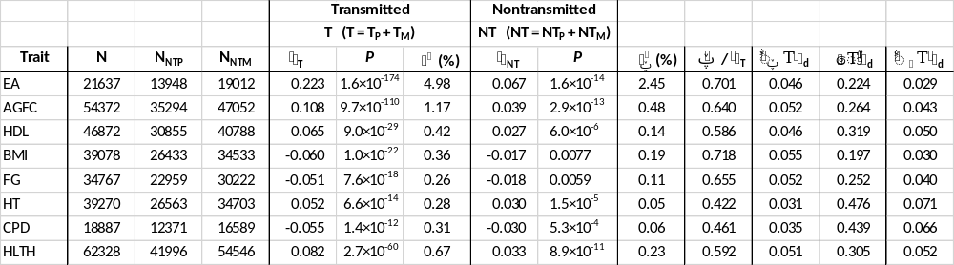
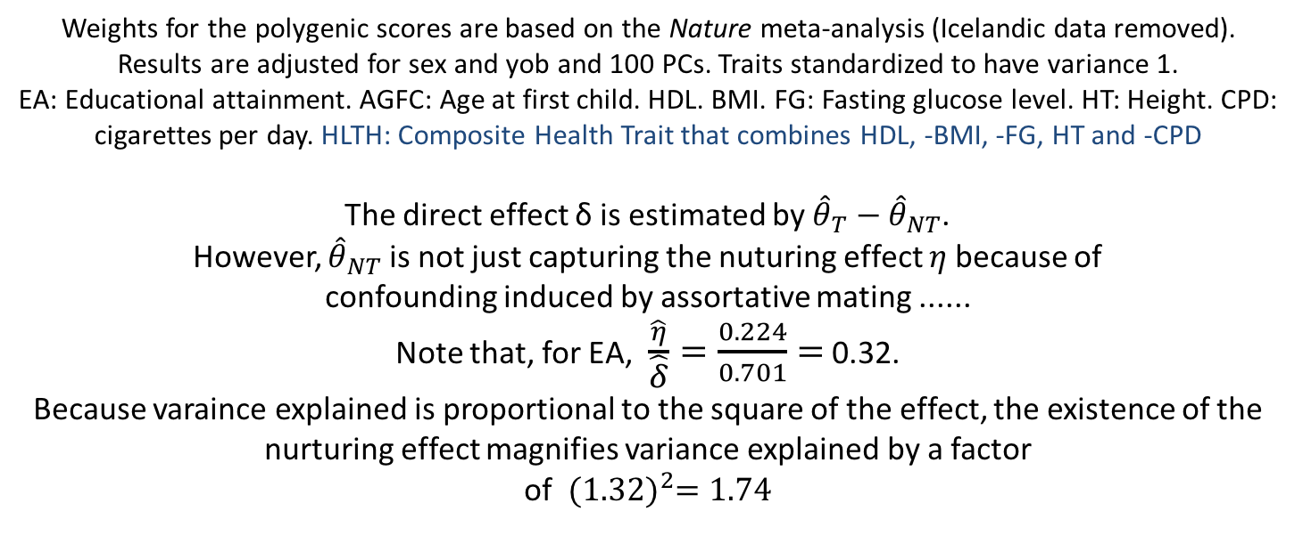
Decomposition of the observed effect of the EA polygenic score into direct, genetic nurturing,
and confounding effects
Weights for the polygenic scores are based on the Nature meta-analysis (Icelandic data removed).
Results are adjusted for sex and yob and 100 PCs. Traits standardized to have variance 1.
EA: Educational attainment. AGFC: Age at first child. HDL. BMI. FG: Fasting glucose level. HT: Height. CPD: cigarettes per day. HLTH: Composite Health Trait that combines HDL, -BMI, -FG, HT and -CPD
The direct effect δ is estimated by ${\hat{θ}}_{T}−{\hat{θ}}_{NT}$.
However, ${\hat{θ}}_{NT}$ is not just capturing the nuturing effect $η$because of
confounding induced by assortative mating ......
Note that, for EA, $\frac{\hat{η}}{\hat{δ}}=\frac{0.224}{0.701}=$0.32.
Because varaince explained is proportional to the square of the effect, the existence of the nurturing effect magnifies variance explained by a factor
of ${(1.32)}^{2}=1.74$

Slide 8
Assortative mating
and correlation of
markers
Father
Mother
between
partner
correlation
A₁
A₂
A₃
A₄
within
person
correlation
B₁
B₂
B₃
B₄
Offspring
A_{p}
A_{m}
cis correlation ϲ
cis correlation ϲ
B_{p}
B_{m}
The A alleles, transmitted or not,
can predict the B alleles (both
transmitted and non-transmitted),
particularly that of the partner.
trans
correlation
τ

Slide 9
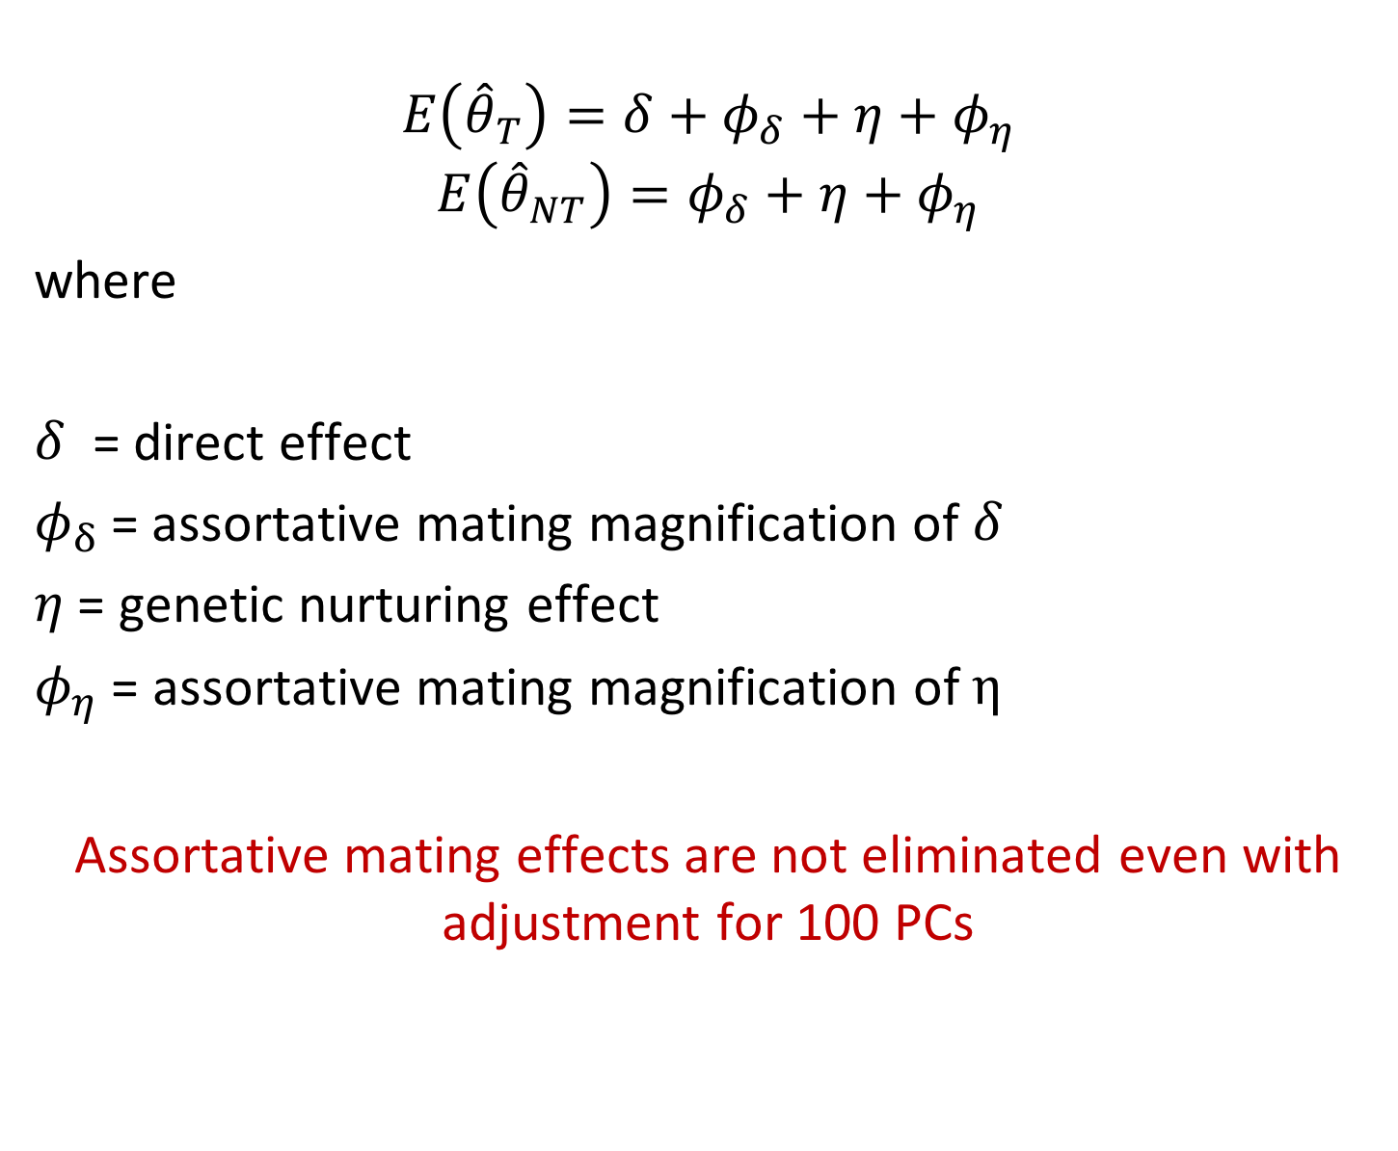
Decomposition of the expectations of ${\hat{θ}}_{T}$ and ${\hat{θ}}_{NT}$
$$E\left({\hat{θ}}_{T}\right)=δ+φ_{δ}+η+φ_{η}$$
$$E\left({\hat{θ}}_{NT}\right)=φ_{δ}+η+φ_{η}$$
where
$δ$ = direct effect
$φ_{δ}$= assortative mating magnification of $δ$
$η$ = genetic nurturing effect
$φ_{η}$ = assortative mating magnification of $η$
Assortative mating effects are not eliminated even with adjustment for 100 PCs

Slide 10
Decomposition of the observed effect of the EA polygenic score into direct, genetic nurturing,
and confounding effects
Weights for the polygenic scores are based on the Nature meta-analysis (Icelandic data removed).
Results are adjusted for sex and yob and 100 PCs. Traits standardized to have variance 1.
EA: Educational attainment. AGFC: Age at first child. HDL. BMI. FG: Fasting glucose level. HT: Height. CPD: cigarettes per day. HLTH: Composite Health Trait that combines HDL, -BMI, -FG, HT and -CPD
The direct effect δ is estimated by ${\hat{θ}}_{T}−{\hat{θ}}_{NT}$.
However, ${\hat{θ}}_{NT}$ is not just capturing the nuturing effect $η$because of
confounding induced by assortative mating ......
Note that, for EA, $\frac{\hat{η}}{\hat{δ}}=\frac{0.224}{0.701}=$0.32.
Because varaince explained is proportional to the square of the effect, the existence of the nurturing effect magnifies variance explained by a factor
of ${(1.32)}^{2}=1.74$

Slide 11
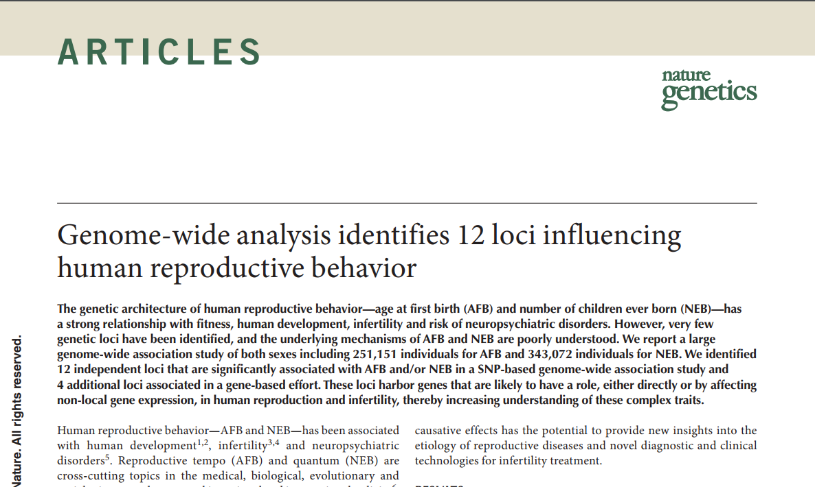
2016

Slide 12
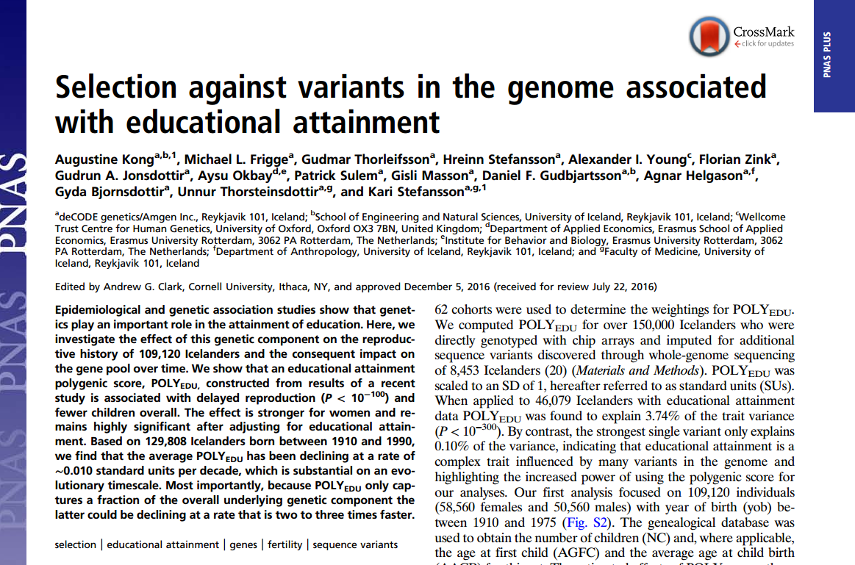
Jan, 2017

Slide 13
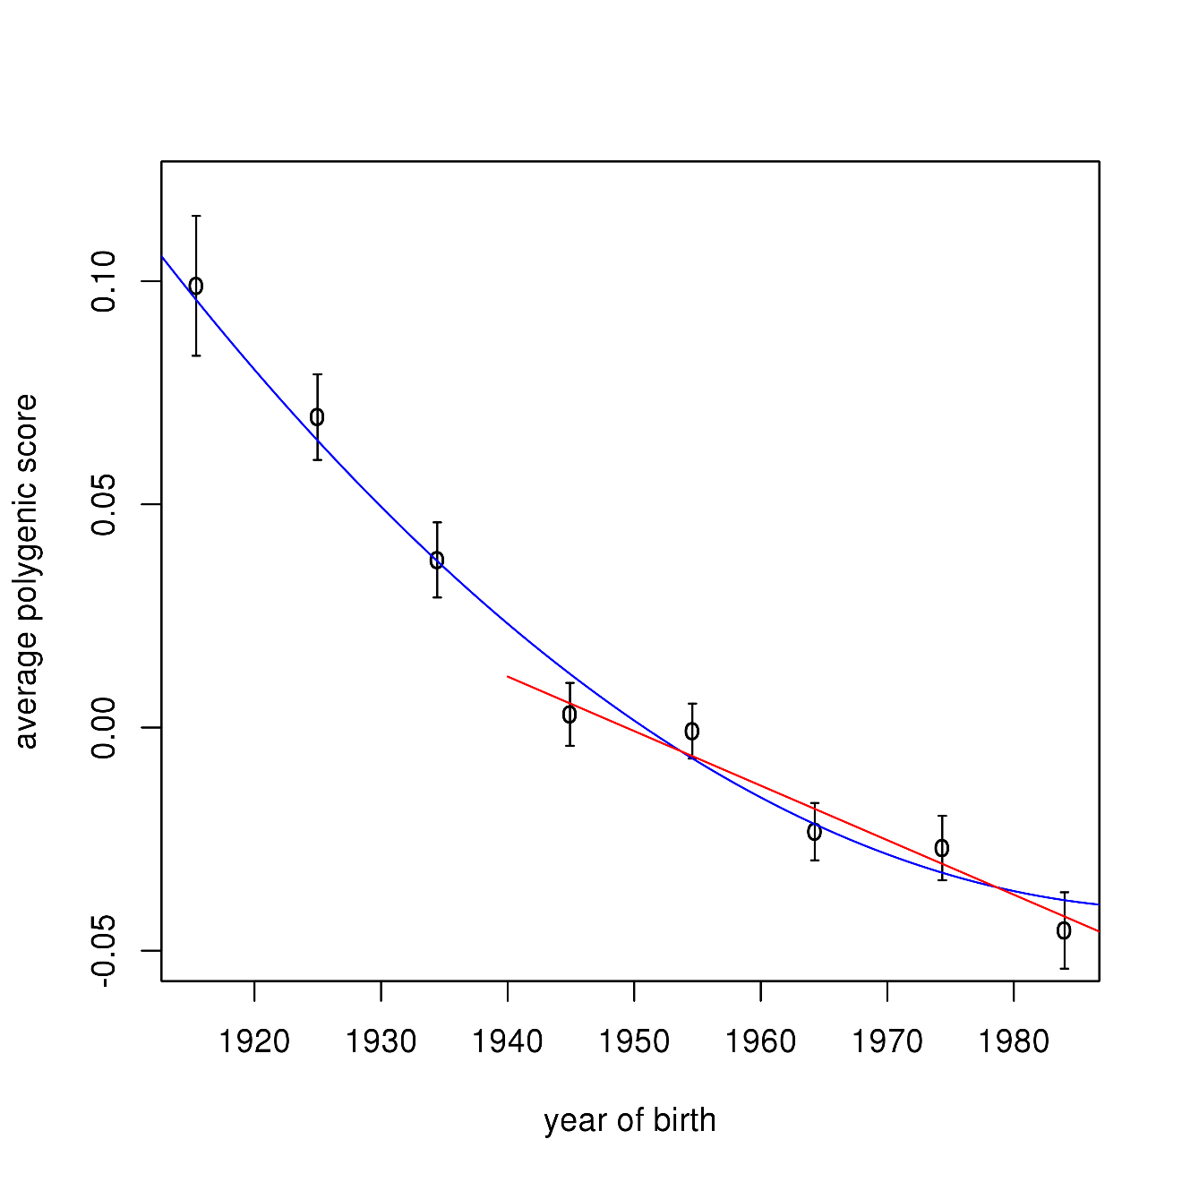
(From the PNAS paper)
Fig. 2. Average education attainment polygenic score and year of birth. Results for 10 year bins are presented. Error bars indicate plus/minus one SE. The blue line is a quadratic fit for the full yob range indicated. The red line is a linear fit applied to individuals with yob ≥1940.
slope red line
-0.012 SD per decade
decline much stronger than if the effect of the polygenic score on reproduction is manifested entirely through education
extrapolating to
POLY_{FULL}, decline
can be 2-3 times
stronger. E.g. a decline of 1SD in 300 or so years

Slide 14
Decomposition of the observed effect of the EA polygenic score into direct, genetic nurturing,
and confounding effects
Weights for the polygenic scores are based on the Nature meta-analysis (Icelandic data removed).
Results are adjusted for sex and yob and 100 PCs. Traits standardized to have variance 1.
EA: Educational attainment. AGFC: Age at first child. HDL. BMI. FG: Fasting glucose level. HT: Height. CPD: cigarettes per day. HLTH: Composite Health Trait that combines HDL, -BMI, -FG, HT and -CPD
The direct effect δ is estimated by ${\hat{θ}}_{T}−{\hat{θ}}_{NT}$.
However, ${\hat{θ}}_{NT}$ is not just capturing the nuturing effect $η$because of
confounding induced by assortative mating ......
Note that, for EA, $\frac{\hat{η}}{\hat{δ}}=\frac{0.224}{0.701}=$0.32.
Because varaince explained is proportional to the square of the effect, the existence of the nurturing effect magnifies variance explained by a factor
of ${(1.32)}^{2}=1.74$

Slide 15
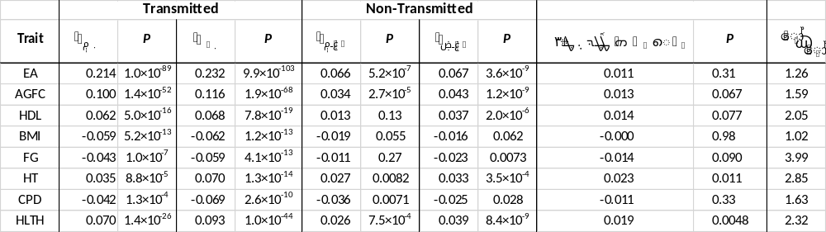
Parent-of-origin specific effects of the polygenic scores
For the composite health trait HLTH, the maternal nurturing effect
is estimated to be 2.32 times that of the paternal nurturing effect.

Slide 16
a)
NT_{P}
T_{P}
T_{M}
NT_{M}
genetic nurturing
path
T_{P}
T_{M}
genetic
nurturing
path
Y_{P}
Y_{M}
direct
effect
path
X₀
b)
Existence of genetic nurture
can profoundly affect how various heritability estimates should be interpreted.
Young et al (Nature Genetics, 2018). Estimating heritability without environmental bias.
Genetic nurture
is not only manifested
through parents.
T
T
T
T
T
Genetic nurture from siblings: P = 0.015

Slide 17
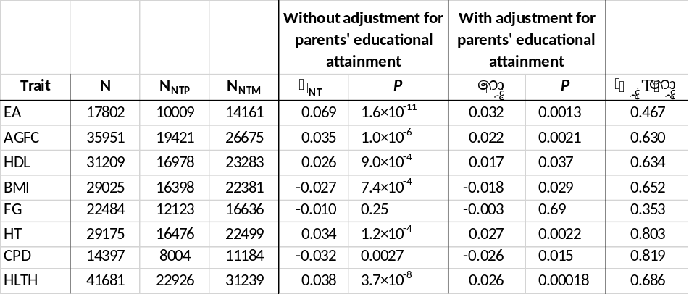
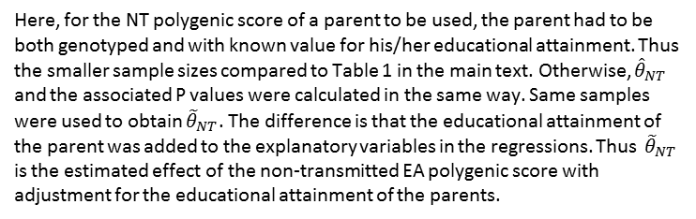
(A better understanding of Y)
Supplementary Table S4. Effects of the non-transmitted EA polygenic score without and with adjustment for the educational attainment of the parent
Here, for the NT polygenic score of a parent to be used, the parent had to be both genotyped and with known value for his/her educational attainment. Thus the smaller sample sizes compared to Table 1 in the main text. Otherwise, ${\hat{θ}}_{NT}$ and the associated P values were calculated in the same way. Same samples were used to obtain ${\tilde{θ}}_{NT}$. The difference is that the educational attainment of the parent was added to the explanatory variables in the regressions. Thus ${\tilde{θ}}_{NT}$ is the estimated effect of the non-transmitted EA polygenic score with adjustment for the educational attainment of the parents.

Slide 18
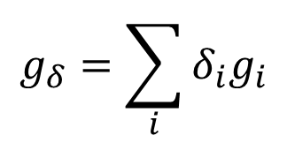
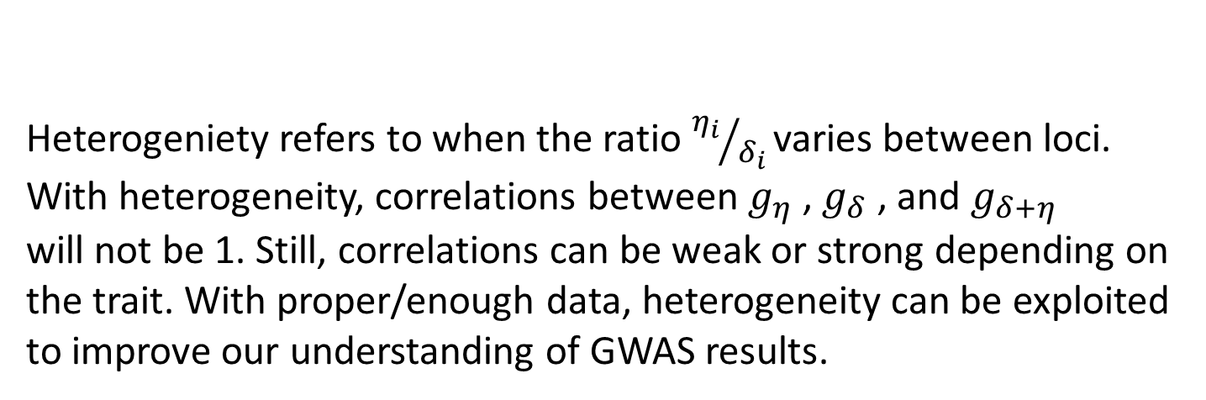
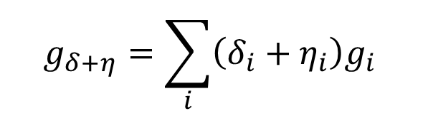
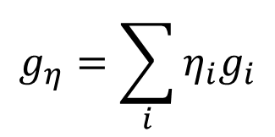
Heterogeneity of direct and nurturing effects between loci
(equations for transmitted alleles)
$$g_{δ}=\sum_{i}{δ_{i}g_{i}}$$
$$g_{η}=\sum_{i}{η_{i}g_{i}}$$
$$g_{δ+η}=\sum_{i}{\left(δ_{i}+η_{i}\right)g_{i} }$$
this is what regular GWAS could attempt to estimate
Heterogeniety refers to when the ratio ${η_{i}}/{δ_{i} }$varies between loci.
With heterogeneity, correlations between $g_{η}$ , $g_{δ}$ , and $g_{δ+η}$
will not be 1. Still, correlations can be weak or strong depending on the trait. With proper/enough data, heterogeneity can be exploited to improve our understanding of GWAS results.

Slide 19
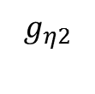





Two-trait model
4 effect sizes and 6 correlations
$$g_{η1}$$
$$g_{η2}$$
$$g_{δ1}$$
$$g_{δ2}$$
The collapsed model
2 effect sizes and 1 correlation
(the correlation is a function of 8 parameters in the model above)
$$g_{δ1+η1}$$
$$g_{δ2+η2}$$
Example: r = -0.13 estimated for EA and BMI (Bulik-Sullivan et al, NG 2015)

Slide 20
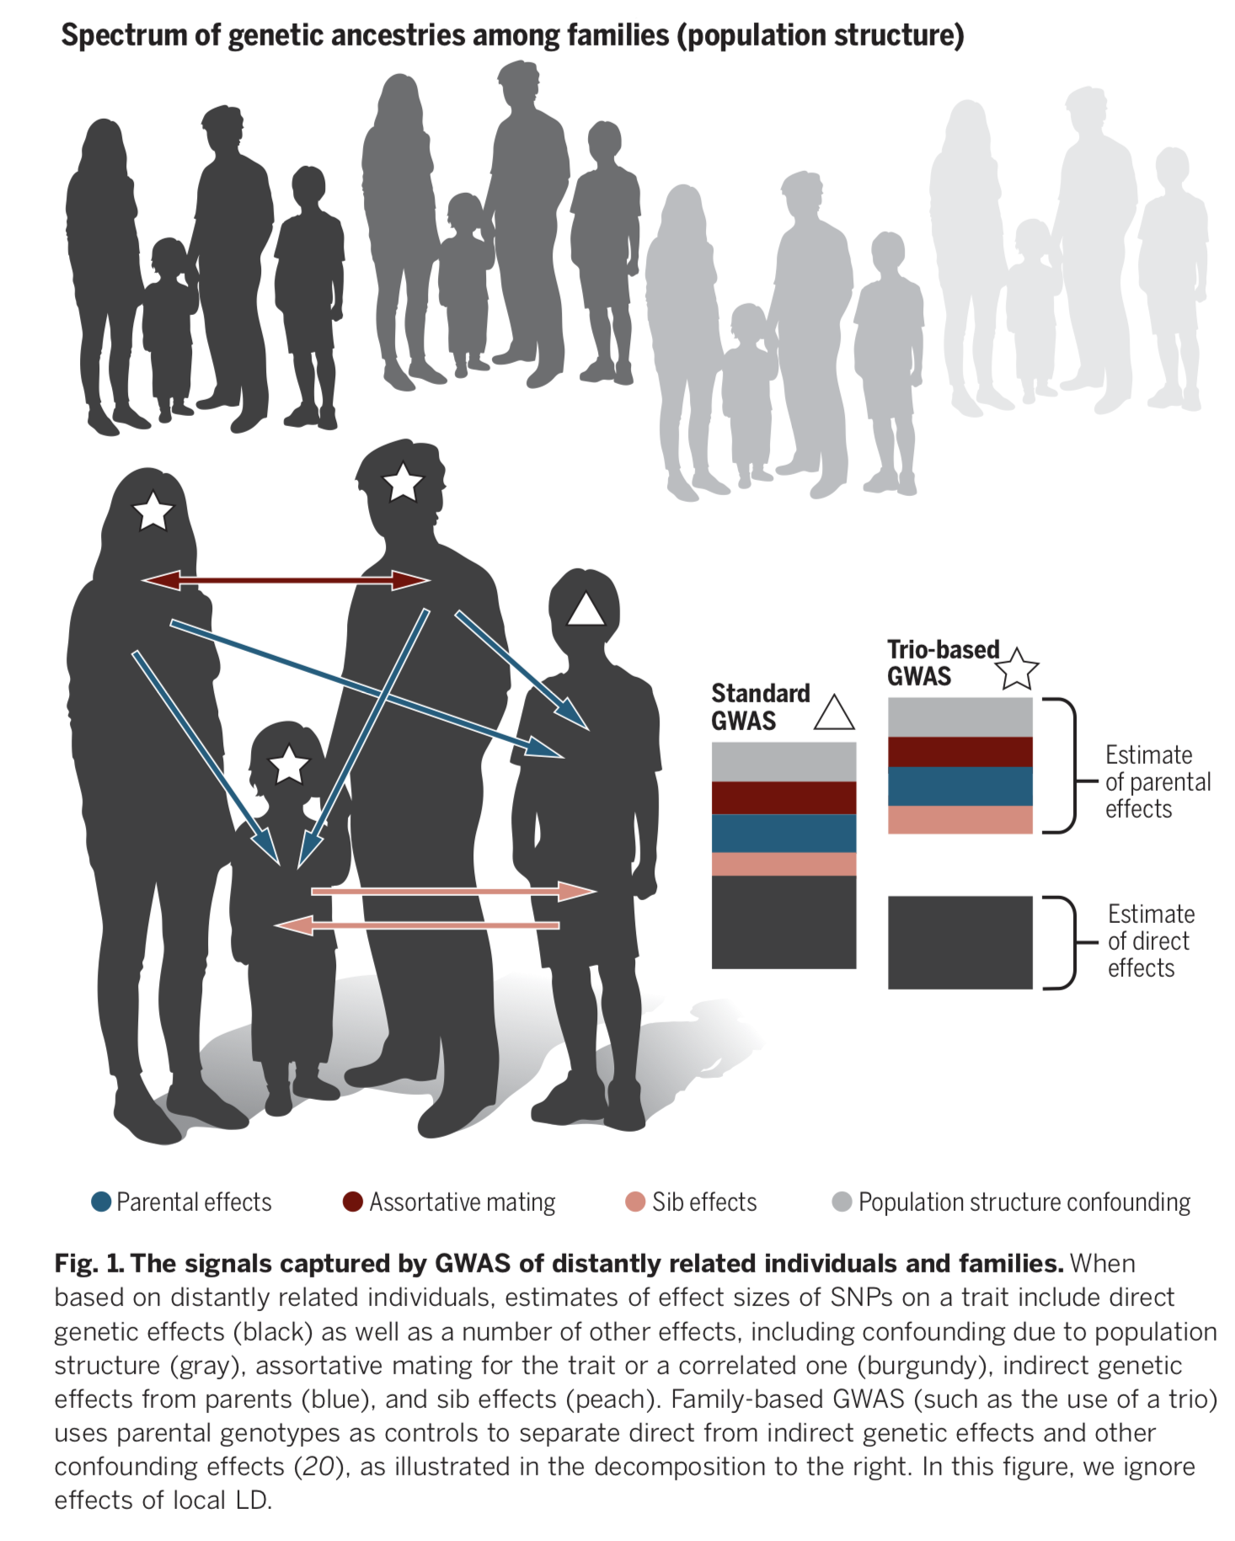
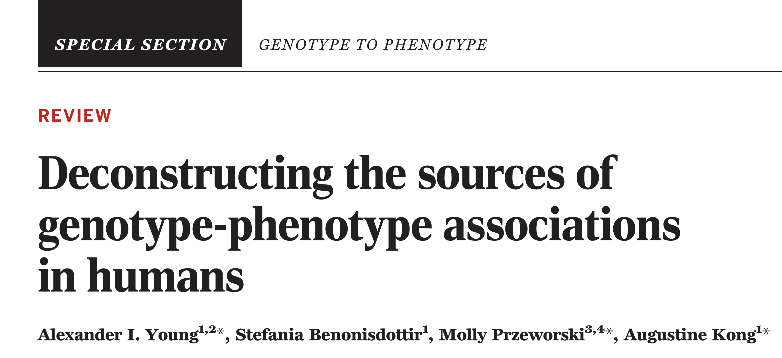
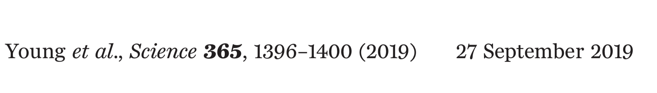
Review for Science 2019
Back to the Future --- Return of Family Data
Figure 3 of the paper shows some interesting properties of higher number PCs
computed from a large number of SNPs.

Slide 21
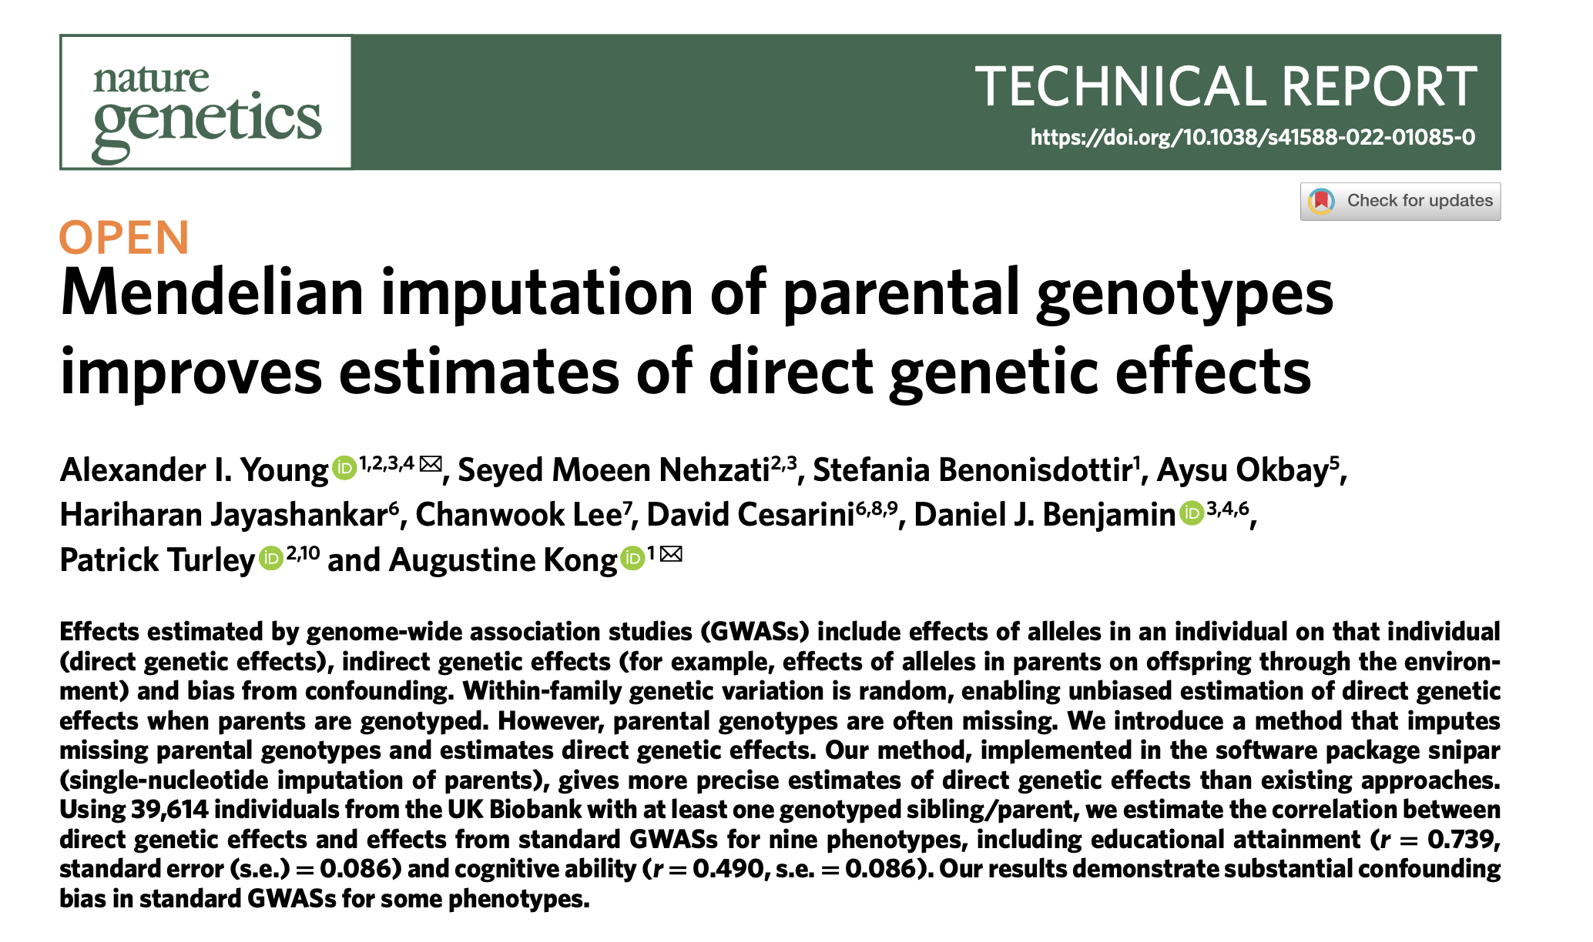
June 2022

Slide 22
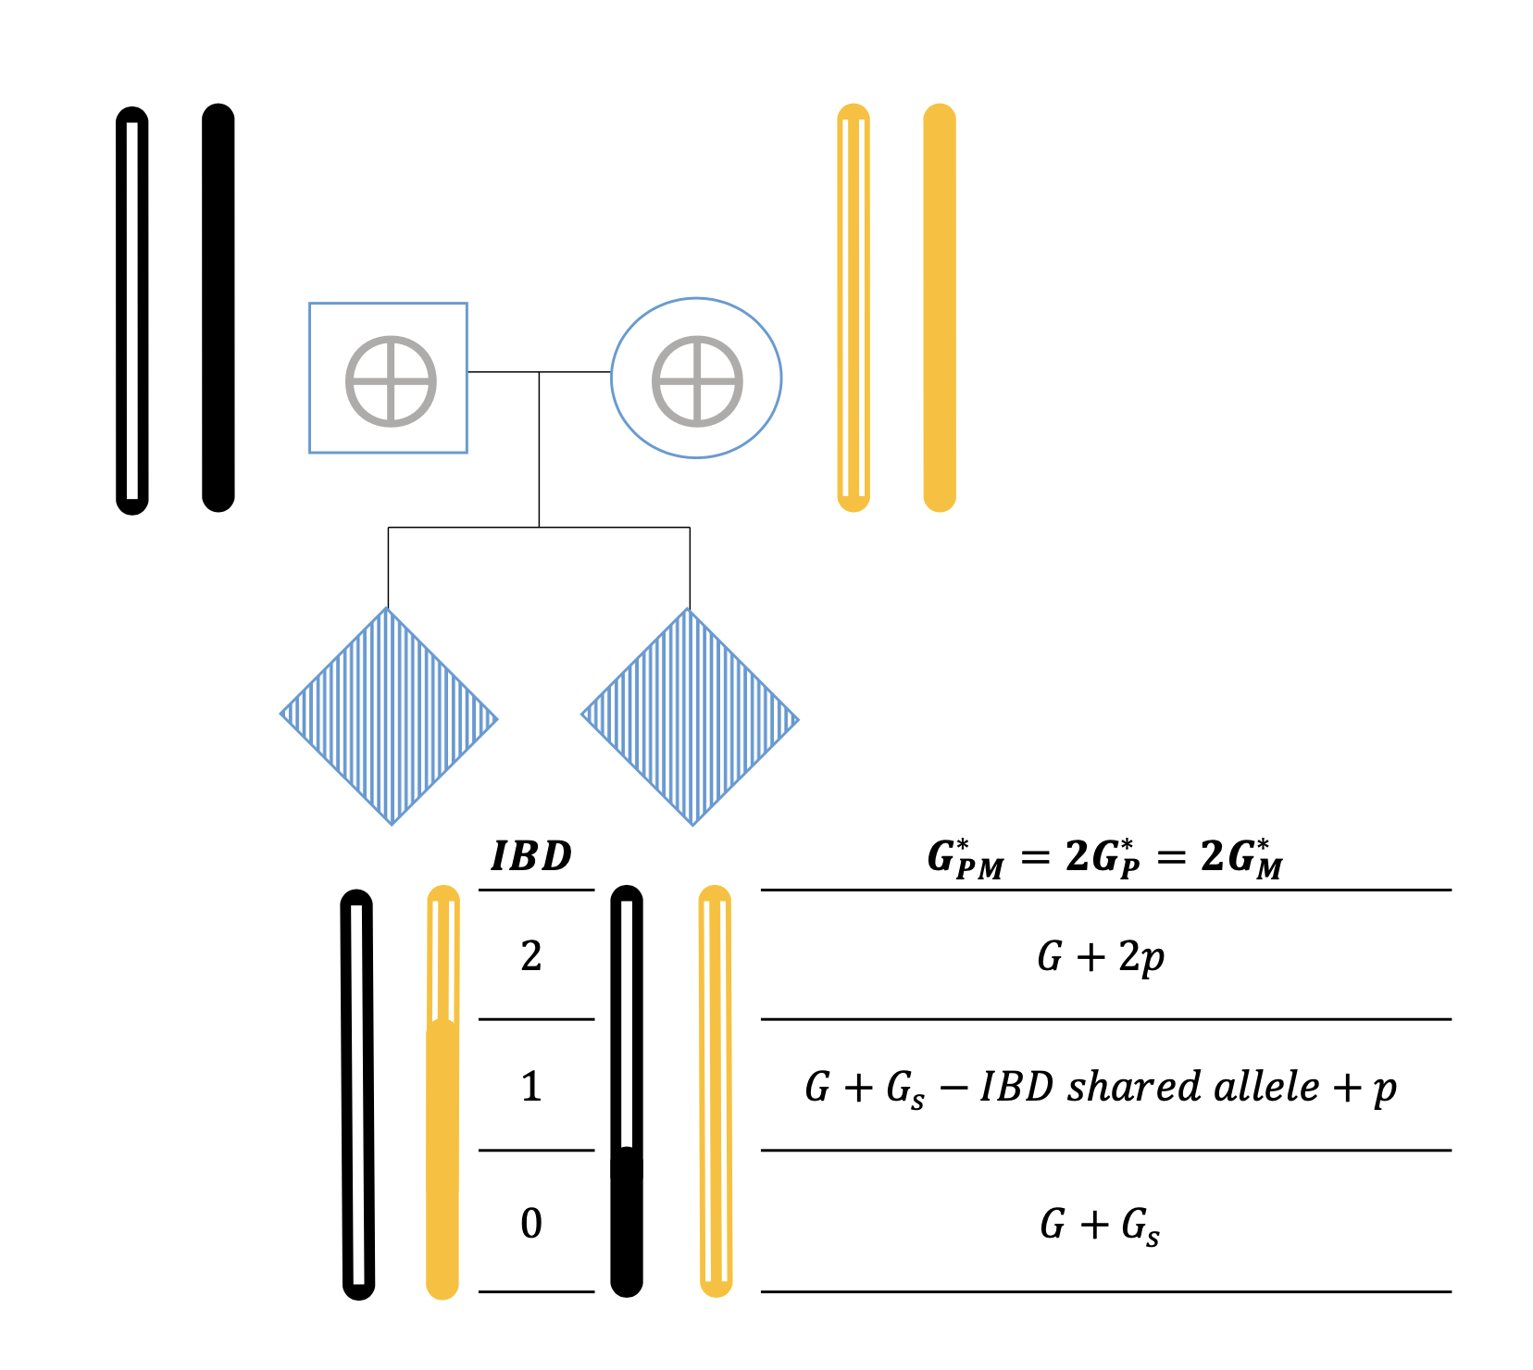
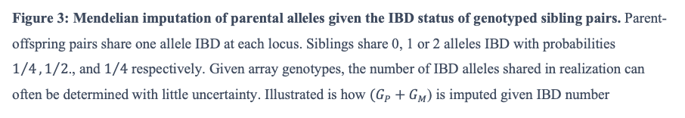
Getting more information for the analyses by (non-linearly) imputing unobserved parental genotypes using the genotypes of siblings

Slide 23
Possible (Missing) Data Patterns
Trios
Complete
Data
Sibpairs
Singletons/GWAS

Slide 24
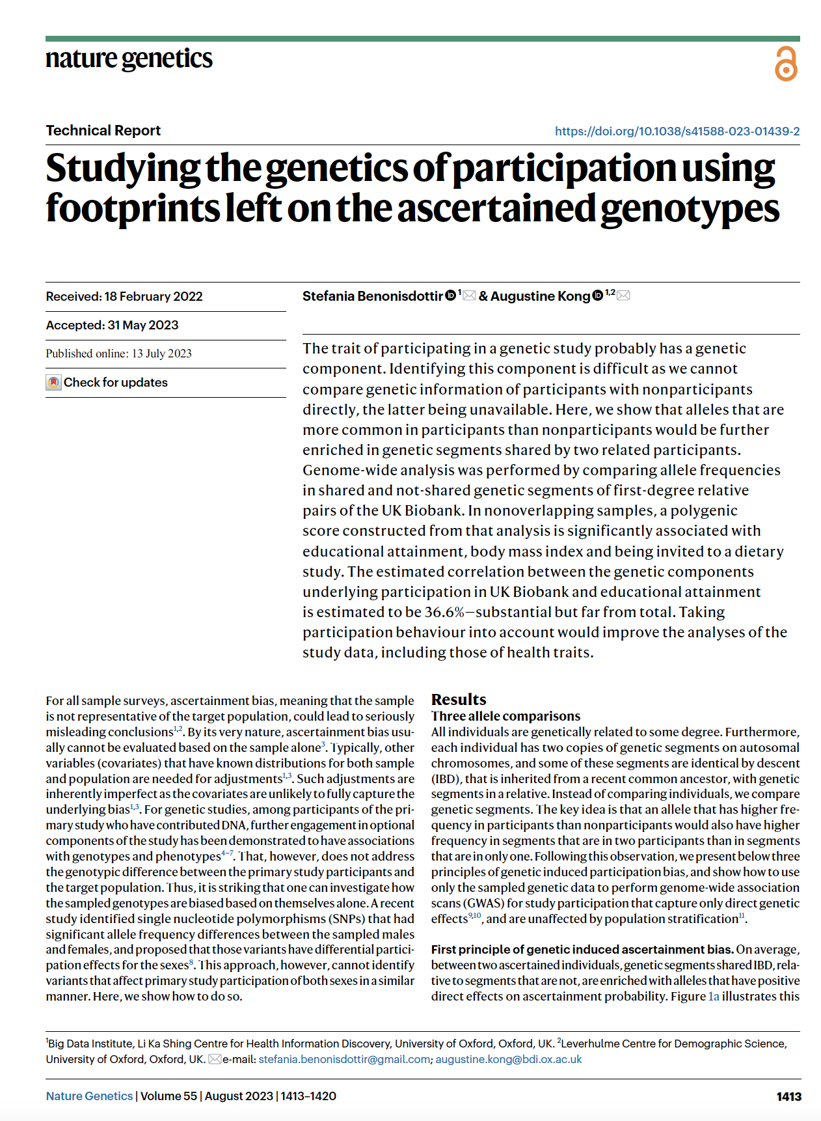


Slide 26
