Slide 1
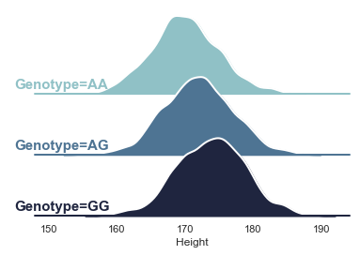


Polygenic Prediction
Aysu Okbay
Vrije Universiteit Amsterdam
a.okbay@vu.nl

Slide 2
Outline
What is a polygenic index?
Predictive power of polygenic indices
Constructing polygenic indices
Applications
Limitations & pitfalls

Slide 3
Outline
What is a polygenic index?
Predictive power of polygenic indices
Constructing polygenic indices
Applications
Limitations & pitfalls

Slide 4
Polygenic index (PGI)
Polygenic score
(PGS)
Polygenic risk score (PRS)
Genome-wide score (GWS)
Genetic risk score (GRS)

Slide 5
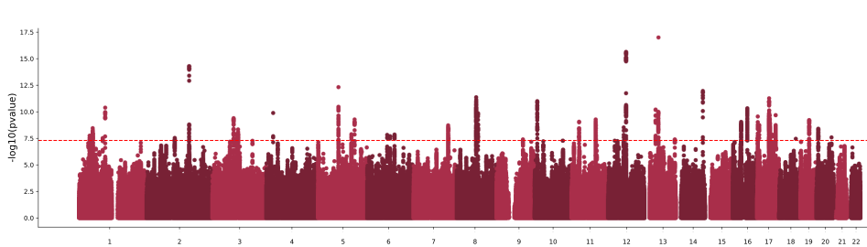

What is a polygenic index?
Effect size of 2cm per G allele
+2
+4
+4
+0
+0
+0
+2
+2
+2

Slide 6
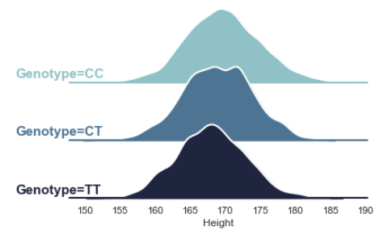

Effect size of -1 per T allele
+0
+0
-1
-1
+0
-2
-2
-1
-2
+4
+4
+0
+0
+0
+2
+2
+2
+2

Slide 7
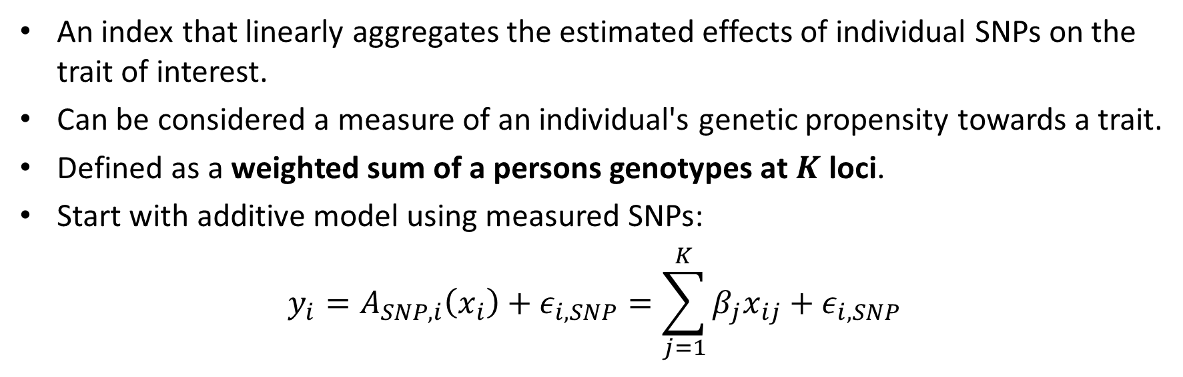
What is a polygenic index?
An index that linearly aggregates the estimated effects of individual SNPs on the trait of interest.
Can be considered a measure of an individual's genetic propensity towards a trait.
Defined as a weighted sum of a persons genotypes at $K$ loci.
Start with additive model using measured SNPs:
$$y_{i}=A_{SNP,i}\left(x_{i}\right)+ε_{i,SNP}=\sum_{j=1}^{K}{β_{j}x_{ij}}+ε_{i,SNP}$$
additive SNP factor

Slide 8

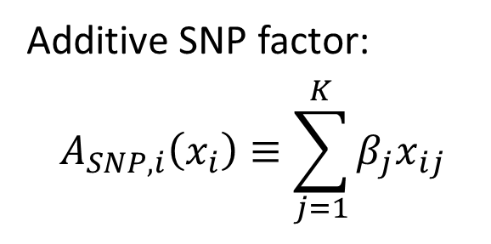
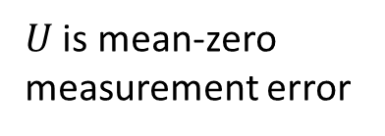
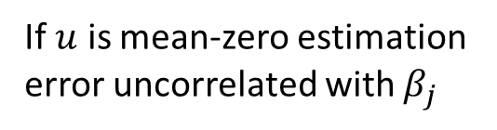

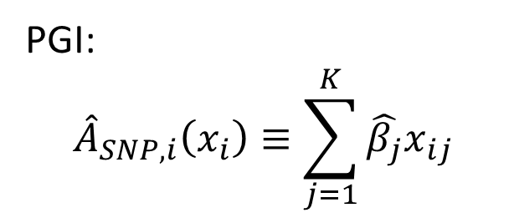
What is a polygenic index?
Additive SNP factor:
$$A_{SNP,i}\left(x_{i}\right)≡\sum_{j=1}^{K}{β_{j}x_{ij}}$$
PGI:
$${\hat{A}}_{SNP,i}\left(x_{i}\right)≡\sum_{j=1}^{K}{\hat{β_{j}}x_{ij}}$$
True effect size of SNP j
Estimated effect size of SNP j
$$\hat{β_{j}}=β_{j}+u_{j}$$
$⇒ {\hat{A}}_{SNP,i}=\sum_{j=1}^{K}{\left(β_{j}+u_{j}\right)x_{ij}}=A_{SNP,i}+U_{i}$ where $U_{i}=\sum_{j=1}^{K}{u_{j}x_{ij}}$
If $u$ is mean-zero estimation error uncorrelated with $β_{j}$
$U$ is mean-zero measurement error
$$E\left({\hat{A}}_{i} | A_{i}\right)=A_{i}$$

Slide 9
Outline
What is a polygenic index?
Predictive power of polygenic indices
Constructing polygenic indices
Applications
Limitations & pitfalls

Slide 10
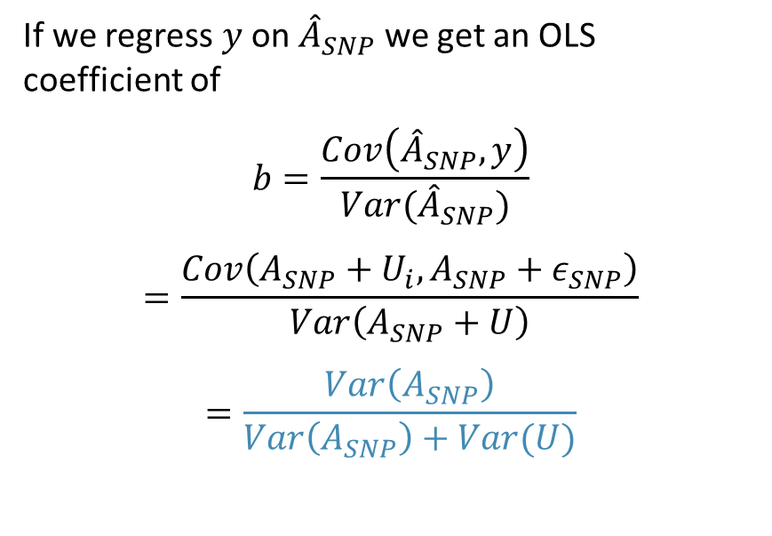
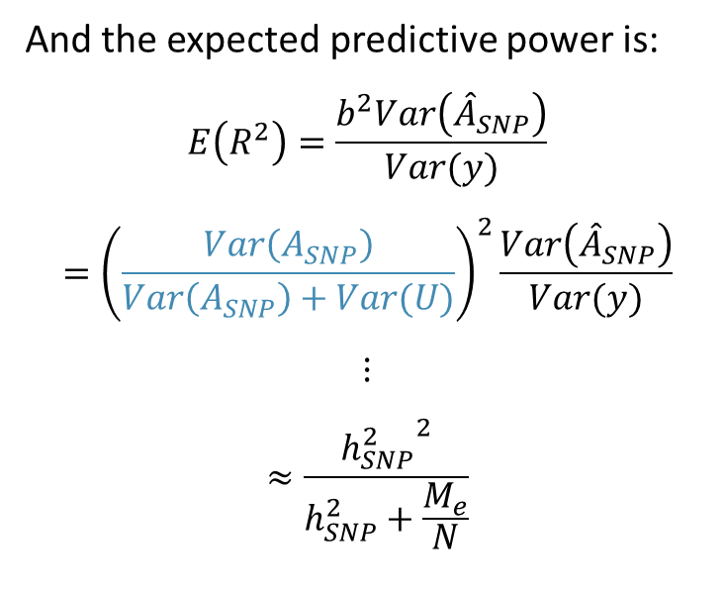
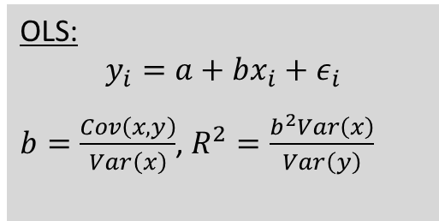
Predictive power of a polygenic index
If we regress $y$ on ${\hat{A}}_{SNP}$ we get an OLS coefficient of
$$b=\frac{Cov\left({\hat{A}}_{SNP},y\right)}{Var({\hat{A}}_{SNP})}$$
$$=\frac{Cov\left(A_{SNP}+U_{i},A_{SNP}+ε_{SNP}\right)}{Var\left(A_{SNP}+U\right)}$$
$$=\frac{Var\left(A_{SNP}\right)}{Var\left(A_{SNP}\right)+Var(U)}$$
And the expected predictive power is:
$$E\left(R^{2}\right)=\frac{b^{2}Var\left({\hat{A}}_{SNP}\right)}{Var(y)}$$
$$={\left(\frac{Var\left(A_{SNP}\right)}{Var\left(A_{SNP}\right)+Var(U)}\right)}^{2}\frac{Var\left({\hat{A}}_{SNP}\right)}{Var(y)}$$
$$⋮$$
$$≈\frac{{h_{SNP}^{2}}^{2}}{h_{SNP}^{2}+\frac{M_{e}}{N}}$$
Sometimes called the Daetwyler formula (Daetwyler et al. 2008)
OLS:
$$y_{i}=a+bx_{i}+ε_{i}$$
$b=\frac{Cov\left(x,y\right)}{Var\left(x\right)}$, $R^{2}=\frac{b^{2}Var\left(x\right)}{Var\left(y\right)}$
Effective number of SNPs in the PGI, estimated to be between 50k-70k in genome-wide data for EUR ancestry (Wray et al. 2013)

Slide 11
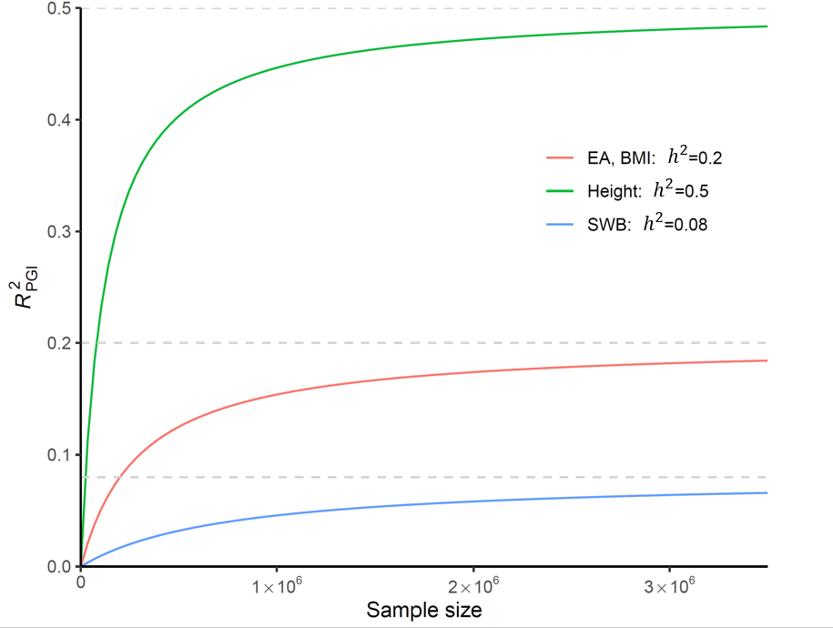
Theoretical projections for $R_{PGI}^{2}$

Slide 12
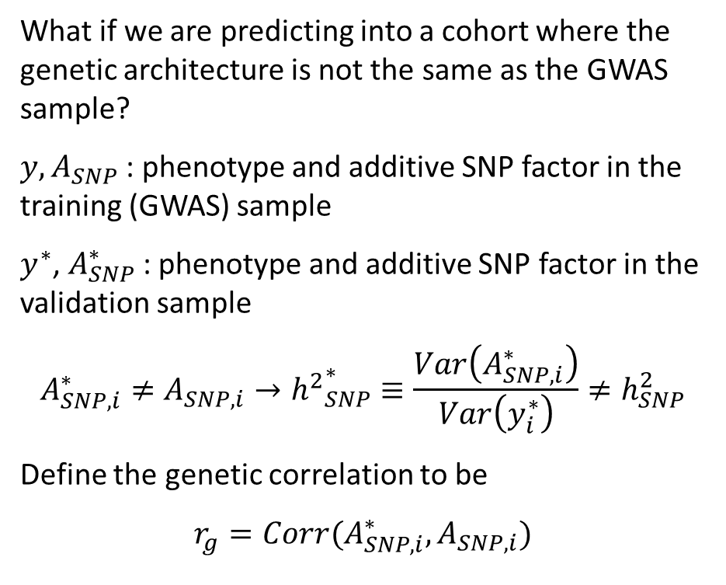
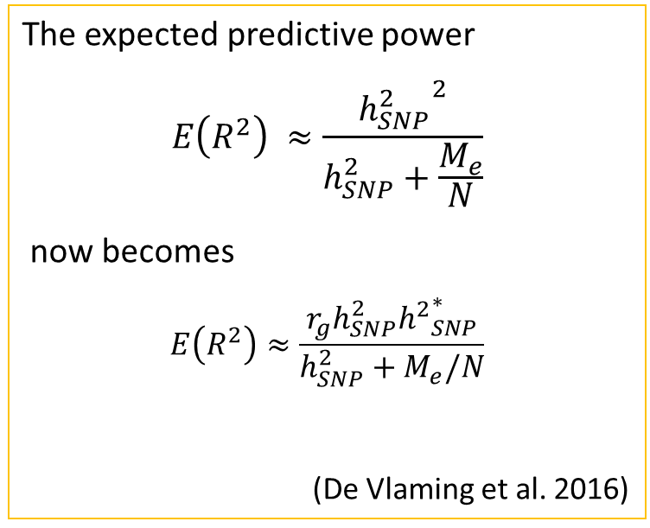
Predictive power and heterogeneity
What if we are predicting into a cohort where the genetic architecture is not the same as the GWAS sample?
$y, A_{SNP}$ : phenotype and additive SNP factor in the training (GWAS) sample
$y^{∗}$, $A_{SNP}^{∗}$: phenotype and additive SNP factor in the validation sample
$$A_{SNP,i}^{∗}≠A_{SNP,i}→{h^{2}}_{SNP}^{∗}≡\frac{Var\left(A_{SNP,i}^{∗}\right)}{Var\left(y_{i}^{∗}\right)}≠h_{SNP}^{2}$$
Define the genetic correlation to be
$$r_{g}=Corr(A_{SNP,i}^{∗},A_{SNP,i})$$
The expected predictive power
$$E\left(R^{2}\right) ≈\frac{{h_{SNP}^{2}}^{2}}{h_{SNP}^{2}+\frac{M_{e}}{N}}$$
now becomes
$$E\left(R^{2}\right)≈\frac{r_{g}h_{SNP}^{2}{h^{2}}_{SNP}^{∗}}{h_{SNP}^{2}+M_{e}/N}$$
(De Vlaming et al. 2016)
This formula will hold even if $y_{i}^{∗}$is a different phenotype!

Slide 13
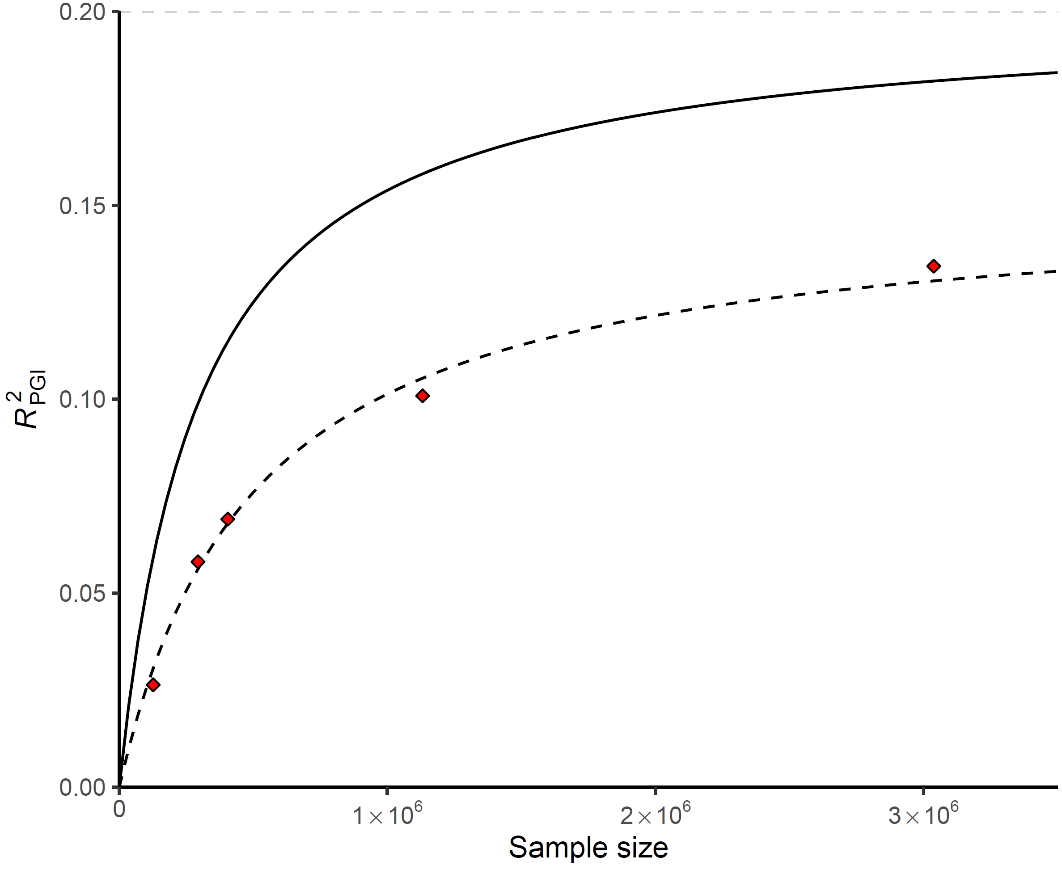
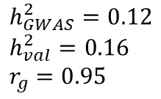
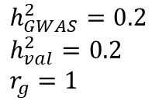
Theoretical projections for $R_{PGI}^{2}$ vs Observed $R_{PGI}^{2}$
$h_{GWAS}^{2}=0.2$
$h_{val}^{2}=0.2$
$r_{g}=1$
EA4 (2022)
$h_{GWAS}^{2}=0.12$
$h_{val}^{2}=0.16$
$r_{g}=0.95$
EA3 (2018)
EA2 Discovery + Replication (2016)
EA2 Discovery (2016)
EA1 (2013)

Slide 14
Outline
What is a polygenic index?
Predictive power of polygenic indices
Constructing polygenic indices
Applications
Limitations & pitfalls

Slide 15

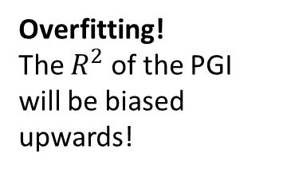
Constructing polygenic indices
What is needed?
Individual-level genotype data from a prediction sample.
Weights: GWAS summary statistics from a discovery sample
Caution: The prediction sample should not overlap with the discovery sample!
GWAS
PGI
Overfitting!
The $R^{2}$ of the PGI will be biased upwards!
GWAS
PGI

Slide 16
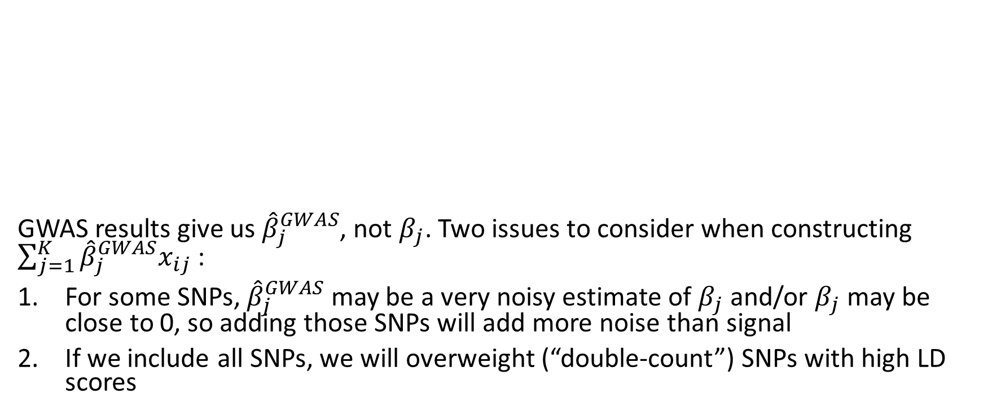
Weights
GWAS results give us ${\hat{β}}_{j}^{GWAS}$, not $β_{j}$. Two issues to consider when constructing $\sum_{j=1}^{K}{{\hat{β}}_{j}^{GWAS}x_{ij}}$ :
For some SNPs, ${\hat{β}}_{j}^{GWAS}$ may be a very noisy estimate of $β_{j}$ and/or $β_{j}$ may be close to 0, so adding those SNPs will add more noise than signal
If we include all SNPs, we will overweight (“double-count”) SNPs with high LD scores

Slide 17

Two solutions
Clumping and thresholding
Include only the most strongly associated SNP from each LD block (Purcell et al., 2009)
Bayesian approaches
Include all SNPs but adjust the effect sizes for LD
$$\sum_{j=1}^{K}{{\hat{β}}_{j}^{GWAS}x_{ij}}$$
Weights: Set equal to GWAS coefficients.
Loci: Selected by
using a clumping algorithm that ensures the included markers are all approximately independent of each other
omitting SNPs whose P value for association with the phenotype is above a certain threshold
Weights: Set to GWAS coefficients adjusted for LD → approximate results from a theoretical multiple regression of the phenotype on all SNPs
Loci: Include all SNPs, no LD-based pruning
Examples: LDpred (Vilhjalmsson et al. 2015, Prive et al. 2020 ), PRS-CS (Ge et al. 2019), SBayesR (Lloyd-Jones et al. 2019)

Slide 18
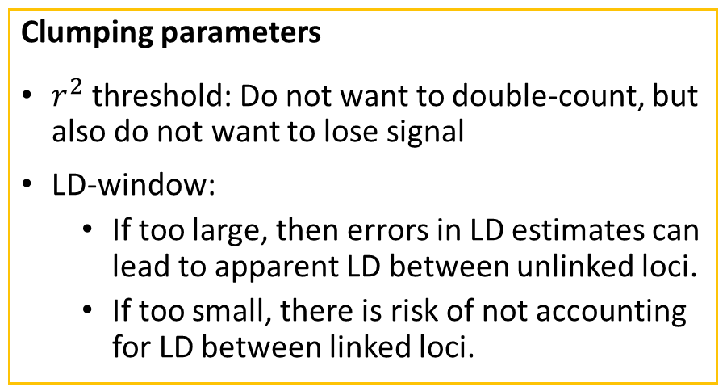
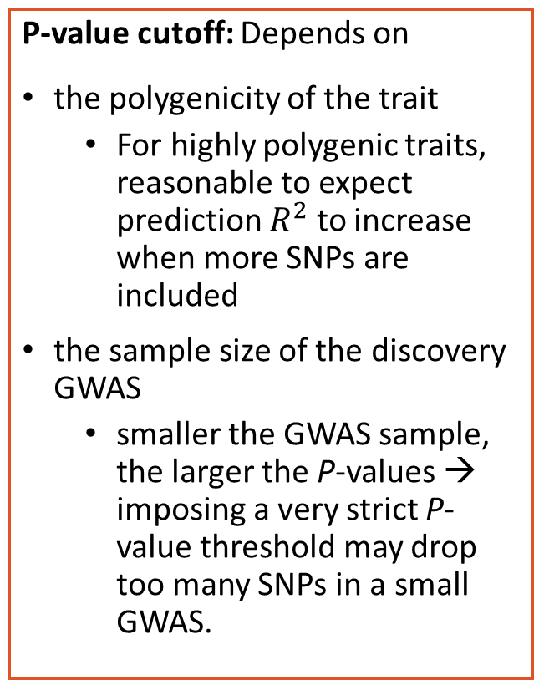
Practical considerations - (C+T)
P-value cutoff: Depends on
the polygenicity of the trait
  For highly polygenic traits, reasonable to expect prediction $R^{2}$ to increase when more SNPs are included
the sample size of the discovery GWAS
  smaller the GWAS sample, the larger the P-values → imposing a very strict P-value threshold may drop too many SNPs in a small GWAS.
Clumping parameters
$r^{2}$ threshold: Do not want to double-count, but also do not want to lose signal
LD-window:
  If too large, then errors in LD estimates can lead to apparent LD between unlinked loci.
  If too small, there is risk of not accounting for LD between linked loci.
Imputed or genotyped SNPs?
Depends on
genotyping chip coverage
quality of imputed SNPs
Notes:
$(r^{2}∈[0.5−0.7]$ )
1Mb

Slide 19
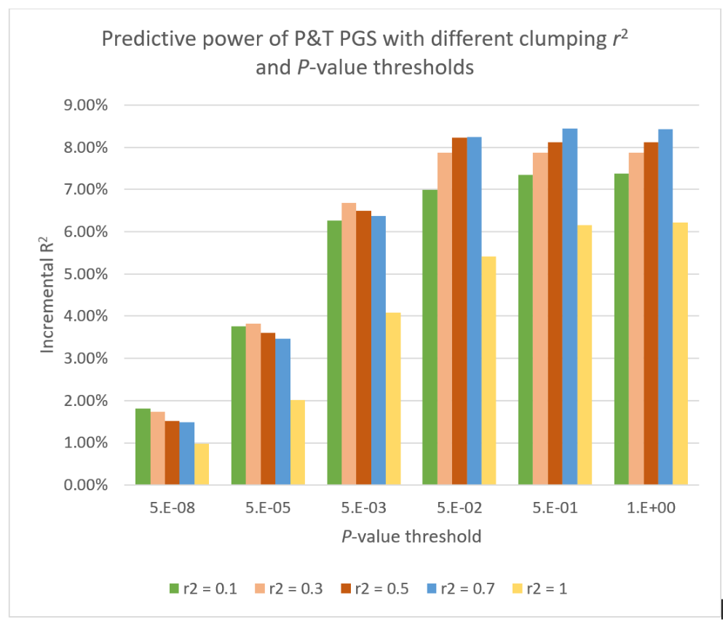








C+T
Cohort: Health and Retirement Study
Phenotype: Educational attainment
$$5×{10}^{−8}$$
$$5×{10}^{−5}$$
$$5×{10}^{−3}$$
$$5×{10}^{−2}$$
$$5×{10}^{−1}$$
$$1$$
$r^{2}$=
$r^{2}$=
$r^{2}$=
$r^{2}$=
$r^{2}$=

Slide 20
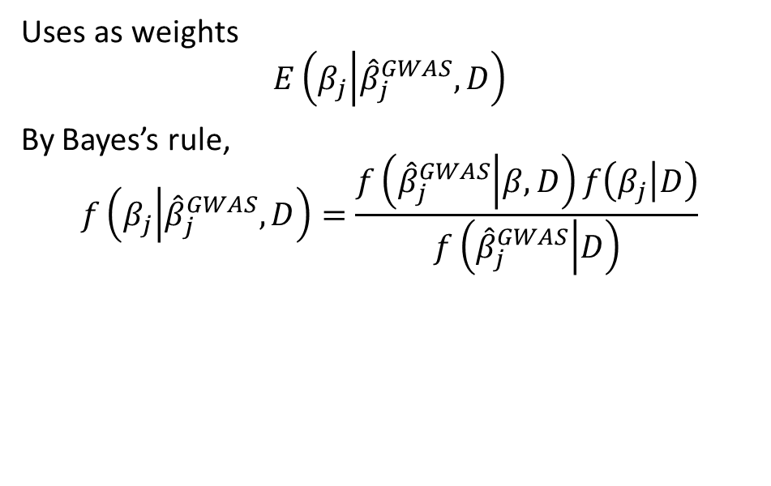
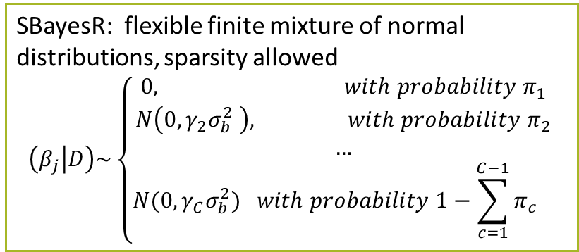
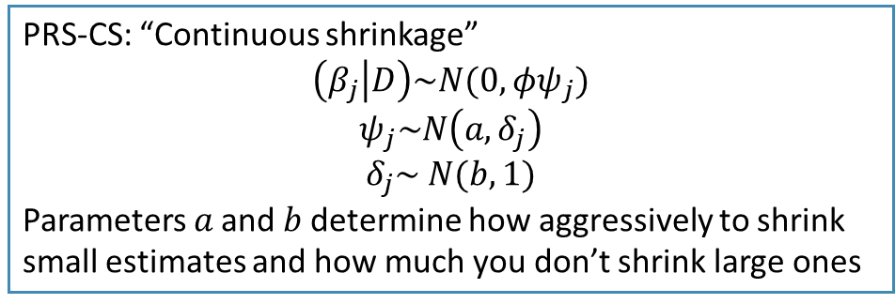
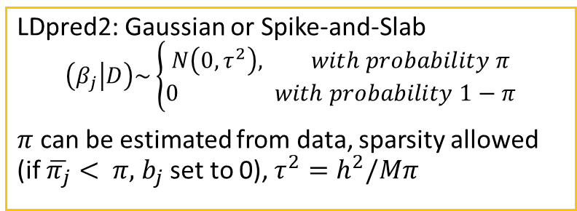
Practical considerations - (Bayesian approaches)
Uses as weights
$$E\left(β_{j} | {\hat{β}}_{j}^{GWAS},D\right)$$
By Bayes’s rule,
$$f\left(β_{j} | {\hat{β}}_{j}^{GWAS},D\right)=\frac{f\left({\hat{β}}_{j}^{GWAS} | β,D\right)f\left(β_{j} | D\right)}{f\left({\hat{β}}_{j}^{GWAS} | D\right)}$$
LDpred2: Gaussian or Spike-and-Slab
$$\left(β_{j} | D\right)\sim \left\{\begin{aligned}N\left(0,τ^{2}\right), with probability π \\ 0 with probability 1−π\end{aligned}\right.$$
$π$ can be estimated from data, sparsity allowed (if $\overline{π_{j}}< π,$ $b_{j}$ set to 0), $τ^{2}=h^{2}/Mπ$
LD matrix
SBayesR: flexible finite mixture of normal distributions, sparsity allowed
$$\left(β_{j} | D\right)\sim \left\{\begin{aligned}0, with probability π_{1} \\ &N\left(0,γ_{2}σ_{b}^{2} \right), with probability π_{2} \\ … \\ N(0,γ_{C}σ_{b}^{2}) with probability {1−\sum_{c=1}^{C−1}{π_{c}}}_{}\end{aligned}\right.$$
Shrinkage depends on the prior!
PRS-CS: “Continuous shrinkage”
$$\left(β_{j} | D\right)\sim N(0,φψ_{j})$$
$$ψ_{j}\sim N\left(a,δ_{j}\right)$$
$$δ_{j}\sim N(b,1)$$
Parameters 𝑎 and 𝑏 determine how aggressively to shrink small estimates and how much you don’t shrink large ones
Notes:
LDpred2 – Implemented in bigsnpR
Gibbs sampler to estimate joint SNP effects (replacing clumping)
Models long range LD such as that found near the HLA region
SBayesR – Implemented in GCTB
Combines a likelihood connecting the joint effects with GWAS summary statistics and a finite mixture of normal distribution priors for marker effects.
Estimates joint SNP effects using Bayesian multiple regression
Typically uses four normal distributions with mean zero and variances
Then performs a Markov chain Monte Carlo Gibbs sampling for the model parameters
Lassosum (and lassosum2) – Implemented in bigsnpR
Penalized (LASSO) regression (complementary to LDpred2 for MHC)
PRS-CS
Joint SNP effects using Bayesian regression with continuous shrinkage priors
JAMPred
Two step Bayesian regression framework

Slide 21
Practical considerations - (Bayesian approaches)
The same consideration applies to C+T but Bayesian approaches are more sensitive to noise in LD estimates!
Imputed or genotyped SNPs?
Same tradeoff between coverage and noise, but
All SNPs included in the PGI also need to be in the ref genotype data used to calculate the LD matrix
If using imputed SNPs in the PGI, will either need
  Imputed reference data to calculate LD → imputation uncertainty introduces noise to LD calculation
  A large enough and representative sequenced sample → may not be available
Solutions:
Use genotyped SNPs and genotype data from the validation cohort to estimate LD → may not be optimal if
  the number of genotyped SNPs is low
  sample size is low
  cohort has been genotyped using multiple chips
  want to compare prediction results between different cohorts, and hence need the PGI to include the same set of SNPs
Include only SNPs with imputation accuracy above a certain threshold
Use HapMap3 SNPs from the imputed data

Slide 22
Practical considerations - (Bayesian approaches)
Reference genotype data to calculate LD matrix should be
large enough
representative of the GWAS sample
cleaned
  sample-level filters: related individuals, ancestry outliers, individuals with low genotyping rate
  SNP-level filters: low SNP call rate, MAF, HWE P-value (genotyped SNPs), imputation accuracy (imputed SNPs)

Slide 23
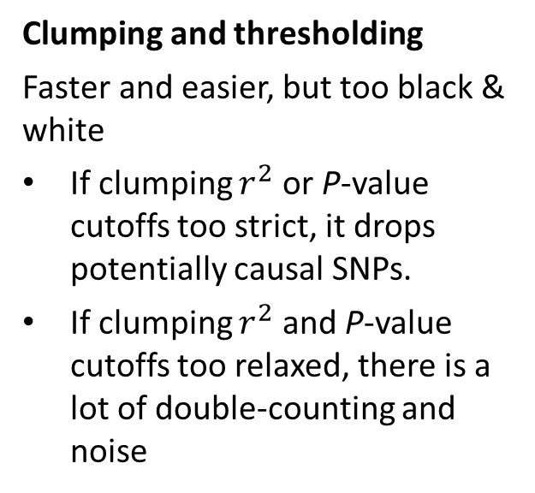
Which method is better?
Clumping and thresholding
Faster and easier, but too black & white
If clumping $r^{2}$ or P-value cutoffs too strict, it drops potentially causal SNPs.
If clumping $r^{2}$ and P-value cutoffs too relaxed, there is a lot of double-counting and noise
Bayesian approaches
utilize information from all SNPs by adjusting SNP weights for LD, but
  if the reference panel is not a good match for the population from which summary statistics were obtained, prediction accuracy might be compromised
  the assumed prior distribution might not accurately model the true genetic architecture

Slide 24
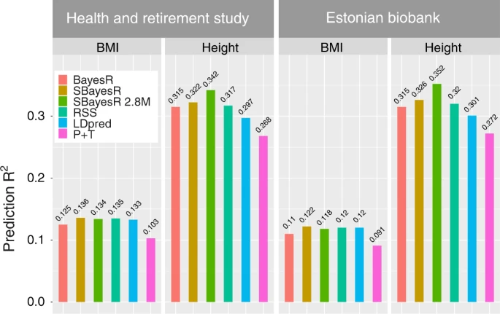
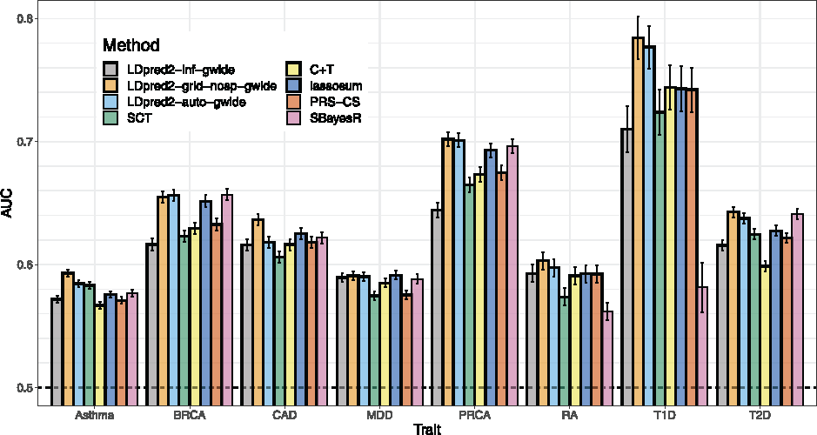
If the purpose is to maximize predictive power, than Bayesian approaches clearly do better
Source: Privé, Arbel, Vilhjálmsson (2020)
Source: Lloyd-Jones et al (2019)
There may still be uses for C+T, e.g. explore how much variance is explained out-of-sample by the genome-wide significant loci

Slide 25
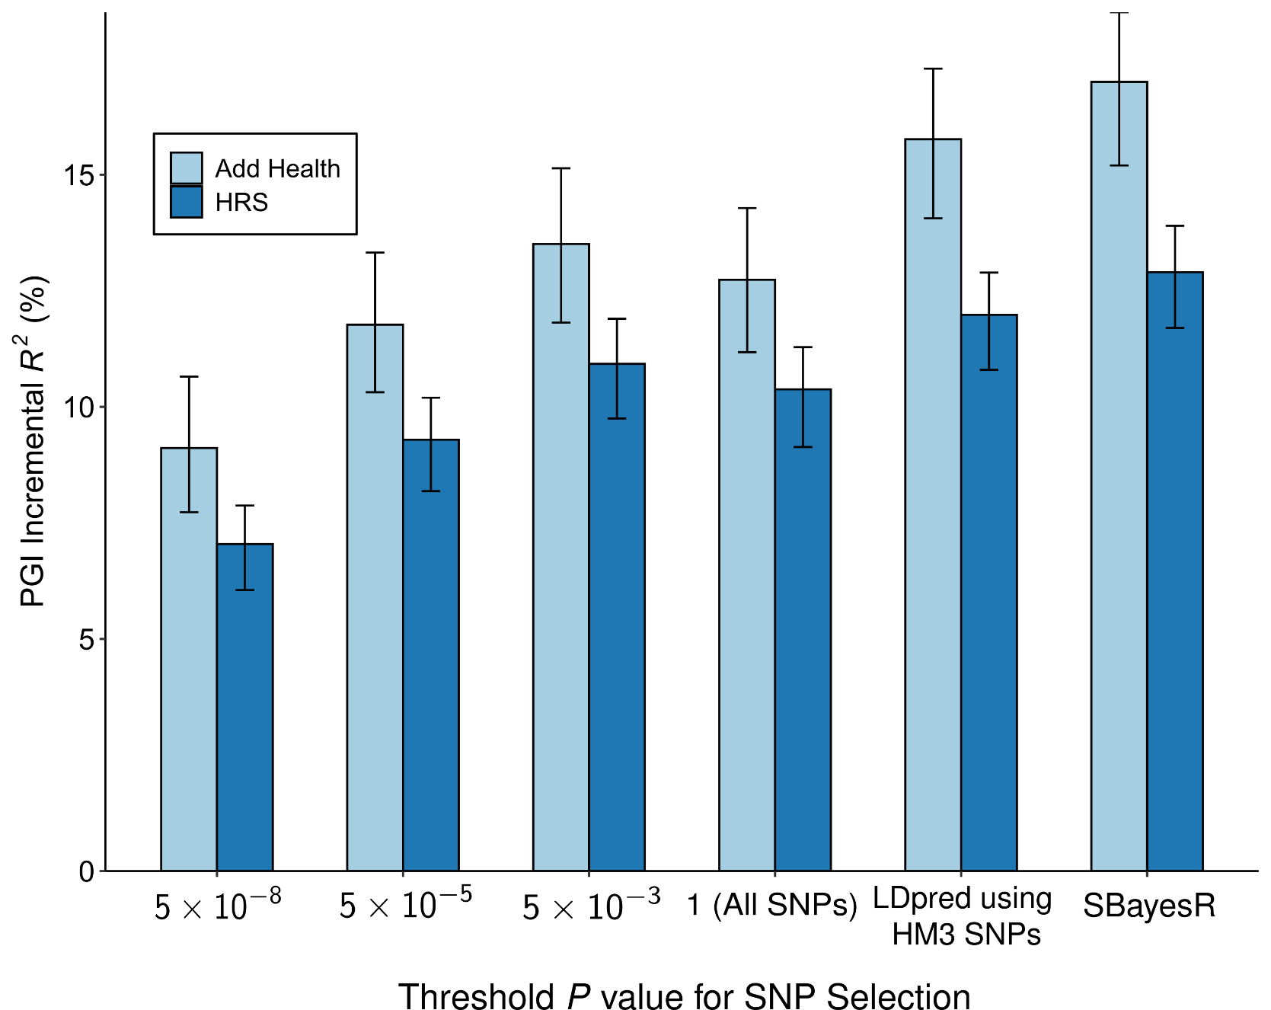
HM3, LDpred
Source: Okbay et al. (2022)

Slide 26
Outline
What is a polygenic index?
Predictive power of polygenic indices
Constructing polygenic indices
Applications
Limitations and pitfalls

Slide 27
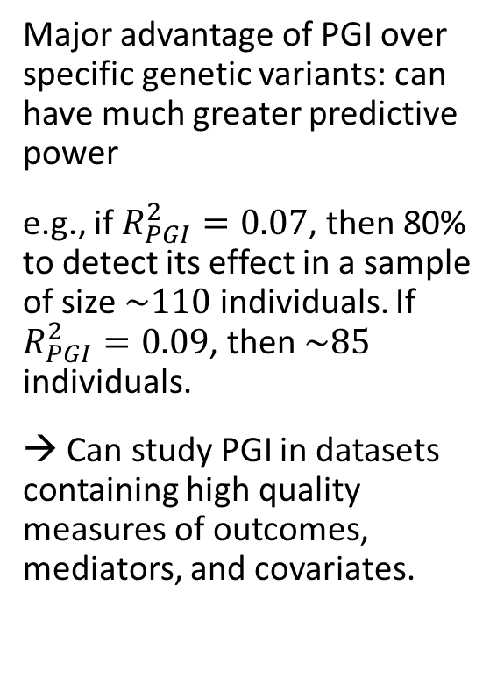

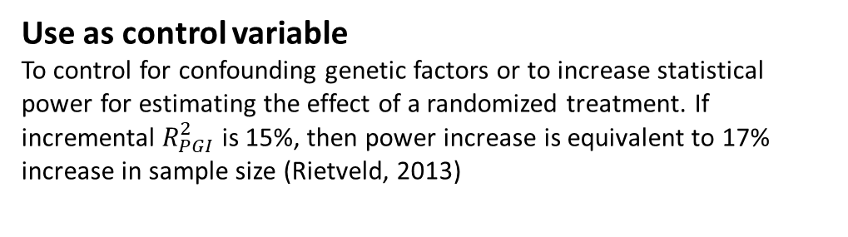
Applications
Identify correlates of genetic factors
e.g. Educational attainment PGI predicts early speech acquisition and is mediated by cognitive ability (Belsky et al., 2016).
Identify causal effects of genetic factors
Sibling data and family fixed effects → causal effect of PGI
Major advantage of PGI over specific genetic variants: can have much greater predictive power
e.g., if $R_{PGI}^{2}=0.07$, then 80% to detect its effect in a sample of size $\sim 110$ individuals. If $R_{PGI}^{2}=0.09$, then $\sim 85$ individuals.
→ Can study PGI in datasets containing high quality measures of outcomes, mediators, and covariates.
Study treatment effect heterogeneity by genotype
e.g. Increase of compulsory schooling age in U.K. reduces BMI only among those with a high-BMI PGI (Barcellos, Carvalho, and Turley 2016)
Use as control variable
To control for confounding genetic factors or to increase statistical power for estimating the effect of a randomized treatment. If incremental $R_{PGI}^{2}$ is 15%, then power increase is equivalent to 17% increase in sample size (Rietveld, 2013)
Use for balance tests of randomization
PGIs should be identically distributed in treatment and control groups (Davies et al. 2016, Barcellos, Carvalho, and Turley 2016)
Identify at-risk individuals
Personalized treatment
$$⋮$$

Slide 28
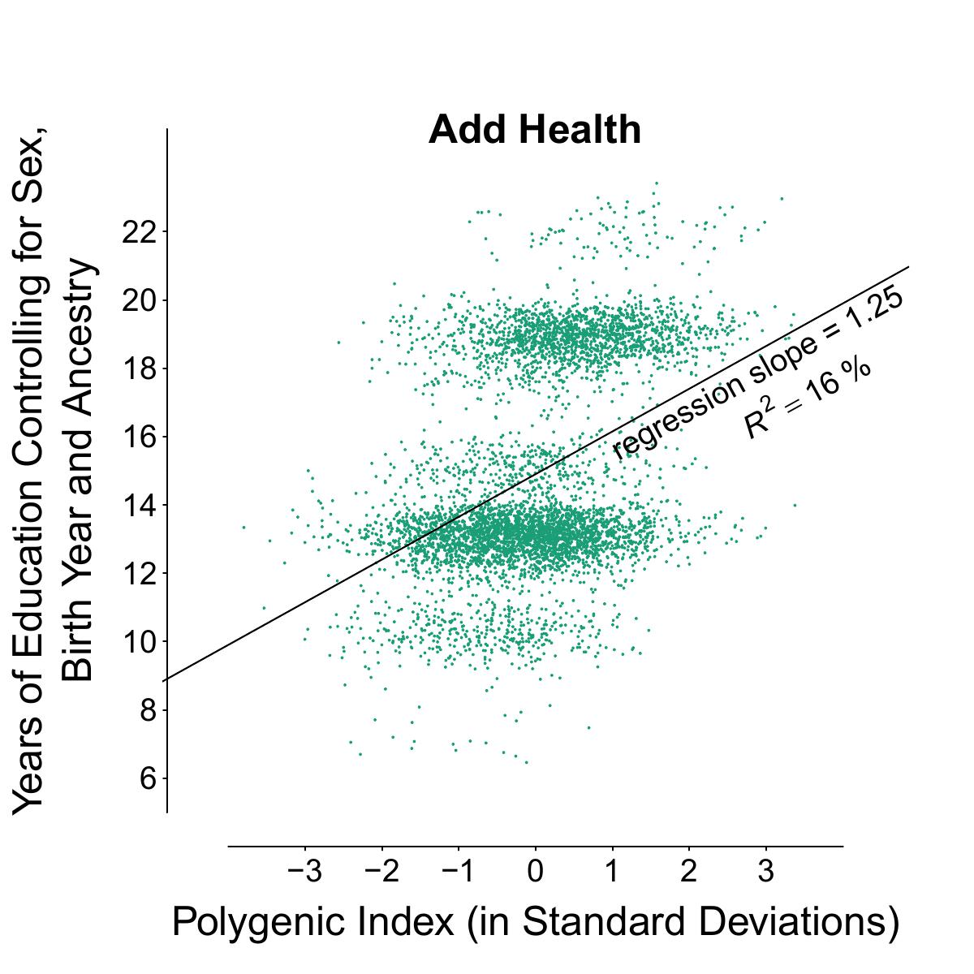
Individual-level prediction is not accurate enough for most complex phenotypes!
Source: Okbay et al. (2022)

Slide 29
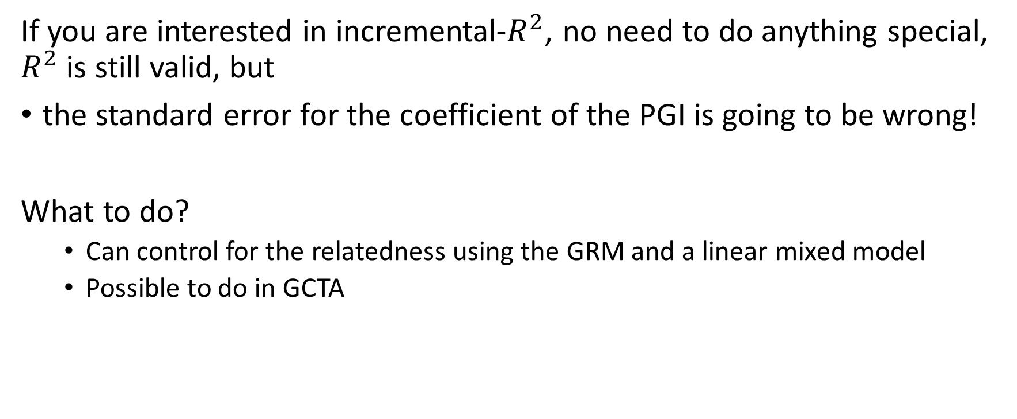
Prediction with related samples
If you are interested in incremental-$R^{2}$, no need to do anything special, $R^{2}$ is still valid, but
the standard error for the coefficient of the PGI is going to be wrong!
What to do?
  Can control for the relatedness using the GRM and a linear mixed model
  Possible to do in GCTA

Slide 30
Outline
What is a polygenic index?
Predictive power of polygenic indices
Constructing polygenic indices
Applications
Limitations and pitfalls

Slide 31
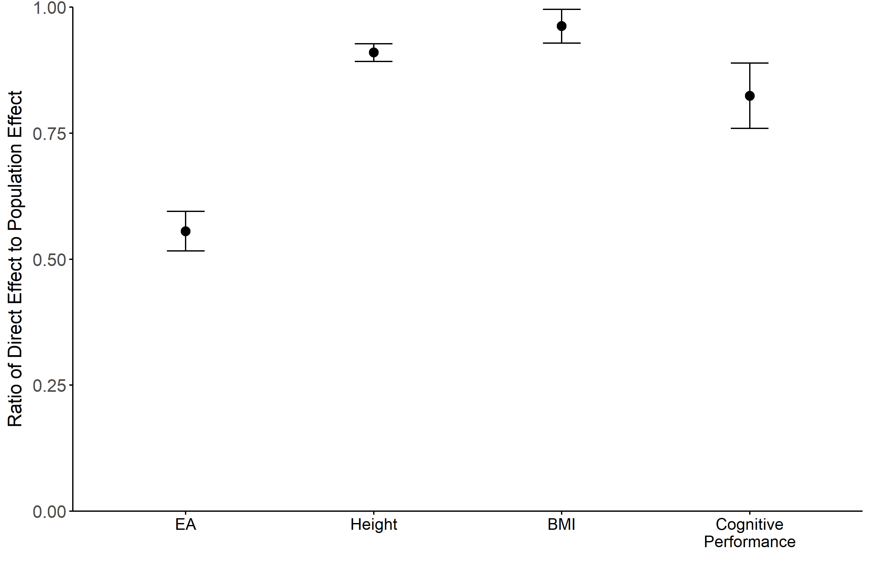
LIMITATIONS & PITFALLS
Mechanisms are poorly understood.
Including many genetic variants
  increases predictive power
  requires including genetic variants with unknown function
→ makes it hard to specify what is captured by PGI.
Source: Okbay et al. (2022)

Slide 32
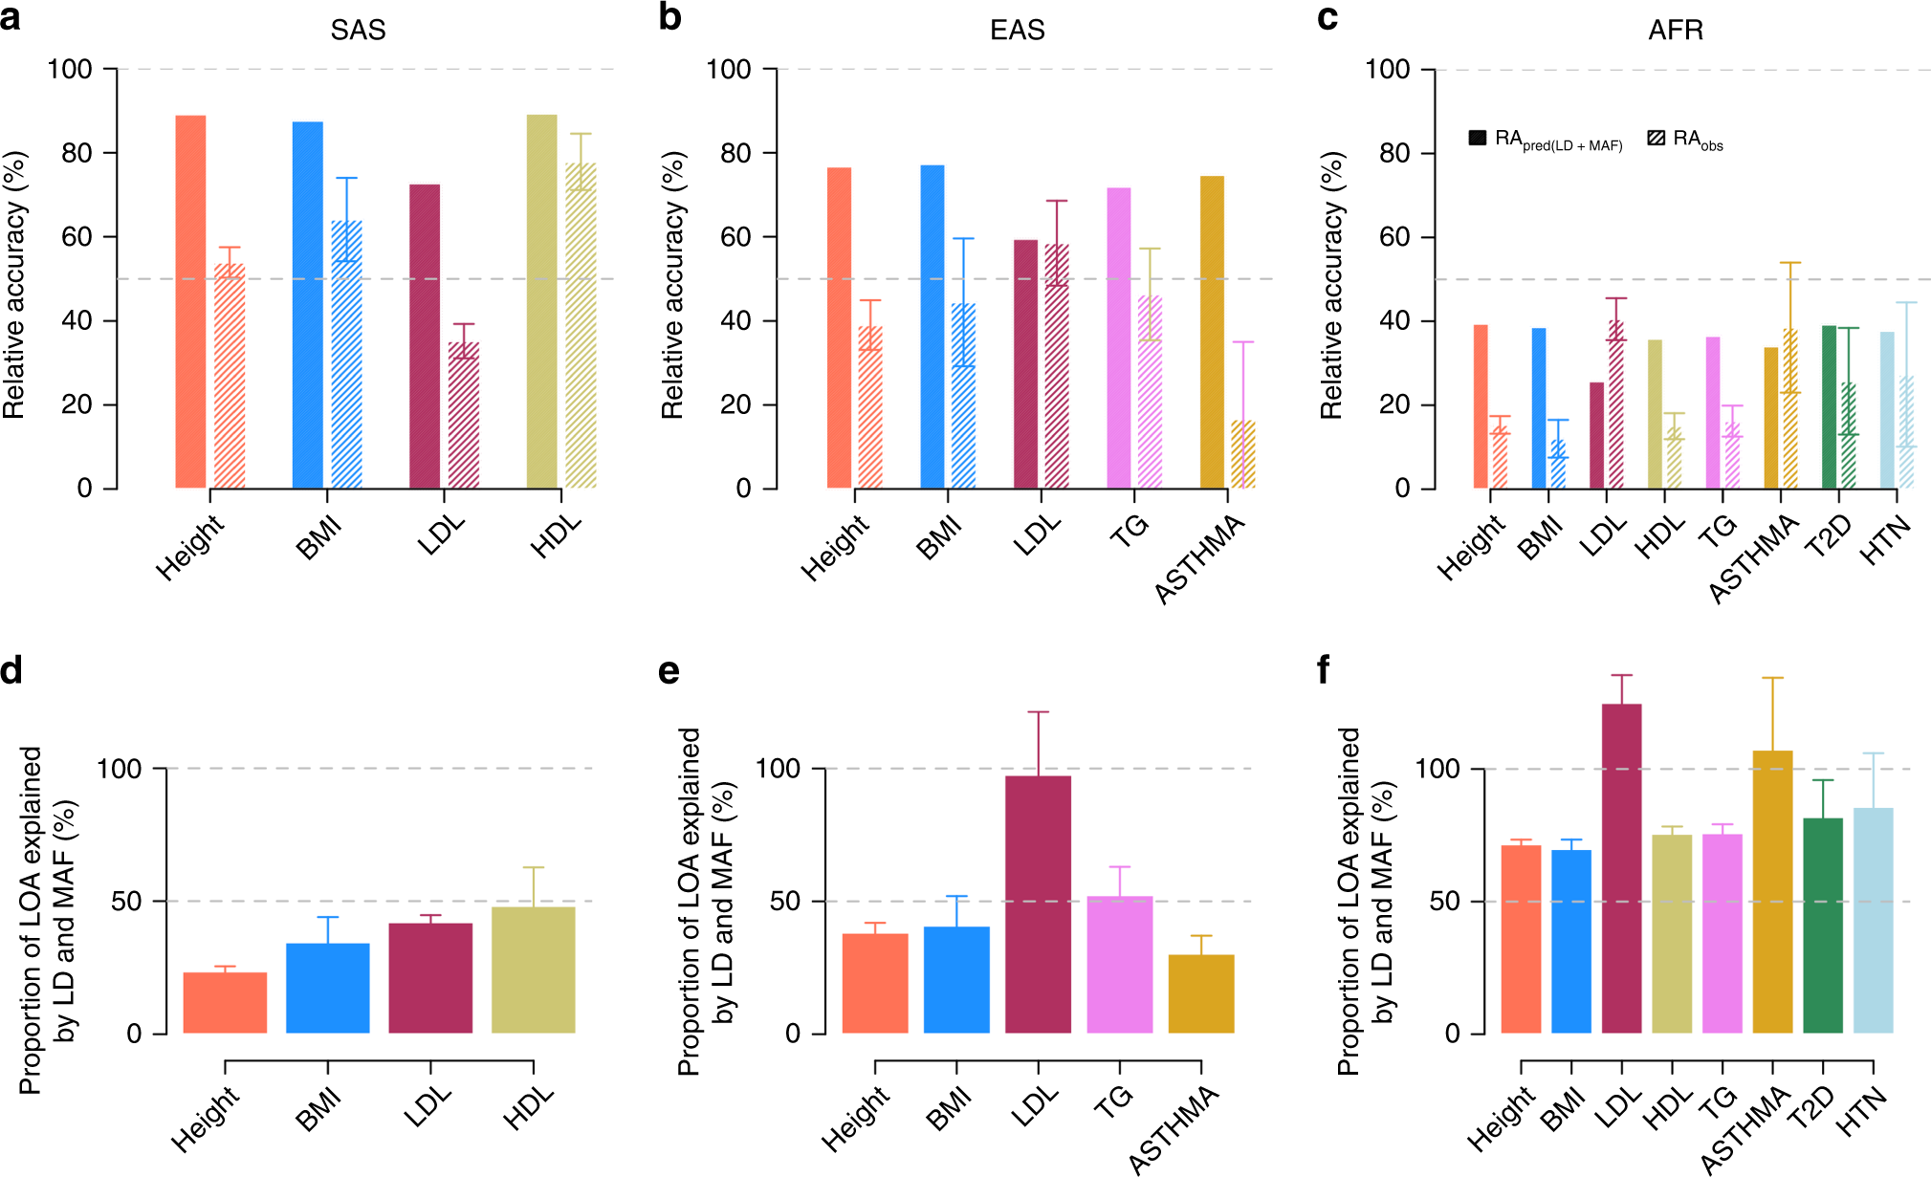
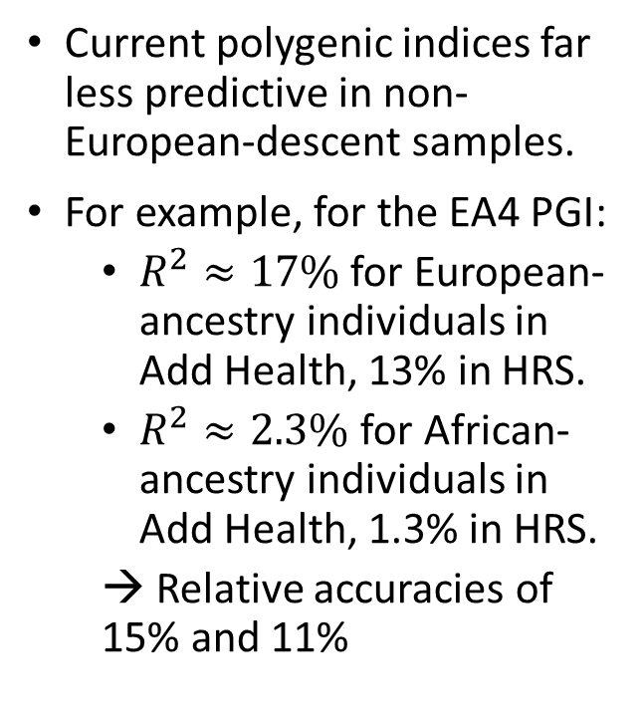
LIMITATIONS & PITFALLS
Current polygenic indices far less predictive in non-European-descent samples.
For example, for the EA4 PGI:
  $R^{2}≈17\%$ for European-ancestry individuals in Add Health, 13% in HRS.
  $R^{2}≈2.3\%$ for African-ancestry individuals in Add Health, 1.3% in HRS.
  → Relative accuracies of 15% and 11%
Source: Wang et al. (2020)

Slide 33
LIMITATIONS & PITFALLS
Two sources of population stratification
In the discovery phase
  leads to bias in the GWAS estimates, so the PGI may give more weight to SNPs that just correspond to ancestry
In the prediction phase
  If the prediction sample is stratified, this can lead to bias in our PGI-based analyses even if SNP-weights are unbiased
Interaction of bias in both phases
  The combination of these two interact so group differences are strongly exaggerated
→ Important to control for PCs in prediction analyses!

Slide 34
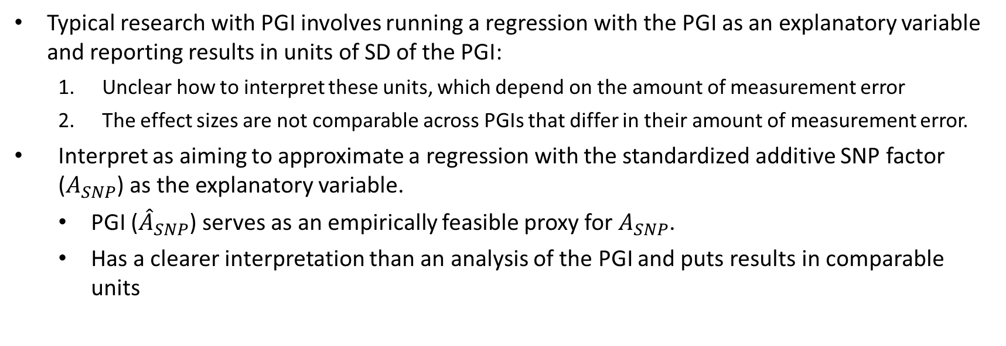
MEASUREMENT ERROR
Typical research with PGI involves running a regression with the PGI as an explanatory variable and reporting results in units of SD of the PGI:
  Unclear how to interpret these units, which depend on the amount of measurement error
  The effect sizes are not comparable across PGIs that differ in their amount of measurement error.
Interpret as aiming to approximate a regression with the standardized additive SNP factor ($A_{SNP}$) as the explanatory variable.
  PGI (${\hat{A}}_{SNP}$) serves as an empirically feasible proxy for $A_{SNP}$.
  Has a clearer interpretation than an analysis of the PGI and puts results in comparable units

Slide 35
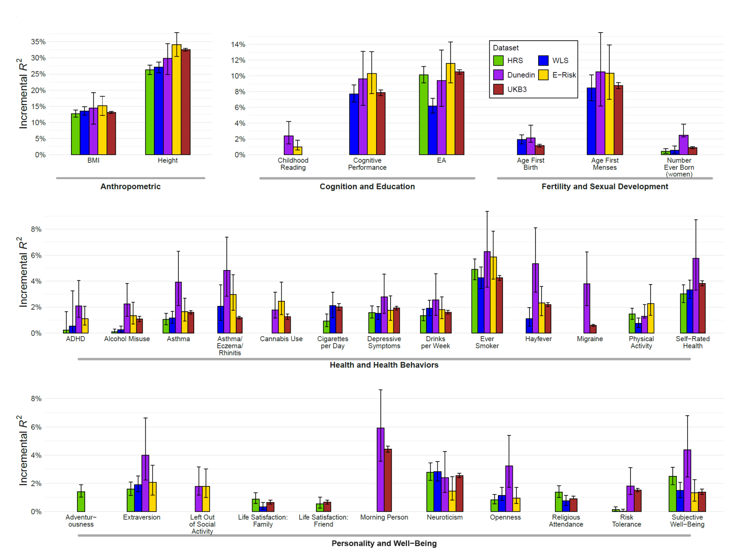
PGI Repository
v1.0
47 phenotypes
11 cohorts
v2.0 (coming soon)
7 new cohorts, 20 new phenotypes
Parental PGIs
Source: Becker et al. (2021)

Slide 36
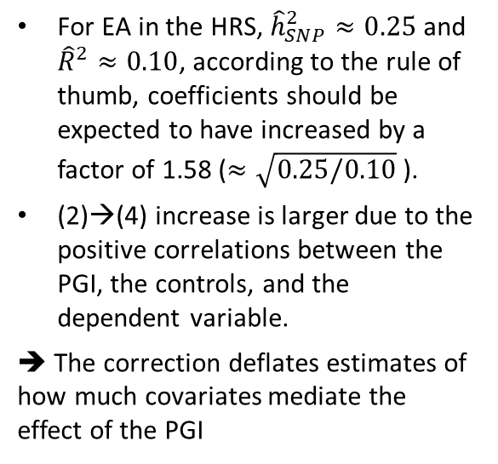




PGI-correct Python tool
https://github.com/JonJala/pgi_correct
We extend known results from errors-in-variables models to derive a consistent estimator for the coefficients from a regression with the $A_{SNP}$ as an explanatory variable.
Papageorge, N. W. & Thom, K. Genes, Education, and Labor Market Outcomes: Evidence from the Health and Retirement Study. J. Eur. Econ. Assoc. 18, 1351–1399 (2020).
Panel A. Association Between EA and the PGI, Without and With Controls for Parental EA
 | Original |  |  |  | Corrected
 | (1) |  | (2) |  | (3) |  | (4)
EA PGI | 0.844 (0.026) |  | 0.619 (0.024) |  | 1.318 (0.041) |  | 1.104 (0.042)
Father’s EA | - |  | 0.154 (0.010) |  | - |  | 0.112 (0.010)
Mother’s EA | - |  | 0.176 (0.011) |  | - |  | 0.141 (0.012)
# Obs. | 8,537 |  | 8,537 |  | 8,537 |  | 8,537
For EA in the HRS, ${\hat{h}}_{SNP}^{2}≈0.25$ and ${\hat{R}}^{2}≈0.10$, according to the rule of thumb, coefficients should be expected to have increased by a factor of 1.58 ($≈\sqrt{0.25/0.10}$).
(2)→(4) increase is larger due to the positive correlations between the PGI, the controls, and the dependent variable.
➔ The correction deflates estimates of how much covariates mediate the effect of the PGI
$$×1.56$$
$$×1.78$$
$$×0.73$$
$$×0.84$$

Slide 37
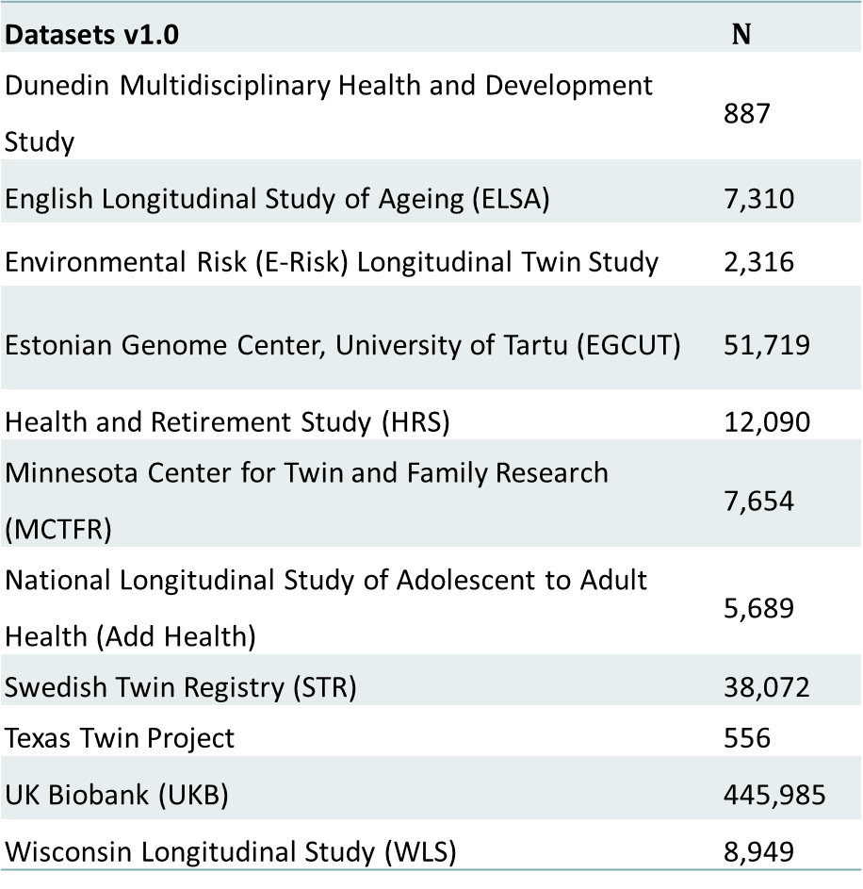
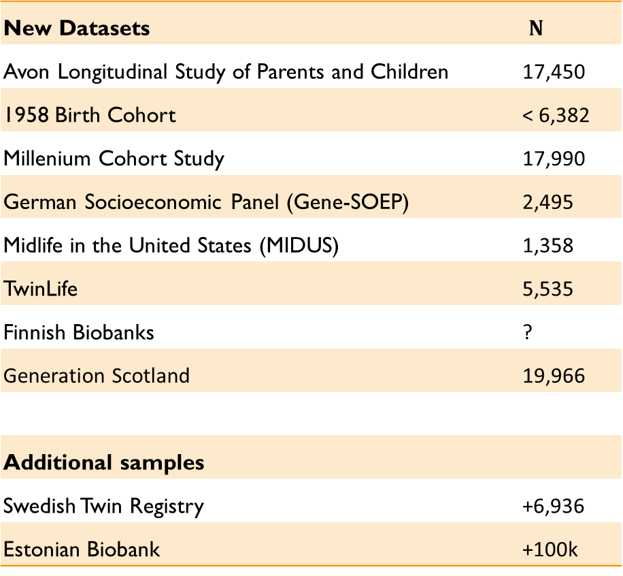
VERSION 2 – datasets
Datasets v1.0 | $N$
Dunedin Multidisciplinary Health and Development Study | 887
English Longitudinal Study of Ageing (ELSA) | 7,310
Environmental Risk (E-Risk) Longitudinal Twin Study | 2,316
Estonian Genome Center, University of Tartu (EGCUT) | 51,719
Health and Retirement Study (HRS) | 12,090
Minnesota Center for Twin and Family Research (MCTFR) | 7,654
National Longitudinal Study of Adolescent to Adult Health (Add Health) | 5,689
Swedish Twin Registry (STR) | 38,072
Texas Twin Project | 556
UK Biobank (UKB) | 445,985
Wisconsin Longitudinal Study (WLS) | 8,949
New Datasets | $N$
Avon Longitudinal Study of Parents and Children | 17,450
1958 Birth Cohort | < 6,382
Millenium Cohort Study | 17,990
German Socioeconomic Panel (Gene-SOEP) | 2,495
Midlife in the United States (MIDUS) | 1,358
TwinLife | 5,535
Finnish Biobanks | ?
Generation Scotland | 19,966
Additional samples
Swedish Twin Registry | +6,936
Estonian Biobank | +100k

Slide 38
PGI Repository v2 – Parental PGIs
Impute missing parental genotypes in datasets with sibling pairs and/or parent-offspring data and make parental PGIs using snipar
Add Health, N=830
GS
Texas, N=328
ALSPAC, N=6,624
MCTFR, N=3,167
TwinLife, N=2,323
E-Risk, N=1,346
MCS
UK Biobank
Estonian Biobank
STR
WLS, N=3,945

Slide 39

QUESTIONS?

Slide 40
References
Becker, J., Burik, C. A. P. P., Goldman, G., Wang, N., Jayashankar, H., Bennett, M., Belsky, D. W., Karlsson Linnér, R., Ahlskog, R., Kleinman, A., Hinds, D. A., Agee, M., Alipanahi, B., Auton, A., Bell, R. K., Bryc, K., Elson, S. L., Fontanillas, P., Furlotte, N. A., … Okbay, A. (2021). Resource profile and user guide of the Polygenic Index Repository. Nature Human Behaviour. https://doi.org/10.1038/s41562-021-01119-3
Daetwyler, H. D., Villanueva, B., & Woolliams, J. A. (2008). Accuracy of Predicting the Genetic Risk of Disease Using a Genome-Wide Approach. PLoS ONE, 3(10), e3395. https://doi.org/10.1371/journal.pone.0003395
de Vlaming, R., Okbay, A., Rietveld, C. C. A., Johannesson, M., Magnusson, P. K. E., Uitterlinden, A. G., van Rooij, F. J. A., Hofman, A., Groenen, P. J. F., Thurik, A. R. R., Koellinger, P. D. P., Wood, A., Esko, T., Yang, J., Vedantam, S., Pers, T., Gustafsson, S., Locke, A., Kahali, B., … Ritchie, S. (2017). Meta-GWAS Accuracy and Power (MetaGAP) Calculator Shows that Hiding Heritability Is Partially Due to Imperfect Genetic Correlations across Studies. PLOS Genetics, 13(1), e1006495. https://doi.org/10.1101/048322
Ge, T., Chen, C.-Y., Ni, Y., Feng, Y.-C. A., & Smoller, J. W. (2019). Polygenic prediction via Bayesian regression and continuous shrinkage priors. Nature Communications, 10(1), 1776. https://doi.org/10.1038/s41467-019-09718-5
Lloyd-Jones, L. R., Zeng, J., Sidorenko, J., Yengo, L., Moser, G., Kemper, K. E., Wang, H., Zheng, Z., Magi, R., Esko, T., Metspalu, A., Wray, N. R., Goddard, M. E., Yang, J., & Visscher, P. M. (2019). Improved polygenic prediction by Bayesian multiple regression on summary statistics. Nature Communications, 10(1), 5086. https://doi.org/10.1038/s41467-019-12653-0
Okbay, A., Wu, Y., Wang, N., Jayashankar, H., Bennett, M., Nehzati, S. M., Sidorenko, J., Kweon, H., Goldman, G., Gjorgjieva, T., Jiang, Y., Hicks, B., Tian, C., Hinds, D. A., Ahlskog, R., Magnusson, P. K. E., Oskarsson, S., Hayward, C., Campbell, A., … Young, A. I. (2022). Polygenic prediction of educational attainment within and between families from genome-wide association analyses in 3 million individuals. Nature Genetics 2022 54:4, 54(4), 437–449. https://doi.org/10.1038/s41588-022-01016-z
Privé, F., Luu, K., Blum, M. G. B., McGrath, J. J., & Vilhjálmsson, B. J. (2020). Efficient toolkit implementing best practices for principal component analysis of population genetic data. Bioinformatics, 36(16), 4449–4457. https://doi.org/10.1093/bioinformatics/btaa520
Purcell, S. M., Wray, N. R., Stone, J. L., Visscher, P. M., O’Donovan, M. C., Sullivan, P. F., Sklar, P., McQuillin, A., Morris, D. W., O’Dushlaine, C. T., Corvin, A., Holmans, P. A., MacGregor, S., Gurling, H., Blackwood, D. H. R. R., Craddock, N. J., Gill, M., Hultman, C. M., Kirov, G. K., … Consortium, T. I. S. (2009). Common polygenic variation contributes to risk of schizophrenia and bipolar disorder. Nature, 460(7256), 748–752. https://doi.org/10.1038/nature08185
Vilhjálmsson, B. J., Yang, J., Finucane, H. K., Gusev, A., Lindström, S., Ripke, S., Genovese, G., Loh, P. R., Bhatia, G., Do, R., Hayeck, T., Won, H. H., Neale, B. M., Corvin, A., Walters, J. T. R., Farh, K. H., Holmans, P. A., Lee, P., Bulik-Sullivan, B., … Price, A. L. (2015). Modeling Linkage Disequilibrium Increases Accuracy of Polygenic Risk Scores. American Journal of Human Genetics, 97(4), 576–592. https://doi.org/10.1016/j.ajhg.2015.09.001
Wang, Y., Guo, J., Ni, G., Yang, J., Visscher, P. M., & Yengo, L. (2020). Theoretical and empirical quantification of the accuracy of polygenic scores in ancestry divergent populations. Nature Communications, 11(1), 1–9. https://doi.org/10.1038/s41467-020-17719-y
Wray, N. R., Yang, J., Hayes, B. J., Price, A. L., Goddard, M. E., & Visscher, P. M. (2013). Pitfalls of predicting complex traits from SNPs. Nature Reviews Genetics, 14(7), 507–515. https://doi.org/10.1038/nrg3457
Further reading
Dudbridge, F. (2013). Power and Predictive Accuracy of Polygenic Risk Scores. PLoS Genetics, 9(3), e1003348. https://doi.org/10.1371/journal.pgen.1003348
Evans, D. M., Visscher, P. M., & Wray, N. R. (2009). Harnessing the information contained within genome-wide association studies to improve individual prediction of complex disease risk. Human Molecular Genetics, 18(18), 3525–3531. https://doi.org/10.1093/hmg/ddp295
Martin, A. R., Kanai, M., Kamatani, Y., Okada, Y., Neale, B. M., & Daly, M. J. (2019). Clinical use of current polygenic risk scores may exacerbate health disparities. Nature Genetics, 51(4), 584–591. https://doi.org/10.1038/s41588-019-0379-x
Witte, J. S., Visscher, P. M., & Wray, N. R. (2014). The contribution of genetic variants to disease depends on the ruler. Nature Reviews Genetics, 15(11), 765–776. https://doi.org/10.1038/nrg3786
Wray, N. R., Goddard, M. E., & Visscher, P. M. (2007). Prediction of individual genetic risk to disease from genome-wide association studies. Genome Research, 17(10), 1520–1528. https://doi.org/10.1101/gr.6665407
Wray, N. R., Lee, S. H., Mehta, D., Vinkhuyzen, A. A. E., Dudbridge, F., & Middeldorp, C. M. (2014). Research Review: Polygenic methods and their application to psychiatric traits. Journal of Child Psychology and Psychiatry, 55(10), 1068–1087. https://doi.org/10.1111/jcpp.12295

Slide 41
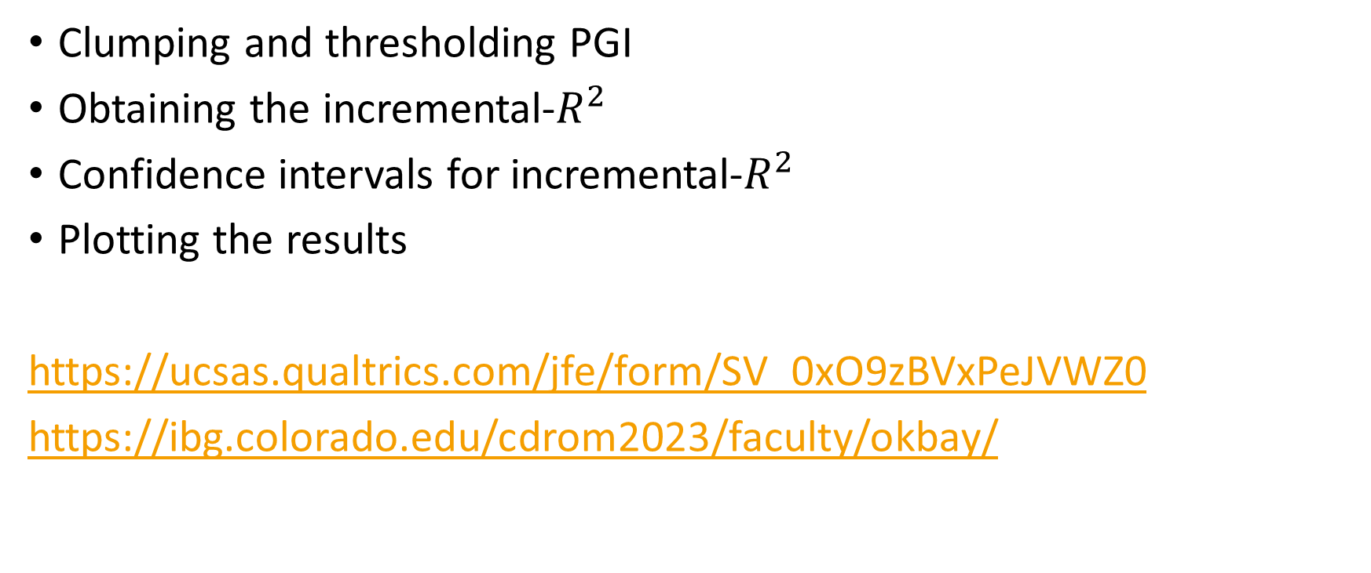
PRACTICAL
Clumping and thresholding PGI
Obtaining the incremental-$R^{2}$
Confidence intervals for incremental-$R^{2}$
Plotting the results
https://ucsas.qualtrics.com/jfe/form/SV_0xO9zBVxPeJVWZ0
https://ibg.colorado.edu/cdrom2023/faculty/okbay/

