Slide 1
Fundamental of Statistical Genetics and data
Allele frequencies; population structure and correlation among loci
Augustine Kong
University of Oxford

Slide 2
Genetic Markers (Polymorphisms) and SNPs
Polymorphisms are locations in the genomes that have variations. Many types of polymorphisms.
Popular these days are Single Nucleotide Polymorphisms (SNPs) because they tend to be stable and can be genotyped efficiently and accurately.
Most SNPs have only two alleles with non-negligible frequencies. Here, for mathematical and computational convenience, we code them as 0/1 alleles. Genotype of a person at a (autosomal) site is made up of two alleles, one inherited from each parent. A genotype without distinguishing between paternal and maternal alleles, what the raw data usually are, can thus be coded as
0 (homozygote 00),
1 (heterozygote 01 or 10),
and 2 (homozygote 11).

Slide 3
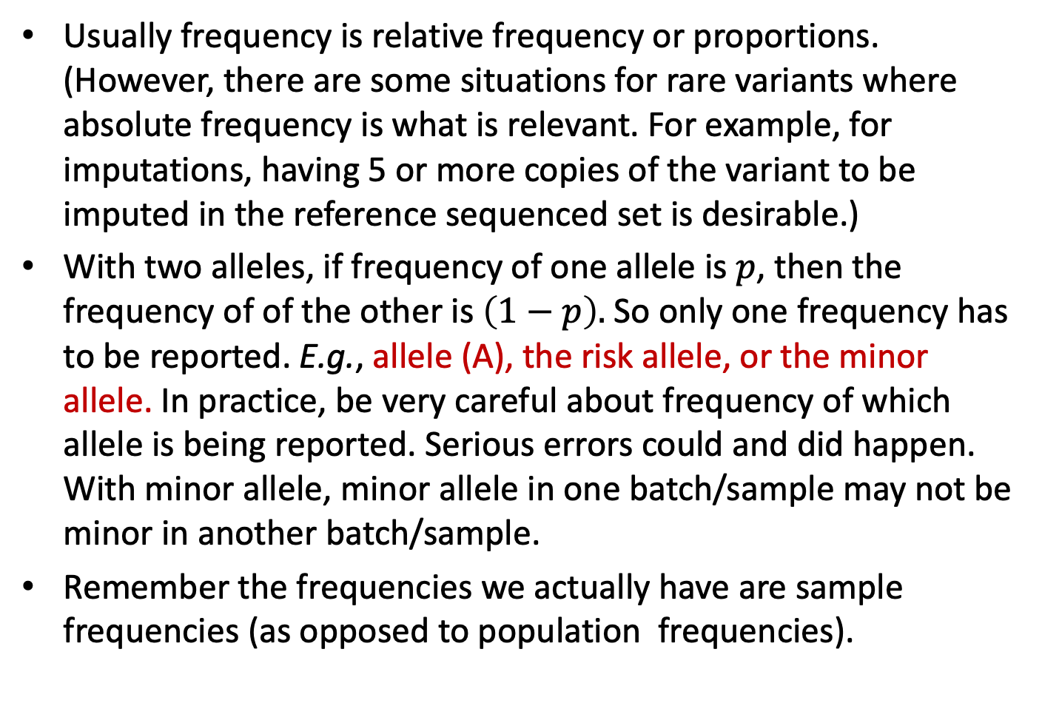
Allele frequencies
Usually frequency is relative frequency or proportions. (However, there are some situations for rare variants where absolute frequency is what is relevant. For example, for imputations, having 5 or more copies of the variant to be imputed in the reference sequenced set is desirable.)
With two alleles, if frequency of one allele is $p$, then the frequency of of the other is $\left(1−p\right).$So only one frequency has to be reported. E.g., allele (A), the risk allele, or the minor allele. In practice, be very careful about frequency of which allele is being reported. Serious errors could and did happen. With minor allele, minor allele in one batch/sample may not be minor in another batch/sample.
Remember the frequencies we actually have are sample frequencies (as opposed to population frequencies).

Slide 4
Haplotypes and Phasing
A SNP haplotype is a string of alleles of a set of SNPs that are inherited from the same parent.
Example, 6 SNPs, the string of alleles inherited from the father is:
110100
From the mother:
011101
The corresponding string of genotypes is:
121201
Determining the two haplotypes from the genotypes is phasing. Only heterozygous SNPs have to be phased (above, SNPs 1,3 and 6). Usually, phasing does not include parent-of-origin (PO) determination, and only include SNPs (markers) on the same chromosome. For the UK Biobank (UKBB) data, the current phasing is usually quite accurate up to SNPs within 5Mb (?), and some progress has been made recently on PO determination. Icelandic data the best in this respect …

Slide 5
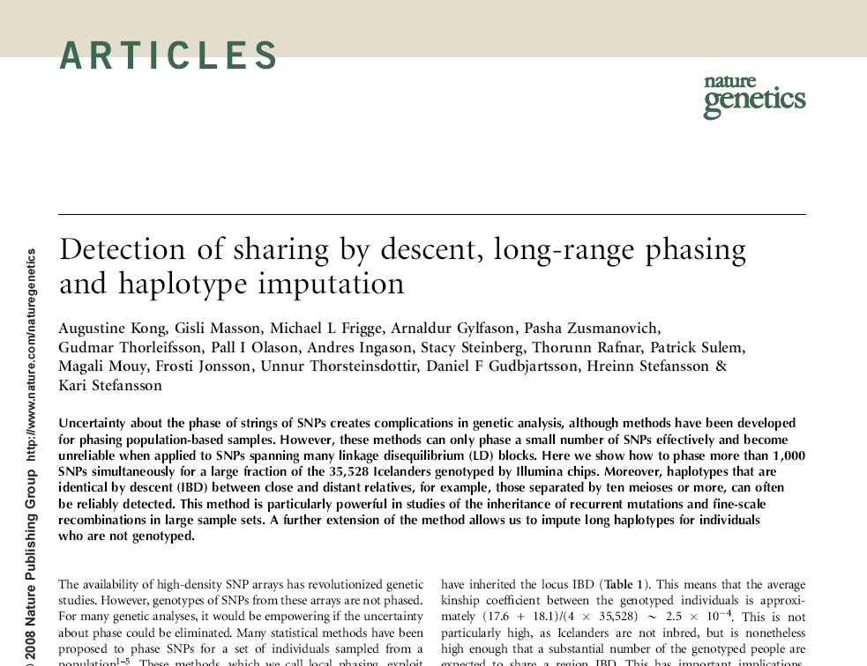
Based on an Icelandic sample size of about 35,000. Even with more sophisticated phasing methods and a much larger sample size, the phasing of the UK Biobank data now still cannot match this
September 2008

Slide 6
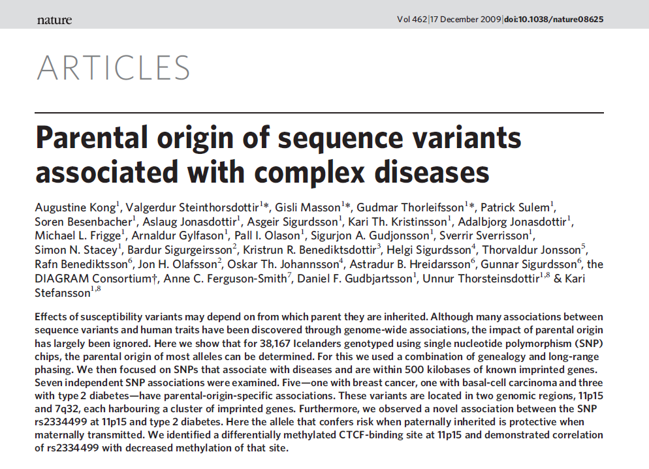
2009

Slide 7
Why are haplotypes important
Imputations of sequence level variations into samples genotype with a gene-chip. Example, from a sequenced panel, the frequencies of two related haplotypes are:
01001011 --- 10%
01000011 --- 0.1%
Then for a genotyped sample estimated to have a haplotype
0100?011
the missing (unobserved) ? allele of snp5 is most likely 1. Tag
Even if made up of entirely common alleles, long haplotypes would have low frequency. Two people sharing the same long rare haplotype is likely to have inherited it from a not too distant common ancestor (identical of descent (IBD)).
Haplotype frequencies are also important for phasing, and many other purposes …… See some other examples in the 2008 paper

Slide 8
How old haplotypes break up and
new haplotypes formed
Father Mother
Two chromosomes/haplotypes
Inherited from the
two grandparents
Sibling 1 Sibling 2
Recombination/crossover event
IBD segments
of the two sibs
Two sites have recombined if the alleles originated from two different grandparents

Slide 9
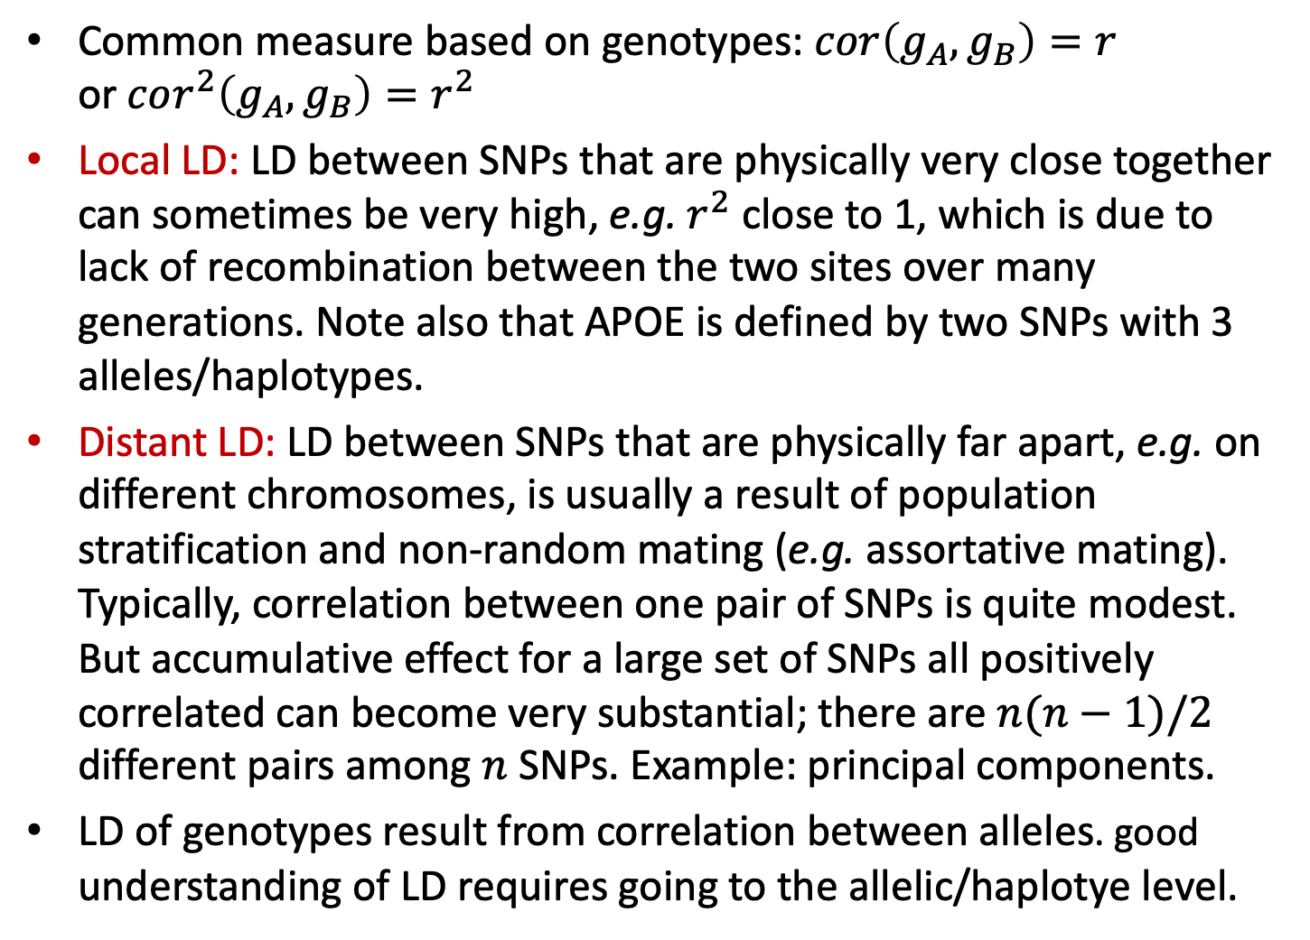
Correlation, or Linkage Disequilibrium (LD) of SNPs
Common measure based on genotypes: $cor\left(g_{A}, g_{B}\right)=r$ or$cor^{2}\left(g_{A}, g_{B}\right)=r^{2}$
Local LD: LD between SNPs that are physically very close together can sometimes be very high, e.g. $r^{2}$ close to 1, which is due to lack of recombination between the two sites over many generations. Note also that APOE is defined by two SNPs with 3 alleles/haplotypes.
Distant LD: LD between SNPs that are physically far apart, e.g. on different chromosomes, is usually a result of population stratification and non-random mating (e.g. assortative mating). Typically, correlation between one pair of SNPs is quite modest. But accumulative effect for a large set of SNPs all positively correlated can become very substantial; there are $n(n−1)/2$ different pairs among $n$ SNPs. Example: principal components.
LD of genotypes result from correlation between alleles. good understanding of LD requires going to the allelic/haplotye level.

Slide 10
Assortative mating
(non-random mating)
and correlation of
markers
Father
Mother
between
partner
correlation
A₁
A₂
A₃
A₄
within
person
correlation
B₁
B₂
B₃
B₄
Offspring
A_{p}
A_{m}
cis correlation ϲ
cis correlation ϲ
B_{p}
B_{m}
trans
correlation
τ

Slide 11
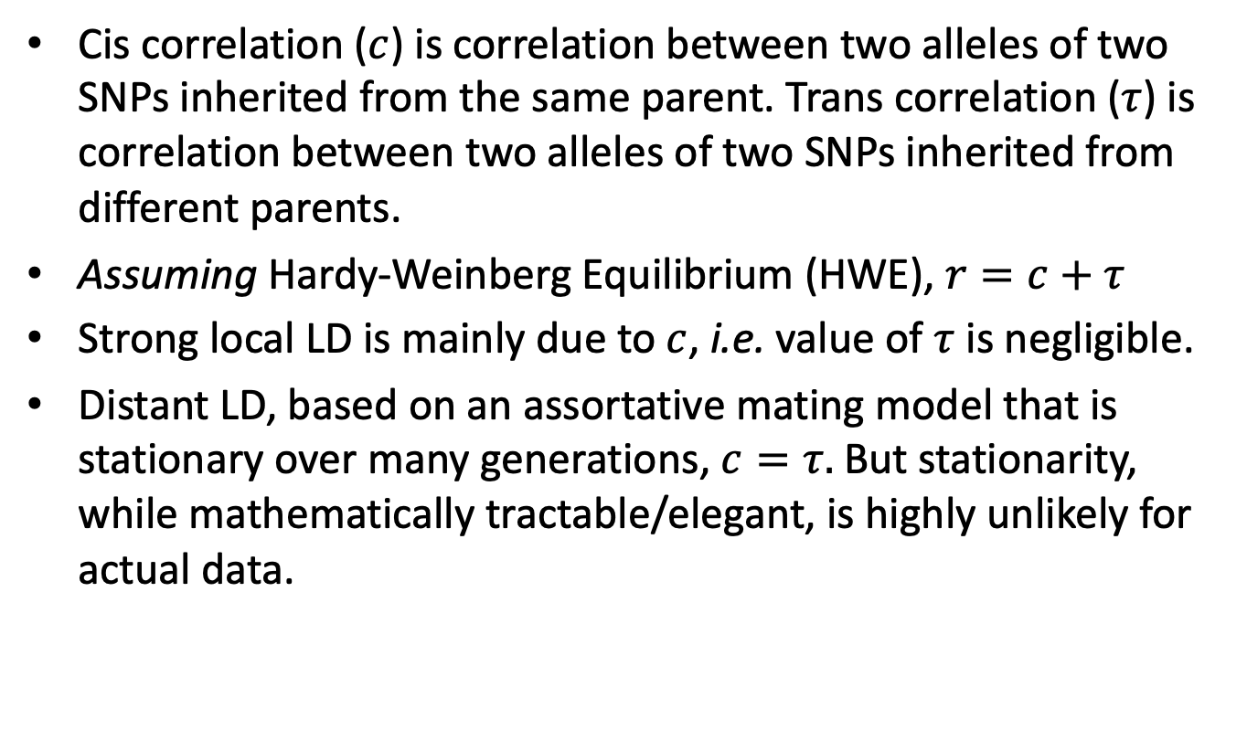

Relationship between $r, c$ and $τ$
Cis correlation ($c$) is correlation between two alleles of two SNPs inherited from the same parent. Trans correlation ($τ$) is correlation between two alleles of two SNPs inherited from different parents.
Assuming Hardy-Weinberg Equilibrium (HWE), $r=c+τ$
Strong local LD is mainly due to $c$, i.e. value of $τ$ is negligible.
Distant LD, based on an assortative mating model that is stationary over many generations, $c=τ.$But stationarity, while mathematically tractable/elegant, is highly unlikely for actual data.

Slide 12
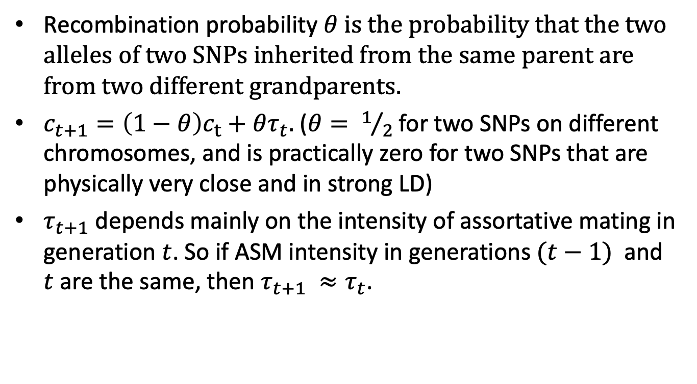

Recursive equations for $c$ and $τ$ for two SNPs with recombination probability $θ$
Recombination probability $θ$ is the probability that the two alleles of two SNPs inherited from the same parent are from two different grandparents.
$c_{t+1}=\left(1−θ\right)c_{t}+θτ_{t}.$($θ= 1/2$ for two SNPs on different chromosomes, and is practically zero for two SNPs that are physically very close and in strong LD)
$τ_{t+1}$ depends mainly on the intensity of assortative mating in generation $t$. So if ASM intensity in generations $(t−1)$ and $t$are the same, then $τ_{t+1} ≈τ_{t}$.

Slide 13
Data Imperfections
(Raw) Data do not have some of the information we want, e.g. phasing, parent-of-origin, and sequence level resolution.
Genotypes have errors. This can be a pain, but can also be very interesting.
Data that are good enough (with respect to errors) for one application can be seriously problematic for another application.
Participation bias. Sample not fully representative of the population of interest.

Slide 14
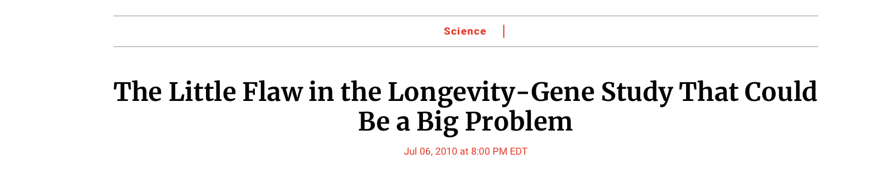
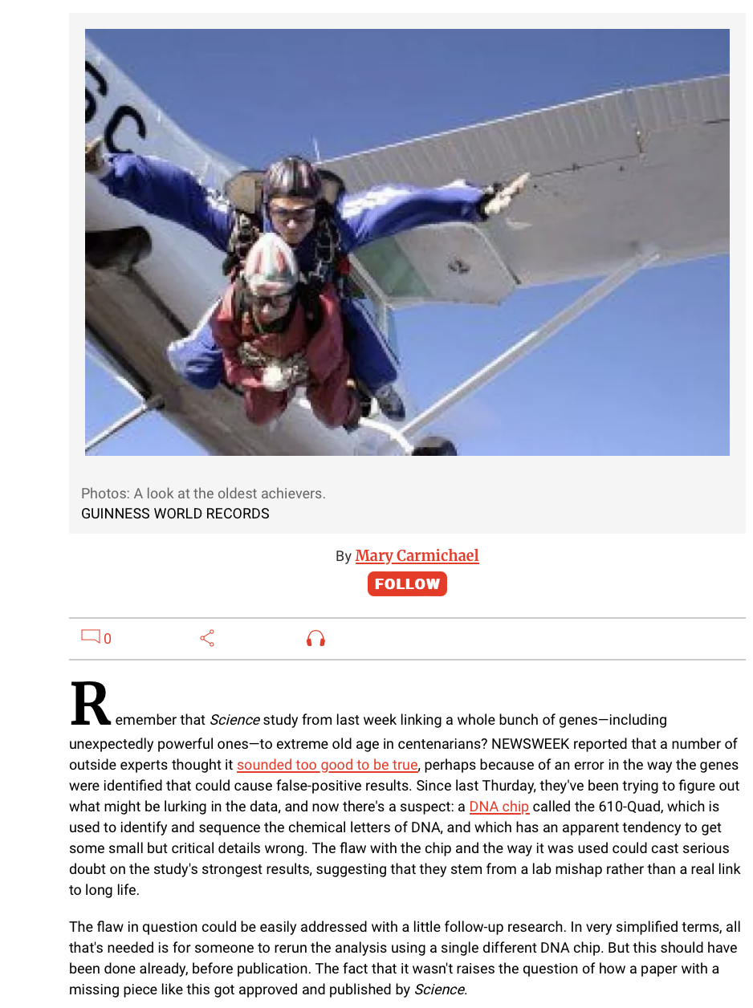
Genetic Signatures of Exceptional
Longevity in Humans
SCIENCE
1 Jul 2010
Vol 329, Issue 5987
Paper retracted by journal July 2011

Slide 15
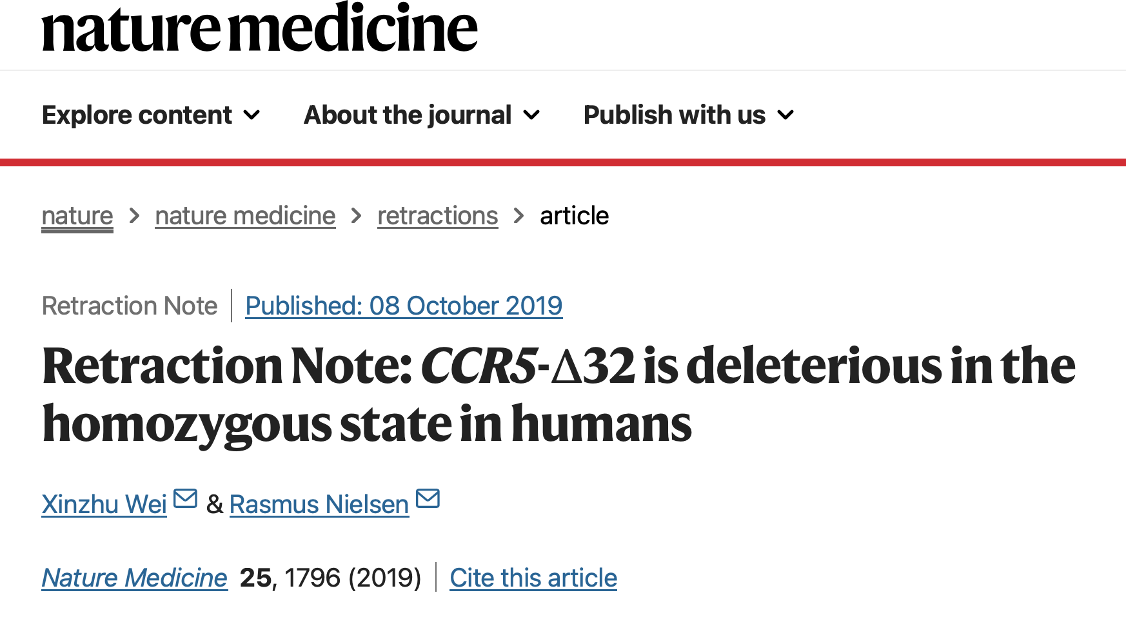
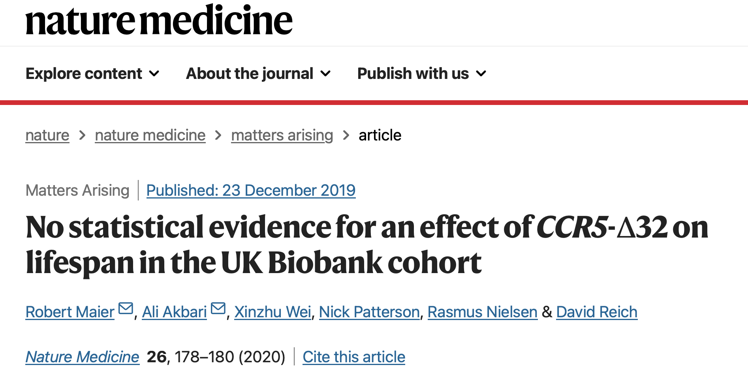
CRISPR gene-edited babies may be at increased risk of early death,
study finds. CNN June 5, October 2019
The Original Article was published on 03 June 2019

