Slide 1



Genetic Discovery
Candidate gene studies vs. GWAS
Meta-analysis
Obtaining independent signals
QC of GWAS summary statistics
Using GWAS results
Aysu Okbay

Slide 2
Genetic discovery
Candidate gene studies vs. GWAS
Meta-analysis
Obtaining independent signals
QC of GWAS summary statistics
Using GWAS results

Slide 3
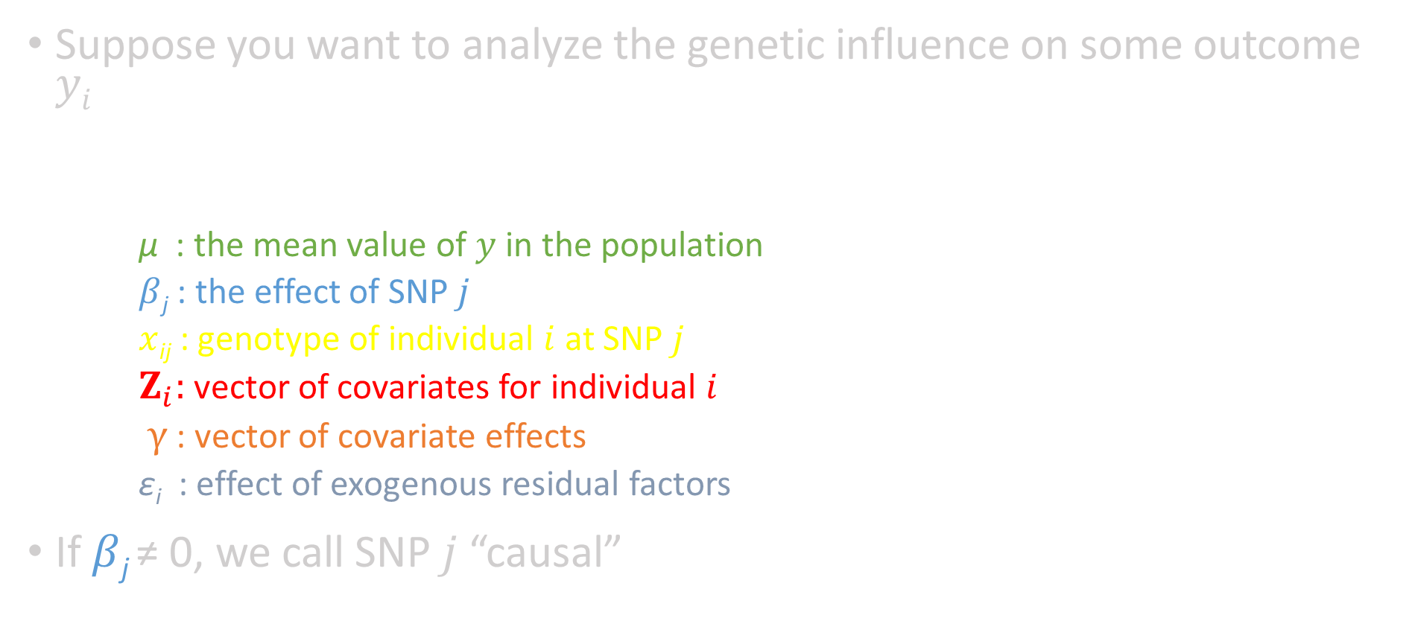
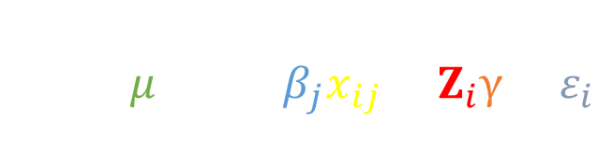
Genetic discovery
Suppose you want to analyze the genetic influence on some outcome $yi$
μ : the mean value of $y$ in the population
$β$_{j} : the effect of SNP $j$
$x$_{ij} : genotype of individual $i$ at SNP $j$
$Z_{i}:$ vector of covariates for individual $i$
$γ$ : vector of covariate effects
ε_{i} : effect of exogenous residual factors
If $β$_{j} ≠ 0, we call SNP $j$ “causal”
$$y_{i}= μ+\sum_{j=1}^{J}{β_{j}x_{ij}}+Z_{i}γ+ε_{i}$$
Notes:
Back to our conceptual framework.
Beta should be understood as the treatment effect from an experiment in which one SNP (and nothing else) is changed at conception.

Slide 4
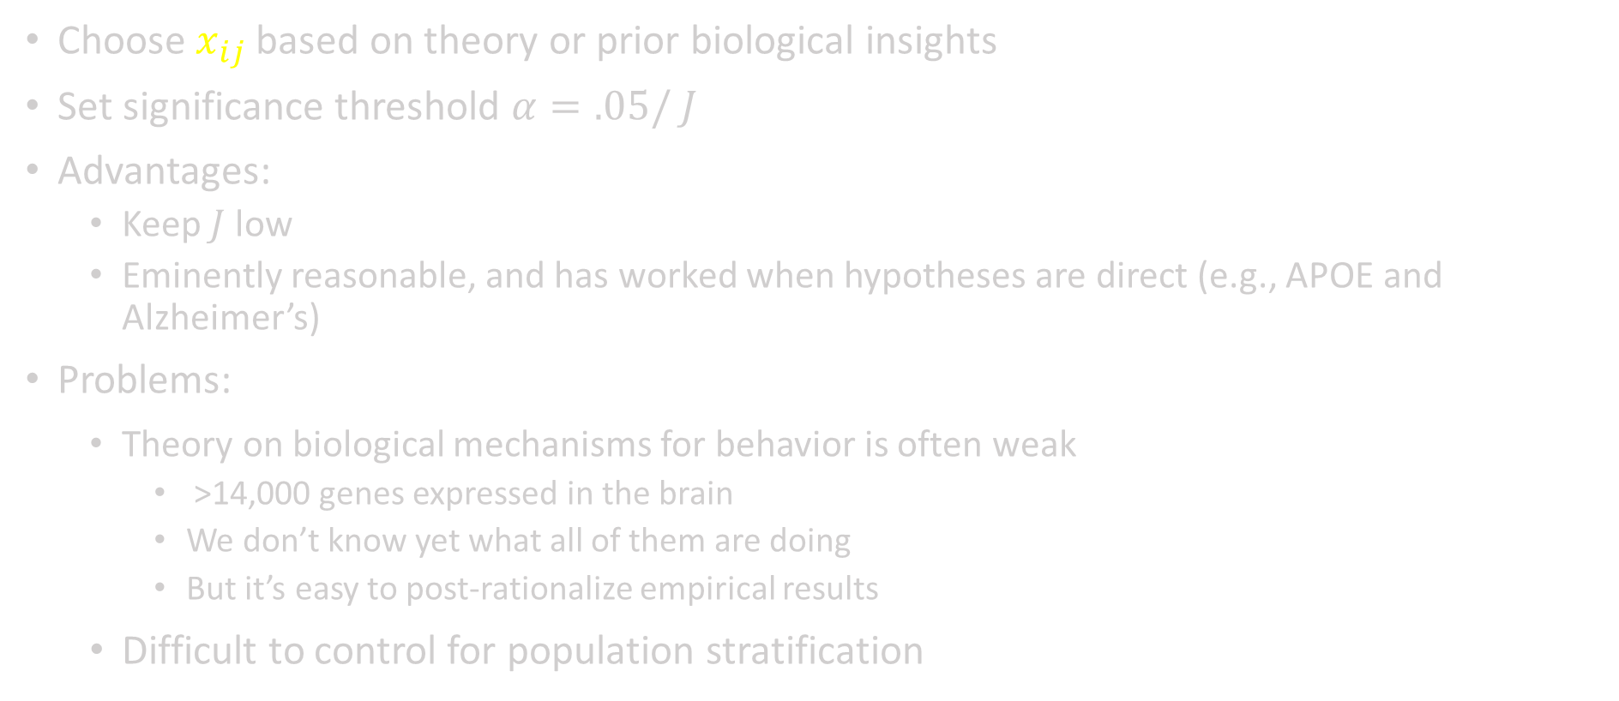
Candidate gene studies – 1
Choose $x_{ij}$ based on theory or prior biological insights
Set significance threshold $α=.05/ J$
Advantages:
  Keep $J$low
  Eminently reasonable, and has worked when hypotheses are direct (e.g., APOE and Alzheimer’s)
Problems:
  Theory on biological mechanisms for behavior is often weak
    >14,000 genes expressed in the brain
    We don’t know yet what all of them are doing
    But it’s easy to post-rationalize empirical results
  Difficult to control for population stratification

Slide 5
Candidate gene studies – 2
Problems (cont’d):
  Typical candidate gene studies assume (implicitly) large effect sizes of genetic variants
    This assumption is false for genetically complex (non-Mendelian) traits
    As a result of wrong assumptions about plausible effect sizes, many candidate gene studies were underpowered (small N)
Also, in the age of cheap genome-wide data, it’s difficult to justify to look at only a few of them

Slide 6
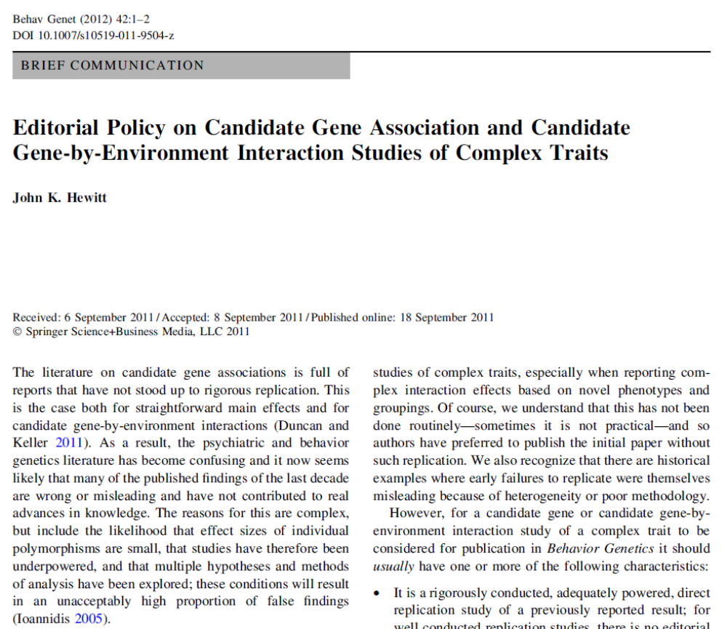
Replication attempts of candidate gene studies
“The literature on candidate gene associations is full of reports that have not stood up to rigorous replication… As a result, the psychiatric and behavior genetics literature has become confusing and it now seems likely that many of the published findings of the last decade are wrong or misleading and have not contributed to real advances in knowledge.”
Notes:
New editorial policy on candidate genes:
It is a rigorously conducted, adequately powered, direct replication study of a previously reported result; for well conducted replication studies, there is no editorial preference in Behavior Genetics for or against null, positive, or contradictory findings.
• It was an exploratory study or test of a novel hypothesis, but with an adequately powered, direct replication study reported in the same paper.
• It was an exploratory analysis or test of a novel hypothesis in the context of an adequately powered study, and the finding meets the statistical criteria for genome wide significance taking into account all sources of multiple testing (e.g. phenotypes, genotypes, environments, covariates, subgroups).
• It is a meta-analysis of several or many studies addressing the same genetic variant and/or environmental variable and the same behavioral outcome.

Slide 7
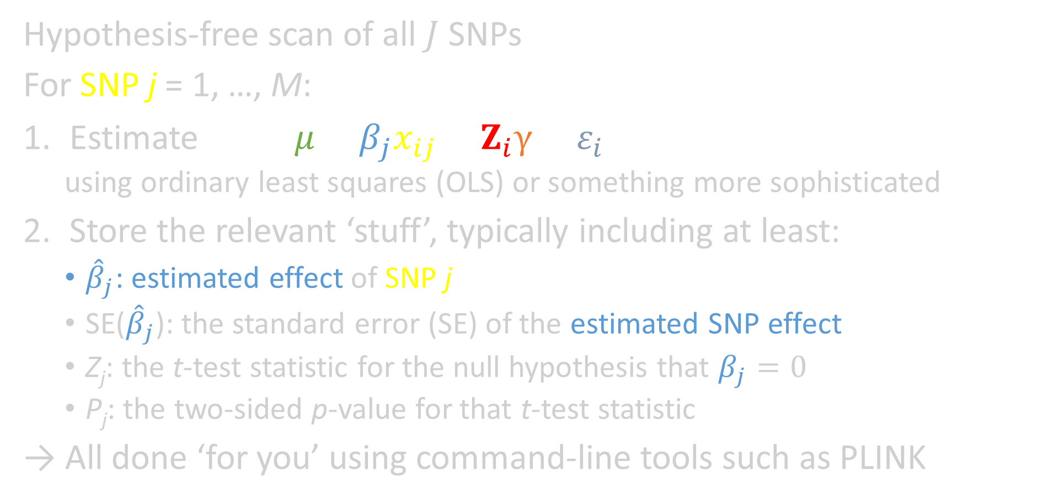
Genome-wide association studies (GWAS)
Hypothesis-free scan of all $J$ SNPs
For SNP j = 1, …, M:
Estimate $y_{i}= μ+β_{j}x_{ij}+Z_{i}γ+ε_{i}$
  using ordinary least squares (OLS) or something more sophisticated
Store the relevant ‘stuff’, typically including at least:
  ${\hat{β}}_{j}$: estimated effect of SNP j
  SE(${\hat{β}}_{j}$): the standard error (SE) of the estimated SNP effect
  Z_{j}: the t-test statistic for the null hypothesis that $β_{j}=0$
  P_{j}: the two-sided p-value for that t-test statistic
→ All done ‘for you’ using command-line tools such as PLINK
Includes PCs to control
for pop. strat.

Slide 8
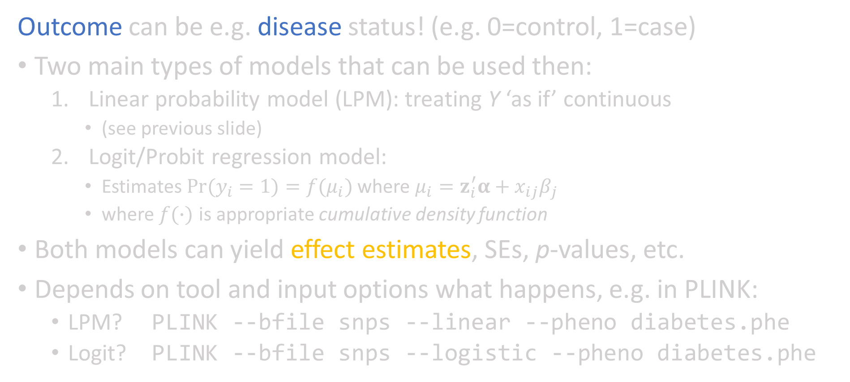
What if Y is binary?
Outcome can be e.g. disease status! (e.g. 0=control, 1=case)
Two main types of models that can be used then:
  Linear probability model (LPM): treating Y ‘as if’ continuous
    (see previous slide)
  Logit/Probit regression model:
    Estimates $Pr(y_{i}=1)=f(μ_{i})$ where $μ_{i}=z_{i}^{′}α+x_{ij}β_{j}$
    where $f(∙)$ is appropriate cumulative density function
Both models can yield effect estimates, SEs, p-values, etc.
Depends on tool and input options what happens, e.g. in PLINK:
  LPM? PLINK --bfile snps --linear --pheno diabetes.phe
  Logit? PLINK --bfile snps --logistic --pheno diabetes.phe

Slide 9

Multiple hypothesis testing – 1/2
GWAS: scans many SNPs for association with Y
we are testing many independent hypotheses!
Conventional significance threshold α = 5%?
if null hypothesis (H₀: given SNP has no effect) is true?
  5% chance to falsely reject in each test
  for one million independent, non-associated SNPs:
    we expect 0.05×10⁶ = 50,000 false positives!… Unacceptable!
    and chance of observing no false positive is basically zero
Simple solution? Bonferroni correction!
Set α* = α/(# independent tests) and use that as significance level

Slide 10
Multiple hypothesis testing – 2/2
What does a Bonferroni correction accomplish?
  it sets a very high bar: but that’s good :)
  chance of finding one (or more) false positives? ≈ α
  chance of finding no false positive at all? ≈ 1 − α
For GWAS using common SNPs for Europeans:
  # independent tests ≈ 1 million
  So α = 0.05 yields α* = 5×10⁻⁸ = 0.000005%
Only if b_{j} has P-value below α* do we say
  “SNP j is genome-wide significant”

Slide 11
Advantages of GWAS
  Makes the need to correct for multiple hypotheses apparent
  Because whole-genome data are available, more possibilities exist to detect and control for population stratification
  True “discoveries” are possible
  Polygenic indexes can be constructed from the estimated results of all SNPs

Slide 12
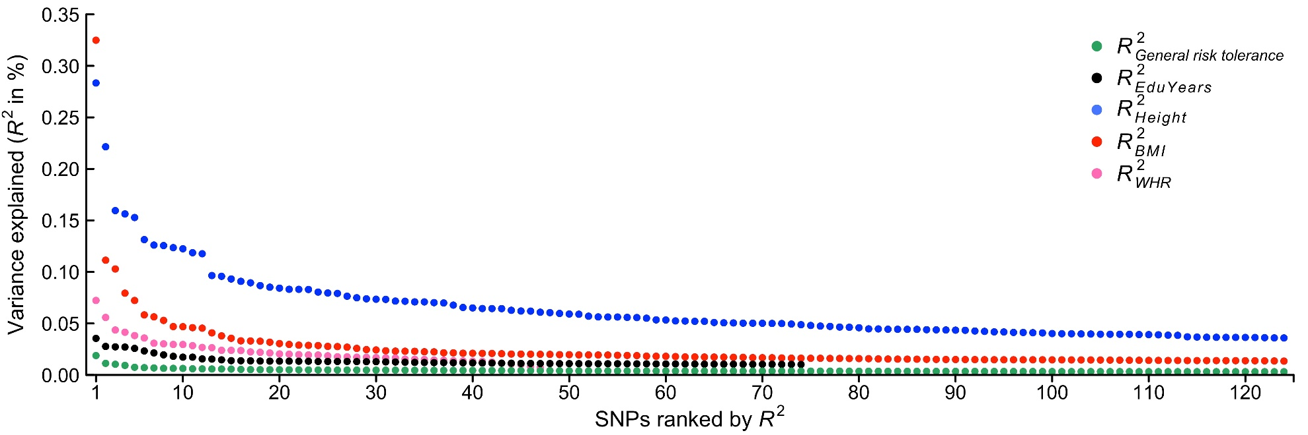
Challenges
Many traits influenced by ‘thousands’ of SNPs with small effects
Very large sample sizes are needed!
Effect sizes genome-wide significant SNPs in terms of R² w.r.t. various traits. SNP with lowest p-value for each approximately independent locus is displayed. Effect sizes are subject to the statistical winner’s curse (i.e. true effects are likely even smaller). Source: Linnér et al. 2018, https://www.biorxiv.org/content/early/2018/02/08/261081

Slide 13
Calculating statistical power
Many tools out there that can help you!
Some calculate power if you provide α, N, R²
Others calculate lowest R² needed to attain desired power, for given α, N
Examples:
G*Power software: https://www.gpower.hhu.de/en.html
Purcell’s power calculator: https://zzz.bwh.harvard.edu/gpc/
MetaGAP calculator: https://devlaming.eu/metagap.html
Fast regression power calculator: https://devlaming.eu/frp.html

Slide 14
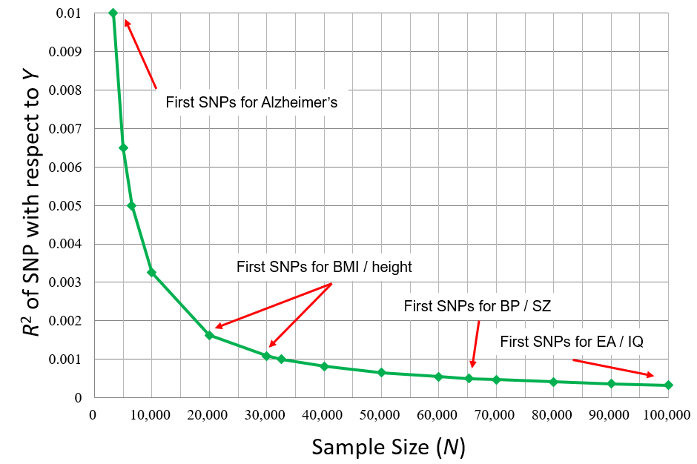
Putting power in context
Required R² (y-axis) between SNP and Y to have 50% power for given N (x-axis) and α = 5×10⁻⁸

Slide 15
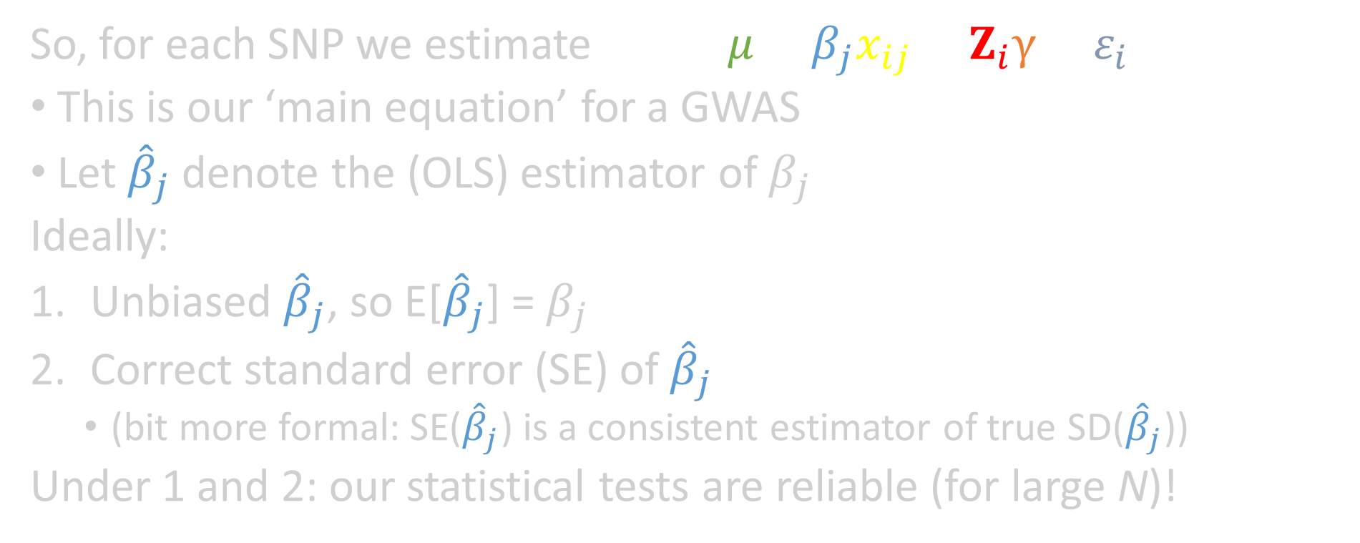
GWAS Assumptions – 1/10
So, for each SNP we estimate $y_{i}= μ+β_{j}x_{ij}+Z_{i}γ+ε_{i}$
This is our ‘main equation’ for a GWAS
Let ${\hat{β}}_{j}$ denote the (OLS) estimator of $β_{j}$
Ideally:
Unbiased ${\hat{β}}_{j}$, so E[${\hat{β}}_{j}$] = $β_{j}$
Correct standard error (SE) of ${\hat{β}}_{j}$
  (bit more formal: SE(${\hat{β}}_{j}$) is a consistent estimator of true SD(${\hat{β}}_{j}$))
Under 1 and 2: our statistical tests are reliable (for large N)!

Slide 16
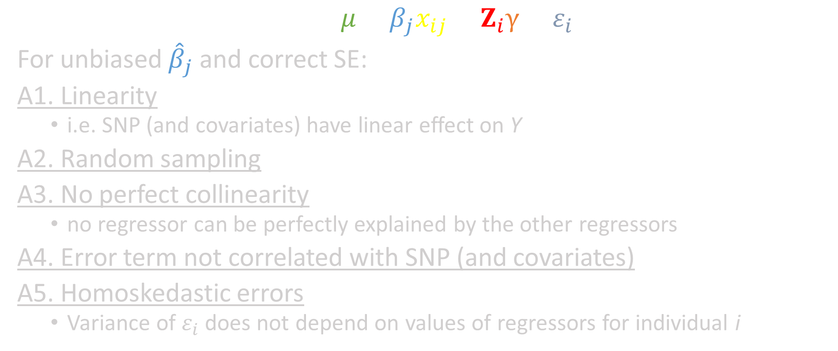
GWAS Assumptions – 2/10
$$y_{i}= μ+β_{j}x_{ij}+Z_{i}γ+ε_{i}$$
For unbiased ${\hat{β}}_{j}$ and correct SE:
A1. Linearity
  i.e. SNP (and covariates) have linear effect on Y
A2. Random sampling
A3. No perfect collinearity
  no regressor can be perfectly explained by the other regressors
A4. Error term not correlated with SNP (and covariates)
A5. Homoskedastic errors
  Variance of $ε_{i}$ does not depend on values of regressors for individual i

Slide 17

GWAS Assumptions – 3/10
A1. Linearity
Little evidence for pervasive dominance effects for complex traits.
Height
So linear SNP effects are reasonable starting point!
AA
AT
TT
  (GWAS including dominance effects is possible)
Genotypes for given SNP

Slide 18
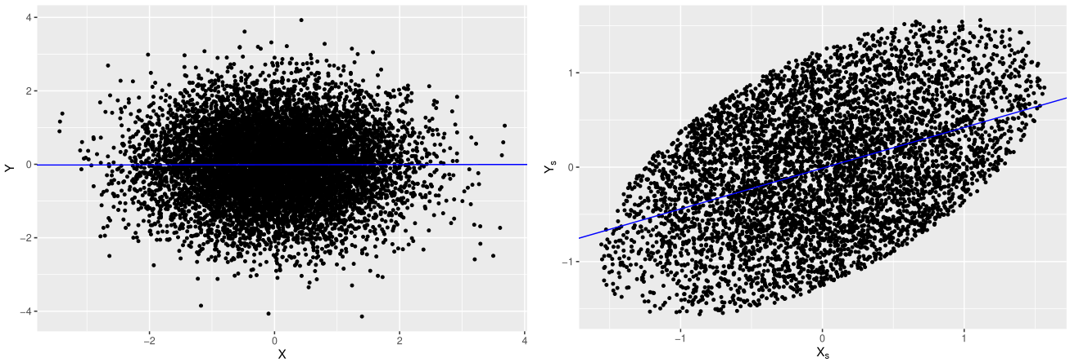
GWAS Assumptions – 4/10
A2. Random sampling
1. Non-representative samples (e.g. case–control cohorts)
  b_{j} can reflect spurious associations
Some simulation with random sampling: same simulation, taking non-random subsample:

Slide 19
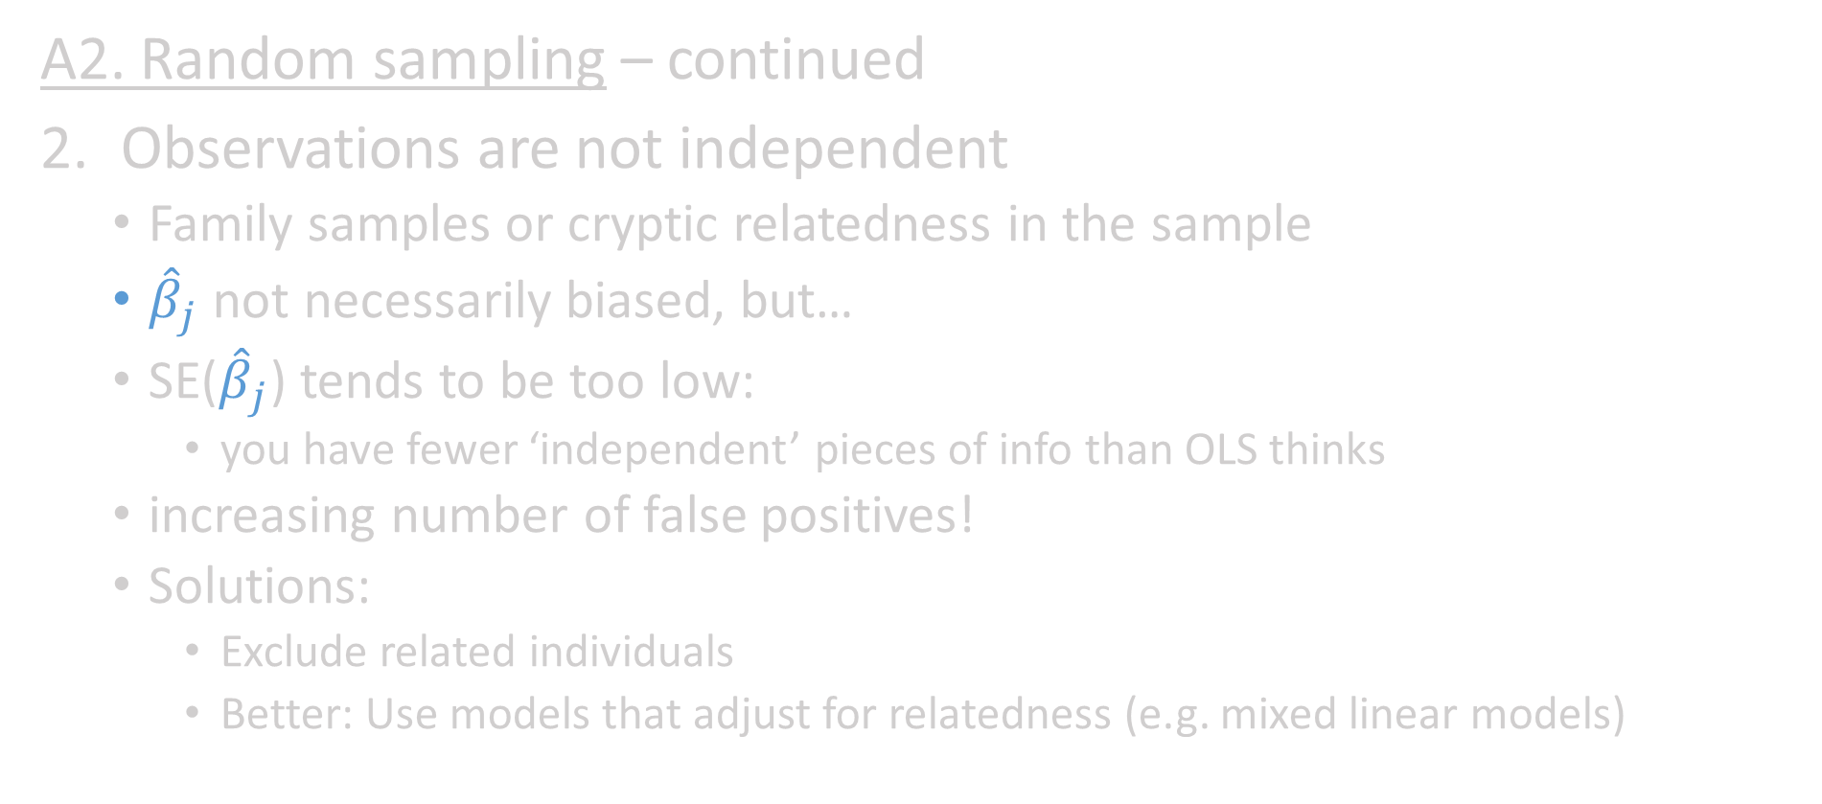
GWAS Assumptions – 5/10
A2. Random sampling – continued
Observations are not independent
  Family samples or cryptic relatedness in the sample
  ${\hat{β}}_{j}$ not necessarily biased, but…
  SE(${\hat{β}}_{j}$) tends to be too low:
    you have fewer ‘independent’ pieces of info than OLS thinks
  increasing number of false positives!
  Solutions:
    Exclude related individuals
    Better: Use models that adjust for relatedness (e.g. mixed linear models)

Slide 20
GWAS Assumptions – 6/10
A3. No perfect collinearity
In GWAS, you just consider one SNP at a time
Choose your covariates wisely such that no covariate is perfectly explained by other covariates
Then in most situations: good to go!

Slide 21
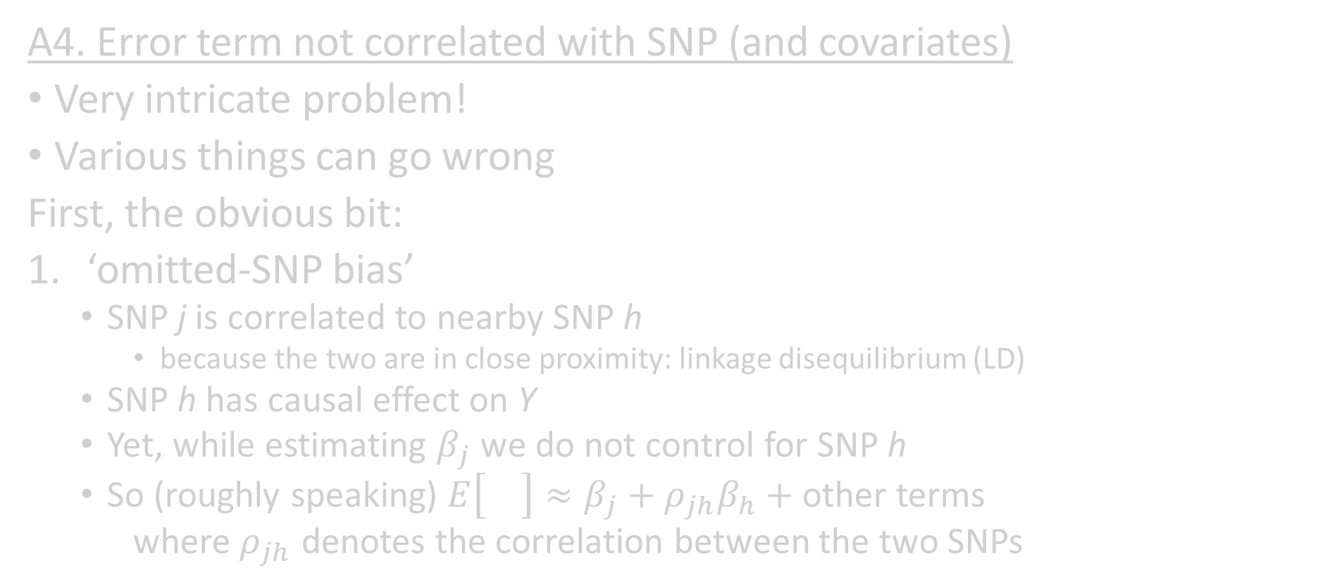
GWAS Assumptions – 7/10
A4. Error term not correlated with SNP (and covariates)
Very intricate problem!
Various things can go wrong
First, the obvious bit:
‘omitted-SNP bias’
  SNP j is correlated to nearby SNP h
    because the two are in close proximity: linkage disequilibrium (LD)
  SNP h has causal effect on Y
  Yet, while estimating $β_{j}$ we do not control for SNP h
  So (roughly speaking) $E\left[{\hat{β}}_{j}\right]≈β_{j}+ρ_{jh}β_{h}+$ other terms
  where $ρ_{jh}$ denotes the correlation between the two SNPs

Slide 22
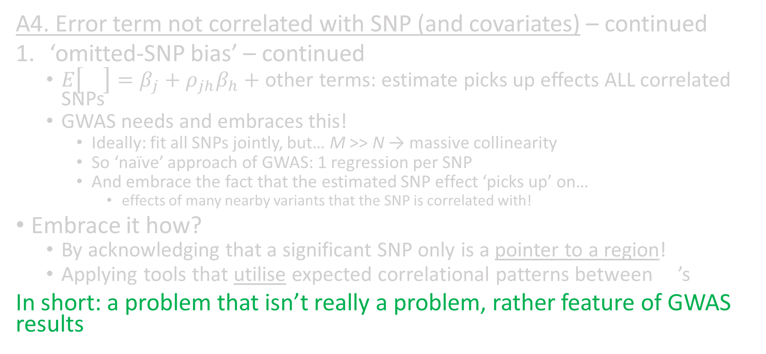
GWAS Assumptions – 8/10
A4. Error term not correlated with SNP (and covariates) – continued
‘omitted-SNP bias’ – continued
  $E\left[{\hat{β}}_{j}\right]=β_{j}+ρ_{jh}β_{h}+$ other terms: estimate picks up effects ALL correlated SNPs
  GWAS needs and embraces this!
    Ideally: fit all SNPs jointly, but… M >> N → massive collinearity
    So ‘naïve’ approach of GWAS: 1 regression per SNP
    And embrace the fact that the estimated SNP effect ‘picks up’ on…
      effects of many nearby variants that the SNP is correlated with!
Embrace it how?
  By acknowledging that a significant SNP only is a pointer to a region!
  Applying tools that utilise expected correlational patterns between ${\hat{β}}_{j}$’s
In short: a problem that isn’t really a problem, rather feature of GWAS results

Slide 23
GWAS Assumptions – 9/10
A4. Error term not correlated with SNP (and covariates) – continued
Other omitted variables, e.g. some types of gene-environment correlation
  population stratification
  genetic nurture
    my genes are correlated to parental genes
    Parental genes partially shaped my environment
    Environment partially shaped my outcomes
    Ideally: control for parental genotypes, or
    similar strategies, involving family data
More on this on Thursday

Slide 24
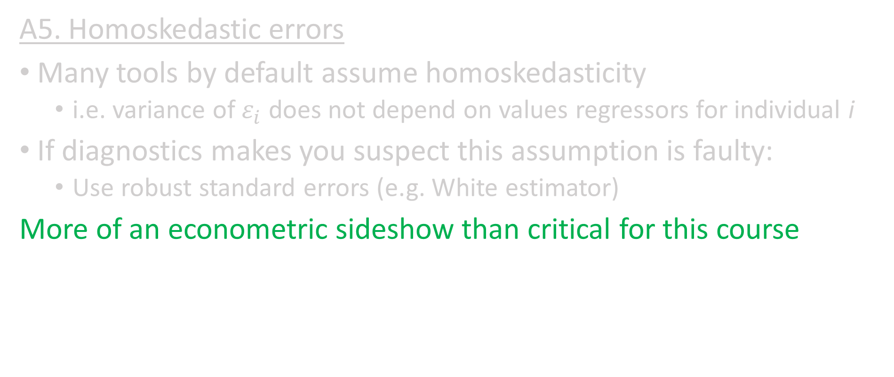
GWAS Assumptions – 10/10
A5. Homoskedastic errors
Many tools by default assume homoskedasticity
  i.e. variance of $ε_{i}$ does not depend on values regressors for individual i
If diagnostics makes you suspect this assumption is faulty:
  Use robust standard errors (e.g. White estimator)
More of an econometric sideshow than critical for this course

Slide 25
Part A - Genetic discovery
Candidate gene studies vs. GWAS
Meta-analysis
Obtaining independent signals
QC of GWAS summary statistics
Using GWAS results

Slide 26
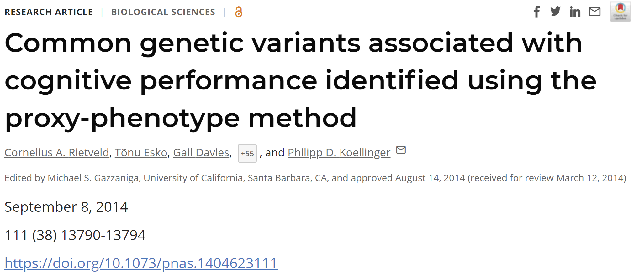

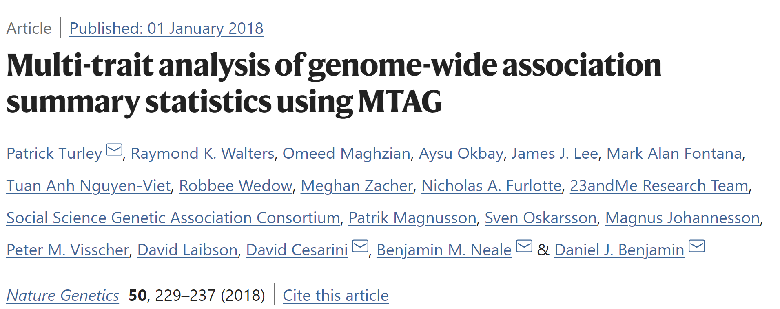
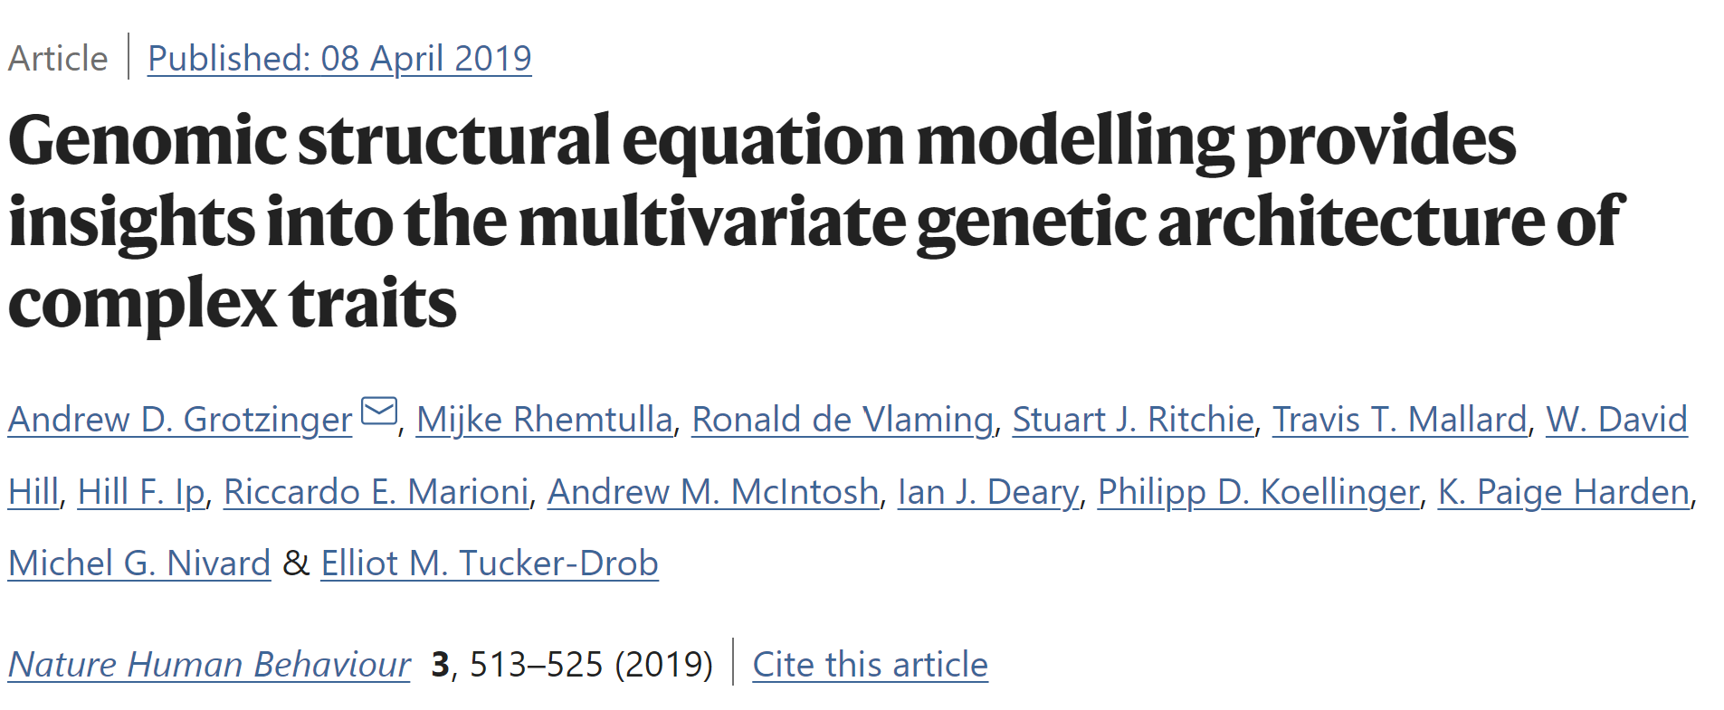
Back to GWAS challenges
Very large sample sizes are needed
  Pooling data from many different datasets (“cohorts”)
    Meta-analysis
    Mega-analysis
    Proxy-phenotypes that are available in N > 100,000
    Multivariate analysis (e.g. MTAG, Genomic SEM)

Slide 27
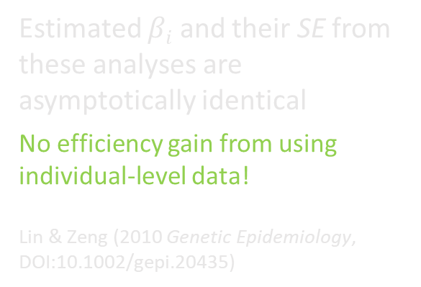
Pooling datasets
Mega-analyses
  Individual-level data are uploaded to a common server and centrally analyzed
    More options for analyzing the data
    Analyses can be done quicker
    Genotype and phenotype data can be checked and adjusted directly
    But often not possible in practice (e.g. IRB, legal issues, privacy)
Meta-analyses
  Summary statistics from GWAS are uploaded to a common server and meta-analyzed
    Practically feasible (protecting individual-level data)
    Local analysts know their data better than central analysts
    Slow
    Limited range of analyses that can be conducted
Estimated $βi$ and their SE from these analyses are asymptotically identical
No efficiency gain from using individual-level data!
Lin & Zeng (2010 Genetic Epidemiology, DOI:10.1002/gepi.20435)
Notes:
Meta-analyses:
Alleviates concerns with privacy of study participants
No need to integrate genotypes and phenotypes from different sources

Slide 28
Meta-analysis workflow
  Write analysis-plan and post it online
  Invite cohorts
    Descriptive statistics
    Collaboration agreement
  Cohorts conduct GWAS according to analysis-plan
  Cohorts upload results to a secure server
  Meta-analysts conduct Quality Control (QC)
    Follow-up on problems, missing information
  Data freeze
  Meta-analysts conduct meta-analysis
    Cross-checking of results
Conference calls
Update emails

Slide 29
Analysis plan
The exact instructions for
cleaning the genotype data,
imputing the genotype data (e.g. reference panel)
clean/ code the phenotypes
what SNPs to include in GWAS
run the GWAS
  regression specification (e.g. linear, logistic, etc.)
  control variables (e.g. sex, birth year, age, important macro events)
  Software
Data upload format (e.g. columns, delimiter)
How complex / specific should an analysis plan be?
Very detailed, comprehensive plans (e.g. including software codes) are less error prone, but
  leave less room for customized solutions
  require additional time from cohort analysts, making it more costly to participate.
More “vague” plans are more prone to error, but allow flexibility and increase response rates of cohorts.

Slide 30
Software
Standard GWAS software tools allow for limited types of association tests
  Linear (OLS)
  Logistic (MLE)
Software METAL (or MTAG?)
  Automatically resolves strand mismatches for markers where strand is obvious
  Can handle gzipped files
  Provides many summary statistics
  Fast and able to handle flexible formatting of input files

Slide 31
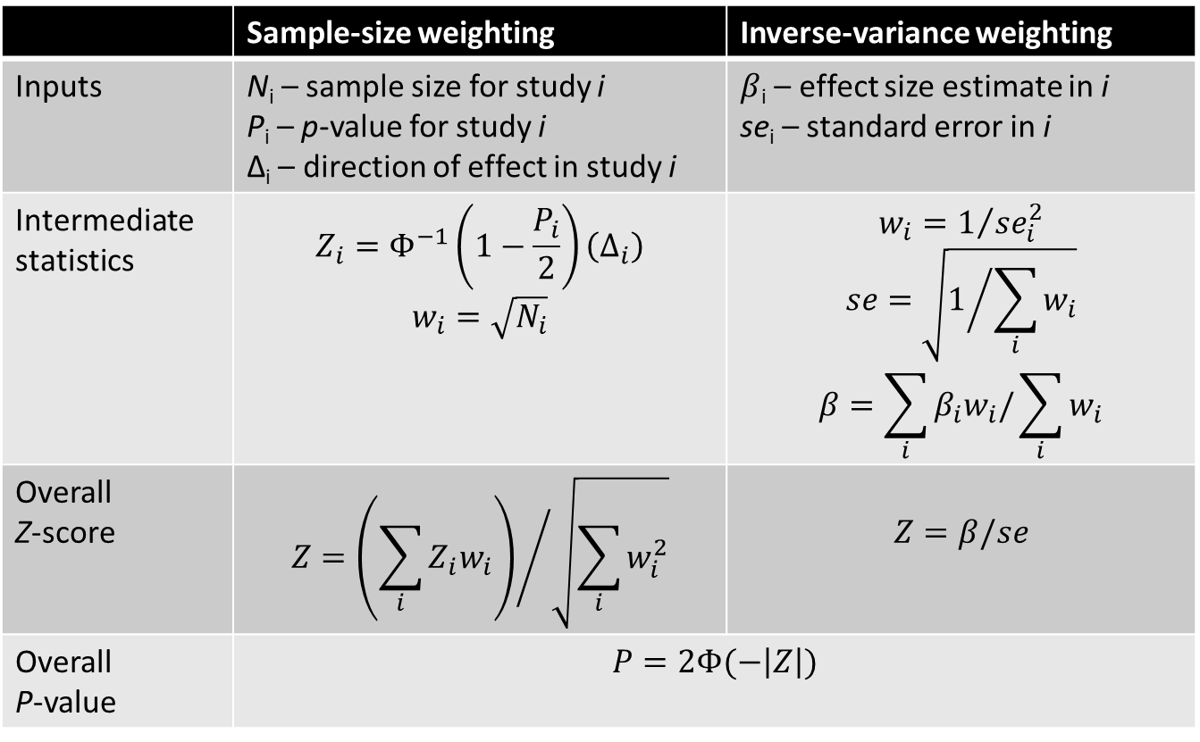
Meta-analysis weighting scheme - 1
 | Sample-size weighting | Inverse-variance weighting
Inputs | N_{i} – sample size for study i P_{i} – p-value for study i Δ_{i} – direction of effect in study i | $β$_{i} – effect size estimate in i se_{i} – standard error in i
Intermediate statistics | $$Z_{i}=Φ^{−1}\left(1−\frac{P_{i}}{2}\right)\left(Δ_{i}\right)$$ $$w_{i}=\sqrt{N_{i}}$$ | $$w_{i}=1/{{se}_{i}^{2}}$$ $$se=\sqrt{1/{\sum_{i}{w_{i}}}}$$ $$β=\sum_{i}{β_{i}w_{i}/\sum_{i}{w_{i}}}$$
Overall Z-score | $$Z={\left(\sum_{i}{Z_{i}w_{i}}\right)}/{\sqrt{\sum_{i}{w_{i}^{2}}}}$$ | $$Z=β/se$$
Overall P-value | $$P=2Φ(−\left|Z\right|)$$
Notes:
NOTE: The formula for Zi in the intermediate statistics and the formula for the overall p-value are INCORRECT in the original article. The formulas displayed here are correct!
Sample-size weighting:
Very flexible approach
Can be used when effect sizes have been estimated on different scales (e.g. height in feet and height in meters – or different coding of the same outcome categories across cohorts)
Inverse variance weighting:
More precise estimates get higher weight.
Asymptotically, the two approaches are equivalent when the trait distribution is identical across samples (such that standard errors are a predictable function of N).
If trait was measured on the same scale, but with varying degrees of accuracy across samples, better use inverse-variance weighting (because otherwise imprecise estimates from some large cohorts may get too much weight)
If trait distribution is equal across samples, the weighting scheme doesn’t matter much, but inverse-variance weighting is slightly more powerful in finite samples.
However, if you have any doubts about whether the phenotype across cohorts was actually reported and analyzed on the same scale, than sample-size weighting is the only option.

Slide 32
Meta-analysis weighting scheme - 2
Sample-size weighting:
Can be used when effect sizes have been estimated on different scales
  height in feet and height in meters
  different coding of the same outcome categories across cohorts
Inverse variance weighting:
More precise estimates get higher weight.
Better to use if trait was measured on the same scale, but with varying degrees of accuracy across samples (to avoid imprecise estimates from some large cohorts getting too much weight)
Slightly more powerful in finite samples
Asymptotically, the two approaches are equivalent when the trait distribution is identical across samples.

Slide 33
Manhattan plot – 1/2
Famous type of plot based on GWAS results!
x-axis: SNPs sorted by chromosome
  And within chromosome: sorted by base-pair position
  So SNPs that are physically close are also close on x-axis
y-axis: −log₁₀(p-value) of the estimated SNP effect:
  insignificant p-value (e.g. 10%) is then at bottom: −log₁₀(0.10) = 1
  highly significant p-value (e.g. 10⁻⁹) is then at top: −log₁₀(10⁻⁹) = 9
Because of ‘omitted-SNP’ bias:
  if given SNP is highly significant
  nearby SNPs also expected to have elevated significance:
    neighbouring SNPs pick up the same effect because of LD
Result? ‘skyscrapers’ of nearby SNPs all (close to) significance

Slide 34
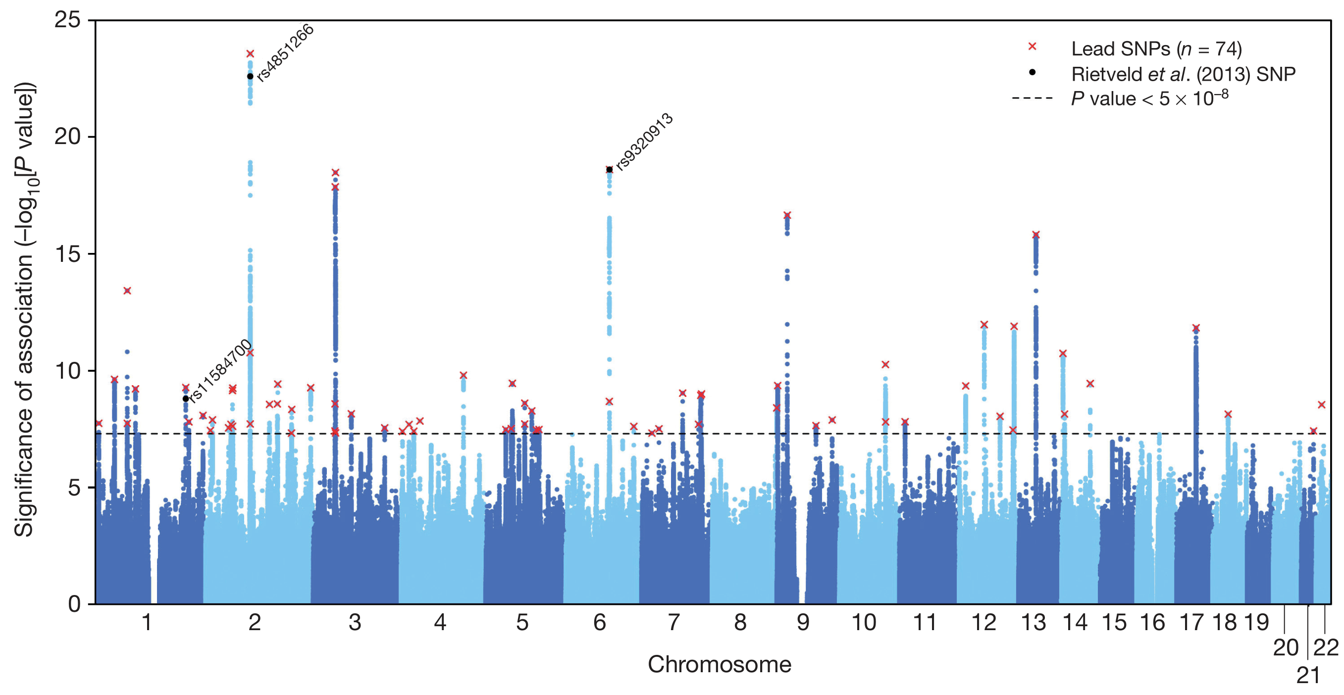
Manhattan plot – 2/2
Manhattan plot from work by Okbay et al. (2016). Genome-wide association study identifies 74 loci associated with educational attainment. Nature, 533, 539–542.

Slide 35
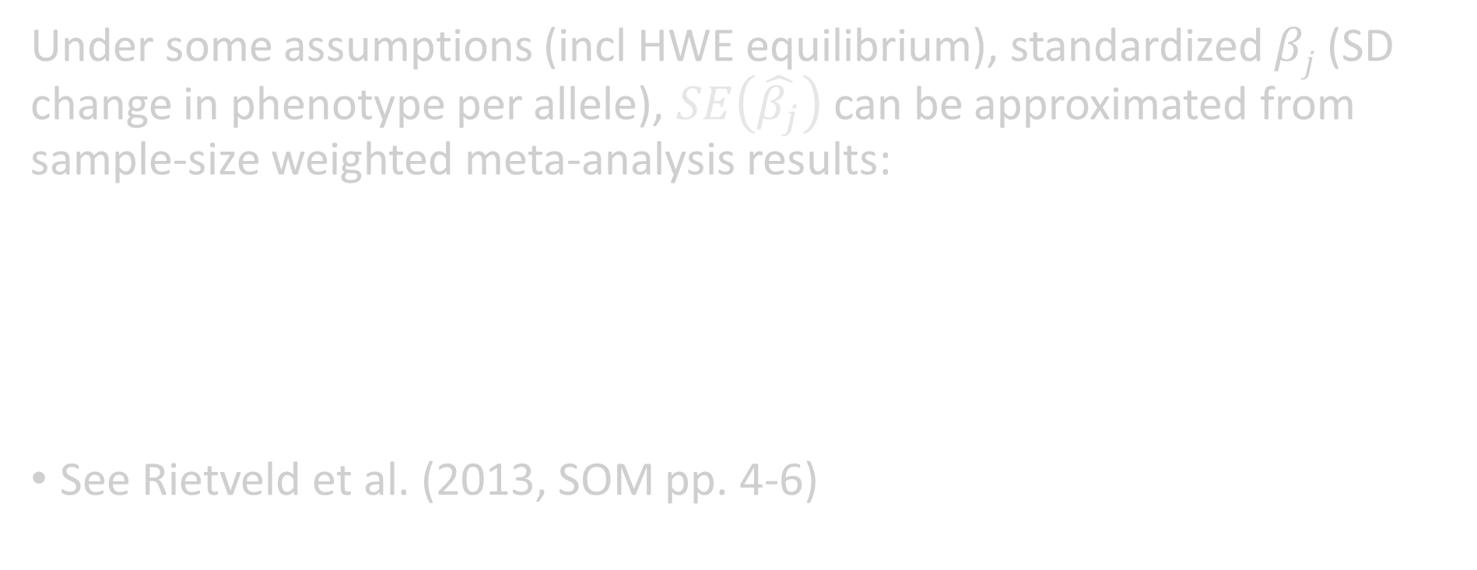
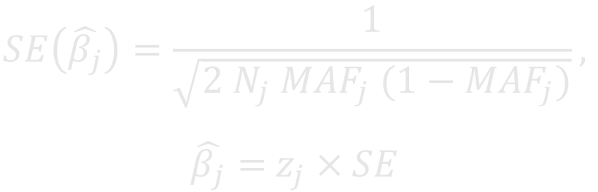
Effect sizes from sample-size weighted meta-analysis results
Under some assumptions (incl HWE equilibrium), standardized $βj$ (SD change in phenotype per allele), $SE\left(\hat{β_{j}}\right)$ can be approximated from sample-size weighted meta-analysis results:
See Rietveld et al. (2013, SOM pp. 4-6)
$$SE\left(\hat{β_{j}}\right)=\frac{1}{\sqrt{2 N_{j} {MAF}_{j} (1−{MAF}_{j})}},$$
$\hat{β_{j}}=$ $z_{j}×SE$

Slide 36
Part A - Genetic discovery
Candidate gene studies vs. GWAS
Meta-analysis
Obtaining independent signals
QC of GWAS summary statistics
Using GWAS results

Slide 37
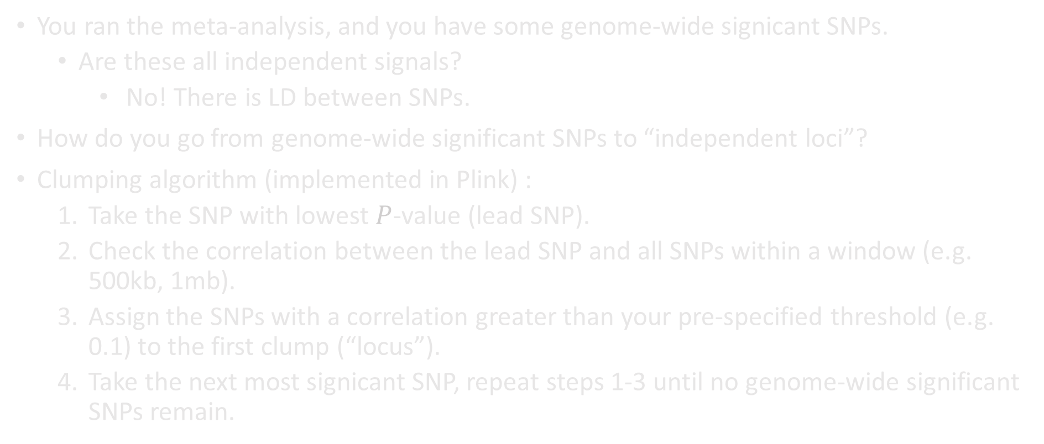
Clumping
You ran the meta-analysis, and you have some genome-wide signicant SNPs.
  Are these all independent signals?
    No! There is LD between SNPs.
How do you go from genome-wide significant SNPs to “independent loci”?
Clumping algorithm (implemented in Plink) :
  Take the SNP with lowest $P$-value (lead SNP).
  Check the correlation between the lead SNP and all SNPs within a window (e.g. 500kb, 1mb).
  Assign the SNPs with a correlation greater than your pre-specified threshold (e.g. 0.1) to the first clump (“locus”).
  Take the next most signicant SNP, repeat steps 1-3 until no genome-wide significant SNPs remain.

Slide 38
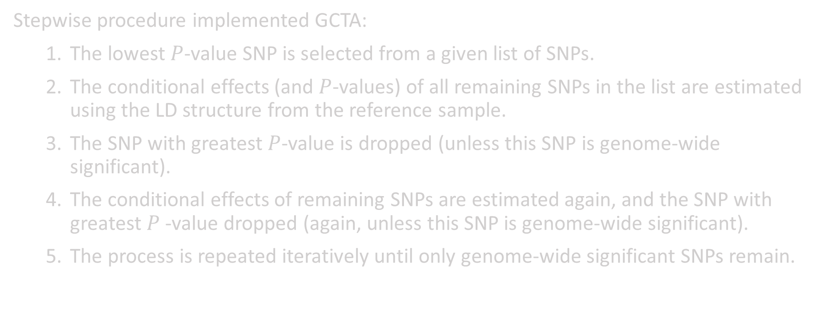
Conditional and joint multiple-SNP analysis
Stepwise procedure implemented GCTA:
  The lowest $P$-value SNP is selected from a given list of SNPs.
  The conditional effects (and $P$-values) of all remaining SNPs in the list are estimated using the LD structure from the reference sample.
  The SNP with greatest $P$-value is dropped (unless this SNP is genome-wide significant).
  The conditional effects of remaining SNPs are estimated again, and the SNP with greatest $P$-value dropped (again, unless this SNP is genome-wide significant).
  The process is repeated iteratively until only genome-wide significant SNPs remain.

Slide 39
Part A - Genetic discovery
Candidate gene studies vs. GWAS
Meta-analysis
Obtaining independent signals
QC of GWAS summary statistics
Using GWAS results

Slide 40
Meta-analysis workflow
  Write analysis-plan and post it online
  Invite cohorts
  Cohorts conduct GWAS according to analysis-plan
  Cohorts upload results to a secure server
  Data freeze
  Meta-analysts conduct meta-analysis
What if the cohort analyst made a mistake?

Slide 41
Meta-analysis workflow
  Write analysis-plan and post it online
  Invite cohorts
  Cohorts conduct GWAS according to analysis-plan
  Cohorts upload results to a secure server
  Quality control
  Data freeze
  Meta-analysts conduct meta-analysis
What if the cohort analyst made a mistake?

Slide 42
What does QC mean in the context of GWAS?
Inspect the cohort-level results for anomalies and make sure the data going into the meta-analysis are sensible.
Is QC that important?
YES!
Bad/No QC ➔ Lower power to detect true associations, increased chance of false positives

Slide 43
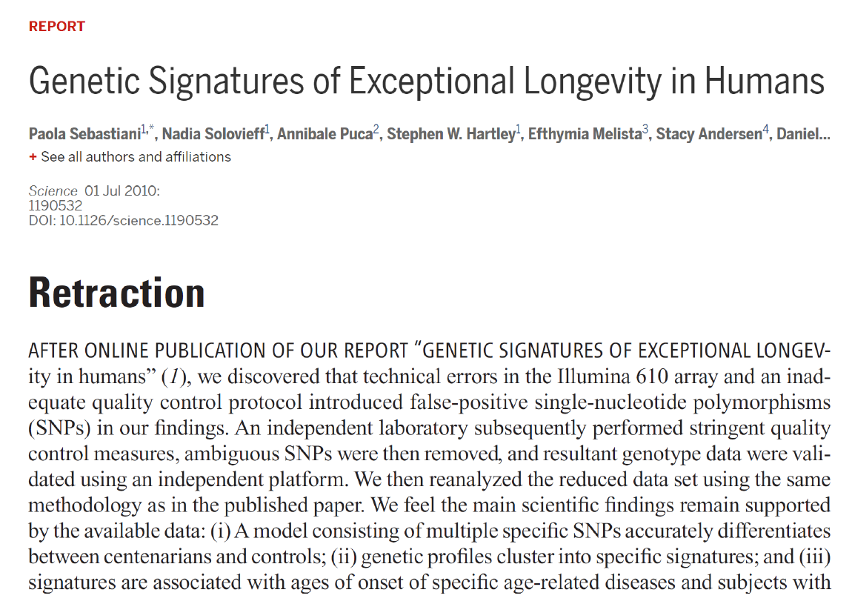

Slide 44
What can go wrong?
Anything you can think of! Examples:
Incorrect coding of the outcome, e.g. reverse-coding, incorrect missing value coding
Incorrect model specification, e.g. omission of necessary covariates, no proper control for population stratification
Problems with genotype data, e.g. flipped SNP alleles, errors in imputation
Unreliable SNPs, e.g. low imputation quality, low minor allele frequency.

Slide 45
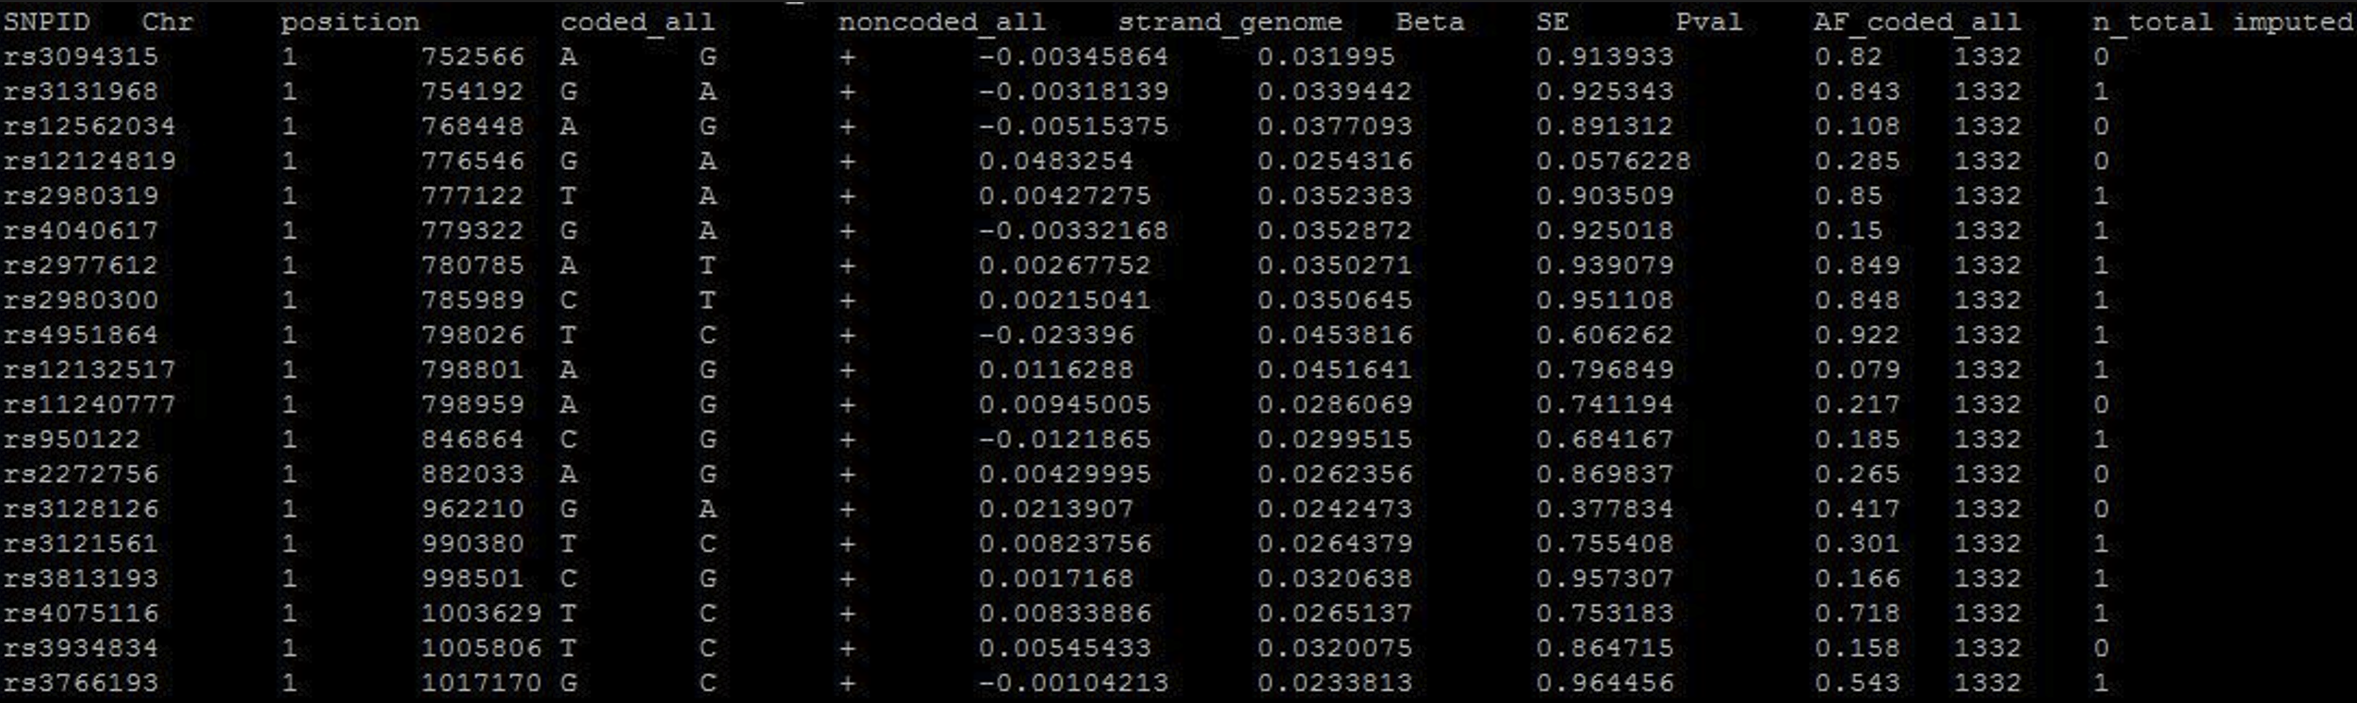
How to detect – Step 0
Step 0: Check file format
What do uploaded data look like?

Slide 46
How to detect – Step 0
Analysis plan asks the analysts to upload the files in a certain format.
  Delimiter (e.g. tab-delimited), file format (e.g. *.txt), header/no header
  Variables to include: SNP ID, effect allele, other allele, effect allele frequency, imputation accuracy, beta, SE, $P$-value, sample size, etc.
Before starting quality control, make sure that
  The files are in the specified format, re-format when necessary
  All requested variables are included, contact the cohort analyst if something is missing
  All requested descriptive statistics, such as phenotype distribution, genotyping chip, imputation software, etc. are provided

Slide 47
How to detect? – Step 1
Step 1: SNP filtering
EasyQC: R package for QC that implements an extensive protocol by Winkler et al (2014).
Filter out low-quality SNPs, such as
  SNPs with missing/incorrect values for requested variables, e.g. no effect allele, $P$-value's outside the range [0,1], etc.
  SNPs with low minor allele frequency (MAF), e.g. MAF < 1%.
  SNPs with low imputation accuracy: may depend on imputation software, e.g. 0.6 for MaCH, 0.7 for IMPUTE2.
  Variants that are outside the scope of the meta-analysis, e.g. non-autosomal SNPs, indels, or structural variants
Inspect number of SNPs dropped in each step. Too large / too little may indicate problems!

Slide 48
How to detect? – Step 2
Step 2: Diagnostic plots
Inspect diagnostic plots of the cleaned data to detect remaining problems.
Some useful plots to start with (implemented in EasyQC):
  Allele Frequency Plots (AF Plots)
  P-value vs Z-score Plots (PZ Plots)
  Quantile-Quantile Plots (QQ Plots)
  Standard Error - N Plots (SE-N Plots)
Supplement with other plots if needed.

Slide 49
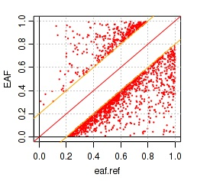
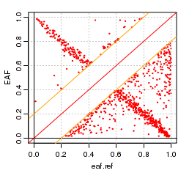
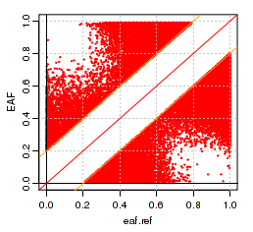
AF-plot

Slide 50
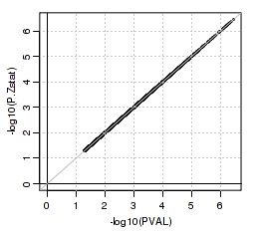
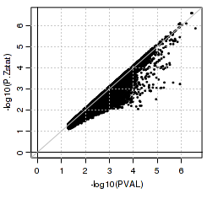
PZ-plot

Slide 51
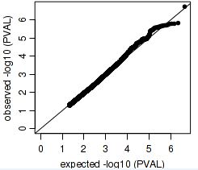
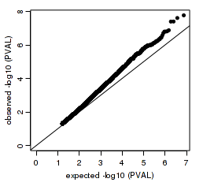
QQ-plot

Slide 52
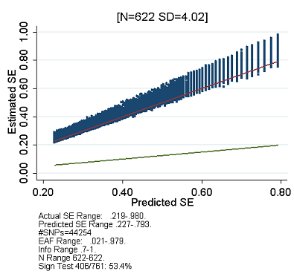
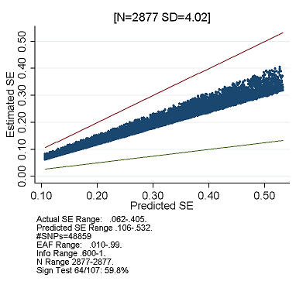
Predicted vs Reported Standard Error plot

Slide 53
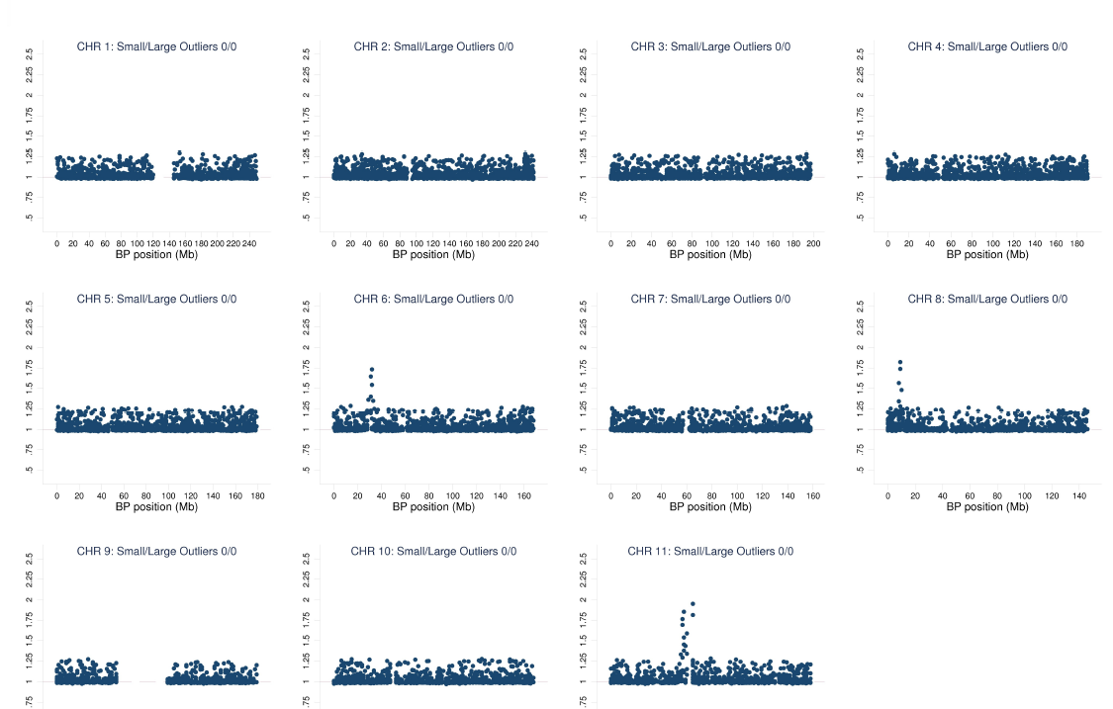
Chromosome-SE plot

Slide 54
How to detect? – Step 3
Step 3: Other diagnostics
Tests of allele misalignment / reverse-coded phenotype:
  Sign-concordance of top SNPs with a reference cohort
  In large cohorts, bi-variate LD-score regression (Bulik-Sullivan et al., 2015) - uses GWAS summary statistics to estimate the genetic correlation between two phenotypes
    Genetic correlations with a reference cohort
    Genetic correlations across phenotypes within the same cohort (in case multiple phenotypes are being analyzed).

Slide 55
How to fix?
Stricter SNP-filters
More serious problems: bad imputation, insufficient controls for population stratification, etc.
  Contact the cohort analyst to figure out what exactly is wrong, ask to re-run analyses correctly if necessary.
  Re-run the QC steps on the newly uploaded results to make sure the problem is fixed.
If problems can't be fixed, drop the cohort from the study.

Slide 56
More on QC...
Winkler et al. (2014). Quality control and conduct of genome-wide association meta-analyses. Nature Protocols, 9(5), 1192-212.
Okbay, Baselmans, et al. (2016). Genetic variants associated with subjective well-being, depressive symptoms, and neuroticism identified through genome-wide analyses. Nature Genetics, 48(6), 624-633. http://doi.org/10.1038/ng.3552
  Supplementary Note 1.G
Okbay, Beauchamp, et al. (2016). Genome-wide association study identies 74 loci associated with educational attainment. Nature, 533(7604), 539-542. http://doi.org/10.1038/nature17671
  Supplementary Methods 1.5

Slide 57
Part A - Genetic discovery
Candidate gene studies vs. GWAS
Meta-analysis
Obtaining independent signals
QC of GWAS summary statistics
Using GWAS results

Slide 58
What to do with GWAS results?
Biological annotation (today)
Heritability, genetic correlations with other traits
Mendelian randomization
Multi-trait analyses: Genomic SEM, MTAG
Construct polygenic indices
LD score regression - next lecture
Thursday

Slide 59
Causality after GWAS results
Life after the Manhattan plot…
Which are the causal variants?
Which are the causal genes?
Which biological pathways are involved?
Which are the tissues of action?

Slide 60
Fine mapping
GWAS peaks can be wide and include:
  No genes → what does the SNP change?
  One gene → does this implicate the gene?
  More than one gene → which gene(s) does this implicate?
Determining a set of “truly” causal genes or SNPs from genotypes is an active area of research
Sometimes LD-buddies are too close, and other data are required to determine causation, e.g. LD=1

Slide 61
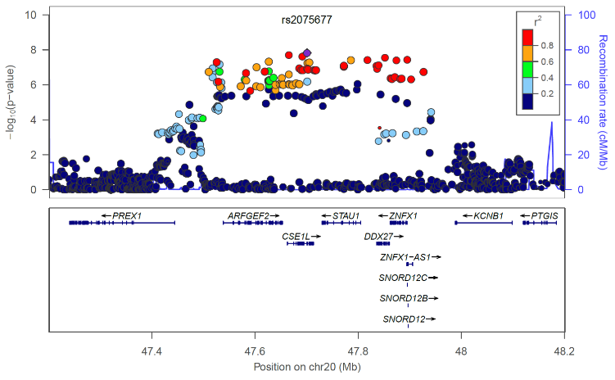

Slide 62
Gene function look-up
What is the function of the gene?
  Look up gene function in databases
    Encode, Regulome DB, Gene Ontology, Reactome, KEGG
    FUMA (Watanabe et al. Nat Comm, 2017) integrates information from functional reference databases
  Look up predicted gene function
    Gene Network – predicts pathway membership based on observed co-regulation of genes annotated to a certain HPO term with other genes (from public RNA-seq data)
  Look up experimental studies on PubMed
Notes:
UCSC genome browser
The Human Phenotype Ontology (HPO) provides a standardized vocabulary of phenotypic abnormalities encountered in human disease. Each term in the HPO describes a phenotypic abnormality, such as Atrial septal defect

Slide 63
Functional follow-up
eQTL
pQTL
Chromatin state/epigenetics
Pathway analysis
Require the tissue of interest
Require the time point of interest
Rarely enough to demonstrate causation
Computational, rapidly evolving

Slide 64
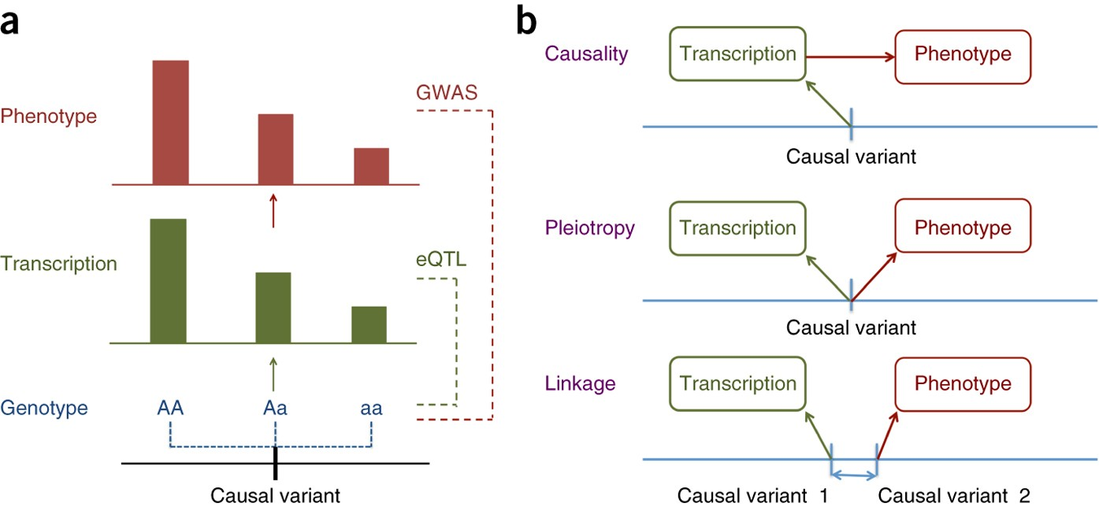
eQTL
Zhu et al. 2016, Nature Genetics
Association between expression of a particular gene and a genomic variant
Expression measured using mRNA levels
Link GWAS SNPs to gene expression using databases (GTEx, brainspan, …) to identify eQTL’s
Rarely sufficient to demonstrate causation

Slide 65
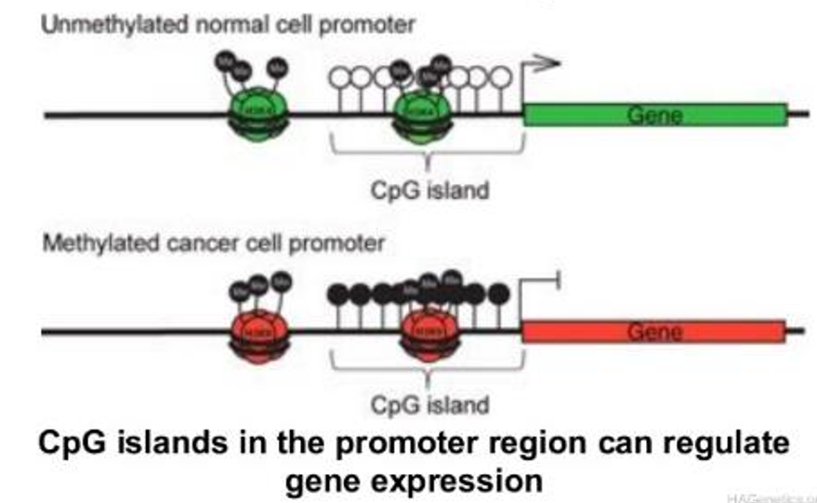
Chromatin state/epigenetics
Methyl groups bind to Cytosine bases, particularly at C-G sequences → CpG sites
  Increased methylation decreases the binding affinity of RNA polymerase → reduced transcription
Acetyl groups bind to histones (proteins that bind and package DNA)
  When histones are deacetylated, chromatin becomes more densely packaged → reduced transcription

Slide 66
Pathway analysis
Experts curate gene sets/pathways (groups of genes that share common biological function, chromosomal location, or regulation)
  KEGG, reactome, gene ontology (and more)
  Bundled in GSEA database: http://software.broadinstitute.org/gsea
Test which gene sets are “enriched” (DEPICT, MAGMA)

Slide 67
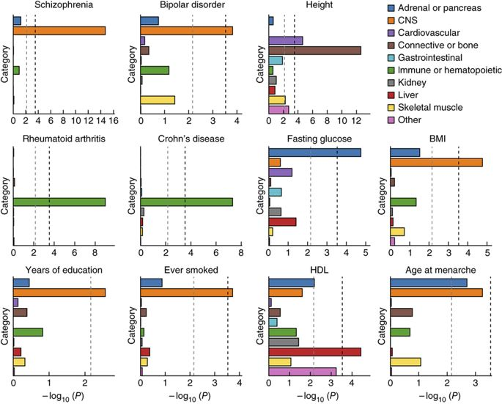
Tests for tissue enrichment
  Using histone mark data; e.g. partitioned LD score regression (Finucane et al., Nat Gen 2015)
    estimate the proportion of genome-wide SNP heritability attributable to various functional categories, using information from all SNPs and explicitly modeling LD
  Using gene expression data (e.g. DEPICT or LDSC-SEG)

Slide 68
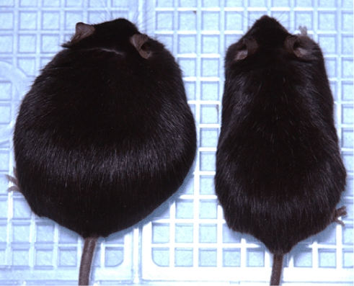
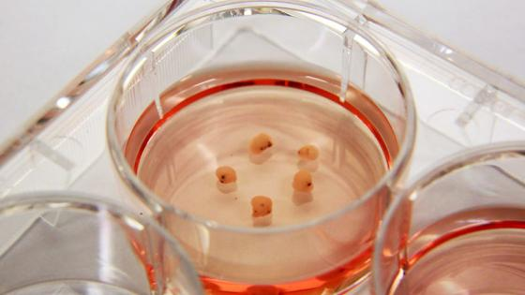
Lab experiments
In vivo: Knockdown/out experiments in lab animals (e.g. CRISPR-cas)
In vitro: Induced pluripotent stem cells (iPSCs) from humans
Prime example:
Claussnitzer et al. NEJM 2015
Genetically identical mice, except double knockdown of leptin gene (left)
iPSCs: “brains in a petri dish”. Growing neurons from skin cells by bringing skin cells back to stem cell stage.

