Slide 1
Mendelian Randomization
Dr Eleanor Sanderson
MRC Integrative Epidemiology Unit,
Population Health Sciences,
University of Bristol.
November 2023

Slide 2
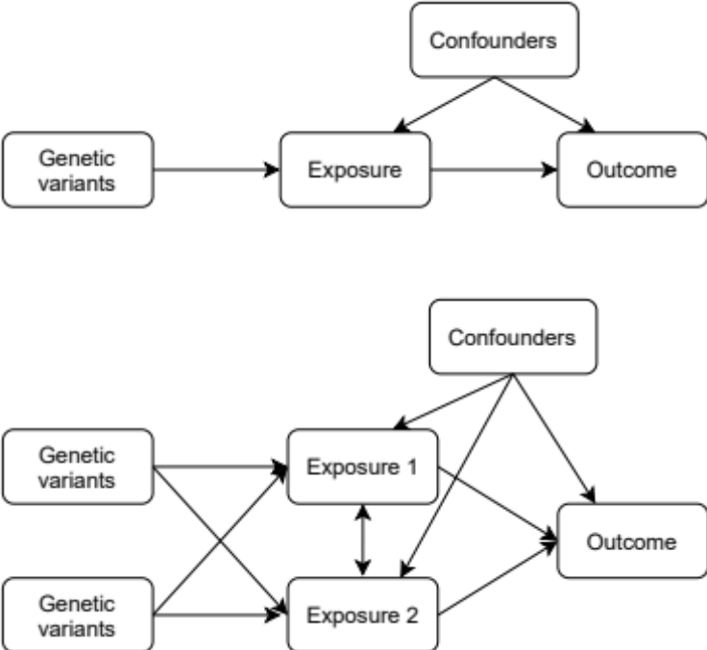
Mendelian Randomization
Genetic variants are;
    Associated with phenotypes
    randomly allocated
Can use this to test for and estimate causal effects
Statistically implemented as instrumental variables estimation

Slide 3
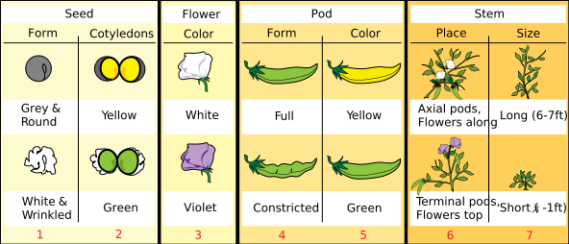
Mendel’s Second Law
Law of independent assortment
“The behaviour of each pair of differentiating characteristics in hybrid union is independent of the other differences between the two original plants, and, further, the hybrid produces just so many kinds of egg and pollen cells as there are possible constant combination forms”
Gregor Mendel, 1865

Slide 4
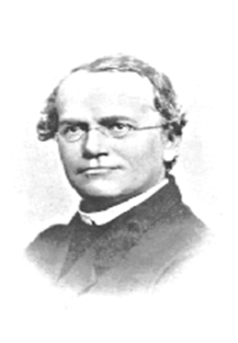
Mendelian randomization
In genetic association studies the laws of Mendelian genetics imply that comparison of groups of individuals defined by genotype should only differ
with respect to the locus under study (and closely related loci that are highly correlated (in linkage disequilibrium) with the locus under study)
Genotypes can proxy for some modifiable risk factors, and there should be no confounding of genotype by
behavioural, socioeconomic or physiological factors (except those that are influenced by alleles at closely proximate loci or due to population stratification)
Mendel in 1862

Slide 5
Mendelian randomization
Random
  Segregation of alleles at conception
  Distribution of genotypes in the population
Comparison of groups of individuals defined by genotype should only differ with respect to the genetic variant/locus under study
With control for population structure, there should be little confounding by any behavioural, socioeconomic or physiological factors

Slide 6
MR vs. observational estimation
Limitations of observational estimation that Mendelian randomization (MR) overcomes:
Confounding
Reverse causation
Measurement error

Slide 7
MR vs. observational estimation
Limitations of observational estimation that Mendelian randomization (MR) overcomes:
Confounding
Reverse causation
Measurement error
Independent assortment
Fixed at conception
Genotyping (high certainty)
X
X
X

Slide 8
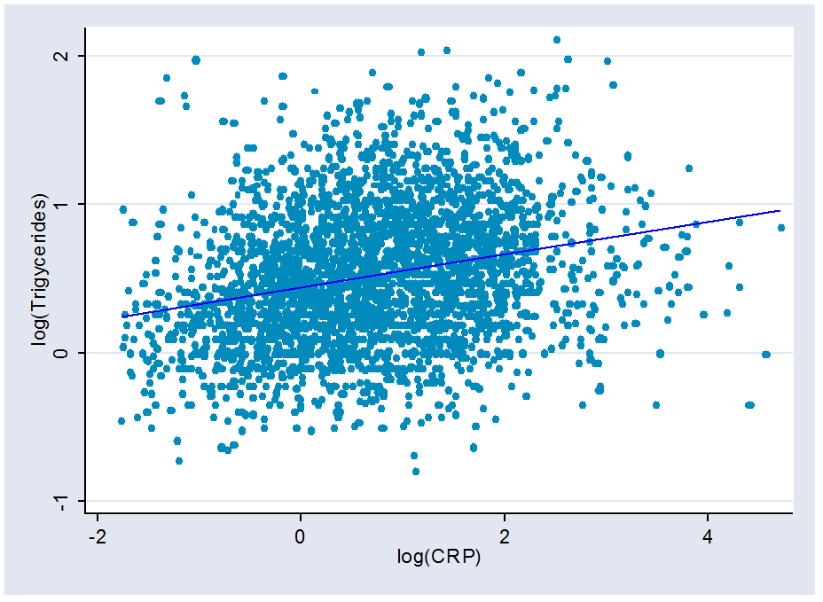
Example

Slide 9
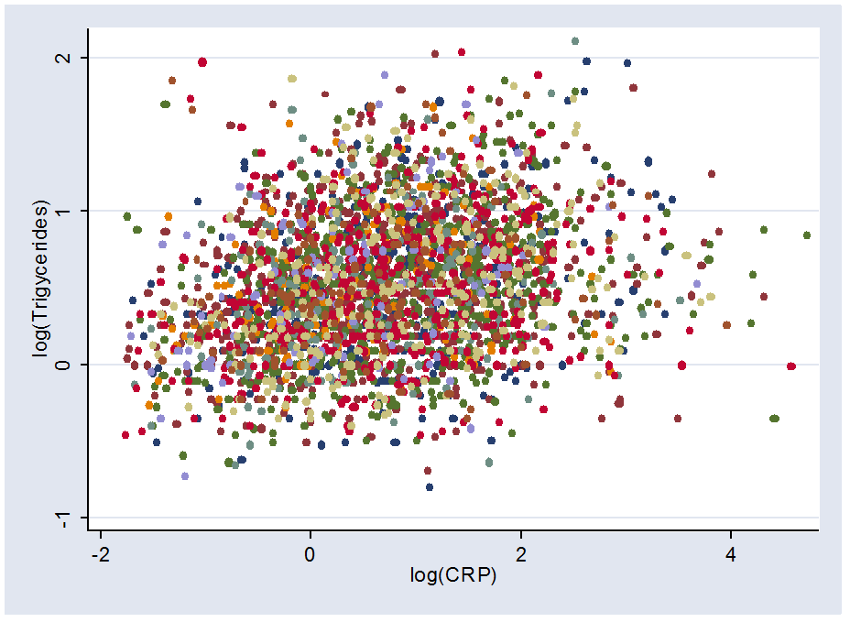
… by CRP genotype

Slide 10
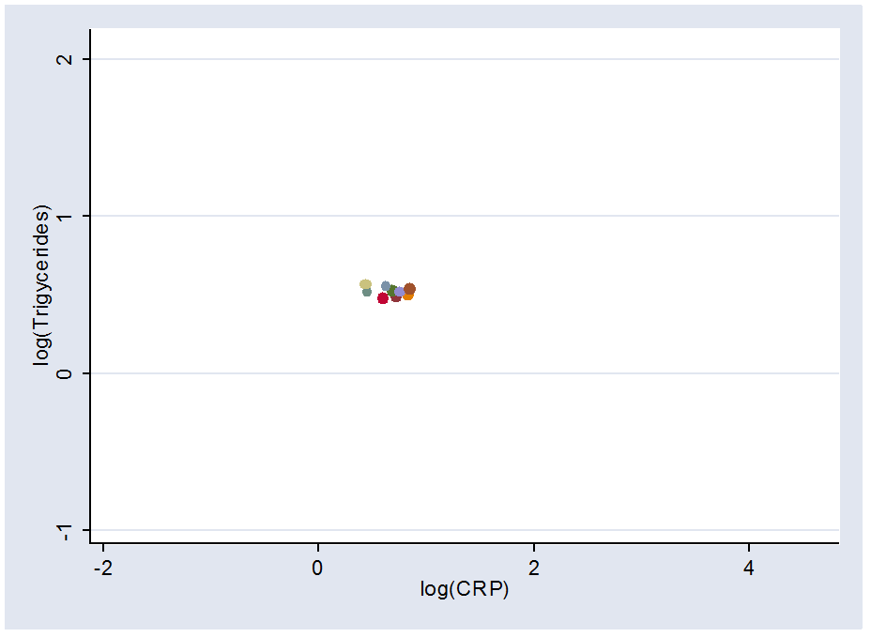
Means by CRP genotype

Slide 11
Means by CRP genotype

Slide 12
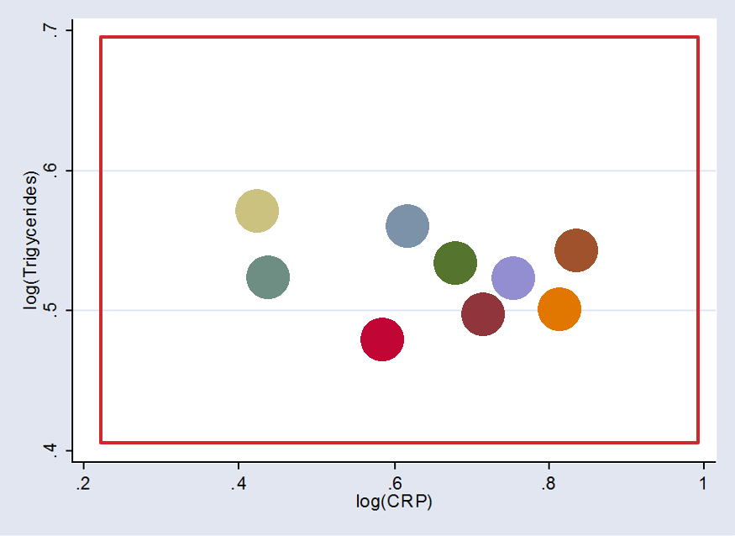
Zoom in...

Slide 13
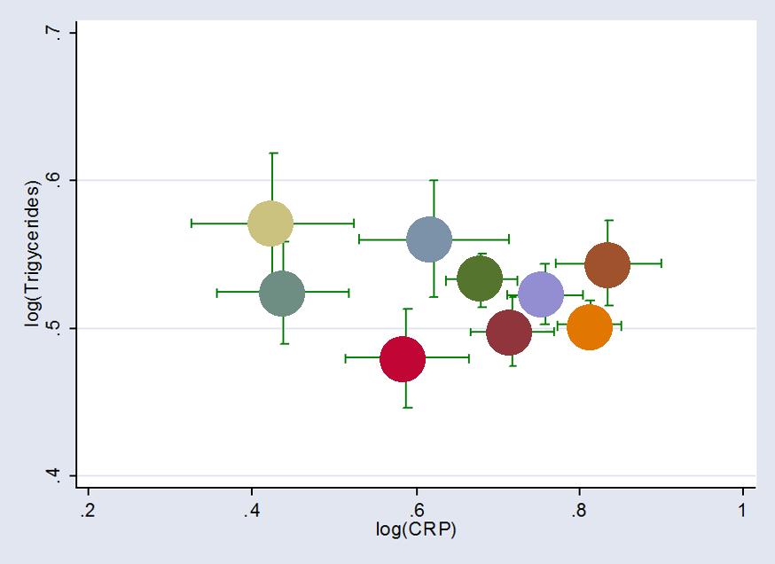
Add standard errors

Slide 14
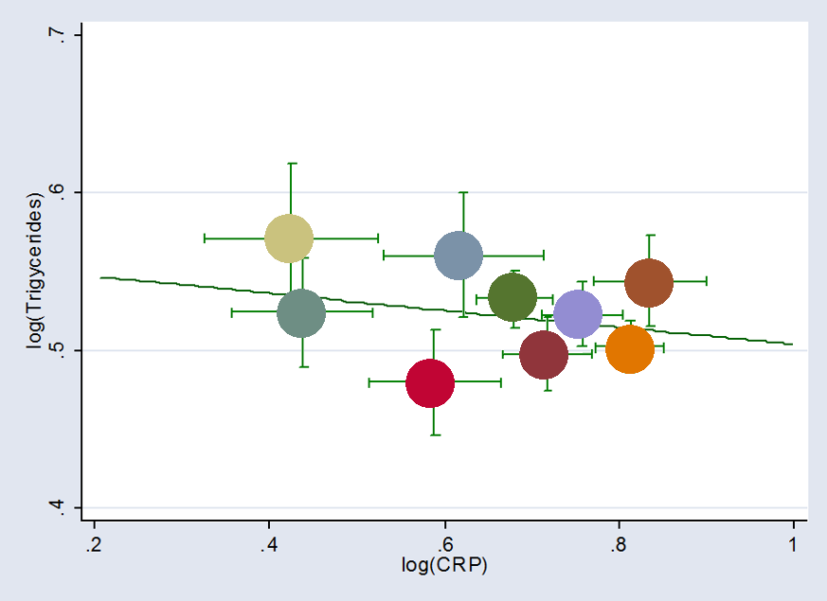
Add fitted line

Slide 15
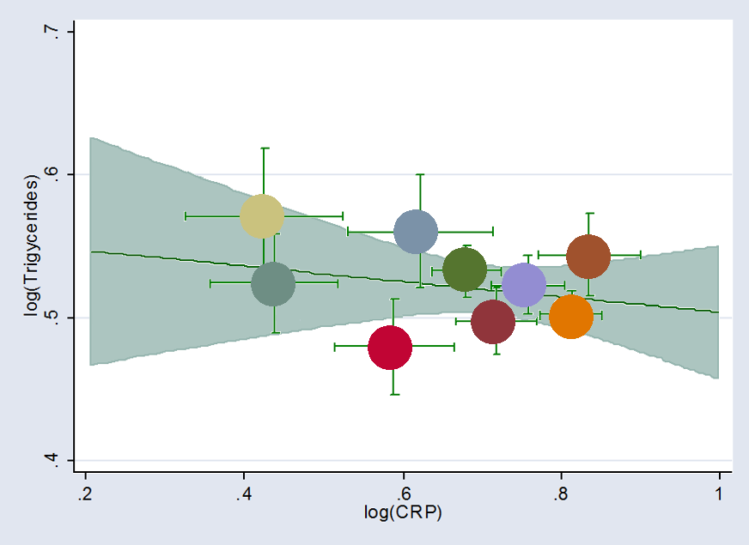
Add confidence interval for fitted line

Slide 16
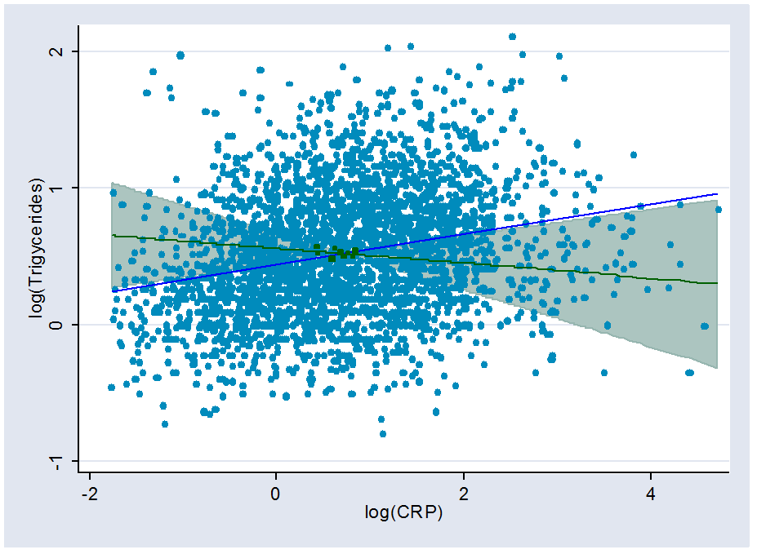
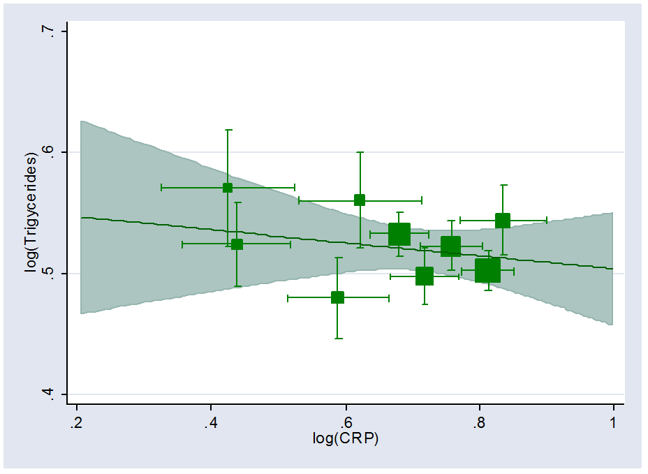
Zoom out…

Slide 17
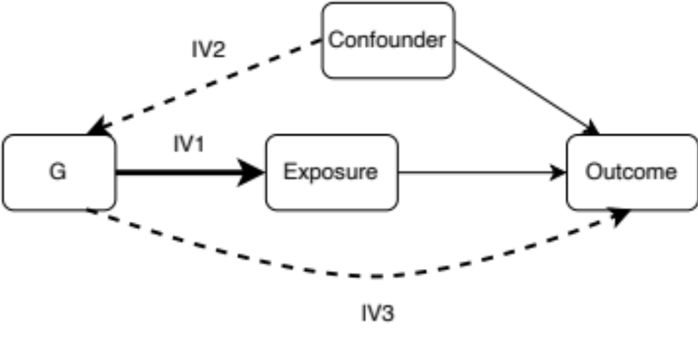
Mendelian Randomization
IV assumptions;
IV1. The IV is associated with the exposure
IV2. No confounders of the outcome and the IV
IV3. No effect of the IV on the outcome that doesn’t act through the exposure

Slide 18
Mendelian Randomization
IV assumptions;
IV1. The IV is associated with the exposure
Can be tested:
Use a F-statistic test for the association between the genetic instruments and the exposure
F > 10 is generally considered ’strong’

Slide 19
Mendelian Randomization
IV assumptions;
IV2. No confounders of the outcome and the IV
Can’t be shown to hold – use sensitivity analyses
Can be violated due to;
population stratification,
assortative mating,
dynastic effects

Slide 20
Mendelian Randomization
IV assumptions;
IV3. No effect of the IV on the outcome that doesn’t act through the exposure
Can’t be shown to hold – use sensitivity analysis
Violations of IV3 are due to ‘horizontal pleiotropy’
Heterogeneity is taken to be an indicator of a violation of IV3

Slide 21
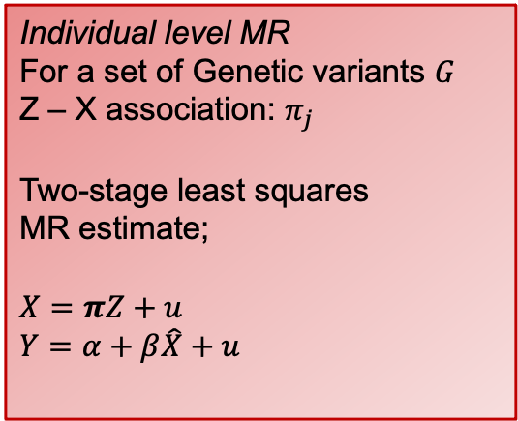
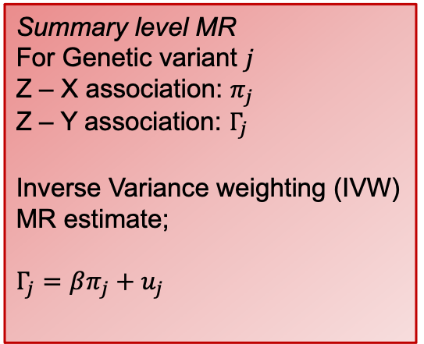
Mendelian Randomization
Implemented using individual level or summary level data
Genetic variants typically SNPs (single nucleotide polymorphisms)
Discovered in a GWAS (Genome-wide association study)
Individual level MR
For a set of Genetic variants $G$
Z – X association: $π_{j}$
Two-stage least squares
MR estimate;
$$X=πZ+u$$
$Y=α+β\hat{X}+u$
Summary level MR
For Genetic variant $j$
Z – X association: $π_{j}$
Z – Y association: $Γ_{j}$
Inverse Variance weighting (IVW) MR estimate;
$Γ_{j}=βπ_{j}+u_{j}$

Slide 22
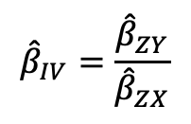
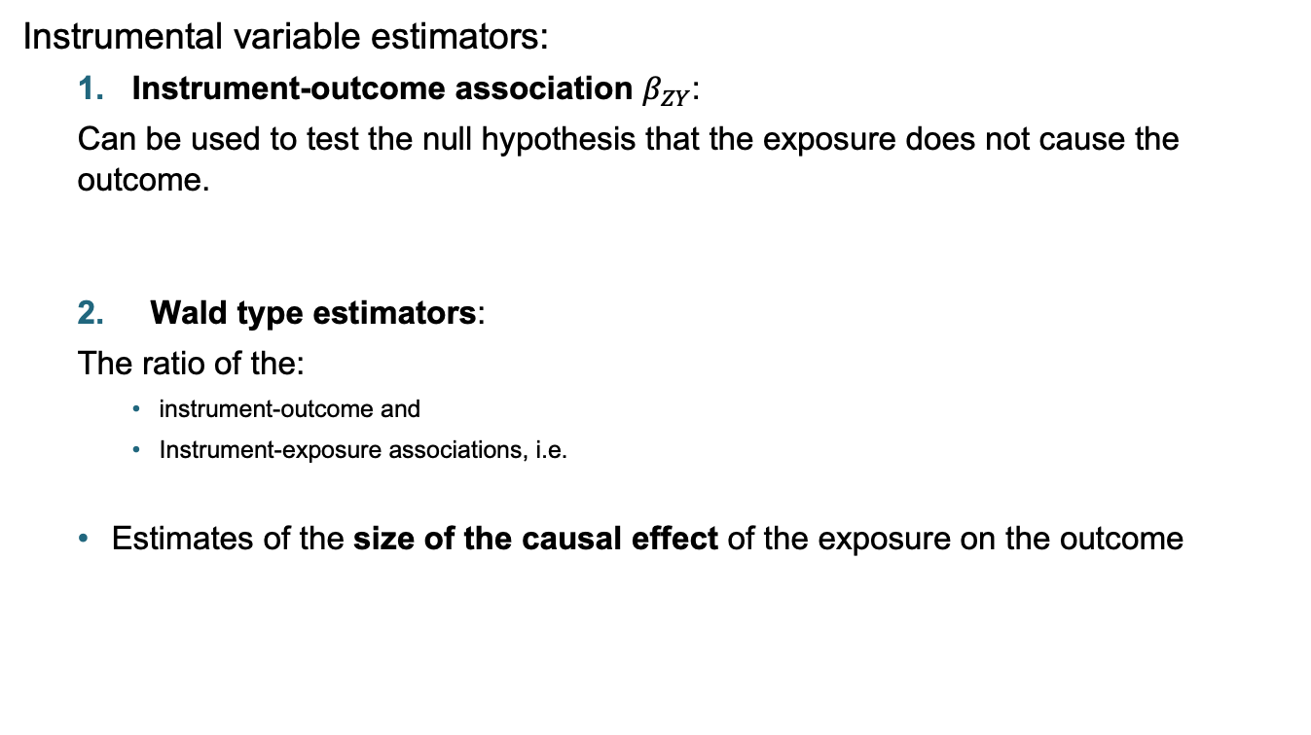
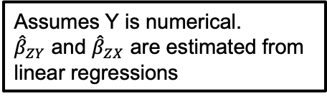
Estimation with individual level data
Instrumental variable estimators:
  Instrument-outcome association $β_{ZY}$:
  Can be used to test the null hypothesis that the exposure does not cause the outcome.
  Wald type estimators:
  The ratio of the:
    instrument-outcome and
    Instrument-exposure associations, i.e.
  Estimates of the size of the causal effect of the exposure on the outcome
Assumes Y is numerical.
${\hat{β}}_{ZY}$ and ${\hat{β}}_{ZX}$ are estimated from linear regressions
$${\hat{β}}_{IV}=\frac{{\hat{β}}_{ZY}}{{\hat{β}}_{ZX}}$$

Slide 23
Estimation with individual level data
Two stage least squares (2SLS/TSLS)
  Very common IV estimator.
  Calculated by:
  Using the instrument to predict the value of the exposure.
  Replacing the exposure with the predicted exposure in a regression of the outcome on the exposure.
  Standard errors then need to be corrected
    This is to account for the uncertainty in the predicted value of the exposure.
    Most stats packages will do this for you!

Slide 24
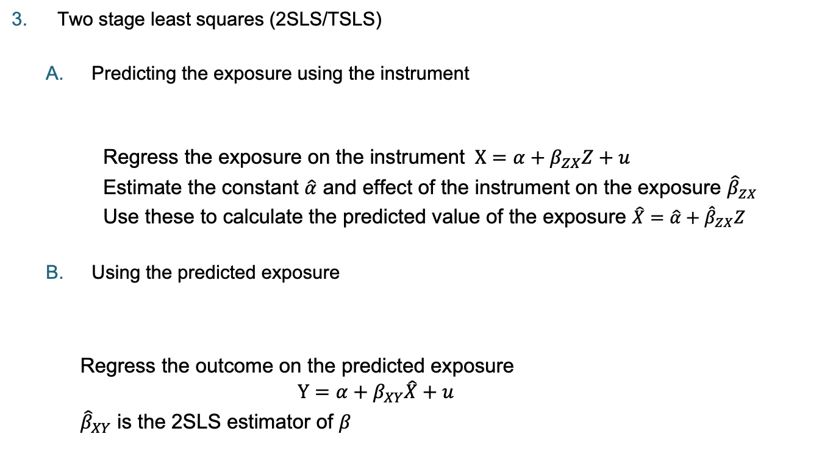

Estimation with individual level data
Two stage least squares (2SLS/TSLS)
  Predicting the exposure using the instrument
  Regress the exposure on the instrument $X=α+β_{ZX}Z+u$
  Estimate the constant $\hat{α}$ and effect of the instrument on the exposure ${\hat{β}}_{ZX}$
  Use these to calculate the predicted value of the exposure $\hat{X}=\hat{α}+{\hat{β}}_{ZX}Z$
  Using the predicted exposure
    Regress the outcome on the predicted exposure
    $$Y=α+β_{XY}\hat{X}+u$$
    ${\hat{β}}_{XY}$ is the 2SLS estimator of $β$
Z
X
$$\hat{X}$$
Y

Slide 25
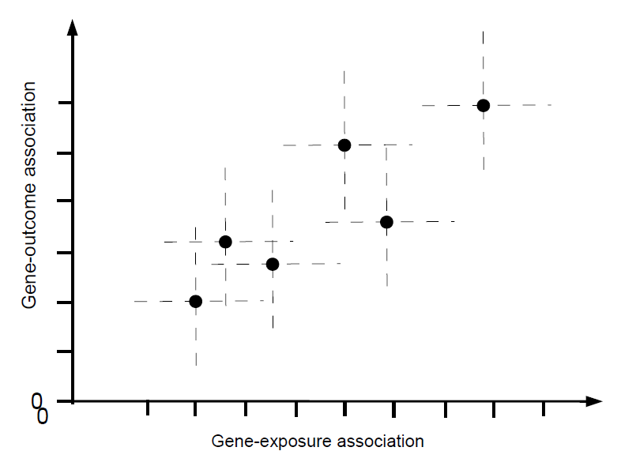
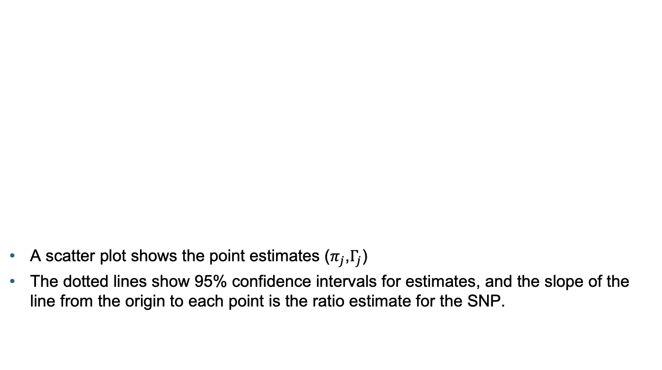
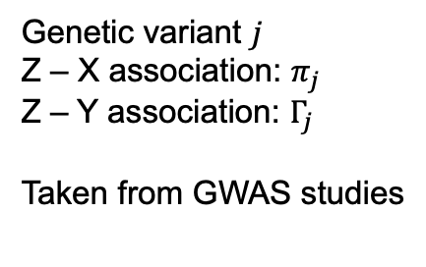
Estimation with GWAS summary statistics
A scatter plot shows the point estimates ($π_{j}$,$Γ_{j}$)
The dotted lines show 95% confidence intervals for estimates, and the slope of the line from the origin to each point is the ratio estimate for the SNP.
Genetic variant $j$
Z – X association: $π_{j}$
Z – Y association: $Γ_{j}$
Taken from GWAS studies

Slide 26
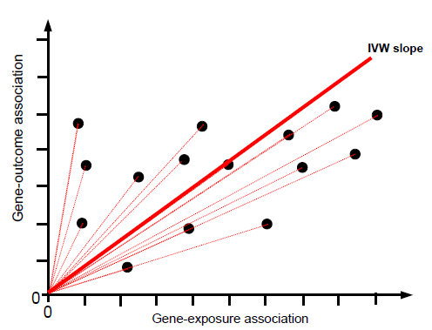
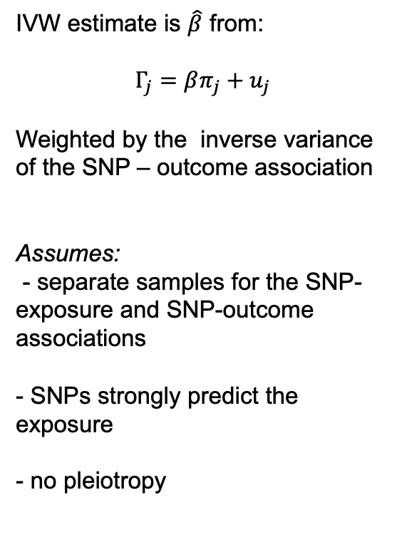
IVW estimation
IVW estimate is $\hat{β}$ from:
$Γ_{j}=βπ_{j}+u_{j}$
Weighted by the inverse variance of the SNP – outcome association
Assumes:
- separate samples for the SNP- exposure and SNP-outcome associations
- SNPs strongly predict the exposure
- no pleiotropy

Slide 27
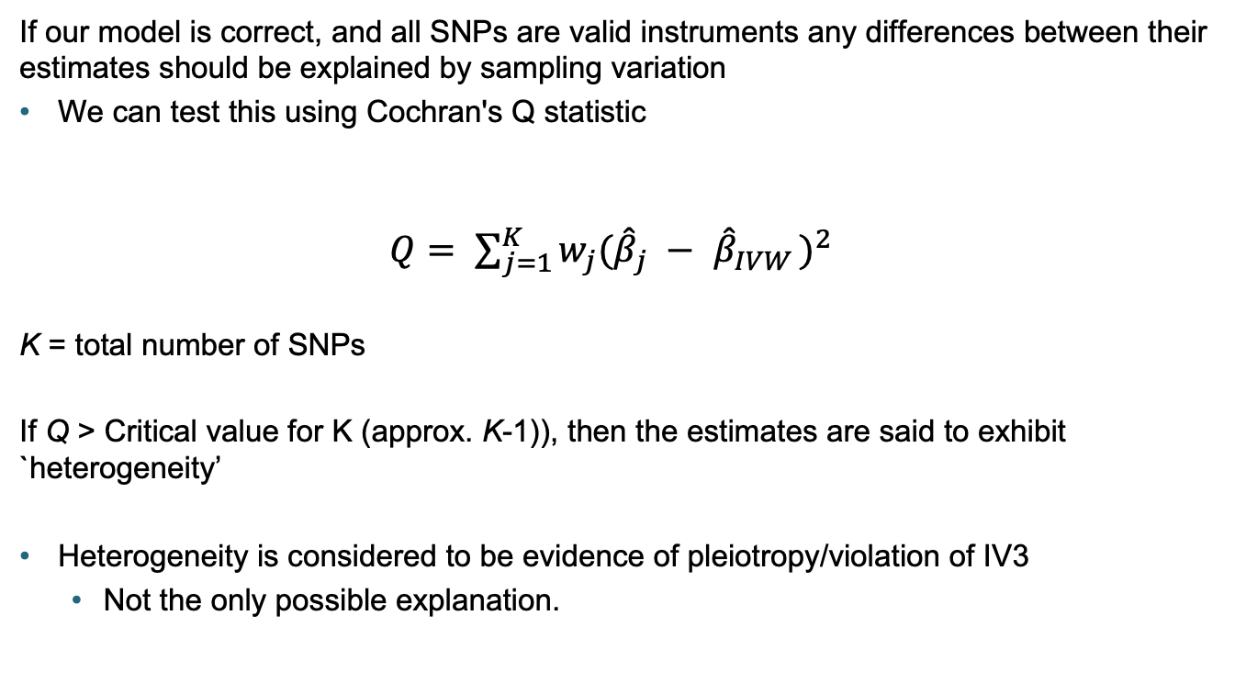
Assessing heterogeneity
If our model is correct, and all SNPs are valid instruments any differences between their estimates should be explained by sampling variation
We can test this using Cochran's Q statistic
$Q= \sum_{j=1}^{K}{w_{j}({\hat{β}}_{j} − }$ ${\hat{β}}_{IVW })^{2}$
K = total number of SNPs
If Q > Critical value for K (approx. K-1)), then the estimates are said to exhibit `heterogeneity’
Heterogeneity is considered to be evidence of pleiotropy/violation of IV3
  Not the only possible explanation.

Slide 28
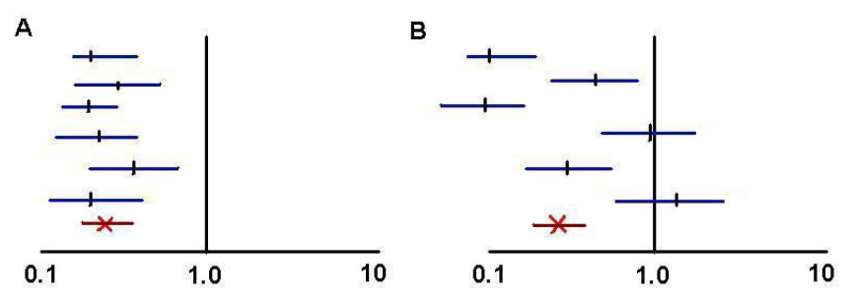
Understanding heterogeneity
Plots show ratio estimates for 6 variants, overall effect shown in red
  (a) - No heterogeneity, all variants estimating same quantity: Q ~ 5
  (b) - Heterogeneity, variants estimating different quantities: Q >> 5

Slide 29
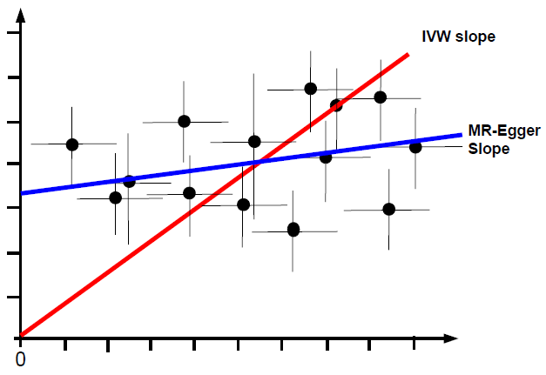
Mendelian Randomization
Testing IV3:
Lots of methods
Most common use some sort of outlier removal/down-weighting
    Weighted mode
    Weighted median
MR Egger allows for directional pleiotropy
  assumes it’s uncorrelated with the
  SNP-exposure association

Slide 30

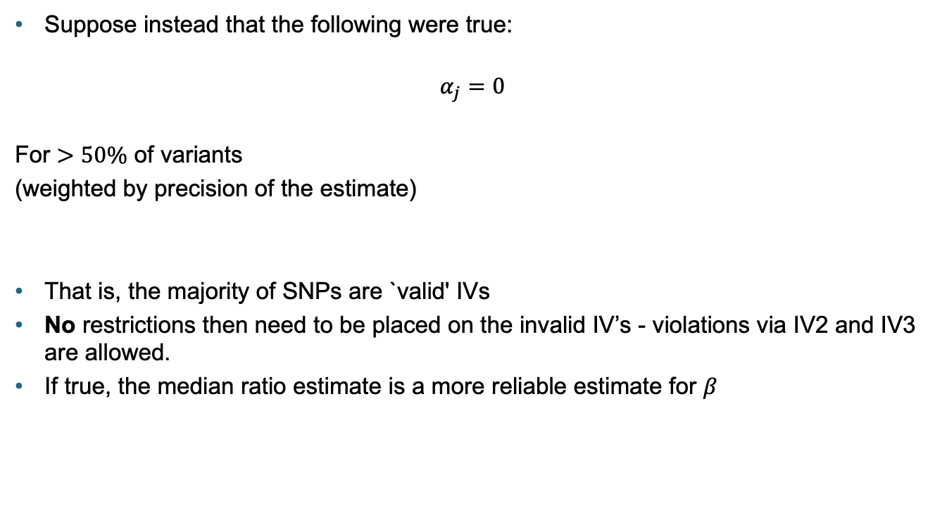
Median-based estimation
$$Γ_{j}=α_{j}+βπ_{j}$$
Suppose instead that the following were true:
$$α_{j}=0$$
For $>50\%$ of variants
(weighted by precision of the estimate)
That is, the majority of SNPs are `valid' IVs
No restrictions then need to be placed on the invalid IV’s - violations via IV2 and IV3 are allowed.
If true, the median ratio estimate is a more reliable estimate for $β$

Slide 31

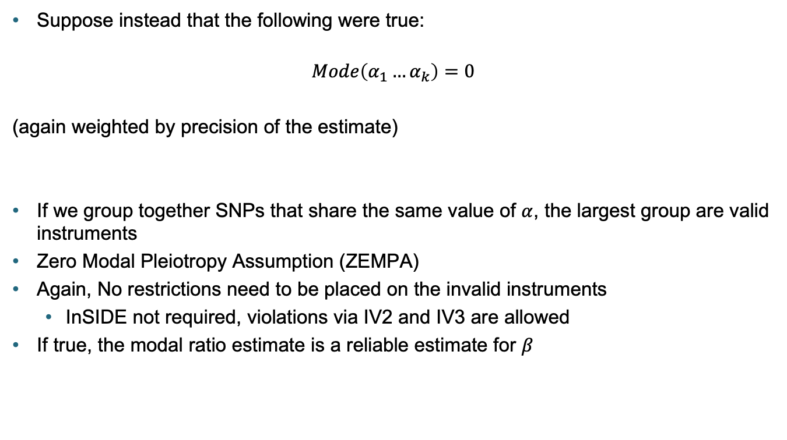

Weighted Mode
$$Γ_{k}=α_{k}+βγ_{k}$$
Suppose instead that the following were true:
$$Mode\left(α_{1}…α_{k}\right)=0$$
(again weighted by precision of the estimate)
If we group together SNPs that share the same value of $α$, the largest group are valid instruments
Zero Modal Pleiotropy Assumption (ZEMPA)
Again, No restrictions need to be placed on the invalid instruments
  InSIDE not required, violations via IV2 and IV3 are allowed
If true, the modal ratio estimate is a reliable estimate for $β$

Slide 32
Multivariable Mendelian Randomization
MR including multiple exposures in the same estimation
  Here have two exposures – could have more.
MR:
MVMR:

Slide 33

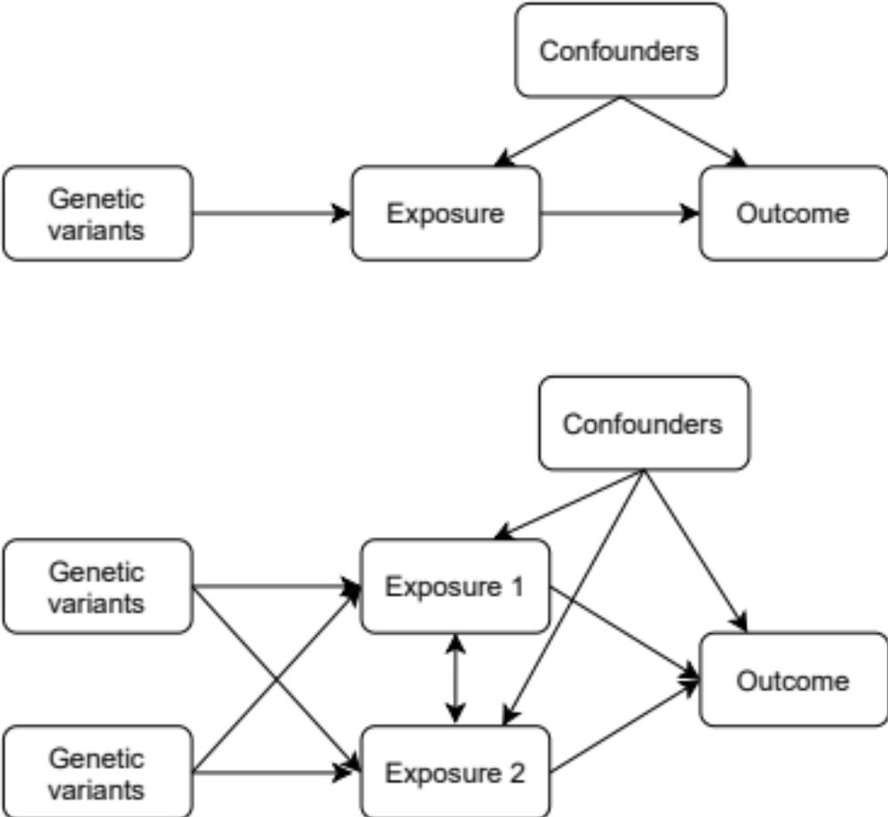
What is Multivariable Mendelian Randomization?
MR: Estimates the total effect of the exposure on the outcome
MVMR: Estimates the direct effect of each exposure on the outcome
NOT via the other exposures included in the estimation.
Difference due to:
Mediation
Pleiotropy

Slide 34
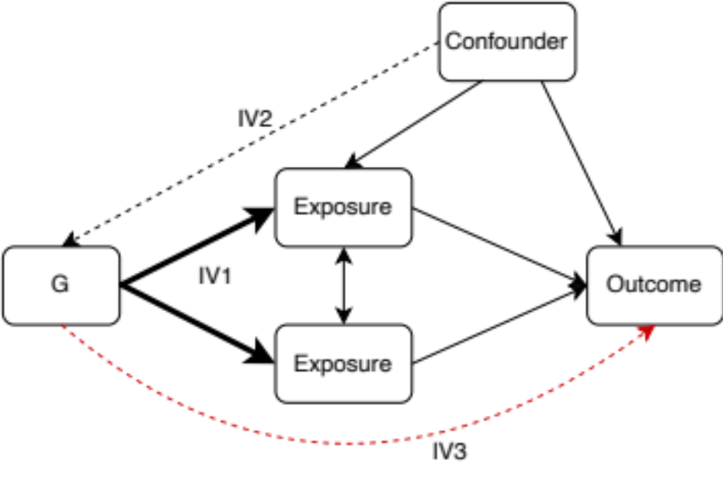
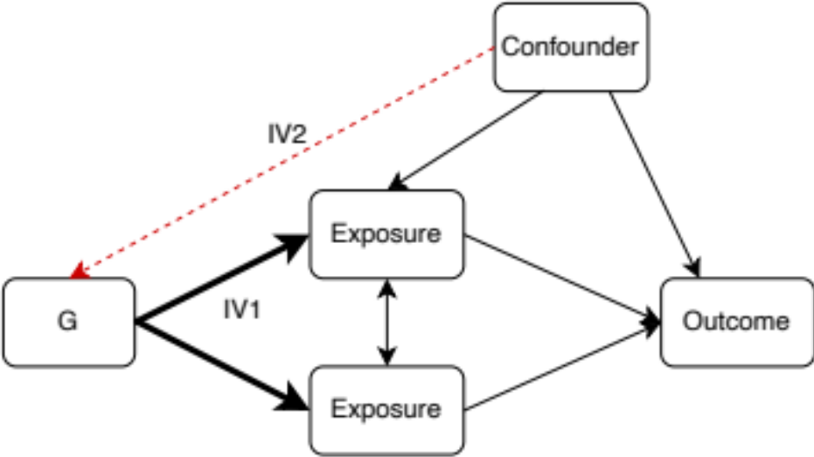
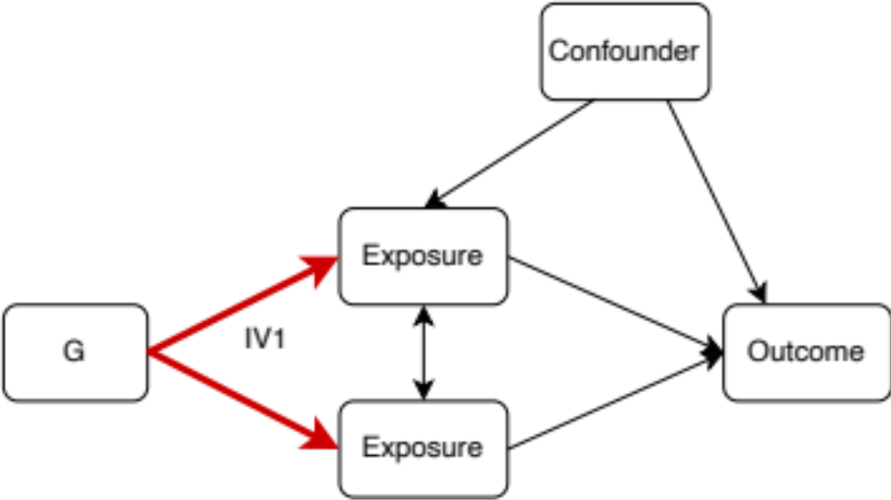
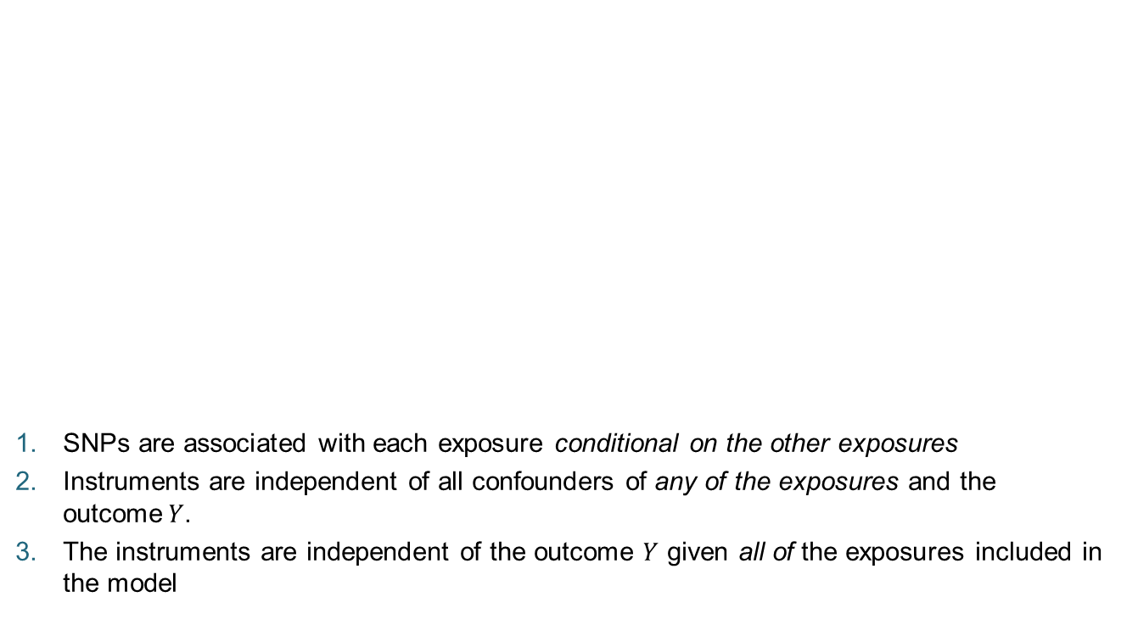
Assumptions of MVMR
SNPs are associated with each exposure conditional on the other exposures
Instruments are independent of all confounders of any of the exposures and the outcome$Y$.
The instruments are independent of the outcome $Y$ given all of the exposures included in the model

Slide 35
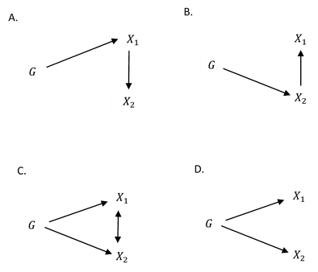
Instrument strength in MVMR
Instruments can appear strong
But actually be weakly associated with each exposure conditional on the other
A/B – Conditionally weak instruments
But could appear individually strong
C/D - Individually strong instruments
But could be conditionally weak
Instrument strength can be tested with a conditional F-statistic

Slide 36

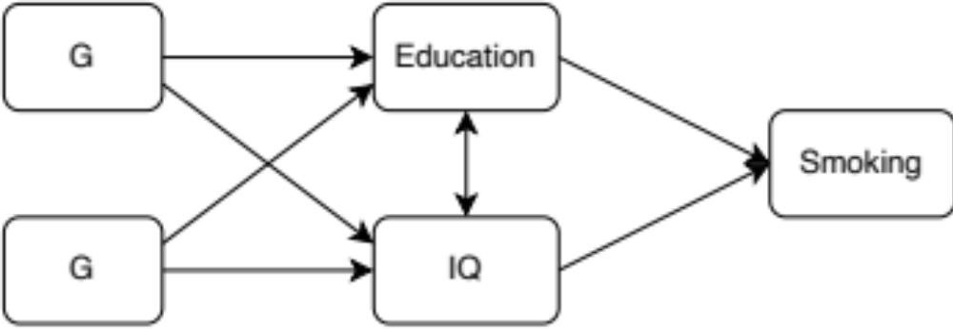
Application of MVMR:
The effect of education and IQ on smoking behaviour

Slide 37
Application of MVMR:
The effect of education and IQ on smoking behaviour
Data:
UK Biobank
N = 120,050
European individuals with
observations on all variables
Instruments are scores from
non UK Biobank GWAS
Outcome: Current Smoking
Univariable MR;
Multivariable MR;
 | Effect | 95% CI | P value | F Statistic
Age completed education | -0.027 | -0.056, -0.017 | <0.001 | 575.75
Standardised general cognitive ability score | -0.026 | -0.044, -0.009 | 0.004 | 920.27
 | Effect | 95% CI | P value | F Statistic
Age completed education | -0.041 | -0.064, -0.017 | 0.001 | 83.29
Standardised general cognitive ability score | 0.049 | -0.005, 0.102 | 0.075 | 83.91

