Slide 1
Mendelian randomization
ESSGN Bootcamp
Venice 7th November 2023
Division of Psychiatry and Department of Statistical Science
Neil M Davies, neil.m.davies@ucl.ac.uk

Slide 2
Questions very welcome!
Please feel free to interrupt at any time, I’m happy to clarify, discuss, debate, whatever.

Slide 3
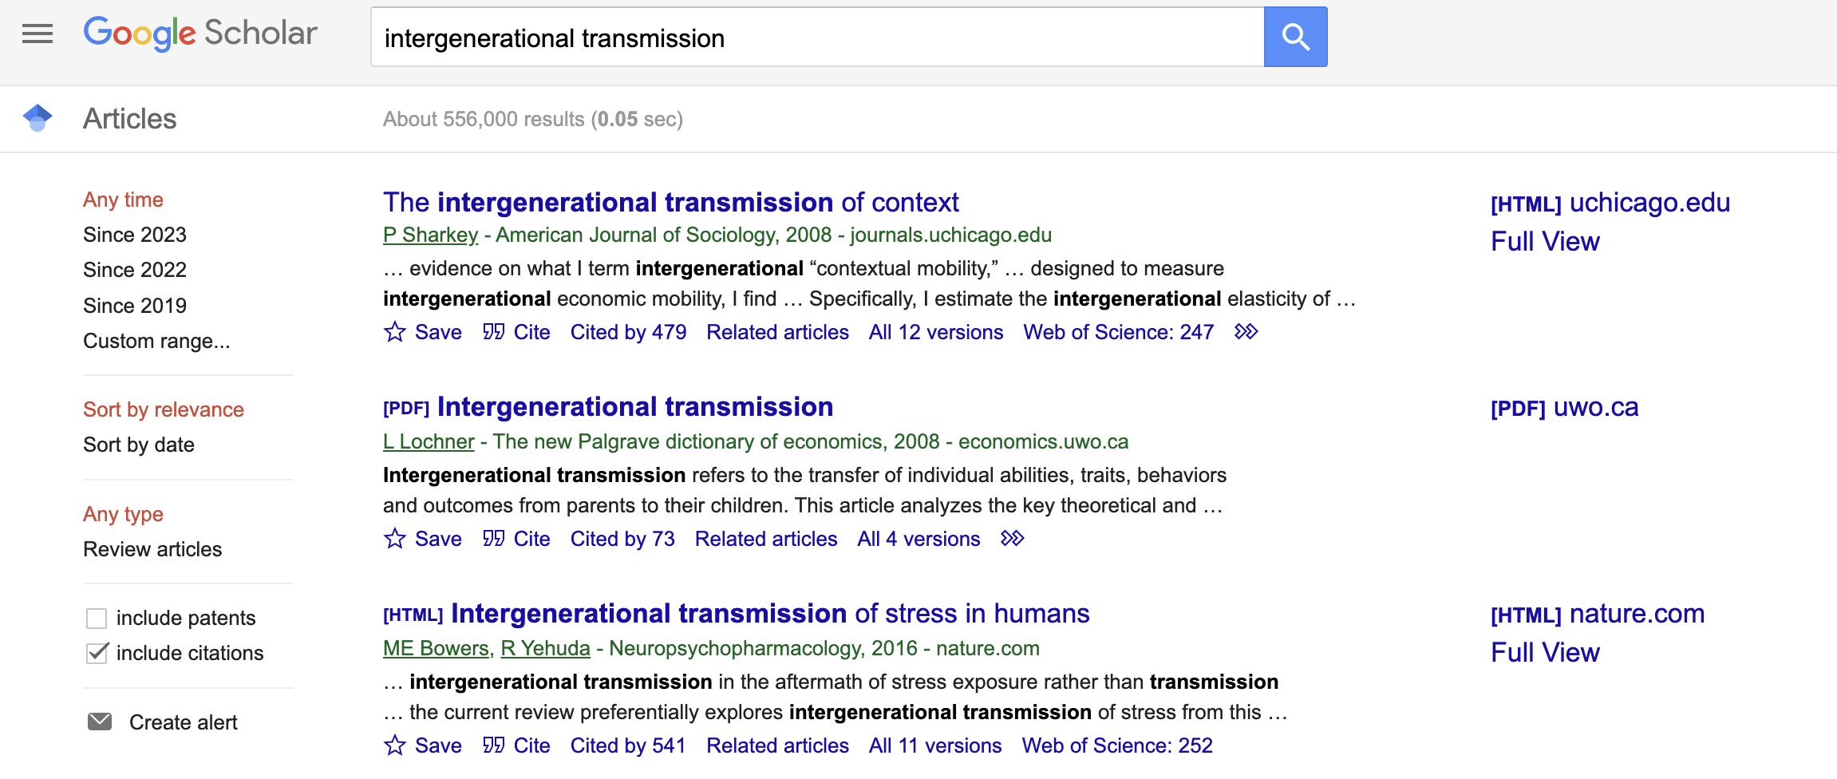
Social scientists thought yes…

Slide 4
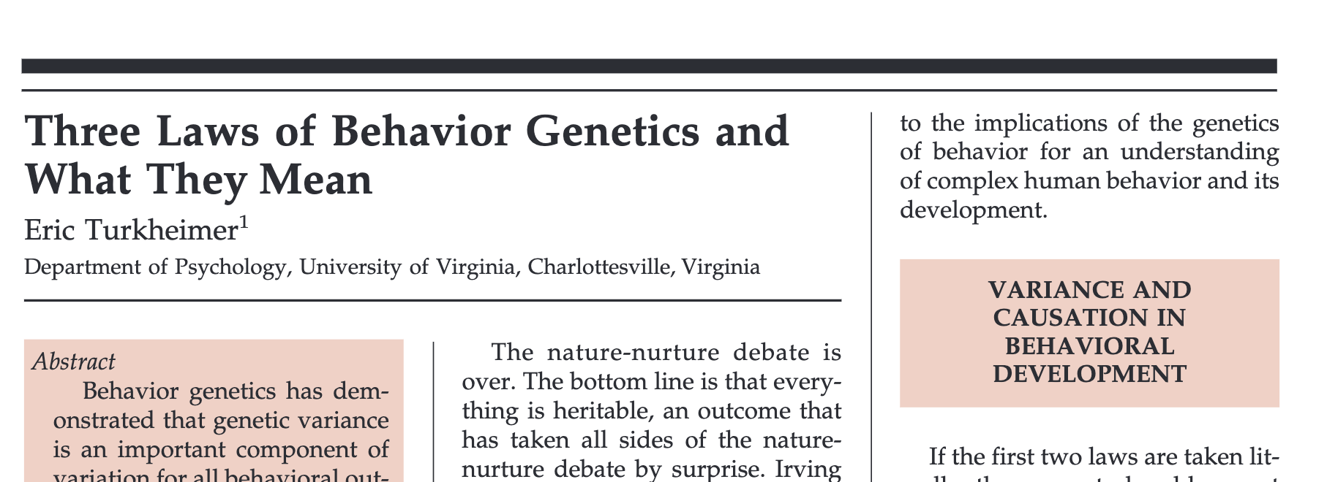
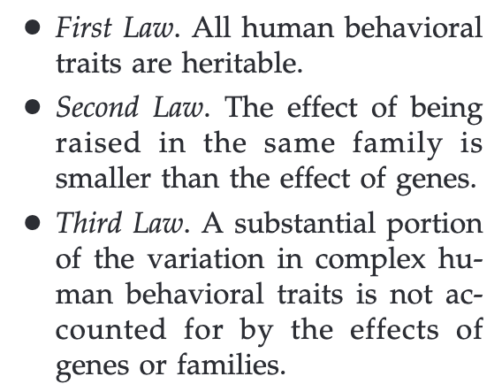
Behavioural geneticists thought not…

Slide 5
How can molecular genetic data help?

Slide 6
Overview
Introduction to Mendelian randomization (genetic IVs)
Sources of bias in population based MR studies
Family based designs
Empirical example: The effects of height and BMI on education, blood pressure and diabetes
The Sibling GWAS
Trios

Slide 7
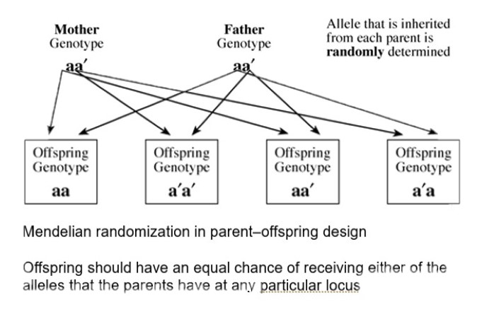
Random genetic inheritance: IVs from the masses
Genetic variants
  Are a point in the genome that differs across the population
  A common type of variant is single nucleotide polymorphisms (SNPs)
  SNPs have one or more alleles
A conception offspring inherit at each SNP
  One of mother’s two alleles
  One of father’s two alleles
Reverse causation impossible.
Literal random inheritance of variants at
each loci within families
Population based MR assumes what is true within
  families is true at the population level.
G. Davey Smith, S. Ebrahim, “Mendelian randomization”: can genetic epidemiology contribute to understanding environmental determinants of disease? Int J Epidemiol. 32, 1–22 (2003).

Slide 8
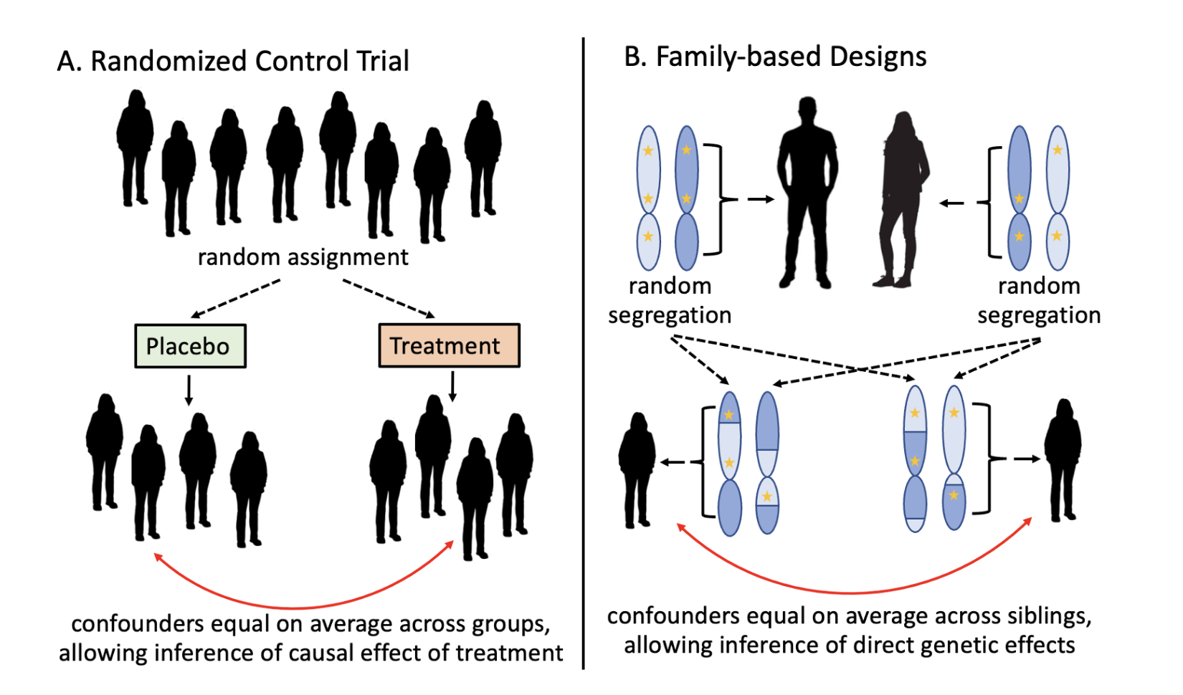
Nature’s randomized trials
G. Davey Smith, S. Ebrahim, What can mendelian randomisation tell us about modifiable behavioural and environmental exposures? BMJ. 330, 1076–1079 (2005).

Slide 9
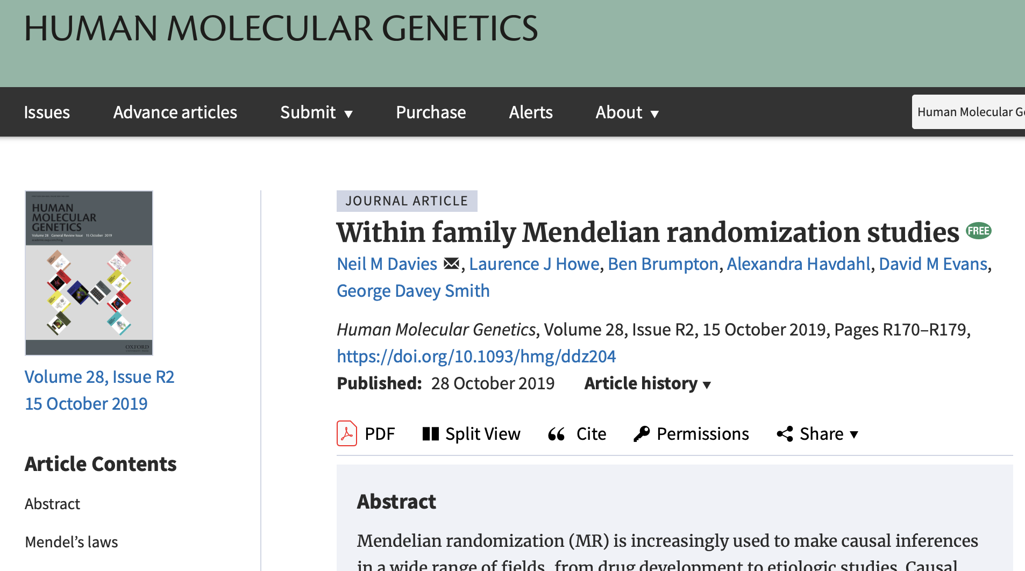

Slide 10
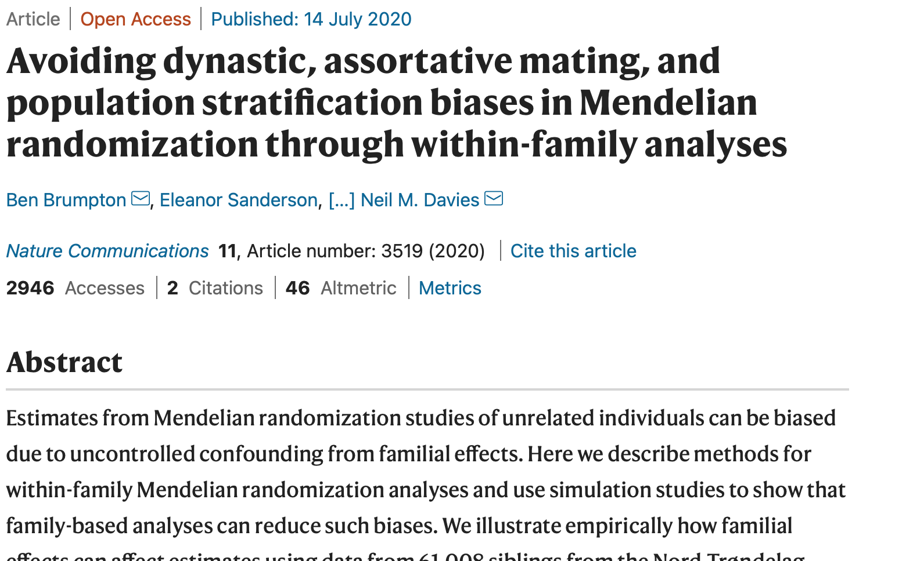

Slide 11
Limitations to conventional MR studies
Used samples of unrelated individuals
  Controlled for standard covariates (age, sex, PCs)
Requires assumption that what is true within families is also true across populations, i.e. random distribution of height and BMI genetic variants
There are reasons to think this may not hold:
  Fine scale population structure (Haworth et al 2019, Abdellaoui et al 2019)
  Dynastic effects (Plomin and Bergeman 1991)
  Assortative mating (Wright 1921)
A. Abdellaoui, D. Hugh-Jones, L. Yengo, K. E. Kemper, M. G. Nivard, L. Veul, Y. Holtz, B. P. Zietsch, T. M. Frayling, N. R. Wray, J. Yang, K. J. H. Verweij, P. M. Visscher, Genetic correlates of social stratification in Great Britain. Nature Human Behaviour (2019), doi:10.1038/s41562-019-0757-5.
S. Haworth, R. Mitchell, L. Corbin, K. H. Wade, T. Dudding, A. Budu-Aggrey, D. Carslake, G. Hemani, L. Paternoster, G. D. Smith, N. Davies, D. J. Lawson, N. J. Timpson, Apparent latent structure within the UK Biobank sample has implications for epidemiological analysis. Nature Communications. 10 (2019), doi:10.1038/s41467-018-08219-1.
R. Plomin, C. S. Bergeman, The nature of nurture: Genetic influence on “environmental” measures. Behavioral and Brain Sciences. 14, 373–386 (1991).
S. Wright, Systems of Mating. III. Assortative Mating Based on Somatic Resemblance. Genetics. 6, 144–161 (1921).
N. M. Davies, L. J. Howe, B. Brumpton, A. Havdahl, D. M. Evans, G. Davey Smith, Within family Mendelian randomization studies. Human Molecular Genetics. 28, R170–R179 (2019).
L.-D. Hwang, N. M. Davies, N. M. Warrington, D. M. Evans, Integrating Family-Based and Mendelian Randomization Designs. Cold Spring Harb Perspect Med, a039503 (2020).

Slide 12
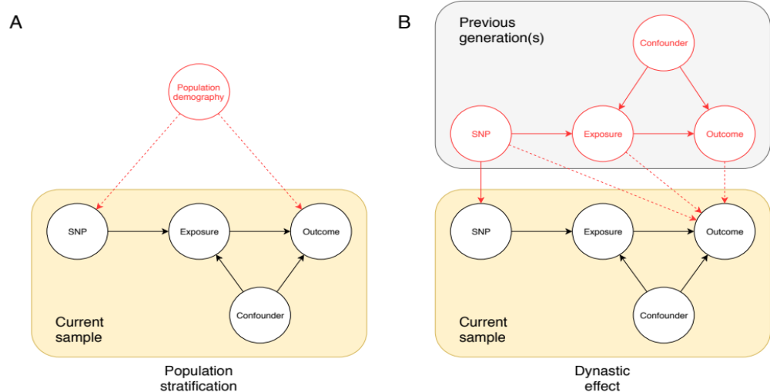
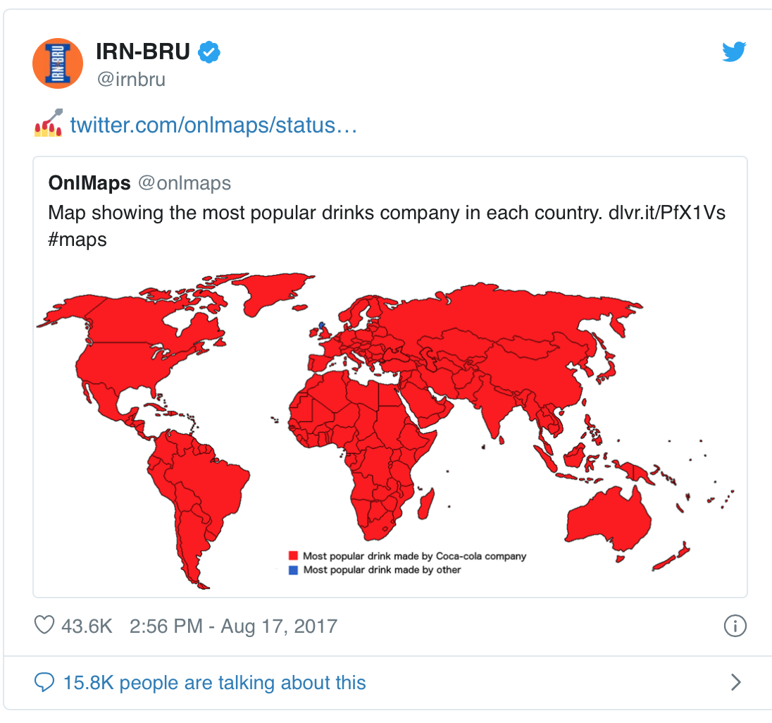

1) Fine scale population structure
Geographic or regional differences in allele frequency that relate to a trait of interest
For example:
  People in Scotland drink more Irn Bru and have adverse health outcomes.
  Some genetic variants will also have modestly different frequencies in Scotland
  E.g. genetic variants associated with lactase persistence are more common in northern areas
  This does not imply that Iru Bru causes adverse health outcomes
G. Davey Smith, D. A. Lawlor, N. J. Timpson, J. Baban, M. Kiessling, I. N. M. Day, S. Ebrahim, Lactase persistence-related genetic variant: population substructure and health outcomes. Eur J Hum Genet. 17, 357–367 (2009).
Notes:
If the allele frequency is higher in one subpopulation and the disease or trait frequecny are higher in that subpopulation. You will see an association between SNP and disease although this is not causal.

Slide 13
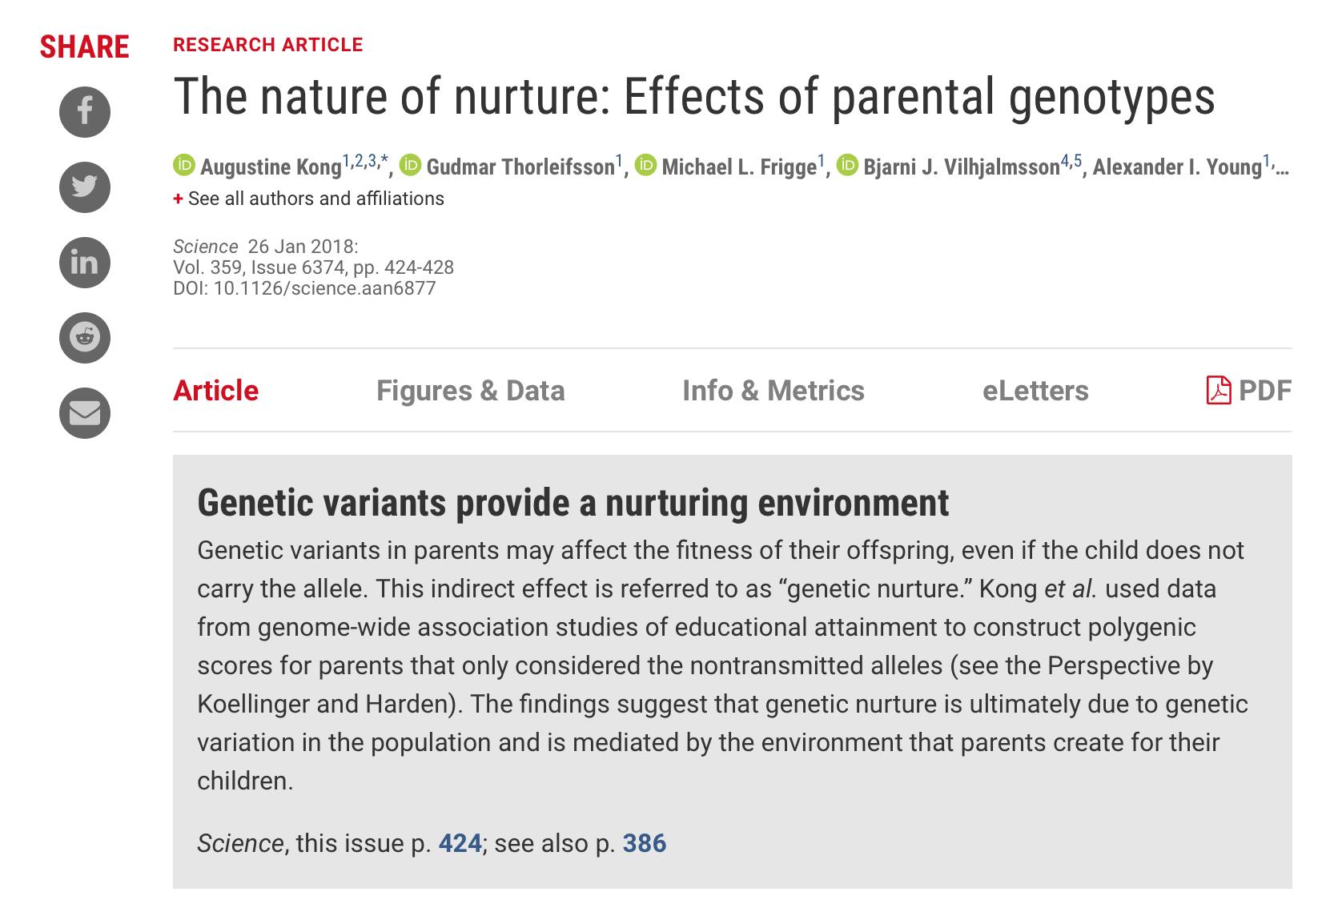
2) Dynastic effects
Family structure:
  dynastic effects that occur when the expression of parent’s genotype directly affects the offspring phenotype.
  For example, if more educated parents can afford tutoring for their children, leading to better educational outcomes for their offspring
  Parents and offspring genotypes correlate 50%
  Results in biased estimates of the effect of exposure in the offspring
Notes:
Dynastic effects can occur when the expression of parental genotype in the parents directly affects the offspring. For example, this could occur if more educated parents have higher incomes and are able to buy tutoring for their offspring.
1) Height > income of the parents > tutoring > education in the child

Slide 14
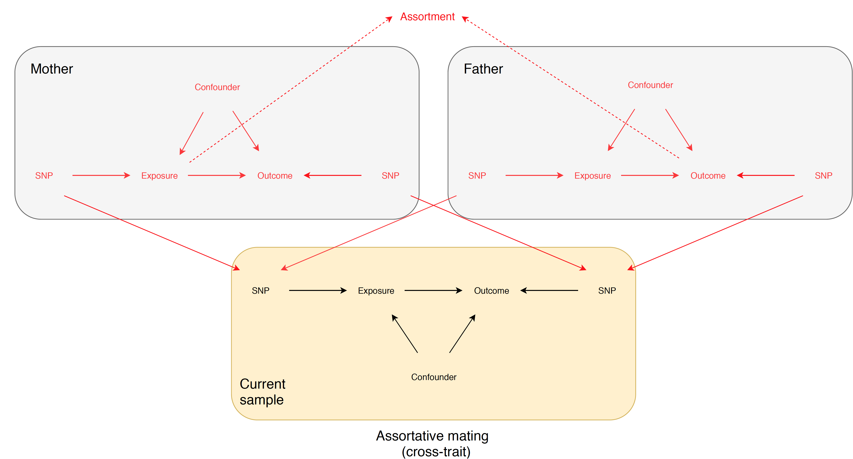
3) Assortative mating
Assortative mating - when individuals do not choose their partners at random but select someone who is more similar to them on particular characteristics than would be expected by chance.
Assortment on education, BMI and height
Causes bias in MR estimates
F. P. Hartwig, N. M. Davies, G. Davey Smith, Bias in Mendelian randomization due to assortative mating. Genetic Epidemiology. 42, 608–620 (2018).
Notes:
The bottom‐left panel illustrates cross‐trait assortative mating on X and Y by two thick lines: from mother's X to father's Y, and from mother's Y to father's X. In this situation, if X does not cause Y, the mother's GXand father's GY, and mother's GY and father's GX will be associated. If X does cause Y, then all parental genetic variables will associate.

Slide 15
How can we overcome these biases?
Difference-in-difference method with sibling data
Family fixed effect with sibling data
Adjusting for parental genotype with mother-father-offspring trios data

Slide 16
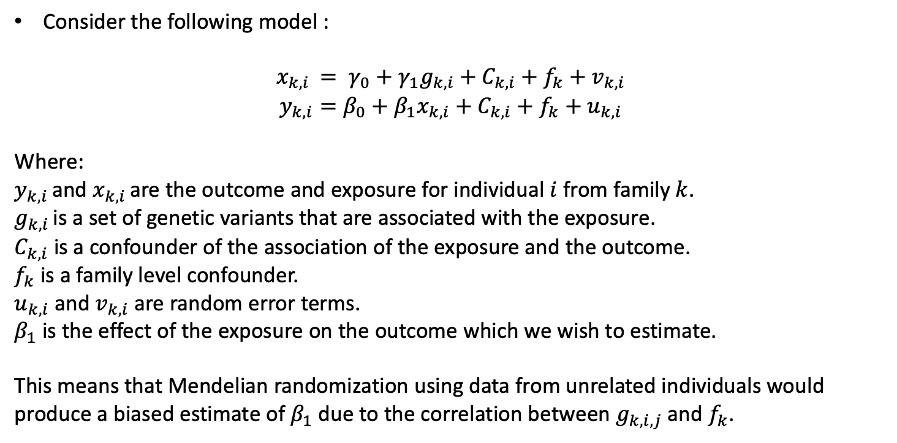
Econometric methods
Consider the following model :
$$x_{k,i }= γ_{0}+γ_{1}g_{k,i}+C_{k,i}+f_{k}+v_{k,i}$$
$$y_{k,i}=β_{0}+β_{1}x_{k,i}+C_{k,i}+f_{k}+u_{k,i}$$
Where:
$y_{k,i }$and $x_{k,i }$are the outcome and exposure for individual $i$ from family $k$.
$g_{k,i }$is a set of genetic variants that are associated with the exposure.
$C_{k,i}$ is a confounder of the association of the exposure and the outcome.
$f_{k}$ is a family level confounder.
$u_{k,i}$ and $v_{k,i}$ are random error terms.
$β_{1}$ is the effect of the exposure on the outcome which we wish to estimate.
This means that Mendelian randomization using data from unrelated individuals would produce a biased estimate of $β_{1}$ due to the correlation between $g_{k,i,j}$and $f_{k}$.
Notes:
$y_{k,i }$and $x_{k,i }$are the outcome and exposure for individual $i$ from family $k$.
$g_{k,i }$is a set of genetic variants that are associated with the exposure.
$C_{k,i}$ is a confounder of the association of the exposure and the outcome.
$f_{k}$ is a family level confounder.
$u_{k,i}$ and $v_{k,i}$ are correlated random error terms.
$β_{1}$ is the effect of the exposure on the outcome which we wish to estimate.

Slide 17
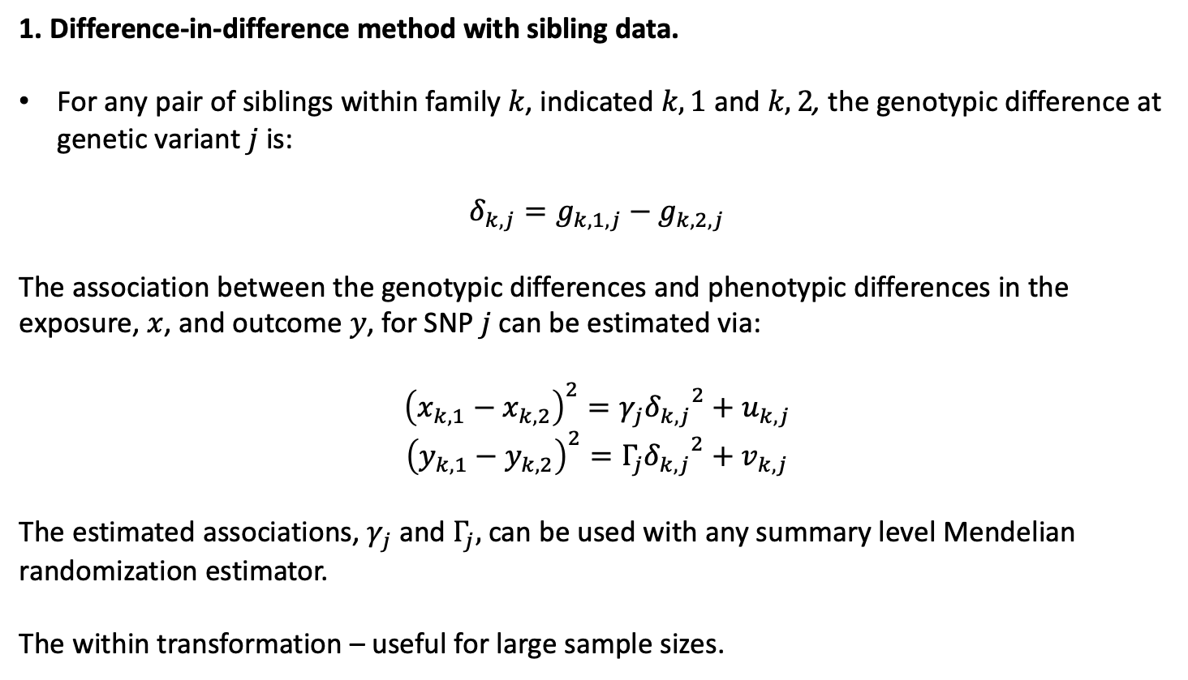
Econometric methods
1. Difference-in-difference method with sibling data.
For any pair of siblings within family $k$, indicated $k,1$ and $k,2$, the genotypic difference at genetic variant $j$ is:
$$δ_{k,j}=g_{k,1,j}−g_{k,2,j}$$
The association between the genotypic differences and phenotypic differences in the exposure, $x$, and outcome $y$, for SNP $j$ can be estimated via:
${\left(x_{k,1}−x_{k,2}\right)}^{2}=γ_{j}{δ_{k,j}}^{2}+u_{k,j}$
${\left(y_{k,1}−y_{k,2}\right)}^{2}=Γ_{j}{δ_{k,j}}^{2}+v_{k,j}$
The estimated associations, $γ_{j}$and $Γ_{j},$can be used with any summary level Mendelian randomization estimator.
The within transformation – useful for large sample sizes.
Notes:
$δ$=delta
Gamma (uppercase Γ, lowercase γ)

Slide 18
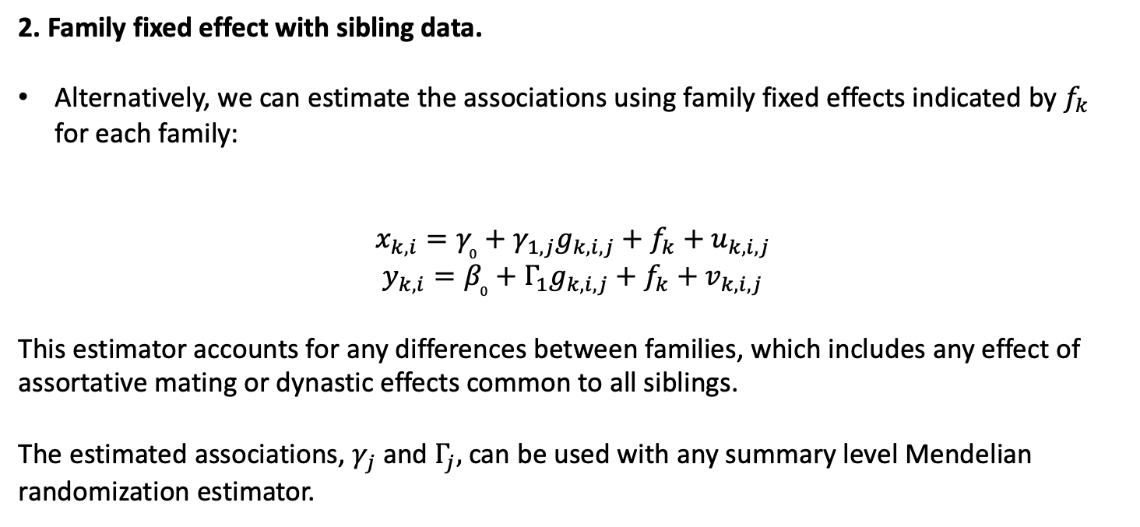
Econometric methods
2. Family fixed effect with sibling data.
Alternatively, we can estimate the associations using family fixed effects indicated by $f_{k}$ for each family:
$$x_{k,i}=γ_{0}+γ_{1,j}g_{k,i,j}+f_{k}+u_{k,i,j}$$
$$y_{k,i}=β_{0}+Γ_{1}g_{k,i,j}+f_{k}+v_{k,i,j}$$
This estimator accounts for any differences between families, which includes any effect of assortative mating or dynastic effects common to all siblings.
The estimated associations, $γ_{j}$and $Γ_{j},$can be used with any summary level Mendelian randomization estimator.
Notes:
$y_{k,i }$and $x_{k,i }$are the outcome and exposure for individual $i$ from family $k$.
$g_{k,i }$is a set of genetic variants that are associated with the exposure.
$C_{k,i}$ is a confounder of the association of the exposure and the outcome.
$f_{k}$ is a family level confounder.
$u_{k,i}$ and $v_{k,i}$ are correlated random error terms.
$β_{1}$ is the effect of the exposure on the outcome which we wish to estimate.

Slide 19
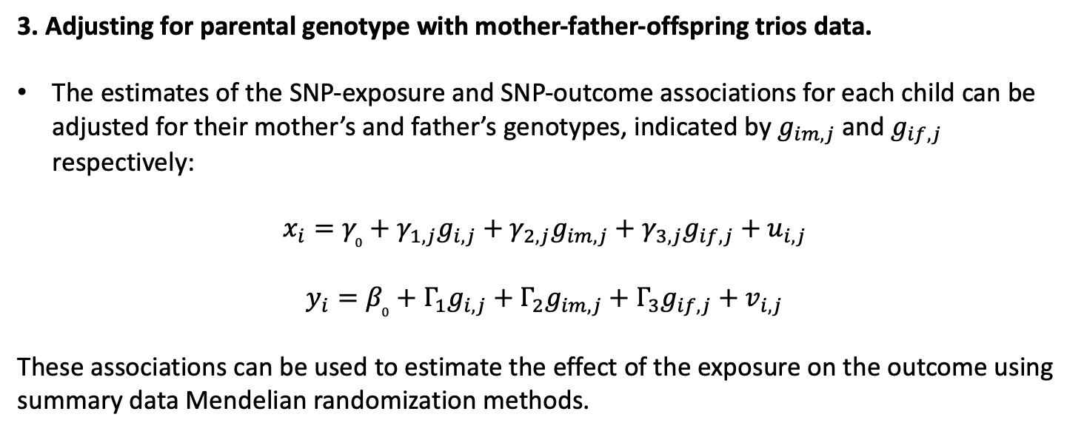
Econometric methods
3. Adjusting for parental genotype with mother-father-offspring trios data.
The estimates of the SNP-exposure and SNP-outcome associations for each child can be adjusted for their mother’s and father’s genotypes, indicated by $g_{im,j}$ and $g_{if,j}$ respectively:
$$x_{i}=γ_{0}+γ_{1,j}g_{i,j}+γ_{2,j}g_{im,j}+γ_{3,j}g_{if,j}+u_{i,j}$$
$$y_{i}=β_{0}+Γ_{1}g_{i,j}+Γ_{2}g_{im,j}+Γ_{3}g_{if,j}+v_{i,j}$$
These associations can be used to estimate the effect of the exposure on the outcome using summary data Mendelian randomization methods.

Slide 20
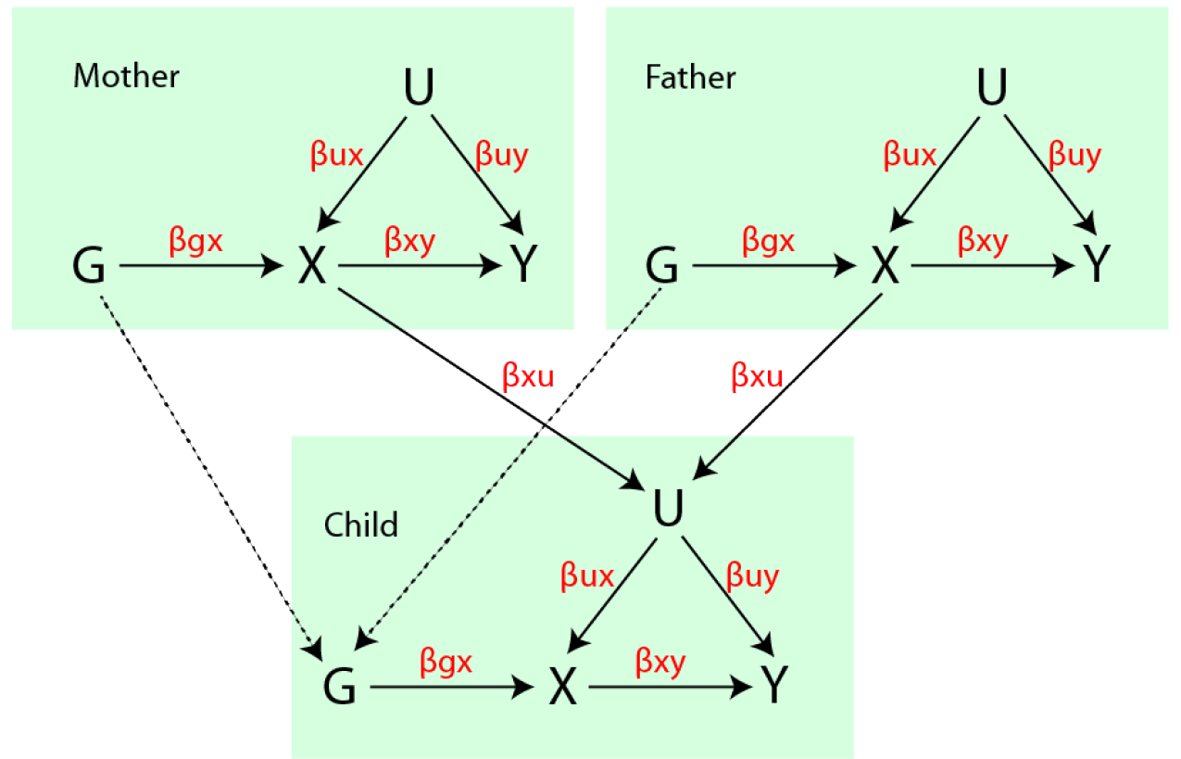
Methods
Simulations
SNP-exposure r2 = 0.05
Sample size = 10,000
90 independent SNPs
Simulation involves an influence of parental exposure influencing child’s confounder.

Slide 21
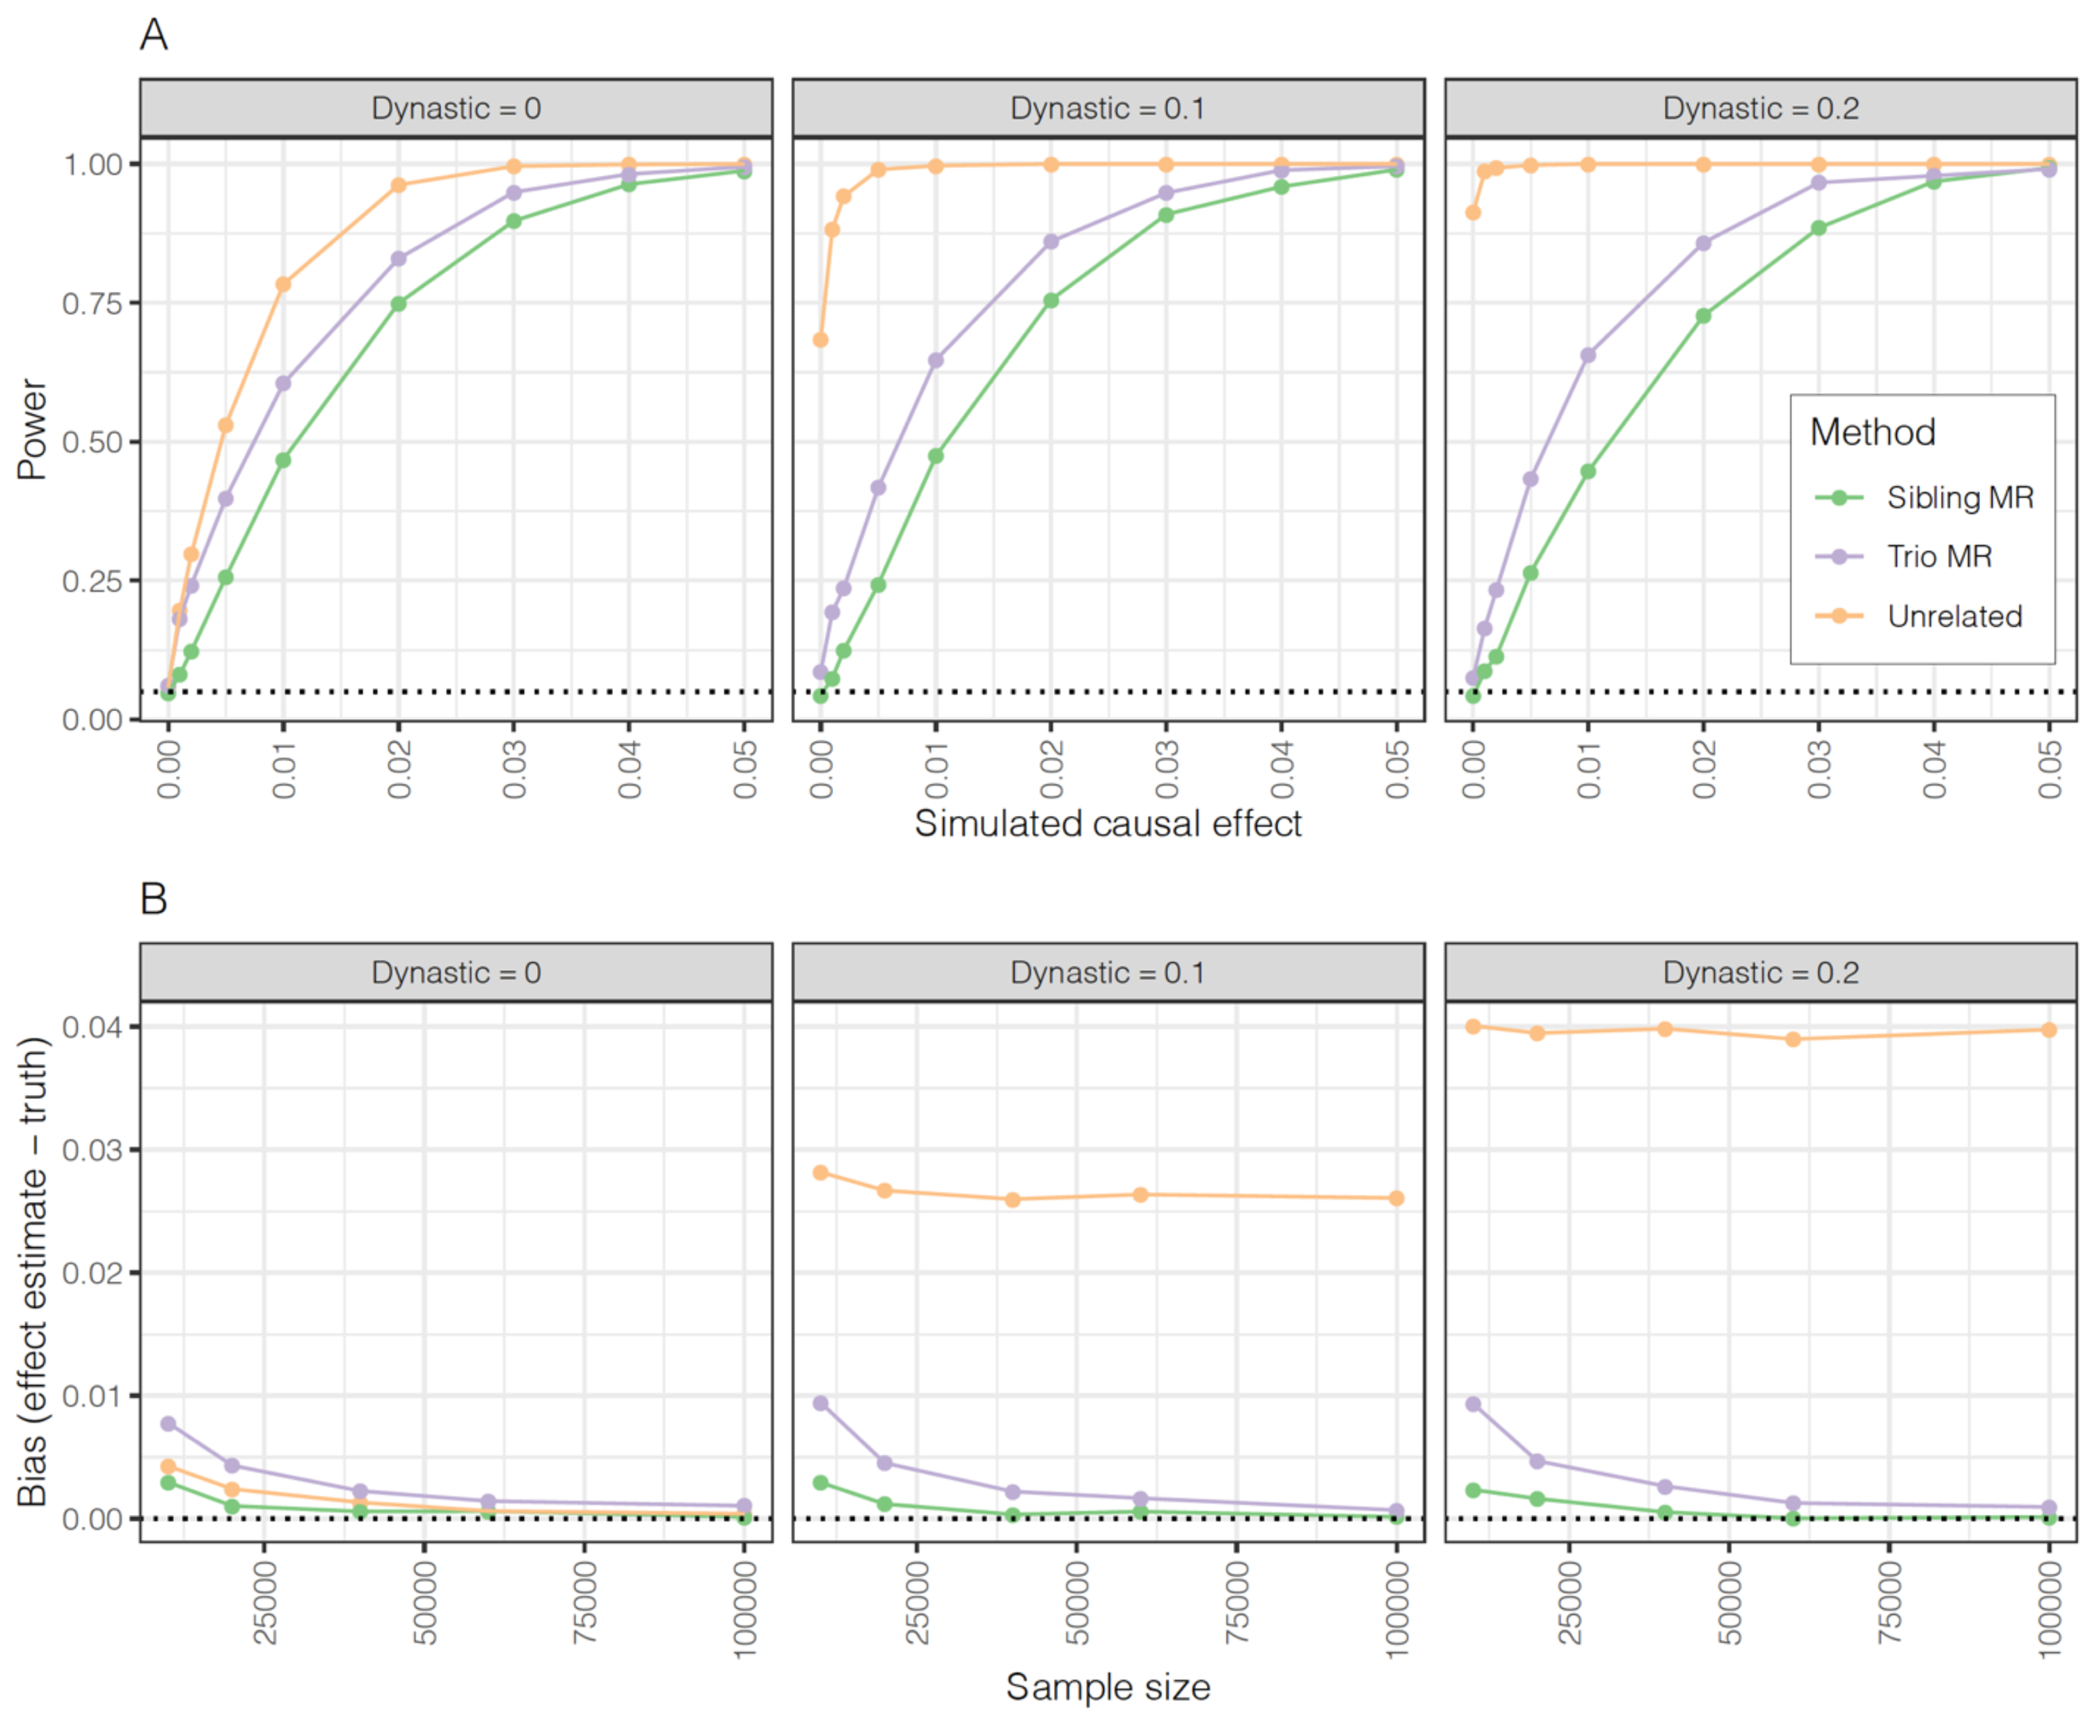
Results
Simulations
Bias occurs if there are dynastic effects. I.e. if the parents affect the offspring outcomes.
However, estimates from within-family designs are less substantially less powerful.
The simulations show how family structure can be exploited to control for the bias either using samples of siblings or mother-father-offspring trios.

Slide 22
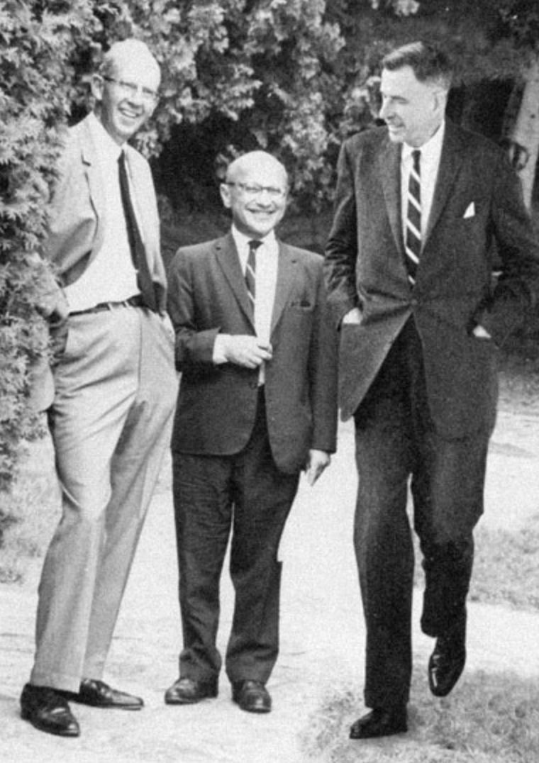
Empirical study
Hypotheses
  What is the effect of BMI on
    Diabetes
    High blood pressure
    Educational attainment
  What is the effect height on
    4. Educational attainment

Slide 23
Data
HUNT
HUNT > ~125,000 unique individuals (H1-3)> ~71,800 genotyped (H2-3) > ~24,000 unrelated (2nd degree) Europeans.
Genotyping - HumanCoreExome12 v1.0, HumanCoreExome12 v1.1 and UM HUNT Biobank v1.0 (n=516,608).
Imputation – merged reference panel constructed from the Haplotype Reference Consortium (HRC) panel (release version 1.1) and a local reference panel
Empirical study (HUNT+UKB)
HUNT2 > 65,237 participated > 56,374 genotyped > 53,288 complete data > 19,492 unrelated | 28,823 siblings > 13,103 families
UKBB > 503,317 participated > 370,180 met inclusion criteria > 33,642 siblings
Exposures and outcomes
Height, BMI > Education
BMI > Diabetes, Blood pressure
Replication: 23andMe 222,368 siblings

Slide 24
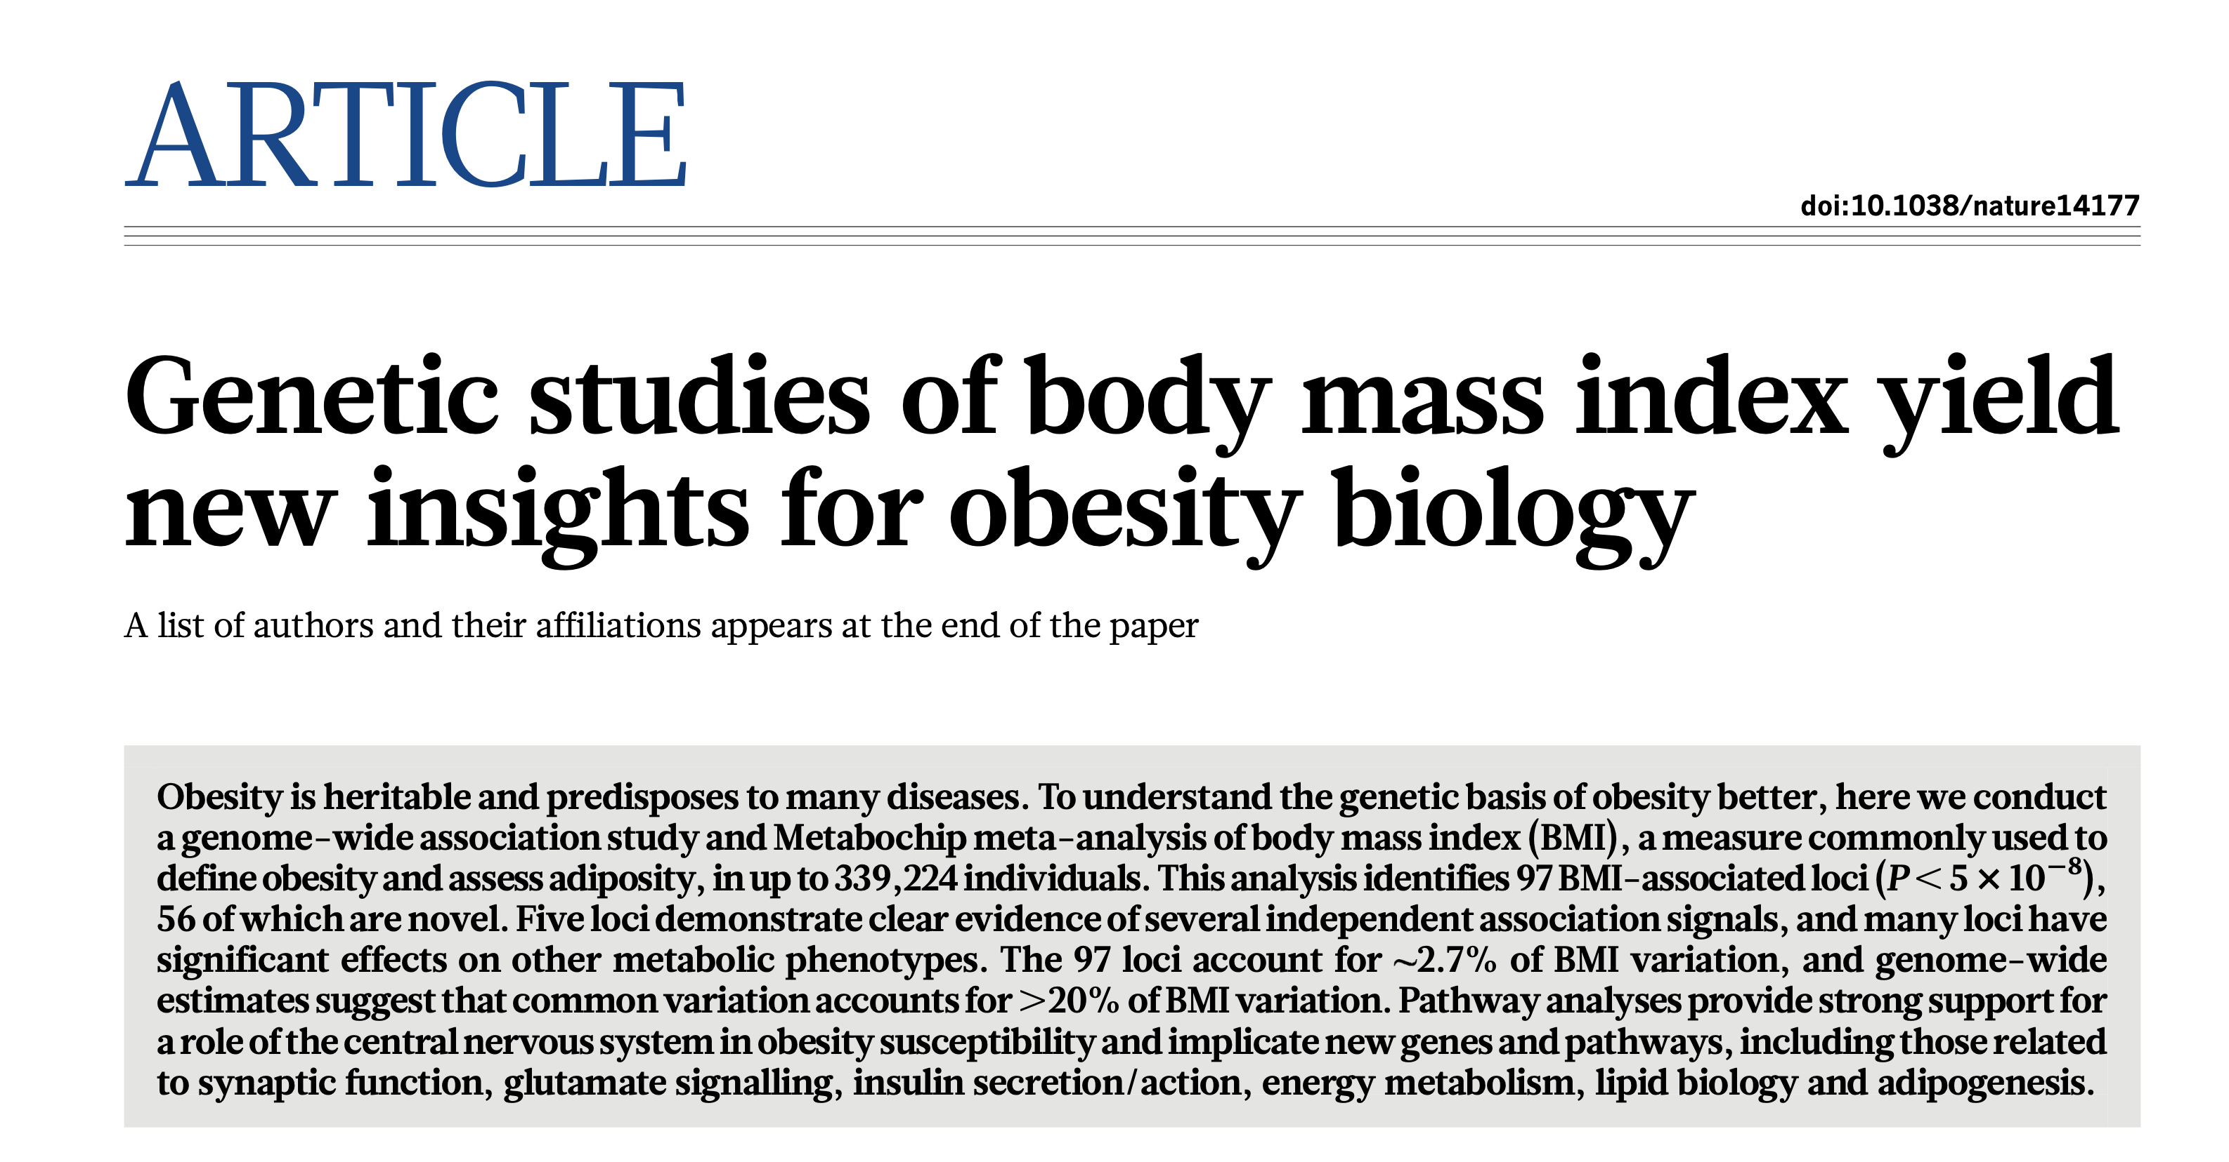
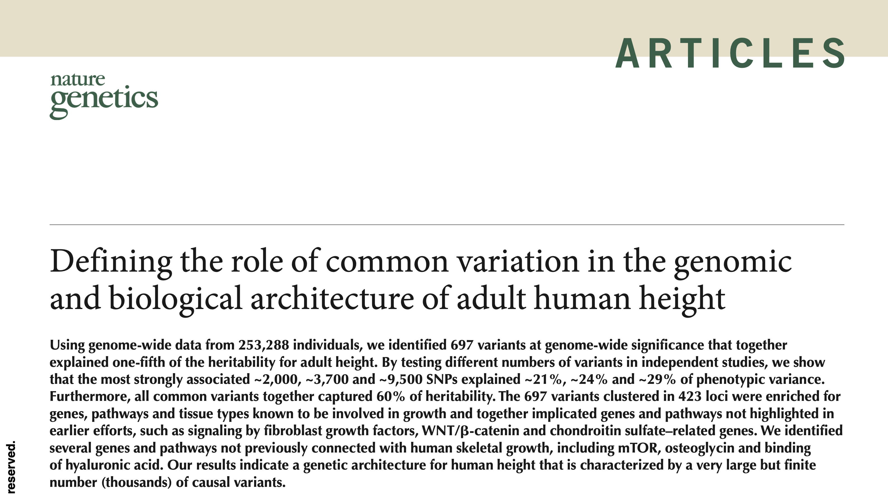
BMI and height GWAS
Clumped using r²<0.01, LD=10,000kb, to select:
79 SNPs associated with BMI
385 SNPs associated with height

Slide 25
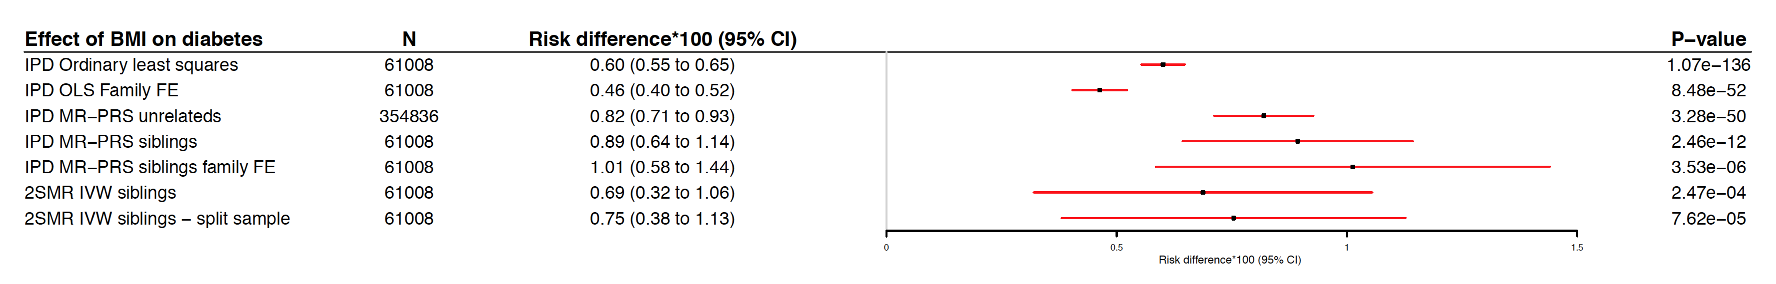
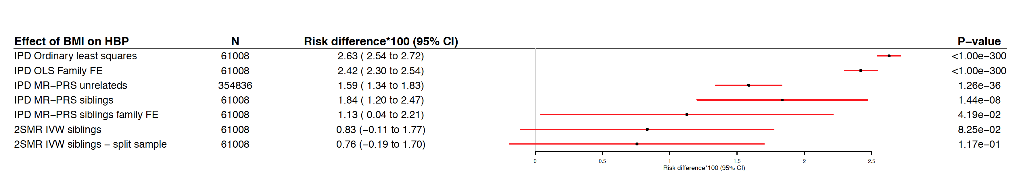
Results HUNT and UK Biobank
BMI > Diabetes
BMI > High blood pressure

Slide 26
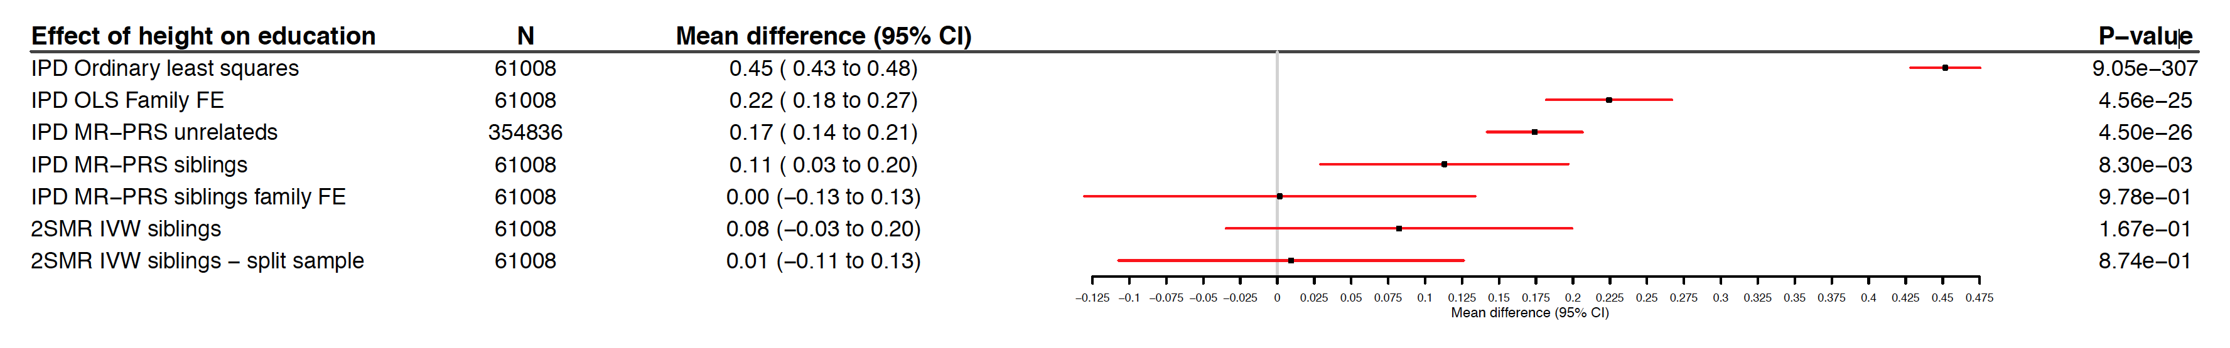
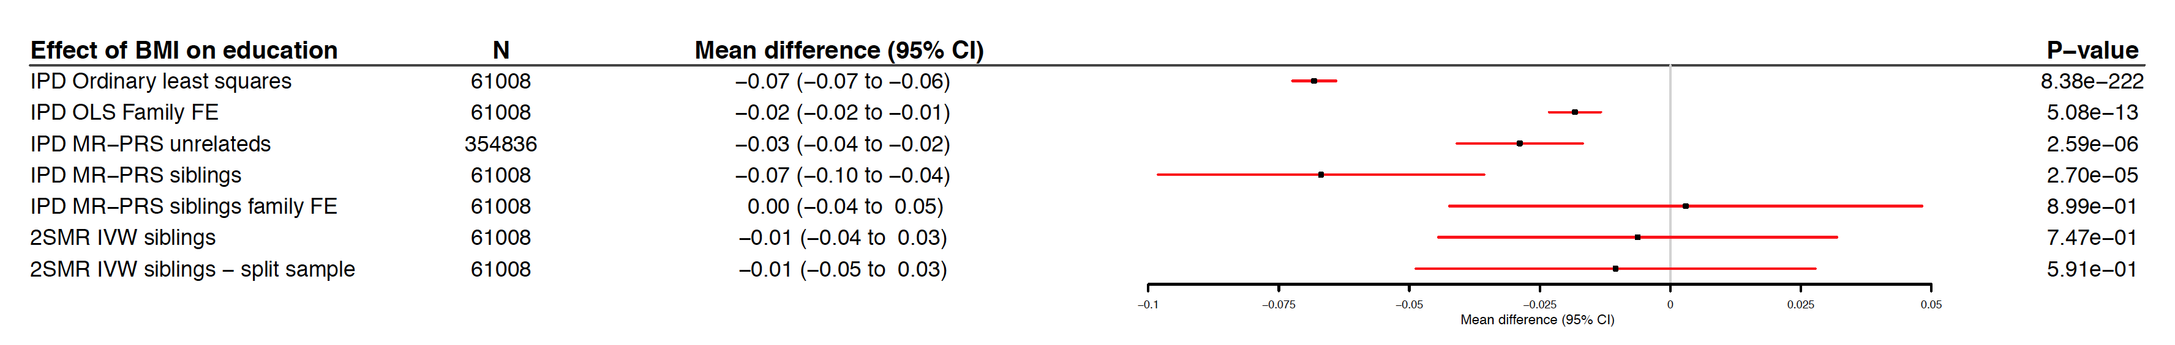
Results HUNT and UK Biobank
Height > Education
BMI > Education

Slide 27
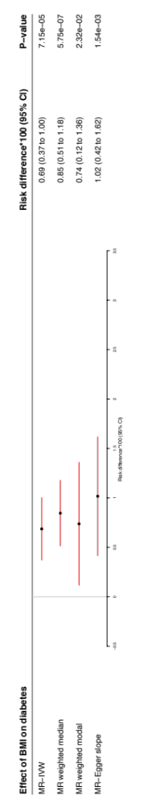
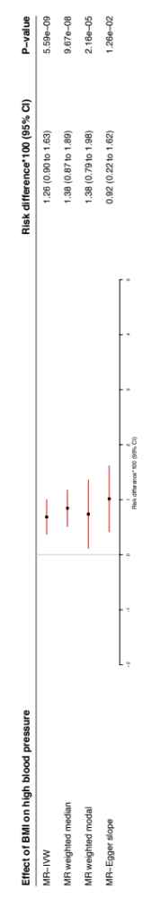
Results 23andMe replication (n=222,368)
BMI > Diabetes
BMI > High blood pressure

Slide 28
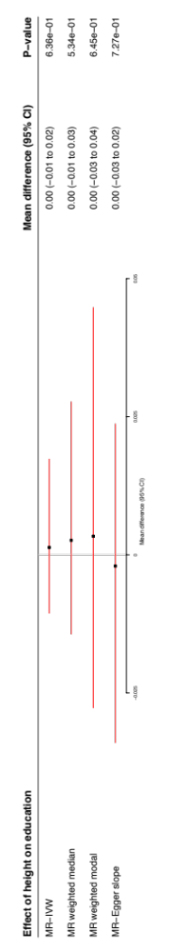
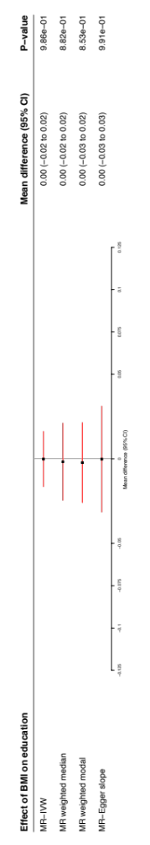
Results 23andMe replication (n=222,368)
Height > Education
BMI > Education

Slide 29
Summary
Meta-analysis of HUNT, UKB and 23andMe
A 1kg/m² increase in BMI causes:
  0.82 (95%CI: 0.55 to 1.06) additional cases of diabetes per 100
  1.25 (95%CI: 0.90 to 1.59) additional cases of high blood pressure per 100
  0.00 (95%CI: -0.018 to 0.018) additional years of education (i.e. <6.6 days)
10cm increase in height causes
  0.00 (95%CI: -0.015 to 0.015) additional years of education (i.e. <5.5 days)
Very well powered estimates.
Confirm established adverse effects of higher BMI on health outcomes.
There is very unlikely to be meaningful causal effect of BMI or height on educational attainment.

Slide 30
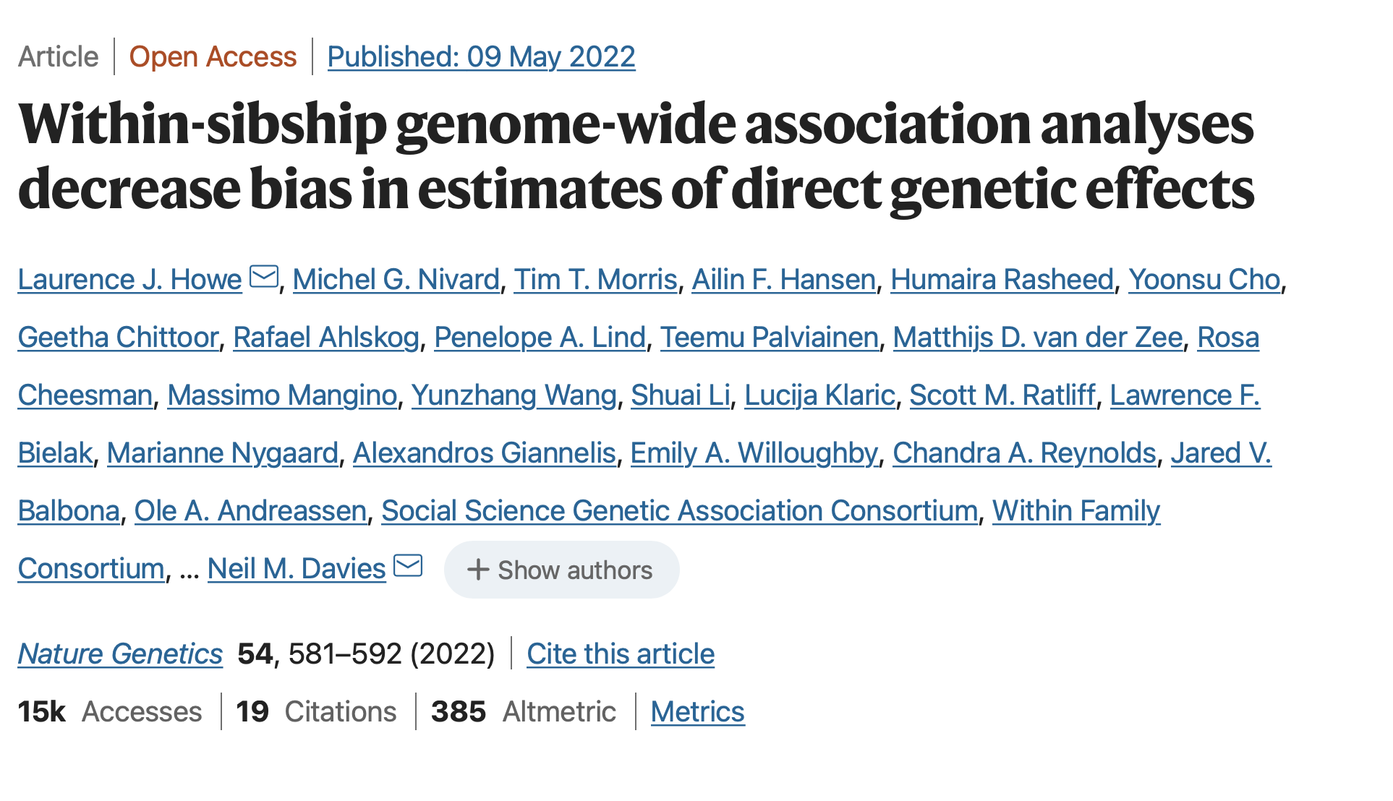
Sibling GWAS
180,000 siblings.
High coverage of phenotypes although sample sizes vary.

Slide 31

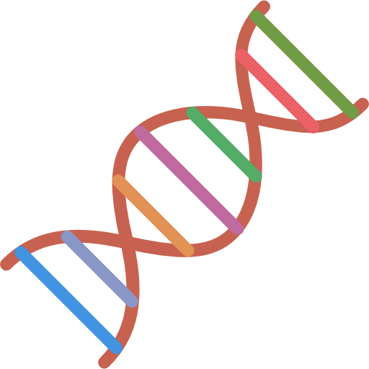
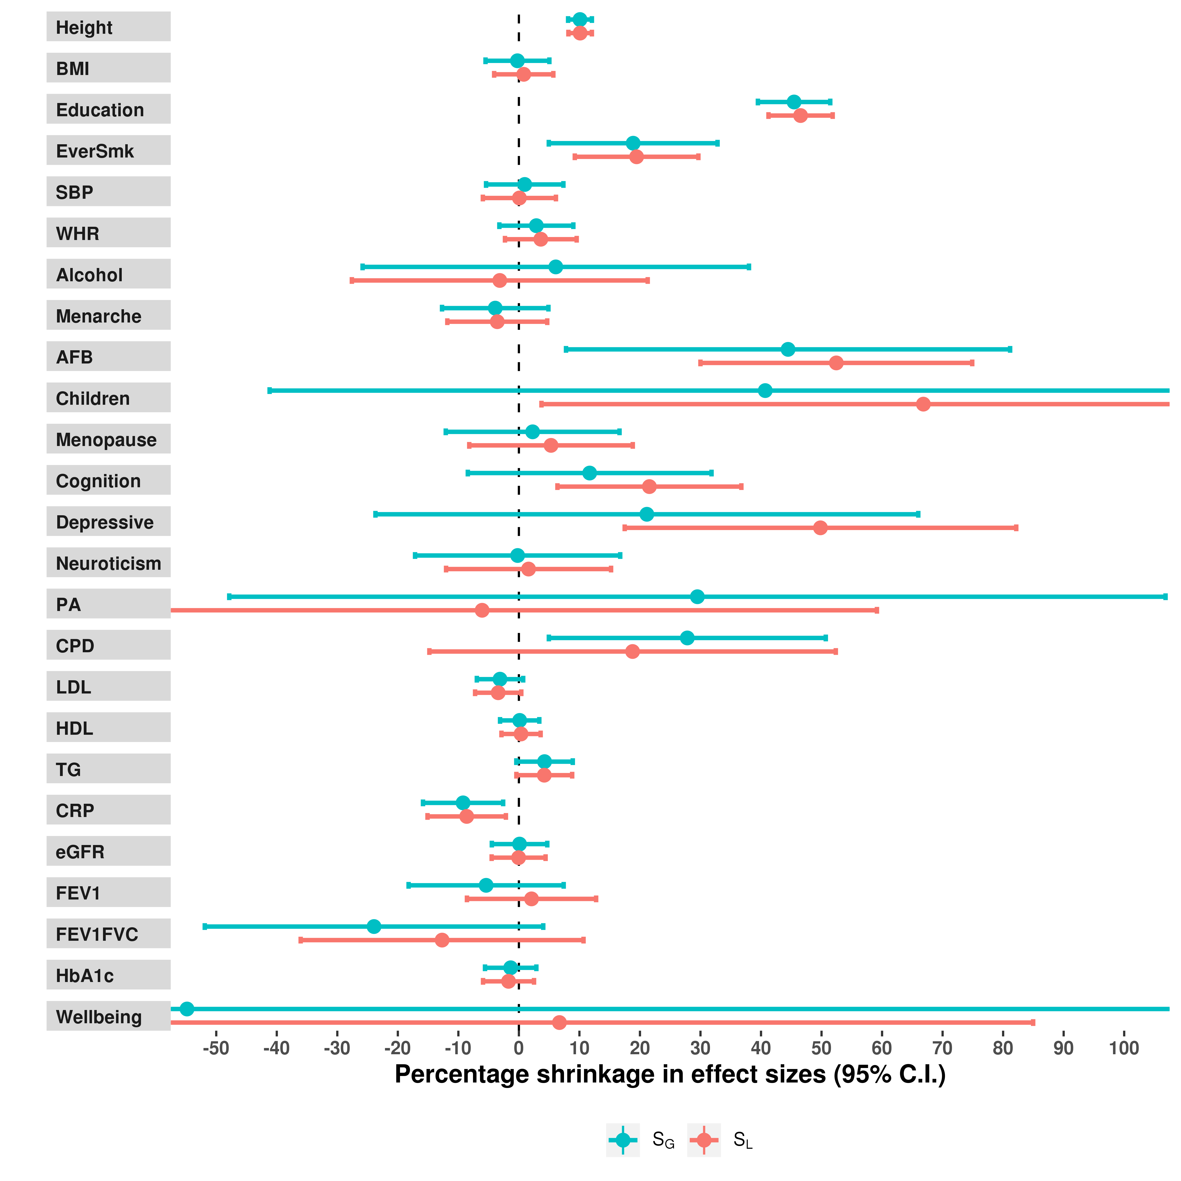
Within-sibship shrinkage estimates
Within
Sibship GWAS
Shrinkage for many “social” phenotypes.
“Molecular” phenotypes largely unaffected.
Inferences only on “top hits” for each phenotype.
Notes:
Across all 25 phenotypes, we observed evidence of within-sibship shrinkage for 7 of the phenotypes which were height (around 10-15%), educational attainment (around 50%) as well as ever smoking, age at first birth, number of children, cognitive ability and depressive symptoms.
Most of the traits with evidence of within-sibship shrinkage were more social or behavioural phenotypes with limited evidence for shrinkage on most of the more molecular phenotypes such as lipids.
Notably the inferences of the shrinkage analyses are limited to just the top hits in the discovery GWAS for each phenotype.

Slide 32
3. Adjustment for parental genotype
We can also control for the familial and demographic biases by controlling for parental genotype.
E.g. to estimate:
  The effects of parents’ BMI on their children’s mental health outcome
  The effects of parents’ education on their children’s exam results.

Slide 33
Research question
How is education transmitted across generations?
Study: MoBa
Exposure: Parents’ educational attainment (ISCED)
  Questionnaire data (97% complete) + linked admin data (99% complete)
Why educational attainment?
  Critical for life outcomes
  Well-measured continuous phenotype (i.e. well powered)
  One of the largest available GWAS
  It’s just really interesting…..

Slide 34
3. Methods
Statistical methods:
  Multivariable adjustment
  Population-based Mendelian randomization
  Within family Mendelian randomization

Slide 35
1. Multivariable adjustment
  Covariates
    Parental age
    Child sex and birth year
    Number of previous pregnancies
    Genetic principal components
    Genotyping batch
    Genotyping centre
  Standard errors clustered by broader family (genetically defined)
  Standard linear models
  Coefficients are mean differences

Slide 36
2. Population-based Mendelian randomization
Conventional IPD Mendelian randomization
Estimates the effect of parents’ education using their polygenic scores
Without adjustment for offspring genotype
Polygenic score
  Okbay et al. Nat Genetics (2022) 3 million people, 3k SNPs
    PGS Mother
    PGS Father
  Clumped 10,000kb, r^2<0.001 = XX SNPs
  Standard errors clustered over families
Covariates
  Same as multivariable adjustment
Father’s PGS
Mother’s PGS
Offspring’s PGS
Father’s EA
Mother’s EA
Offspring exam results

Slide 37
3. Within Family Mendelian randomization
Within family IPD Mendelian randomization
Estimates the effect of parents’ education using their polygenic scores
With adjustment for offspring genotype
Polygenic score
  Okbay et al. Nat Genetics (2022) 3 million people, 3k SNPs
    PGS Mother
    PGS Father
    PGS Offspring (control)
  Clumped 10,000kb, r^2<0.001 = XX SNPs
  Standard errors clustered over families
Covariates
  Same as multivariable adjustment
Father’s PGS
Mother’s PGS
Offspring’s PGS
Father’s EA
Mother’s EA
Offspring exam results

Slide 38
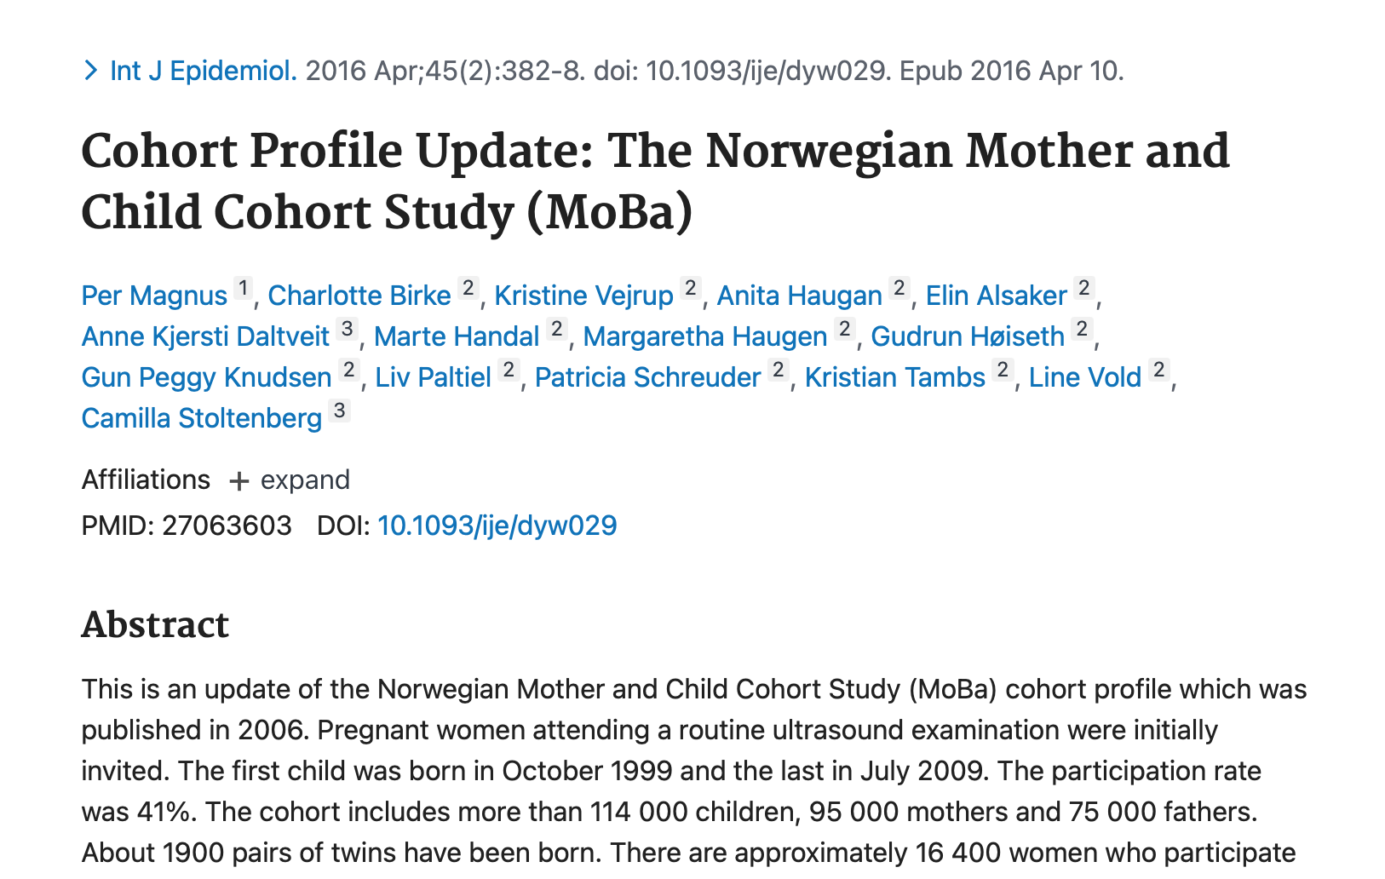

Data
MoBa study
Birth cohort in Norway
1999-2009
114000 children
95000 mothers
75000 fathers
Genotyped – 41,000 complete trios
Linked health and educational records

Slide 39
4. Results
Do the polygenic scores predict the parents’ education?
Univariate associations
Paternal education | Coef | Lower | Upper | Partial R^2 | Partial F-stat
Offspring p<5x10-08 | 0.02 | -0.02 | 0.07
Father p<5x10-08 | 0.77 | 0.73 | 0.81 | 0.37 | 1388.56
Mother p<5x10-08 | 0.52 | 0.48 | 0.56
Maternal education
Offspring p<5x10-08 | 0.01 | -0.03 | 0.05
Father p<5x10-08 | 0.36 | 0.33 | 0.4 | 0.032 | 1187.16
Mother p<5x10-08 | 0.65 | 0.61 | 0.68

Slide 40
4. Results
Do the polygenic scores predict the parents’ education?
Bivariate associations
Paternal education | Coef | Lower | Upper
Offspring p<5x10-08 | 0.02 | -0.1 | 0.06
Father p<5x10-08 | 0.66 | 0.59 | 0.73
Mother p<5x10-08 | 0.52 | 0.45 | 0.58
Maternal education
Offspring p<5x10-08 | 0.01 | -0.03 | 0.06
Father p<5x10-08 | 0.36 | 0.33 | 0.4
Mother p<5x10-08 | 0.64 | 0.61 | 0.68

Slide 41
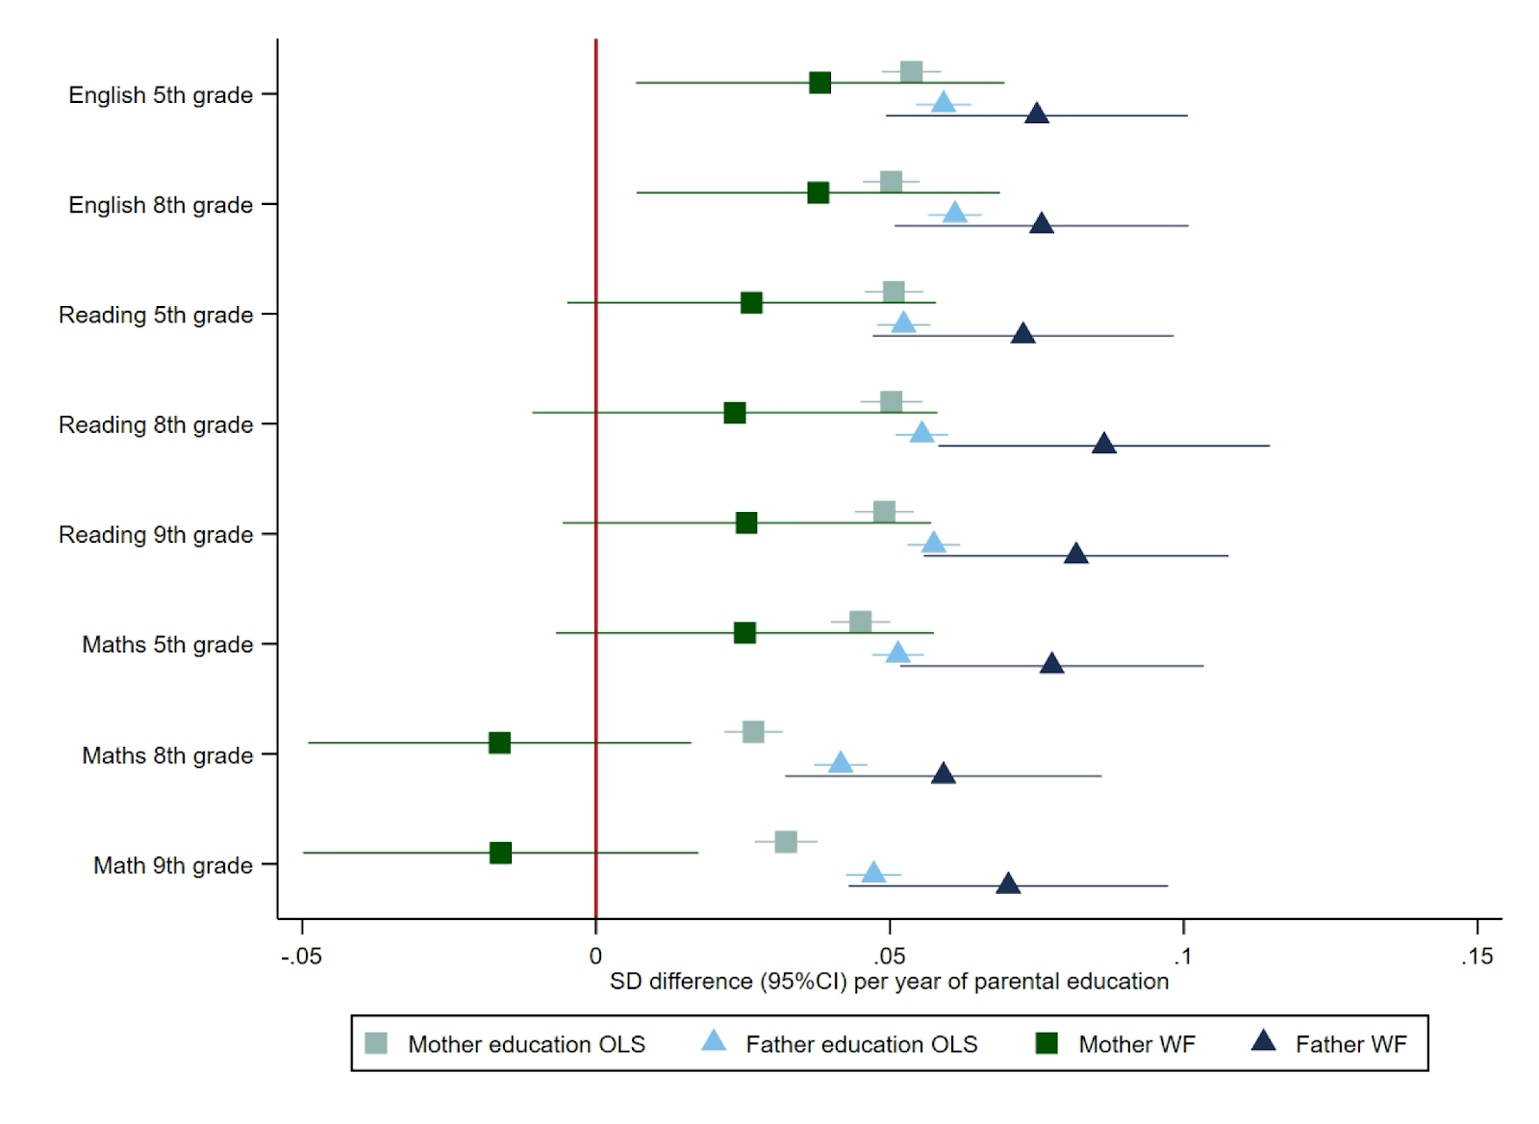
4. Results
Figure 2: Effect of parents educational attainment on offspring educational achievement from linked nationally standardized tests, estimated using multivariable adjusted regression and within family Mendelian randomization. Estimated on the full sample using multiple imputation (N=40,910).

Slide 42
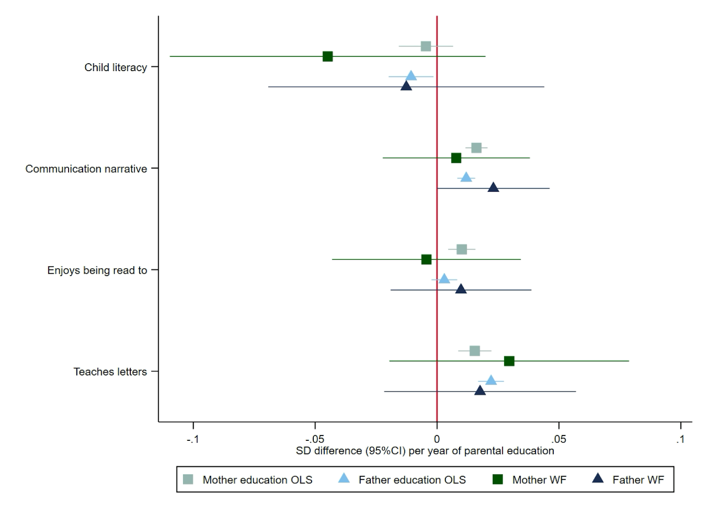
Figure 2: Effect of parents educational attainment on questionnaire measures of early educational attainment and parental nurturing at age 5 , estimated using multivariable adjusted regression and within family Mendelian randomization. Estimated on the full sample using multiple imputation (N=40,910).

Slide 43
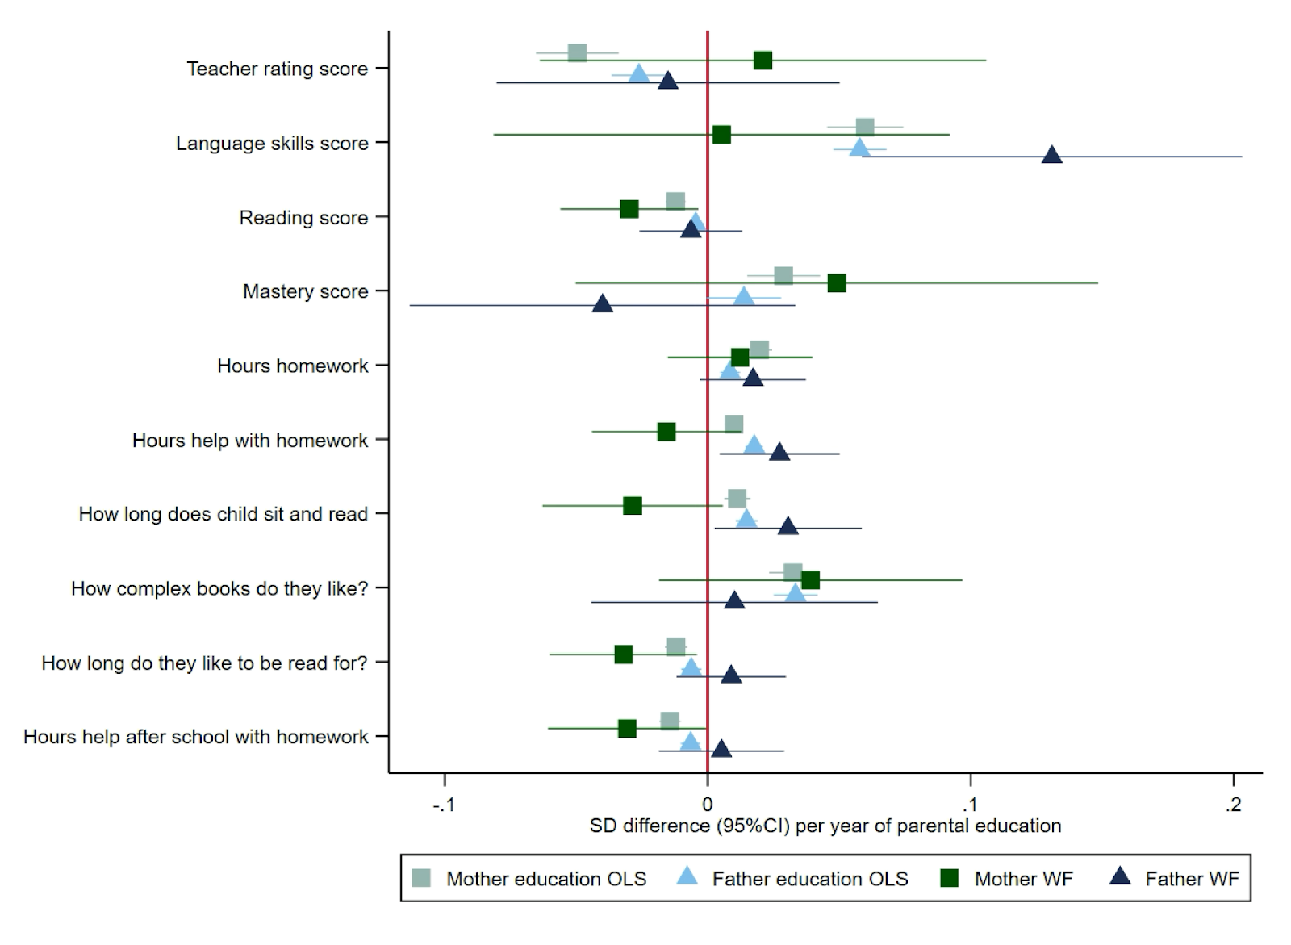
Figure 3: Effect of parents educational attainment on questionnaire measures of early educational attainment and parental nurturing at age 8, estimated using multivariable adjusted regression and within family Mendelian randomization. Estimated on the full sample using multiple imputation (N=40,910).

Slide 44
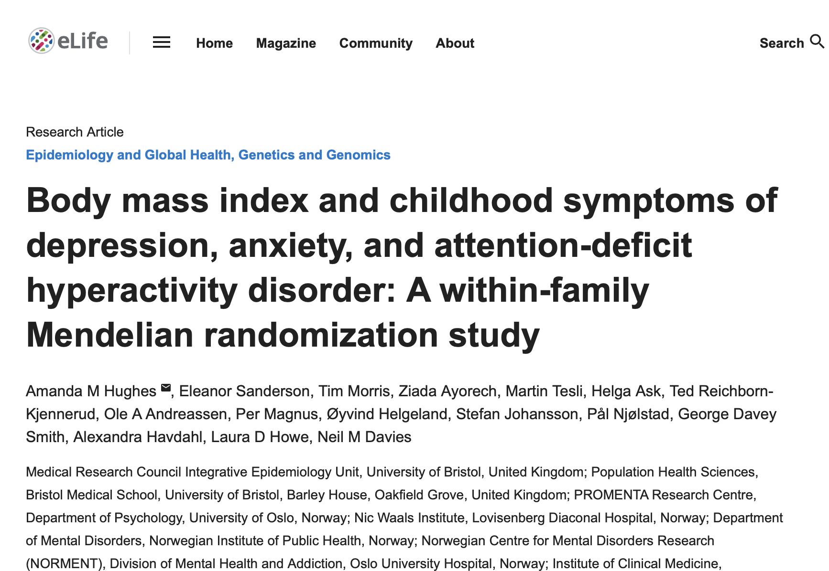

Slide 45
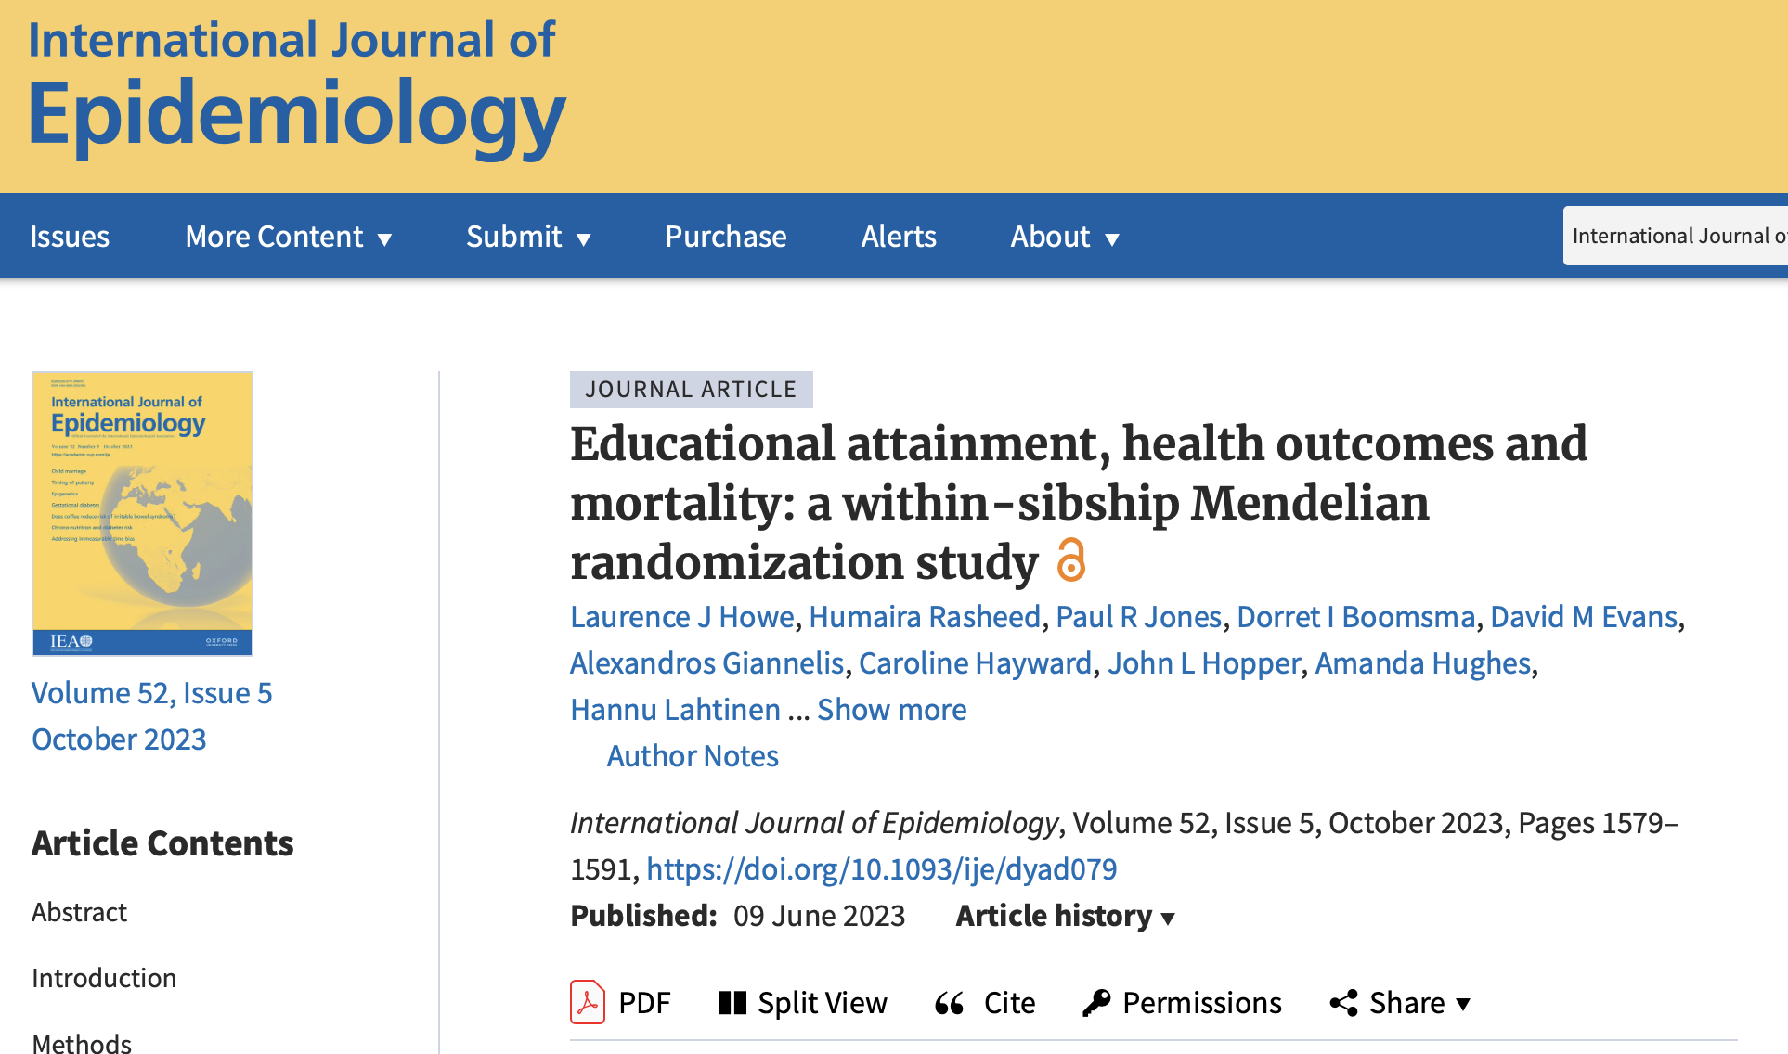

Slide 46
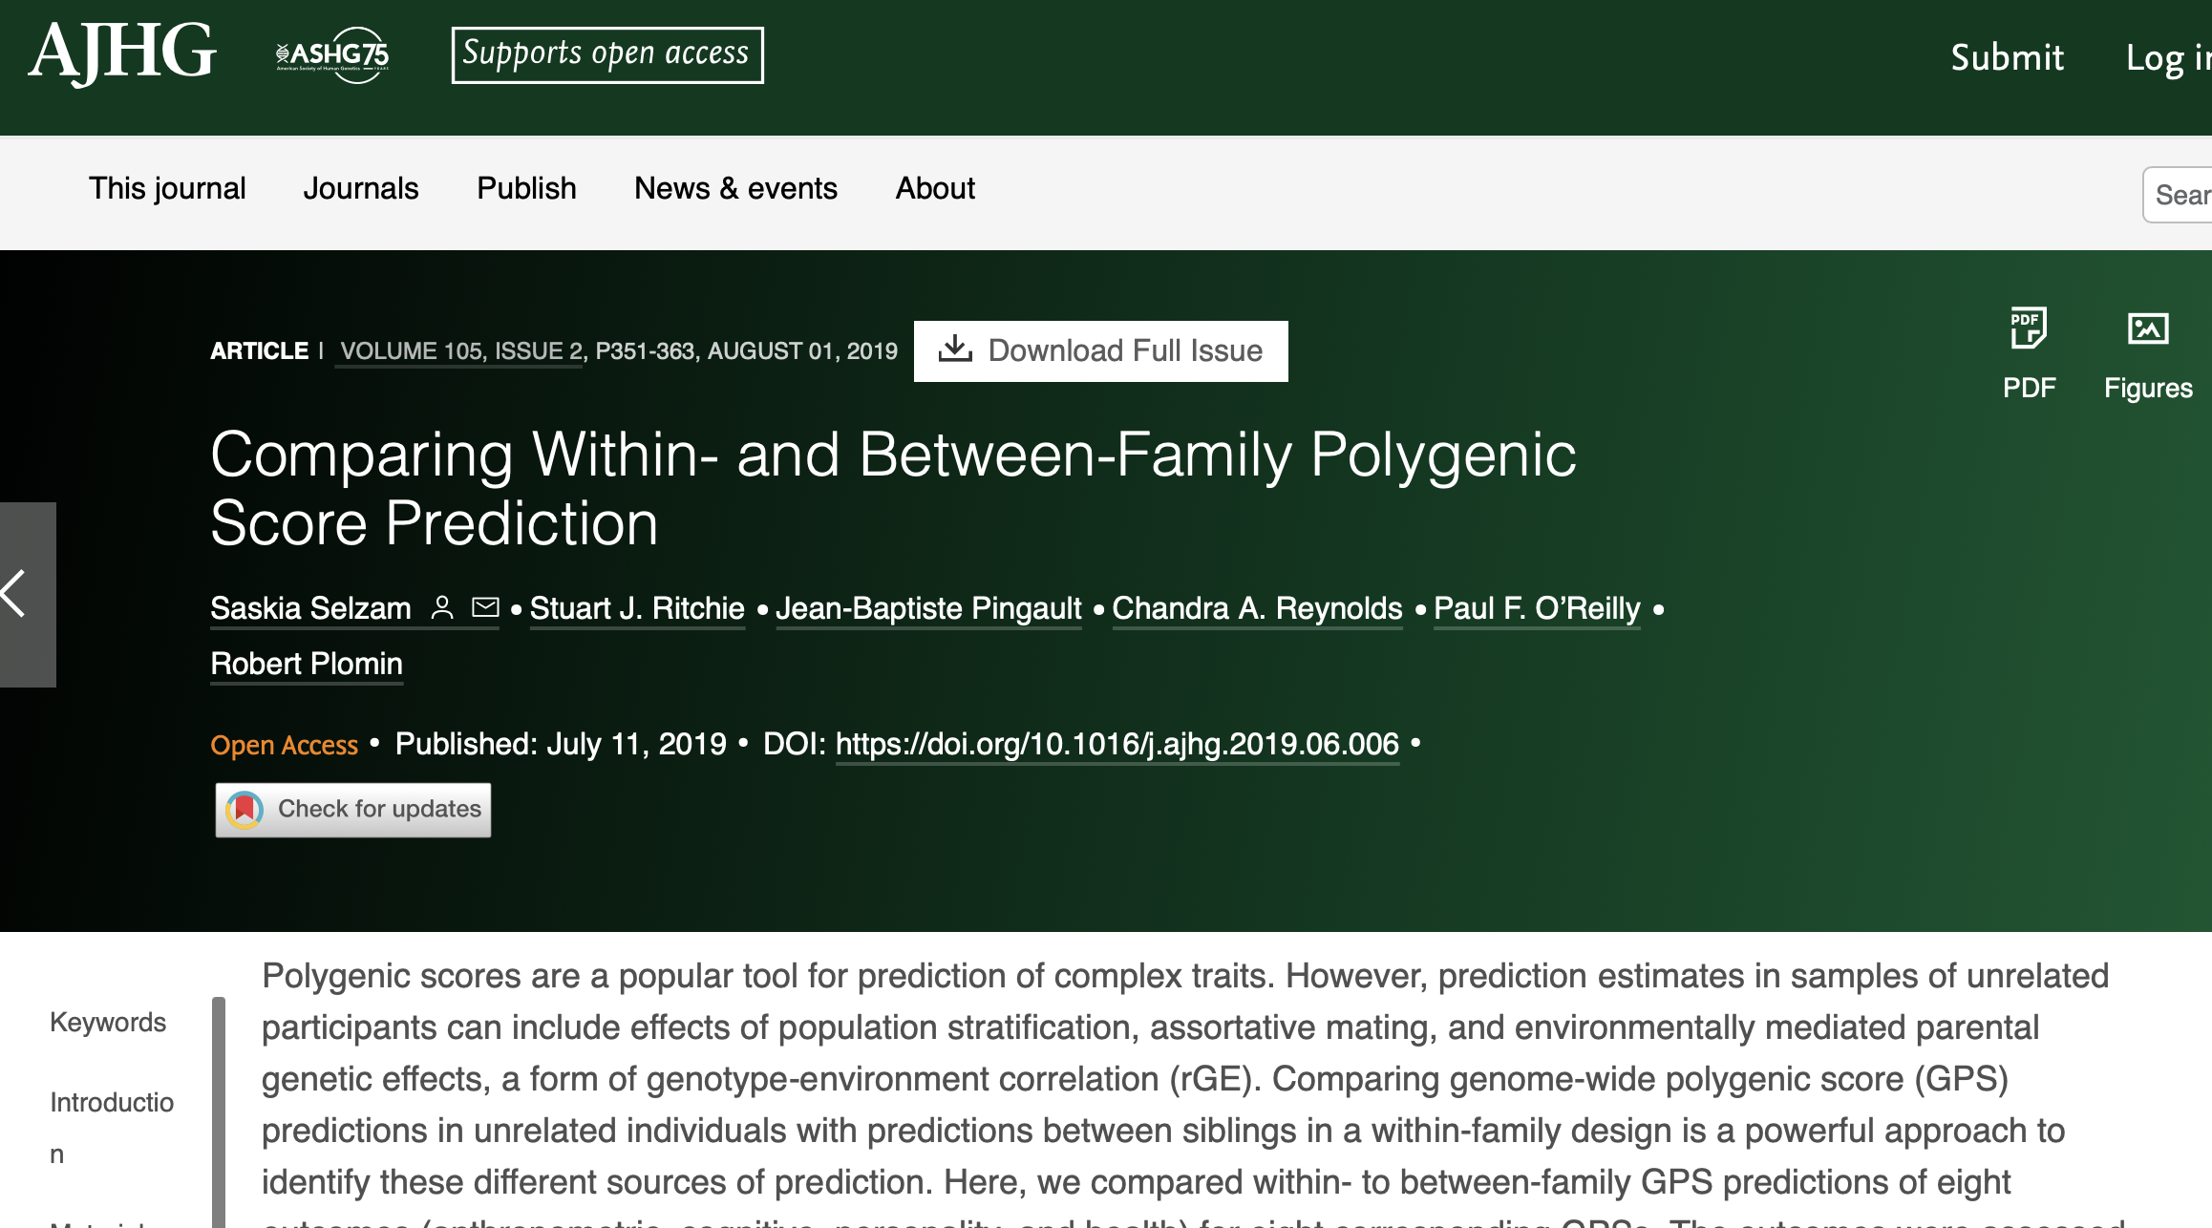

Slide 47
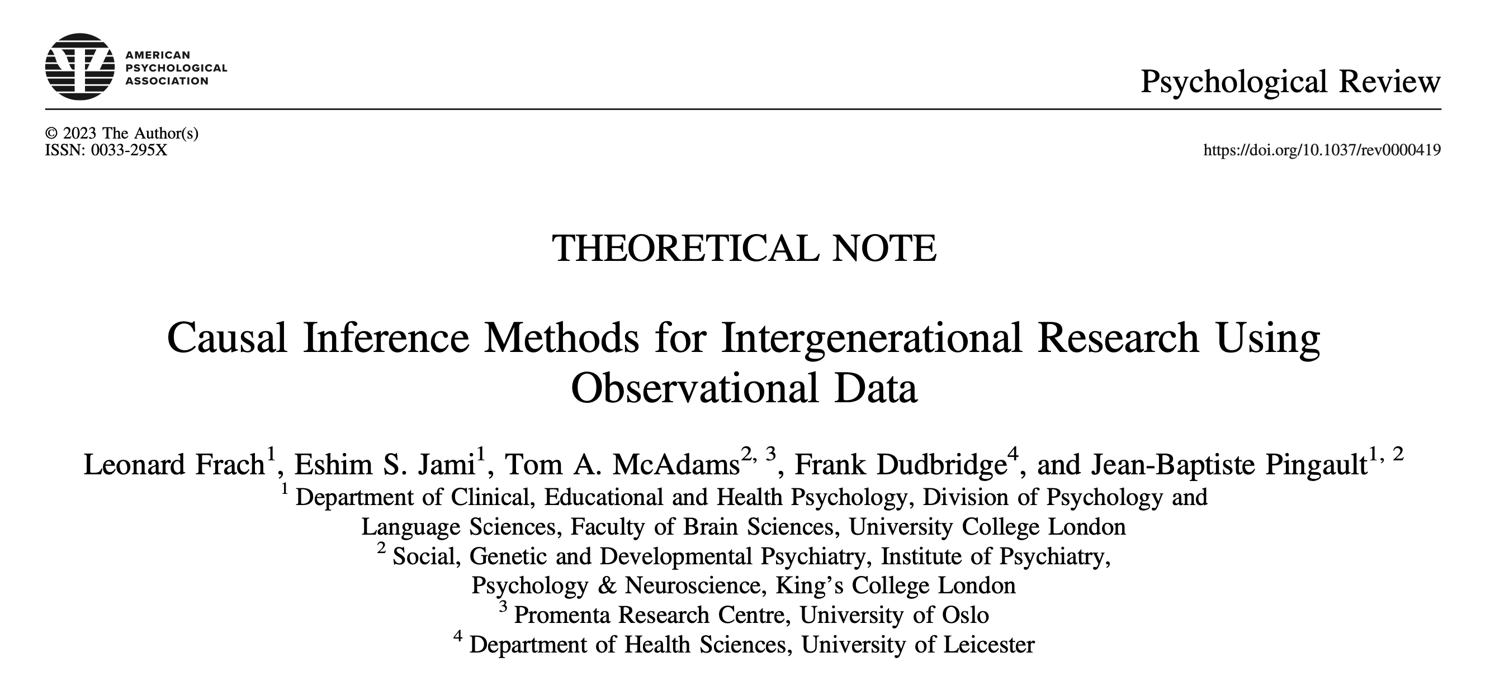

Slide 48
SNP heritability analysis
“Missing heritability”: the associated SNPs from only GWAS explain a small fraction of the heritability.
“Polygenicity”: a lot of SNPs have small and non-significant effects on the trait, add together explained a big proportion of the total phenotypic variance.
Methods
  GCTA (http://cnsgenomics.com/software/gcta/)
  LDAK (http://dougspeed.com/ldak/), we can estimate SNP heritability using individual level genotype and phenotype data.
Can we do the same using summary statistics?

Slide 49
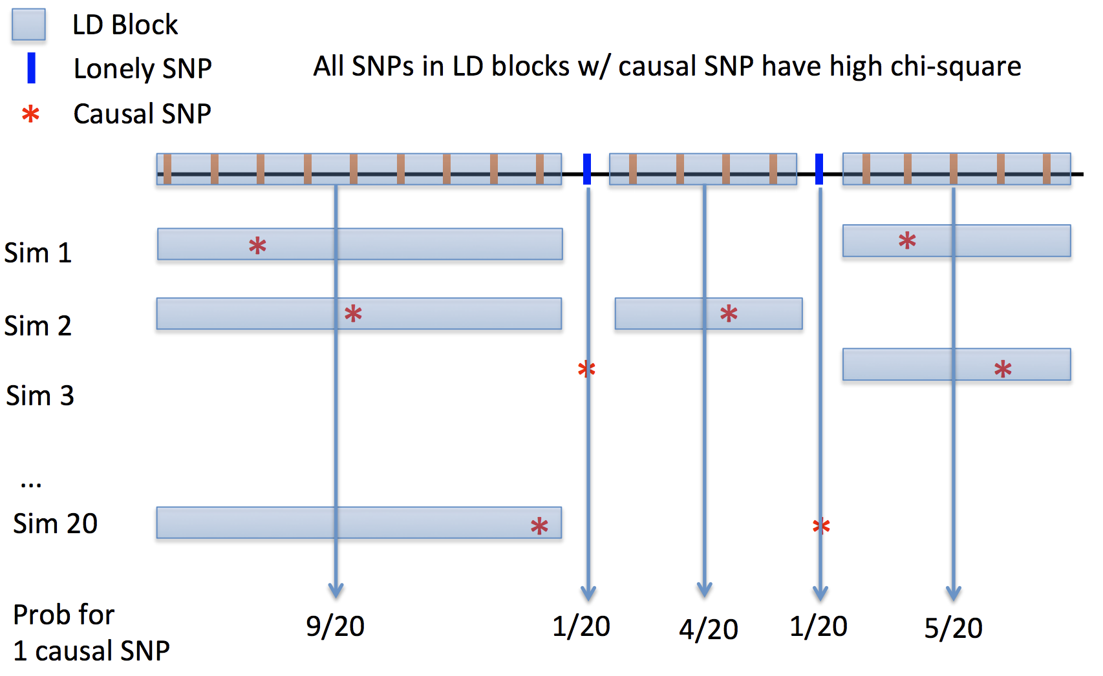
Basic idea of LD score regression
The basic idea is that the more genetic variation a marker tags, the higher the probability
that it will tag a causal variant. In contrast, linkage disequilibrium score (LD score) shouldn’t
be correlated with population stratification

Slide 50
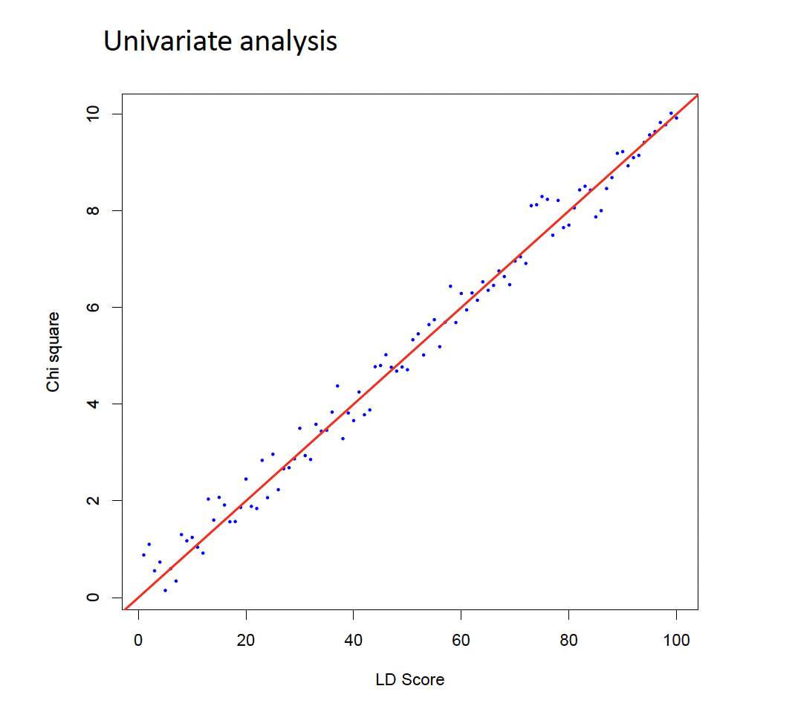
LD Score Regression

Slide 51
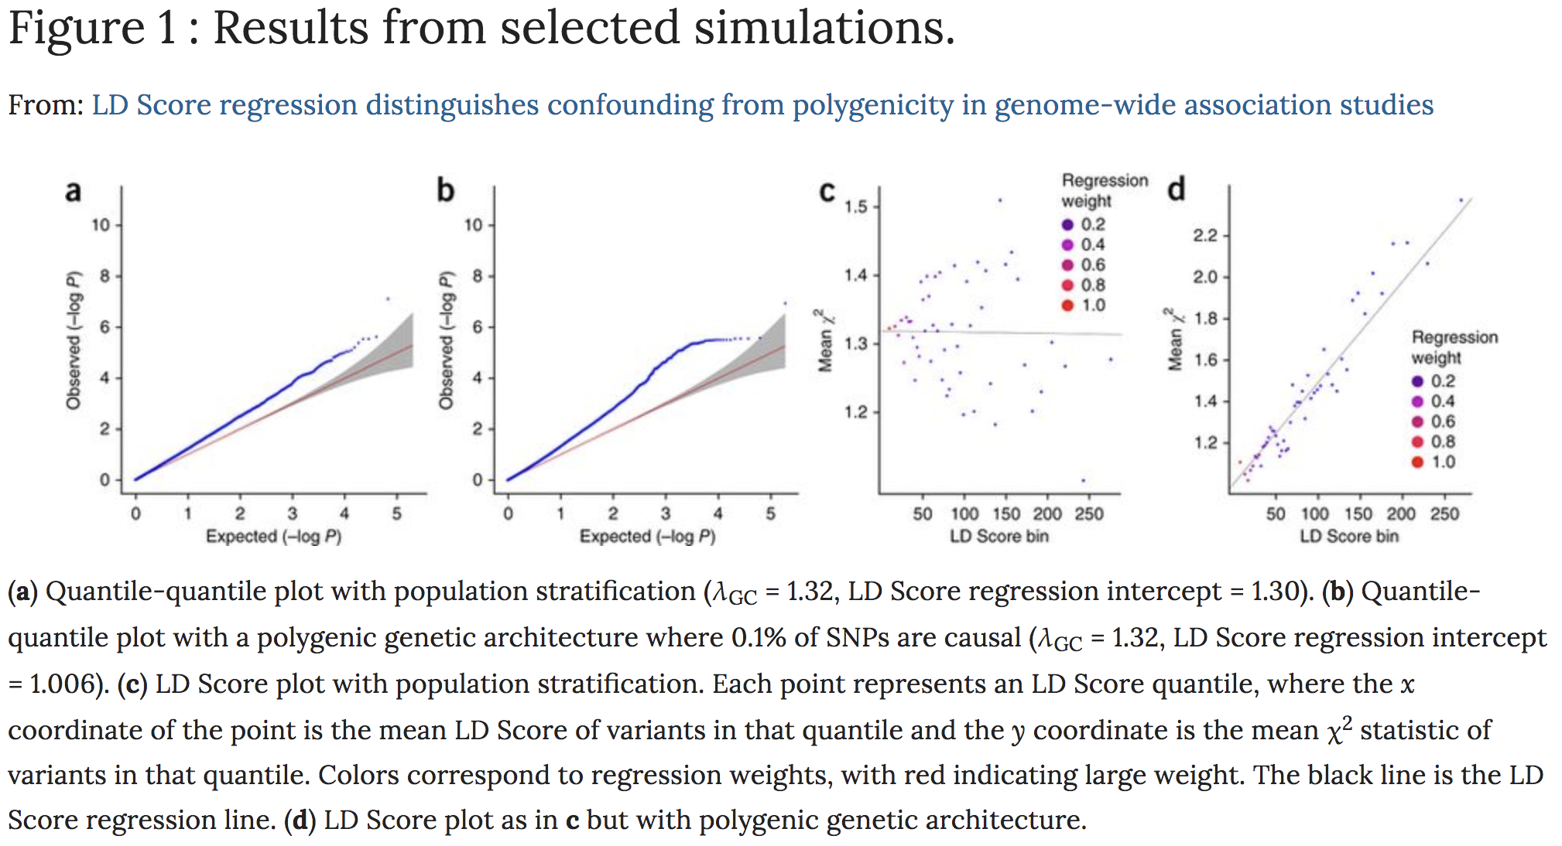
Distinguish confounding from polygenicity
Bulik-Sullivan, B., Loh, PR., Finucane, H. et al. LD Score regression distinguishes confounding from polygenicity in genome-wide association studies. Nat Genet 47, 291–295 (2015). https://doi.org/10.1038/ng.3211

Slide 52
Conclusions
Familial effects can bias SNP-phenotype associations
These effects can bias genetic approaches such as Mendelian randomization.
We demonstrated how family structure can be used to control for these effects either using samples of siblings or mother-father-offspring trios.
However, estimates from within-family Mendelian randomization are less precise than estimates using unrelated individuals.
MR

Slide 53
Conclusions
Limitations
1. Pleiotropy While allowing for family fixed effects or using difference-in-difference estimators will account for dynastic effects or assortative mating, these methods will not address bias due to violations of the second Mendelian randomization assumption (exclusion restriction/pleiotropy).
Use these estimators with the summary data methods (MR-Egger, weighted median and mode).
Any one study is likely to be underpowered to use both within family methods and pleiotropy robust methods.
2. Selection bias Family based designs do not protect against selection bias

