Slide 1
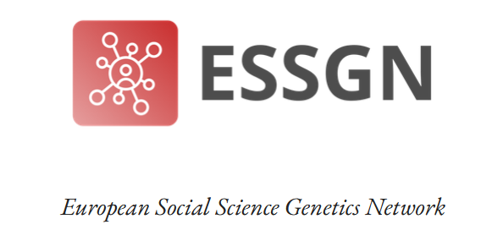
Genetic relatedness, Genetic ancestry, Assortative mating
Bootcamp and Kick-off meeting
San Servolo, Venice
Luca Pagani
Molecular Anthropologist, University of Padova
8 November 2023

Slide 2
Three sequences

Slide 3
A common ancestor – what does it tell us?
Molecular clock (mutation rate) is known,
so I can estimate the TMRCA*
*Time to the Most Recent Common Ancestor

Slide 4
Genetic Relatedness
All living beings share common ancestors
Some pairs of humans share common ancestors that lived not so long ago
But what is an ancestor?

Slide 5
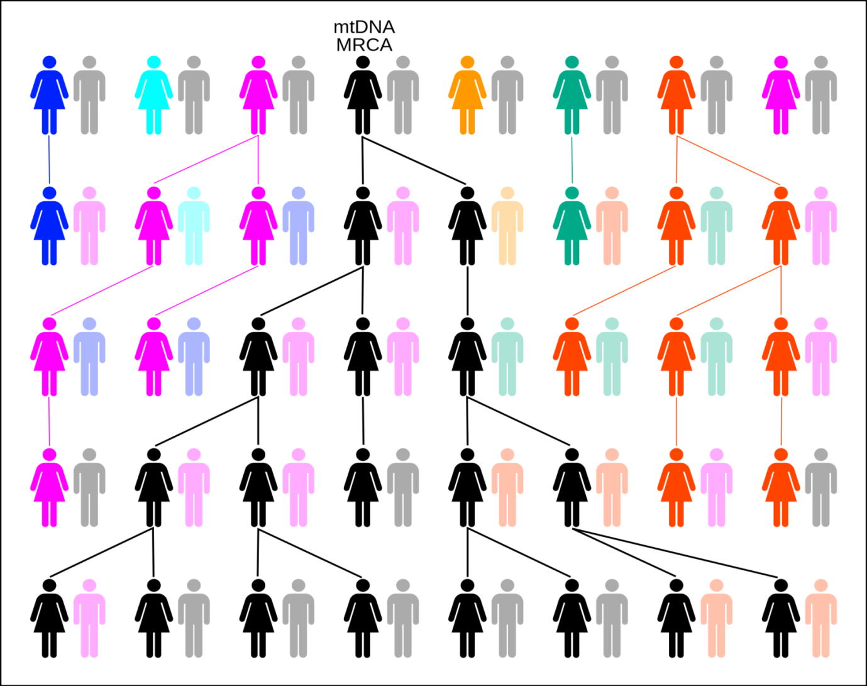
How many ancestors?
Today -> Me (1)
1 Generation ago -> My 2 parents (or 2^1)
2 Generations ago -> My 4 grandparents (or 2^2)
3 Generations ago -> My 8 Great-grandparents (or 2^3)
How many ancestors 33 generations (or ~1000 years) ago?

Slide 6
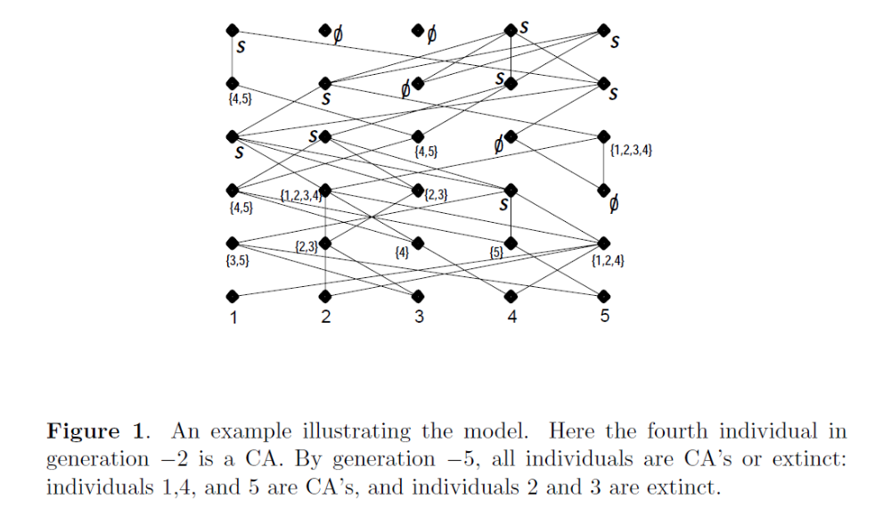
Diploid mating, a realistic scenario!

Slide 7
Go big, or go extinct…
Padova
CA: first person to be common ancestor; IA: all living people are either CA or extinct

Slide 8
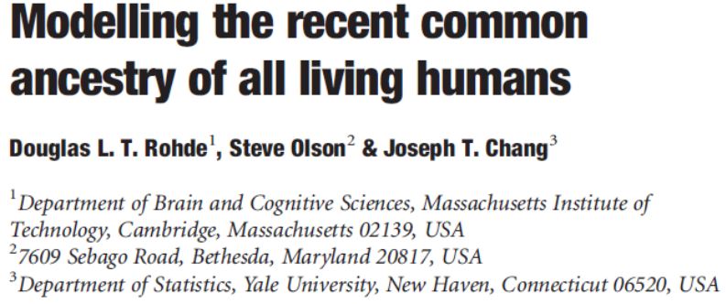
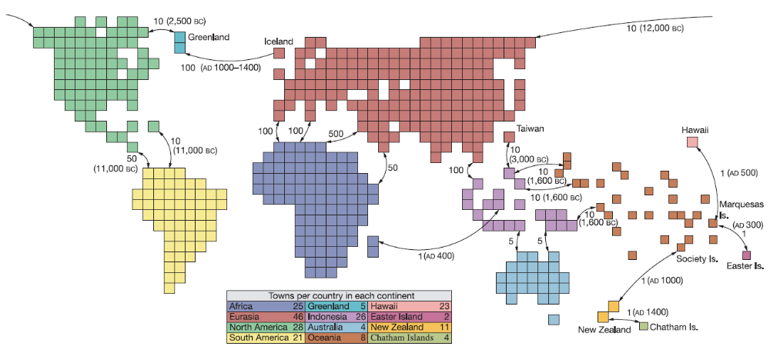
Let’s be realistic

Slide 9
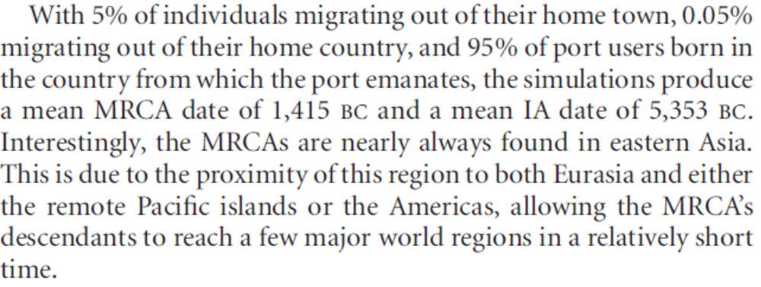
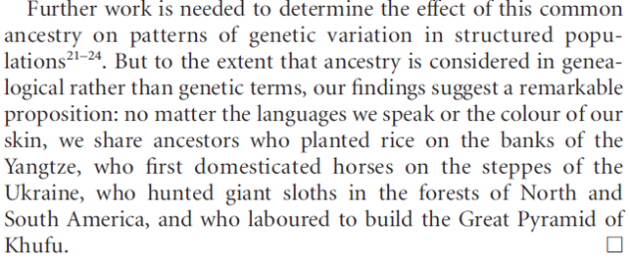
Let’s be realistic

Slide 10
But of course not everybody draws from the same IA at the same rate!
IA1 IA2 IA3 IA4
Mr. X Ms. Y Ms. Z

Slide 11
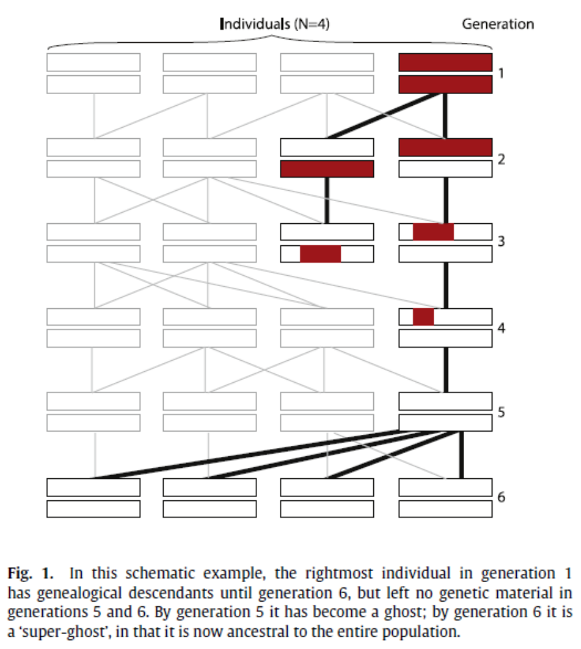
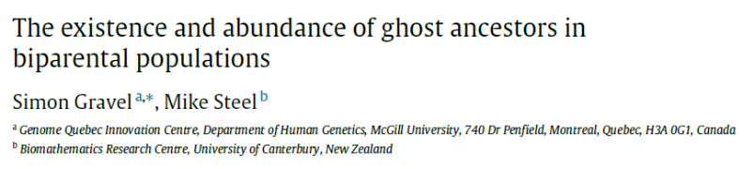
In addition, certain ancestors may be ghosts

Slide 12
Implications (my view..)
Locus 1
Locus 2
Genetic MRCA
1sg 2 3 4sg 5 3rd gen IA
1 2sg 3 4sg 5
Genetic MRCA
1 2 3sg 4sg 5 2nd gen IA
1sg 2 3 4 5sg
1 2 3supeghost 4 5 1st gen IA
1 2 3 4 5sg
… … … … …
… … … … …
… … … … …
… … … … …
Mr. X Ms. Y Ms. Z
Mr. X Ms. Y Ms. Z

Slide 13
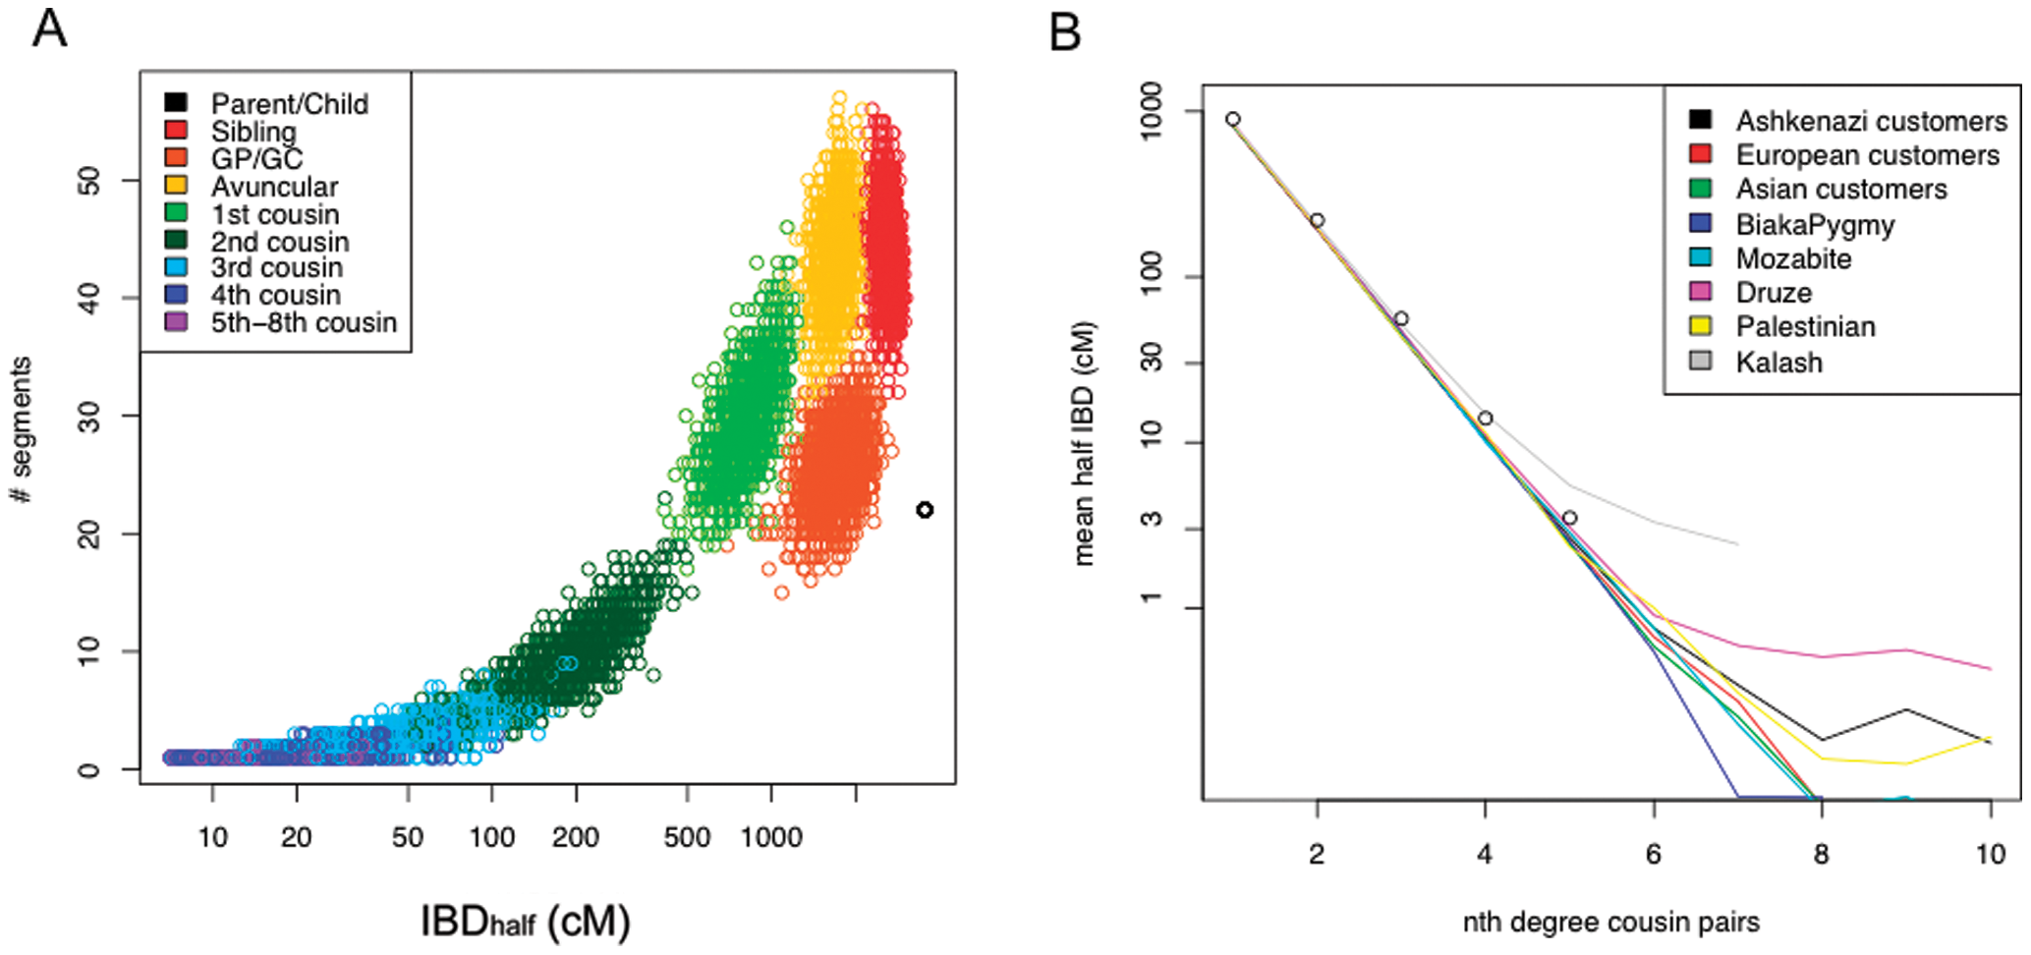
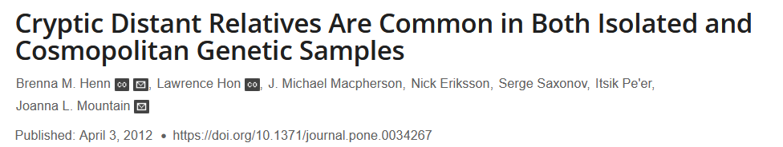
What do we hope to see from real data?

Slide 14
SNP1
SNP1
SNP2
A B
n=3 haplotypes
A
n=2 haplotypes
A b
a
a B

Slide 15
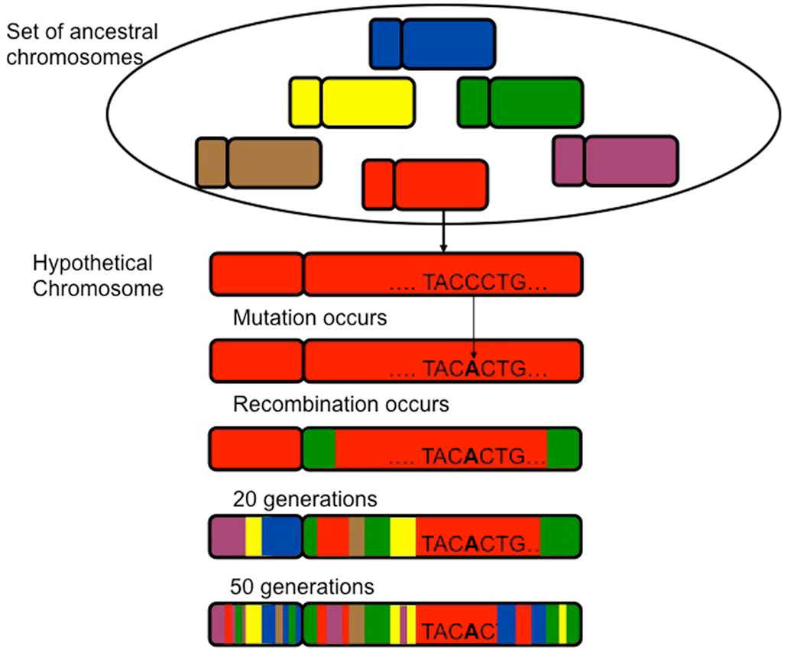
Recombination destroys Linkage Disequilibrium
www.frontiersin.org

Slide 16
SNP1
SNP1
SNP2
A B
n=3 haplotypes
A
Recombination
n=2 haplotypes
A b
a
a B
SNP1
SNP2
A B
A b
n=4 haplotypes
a B
a b

Slide 17
Neutrality Founder’s Effect Inbreeding
Demography sometimes masks out recombination
Generations
Generations
Generations

Slide 18
Neutrality Founder’s Effect Inbreeding
Demography sometimes masks out recombination
Generations
Generations
Generations

Slide 19
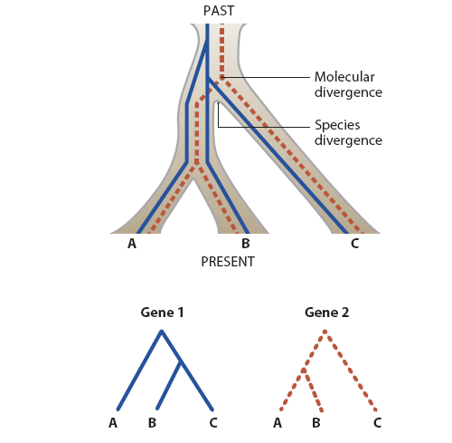
In addition, and at all levels, Incomplete Lineage Sorting may create spurious affinities (which are however not immune to recombination)
Complete Lineage Sorting – if all gene trees = species/pop trees
Incomplete Lineage Sorting (ILS) – if some gene trees support alternative topologies
ILS

Slide 20
Genetic Ancestry
How related are unrelated people?
Can we see any pattern that can help us seclude a continuum into small boxes that our simple human minds can handle?

Slide 21
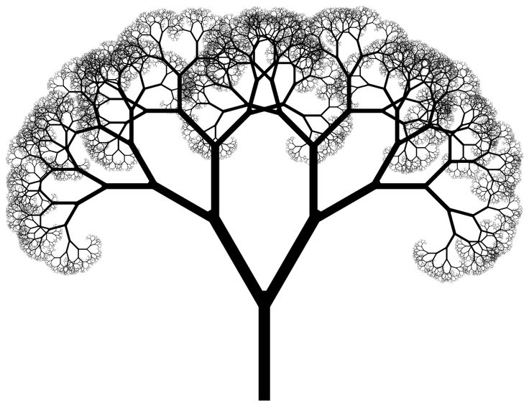
Effect of mutations on sequences divergence
Number of mutations
A G
Frequency within a population
A G
Most recent common ancestor (MRCA)

Slide 22
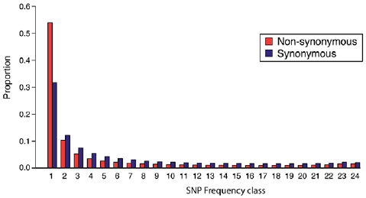
Effect of mutations on sequences divergence
Number of mutations
Frequency within a population

Slide 23
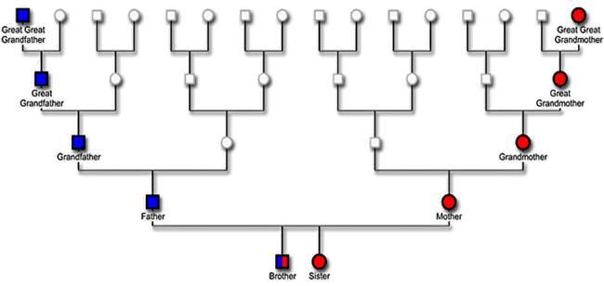


We can use these mutations to trace the inheritance of a given lineage (ChrY and mtDNA)
Chr Y
mtDNA

Slide 24
We can use these mutations to trace the inheritance of a given genomic region (Nuclear Genome)
Genomic DNA: a mix of our ancestors

Slide 25
Or we can infer the movement through space/time using coalescent theory
Present ← Past
Africa
Eurasia

Slide 26
Or we can infer the movement through space/time using coalescent theory
Present ← Past
Africa
Eurasia

Slide 27
Or we can infer the movement through space/time using coalescent theory
Present ← Past
Most recent common ancestor (MRCA)
Africa
Eurasia

Slide 28
Or we can infer the movement through space/time using coalescent theory
Present ← Past
Africa
Eurasia

Slide 29
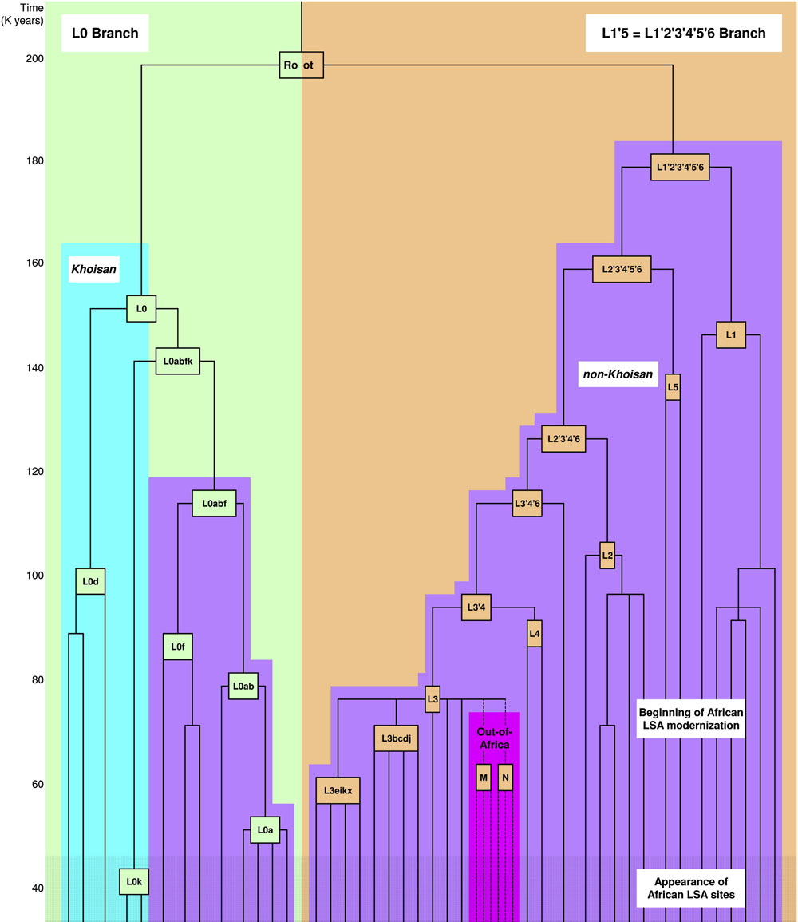
A mitochondrial perspective
Root
Khoisan
Non-Africans
Behar et al. 2008
Notes:
Il viola è non khoisan, il rosso sono gli aplogruppi presenti nelle prime popolazioni che hanno fatto l’out of africa
La maggiore variabilità dell’aplogruppo è in africa

Slide 30
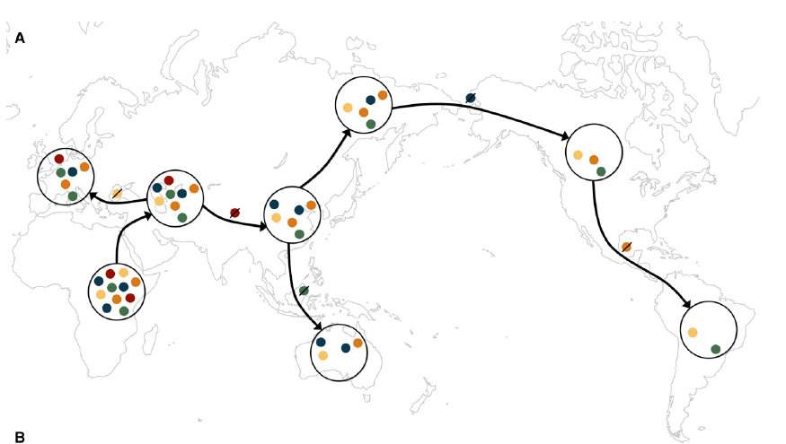
Our last <100.000 years…

Slide 31

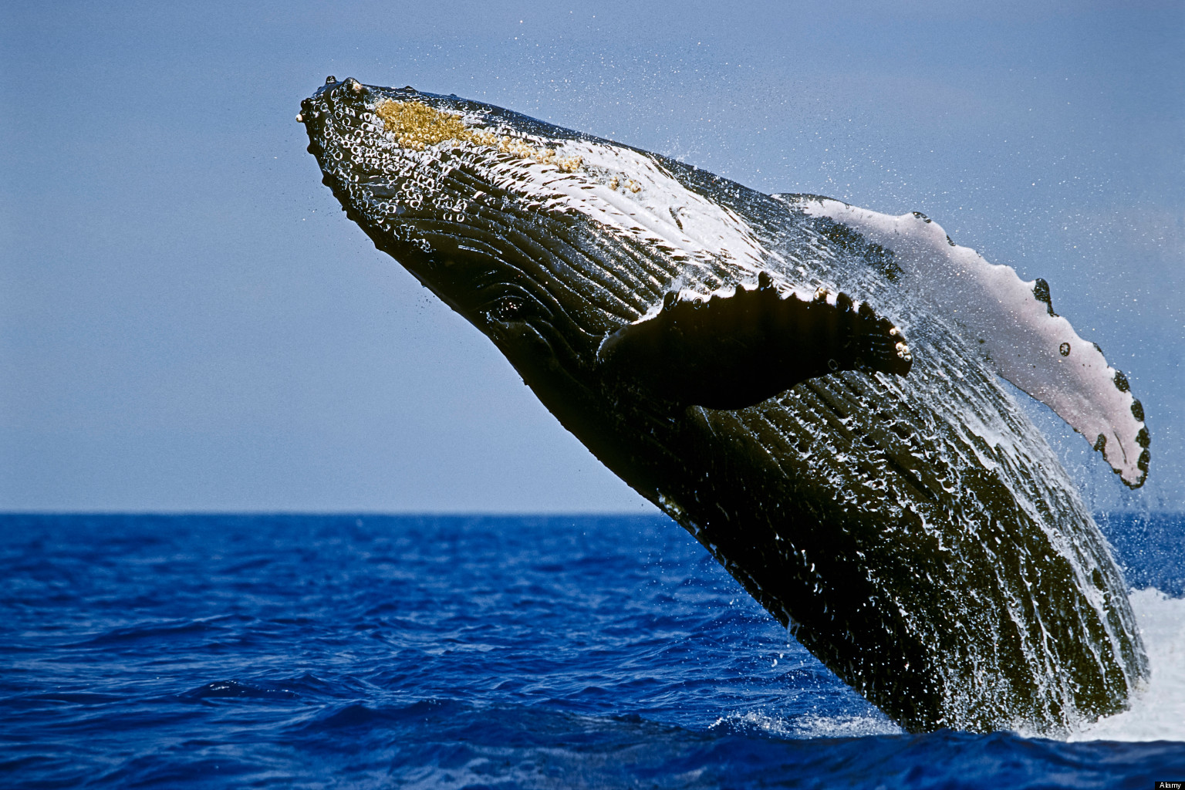
The Wahlund Effect
1

Slide 32
The Wahlund Effect
1
2

Slide 33
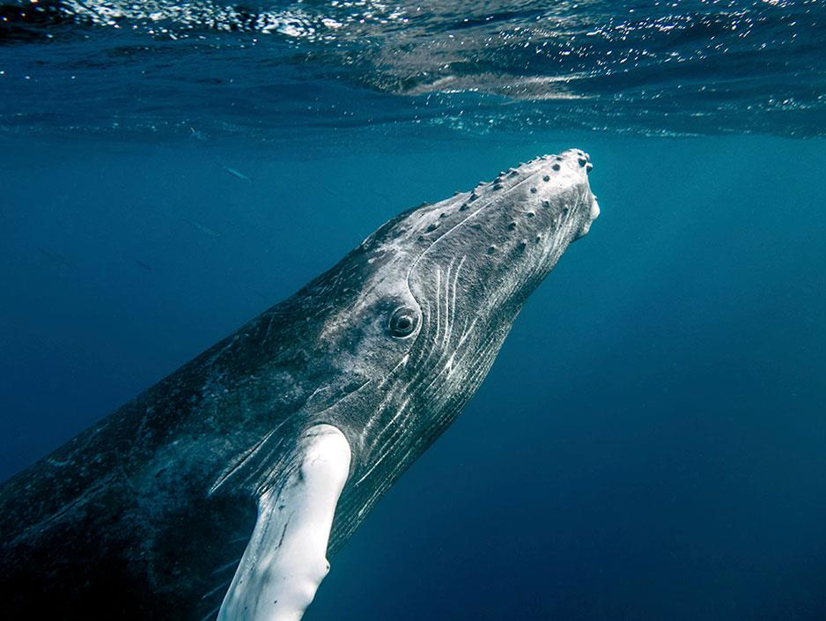
The Wahlund Effect
1
2
M

Slide 34
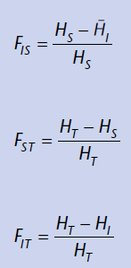
The Wahlund Effect
1
2
M

Slide 36
Fst
Population | p | q | Expected Hs 2pq
England | 0.35 | 0.65 | 0.455
Italy | 0.4 | 0.6 | 0.48
Total | 0.38 | 0.62 | 0.4712
Average
Hs=0.4675
=H_{T}
F_{ST} = (H_{T}-H_{S})/H_{T}=0.007852
0.8% of variation among the populations
99.2% of variation within the populations

Slide 37
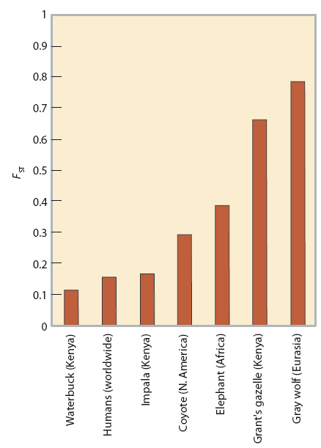



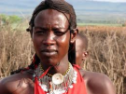

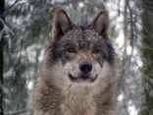

Human F within a broader context
F_{ST}=0.4

Slide 38
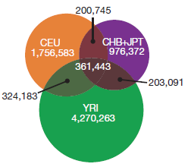
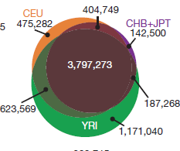
Common variants tend to be shared among populations
EUROPE
E. ASIA
EUROPE
E. ASIA
W.AFRICA
W.AFRICA
Known common variants
New rare variants
1000 Genome Consortium, 2012

Slide 39
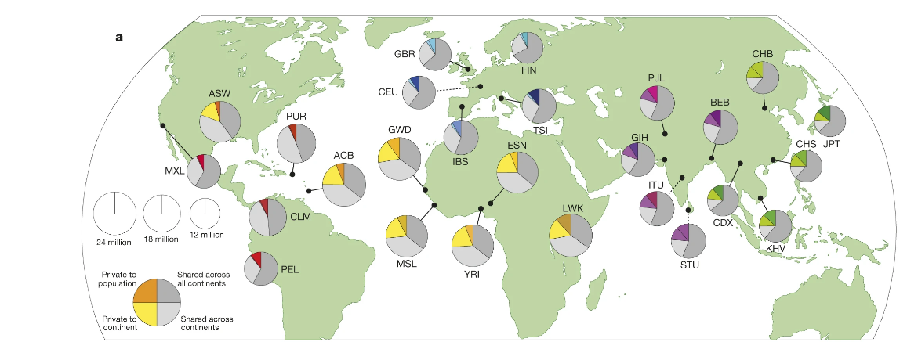
Humankind: a bunch of clones

Slide 40
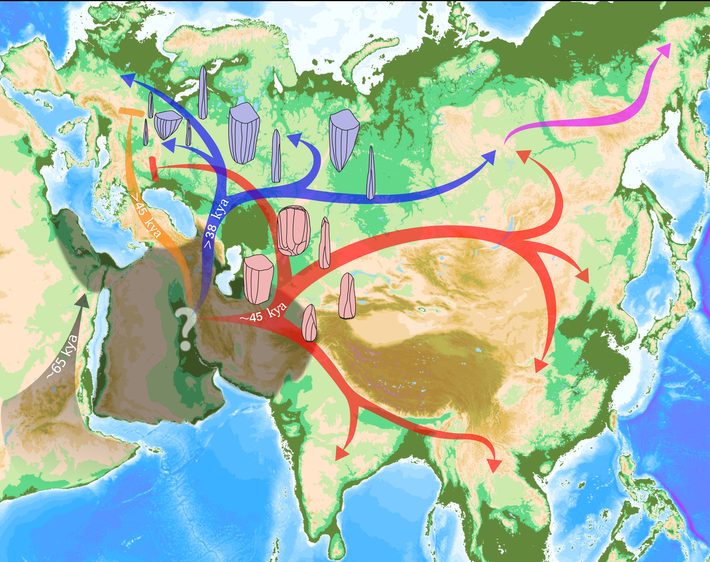
Yet some thousand years of independent genetic drift have happened
Vallini et al. 2022

Slide 41
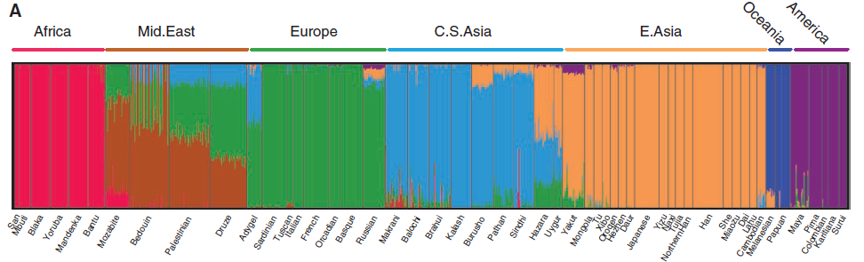
And can be inferred at a genome-wide level
Li et al. 2008

Slide 42
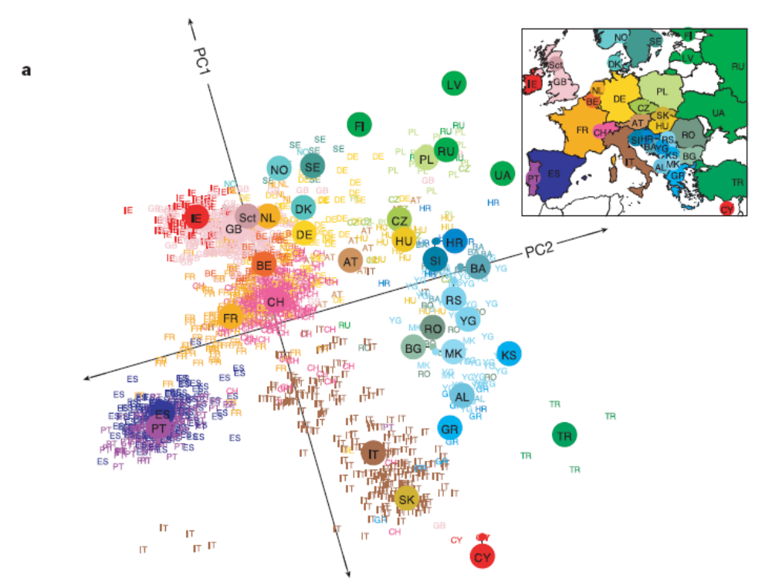
And at an astonishingly fine geographic level
Principal component genetic ancestry map of Europe (3000 individuals) based on half a million SNP markers (Novembre et al. 2008). Birthplace of individuals can be predicted with the accuracy of a few hundred kilometers. PC1 and PC2 together account for 0.45% of genetic variation in Europe.

Slide 43
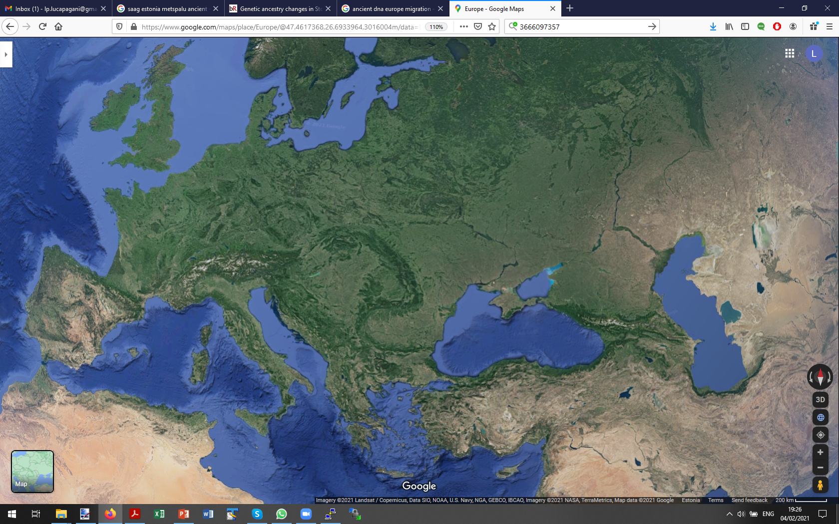
Pre-Neolithic
Before…

Slide 44
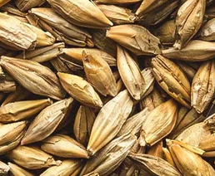
Neolithic
<10,000 ya

Slide 45
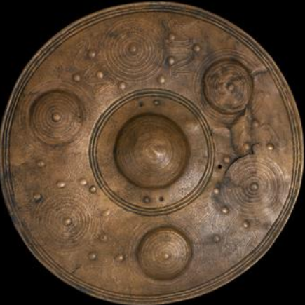
Bronze Age
<5000 ya

Slide 46
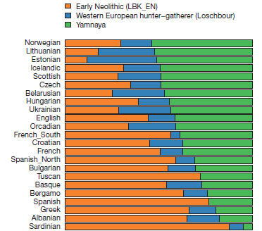
Europe, today…
Today

Slide 47
We can leverage this, and excavate
Ancestry-specific stories (or Polygenic Scores)

Slide 48
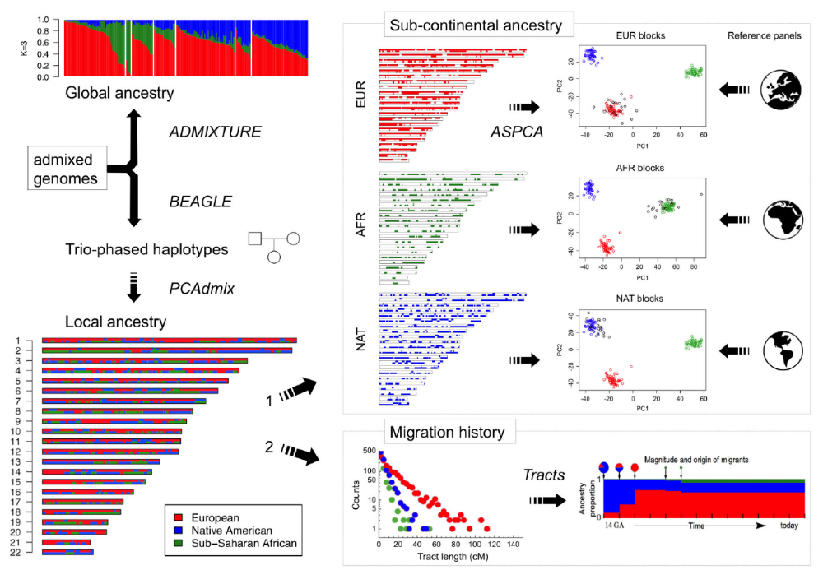
Dissecting Admixed Caribbeans with LA
Moreno-Estrada et al. 2013

Slide 49

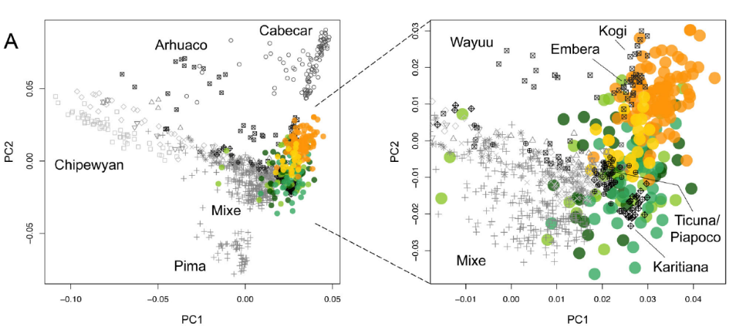
Disecting Admixed Caribbeans with LA
Moreno-Estrada et al. 2013

Slide 50
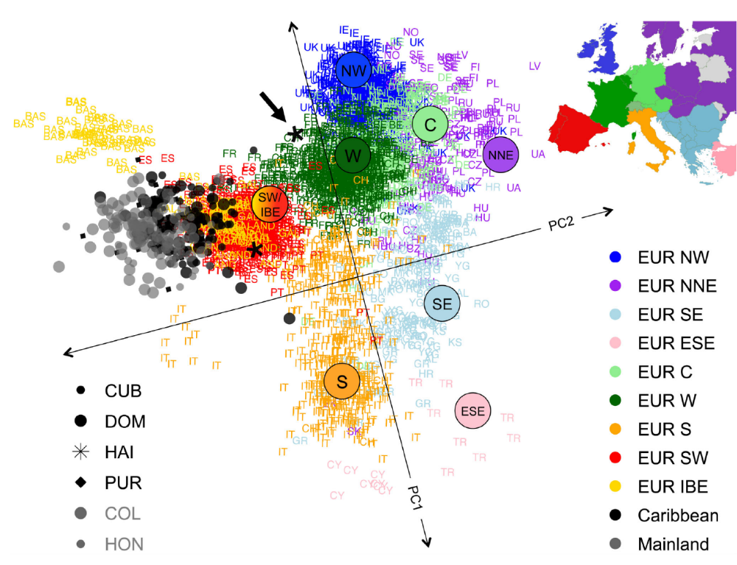
Disecting Admixed Caribbeans with LA
Moreno-Estrada et al. 2013

Slide 51
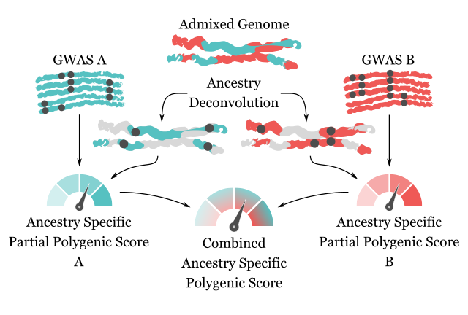

Ancestry Specific Polygenic Scores
Marnetto et al. 2020

Slide 52
Public understanding of Ancestry

Slide 53
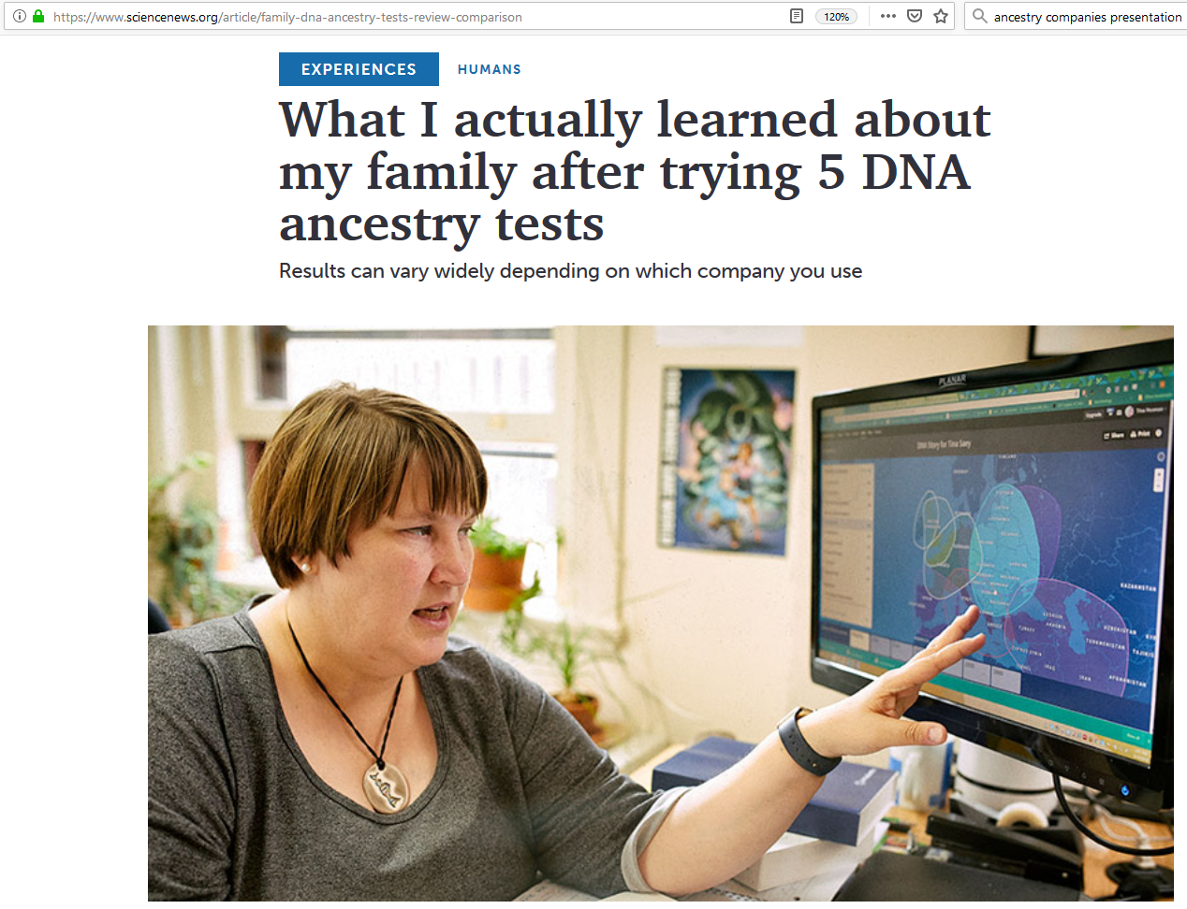
A bit of a jungle?

Slide 54
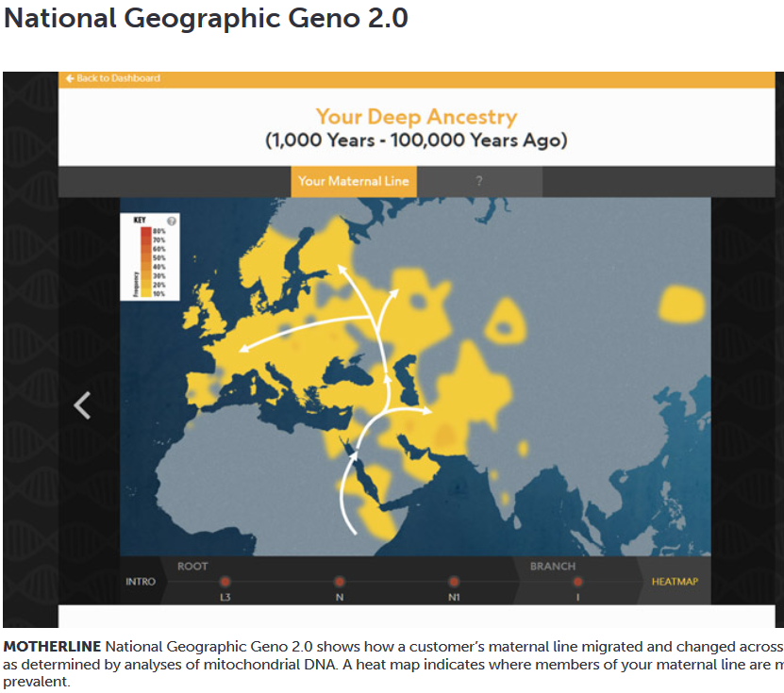
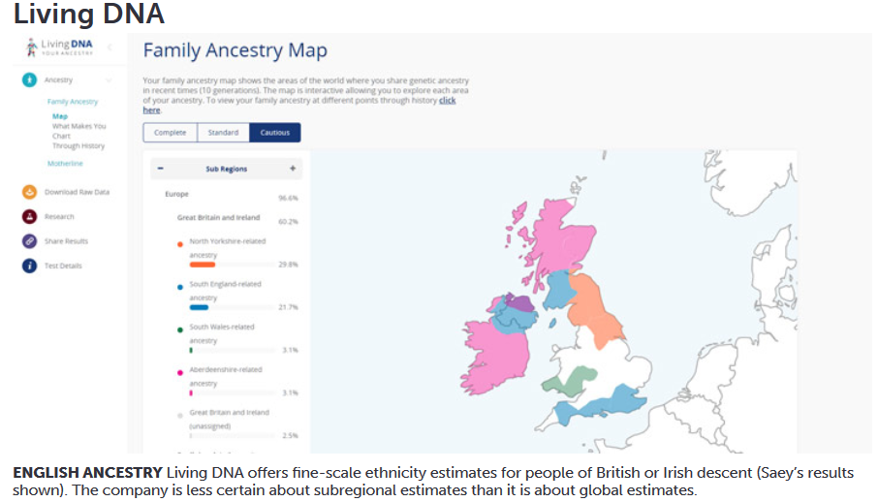
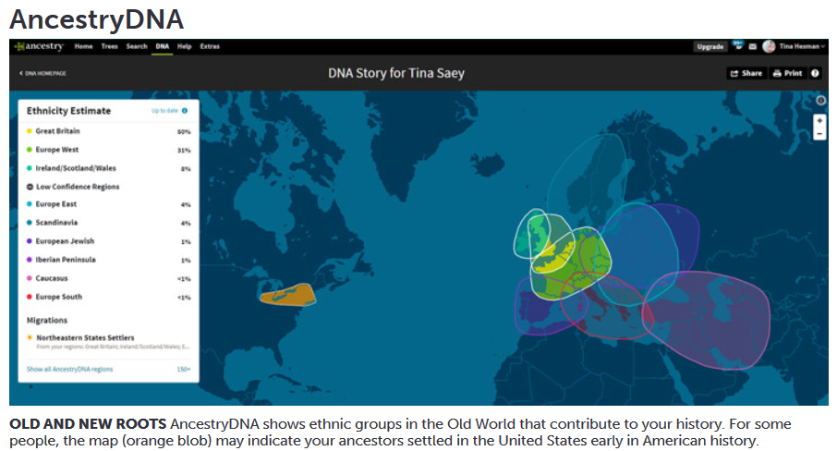
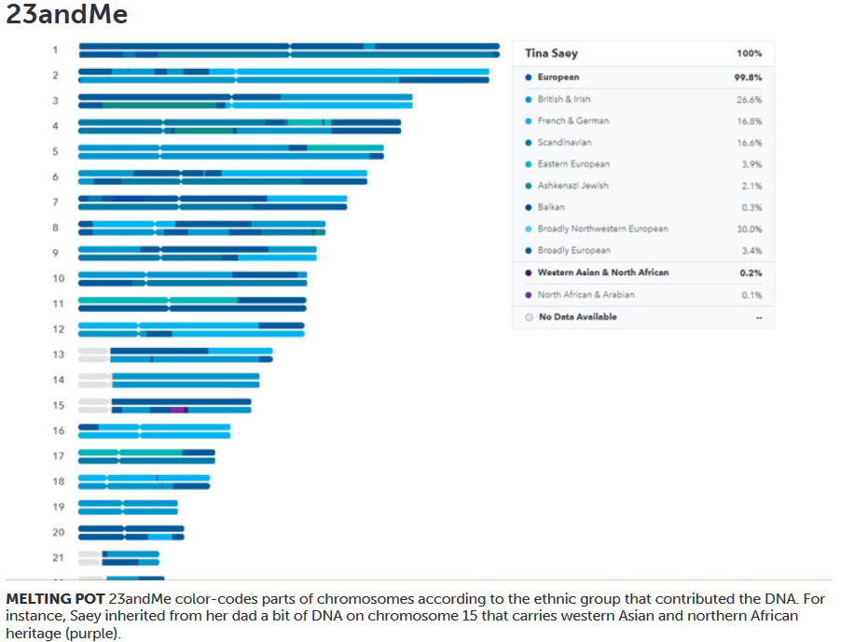
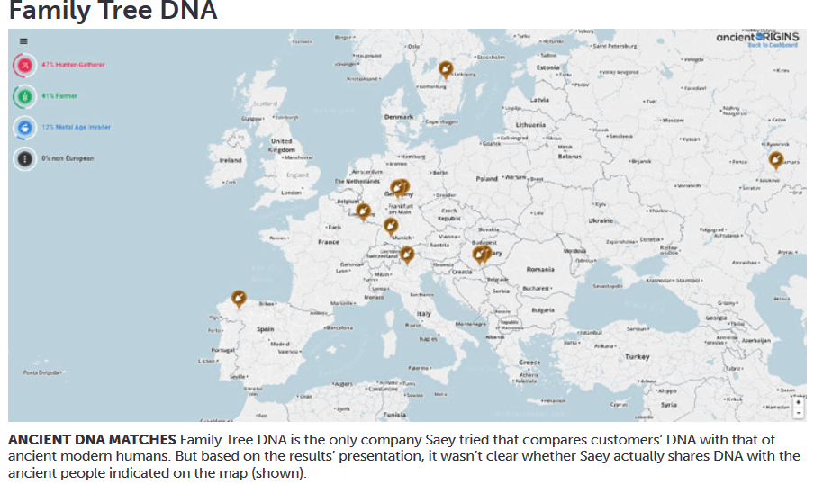

Slide 55
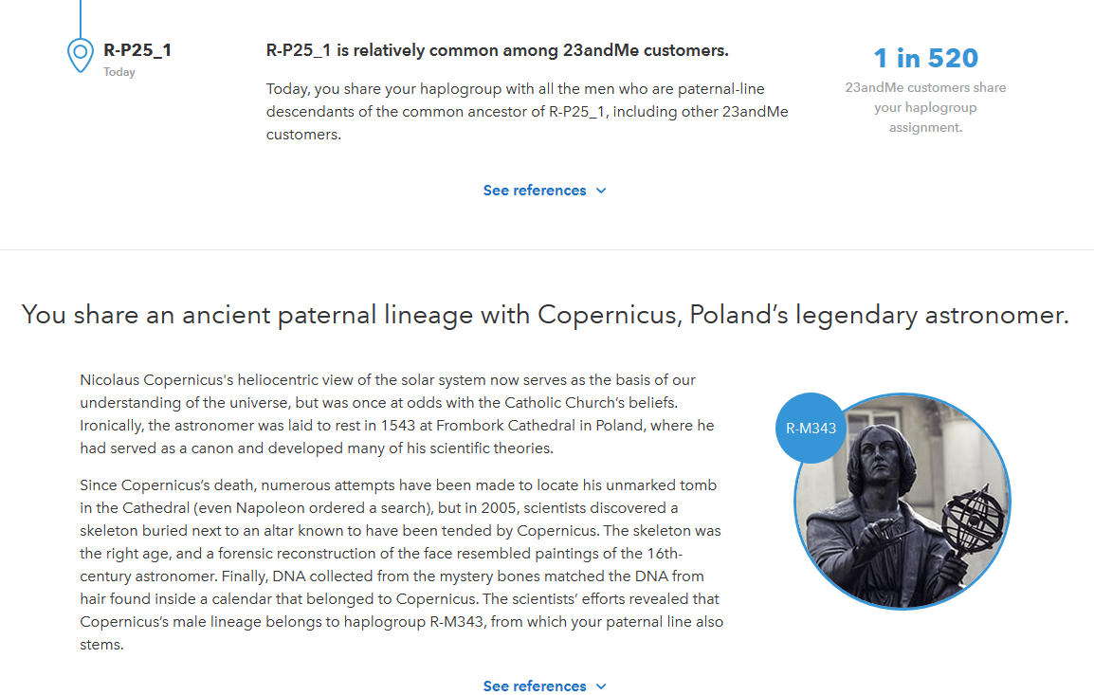
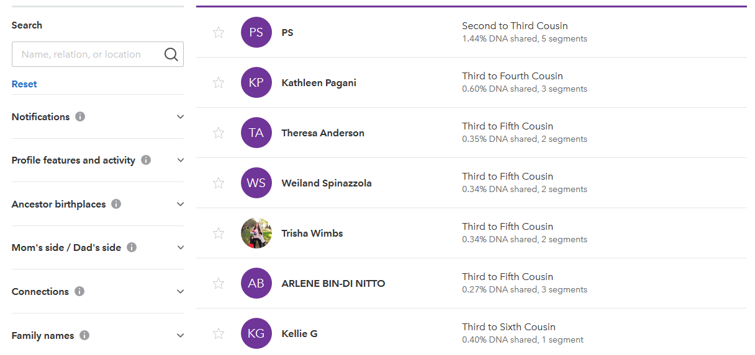
Pop ancestry

Slide 56
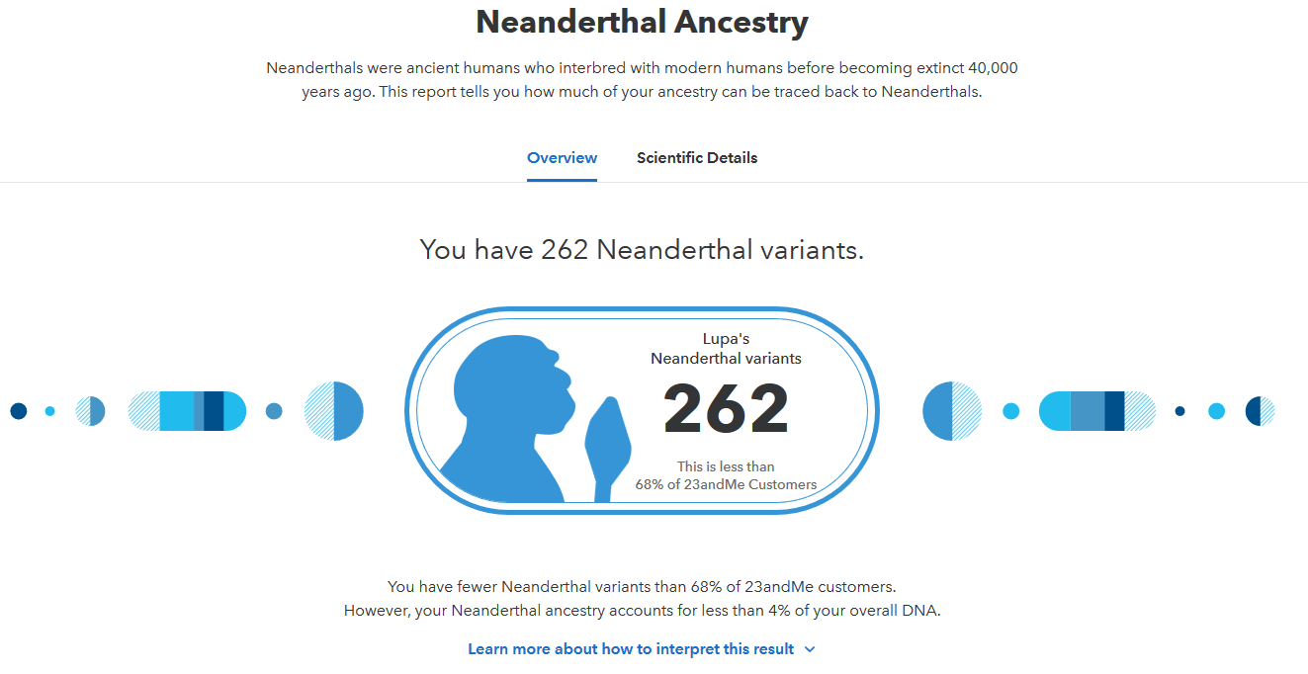
Pop ancestry

Slide 57
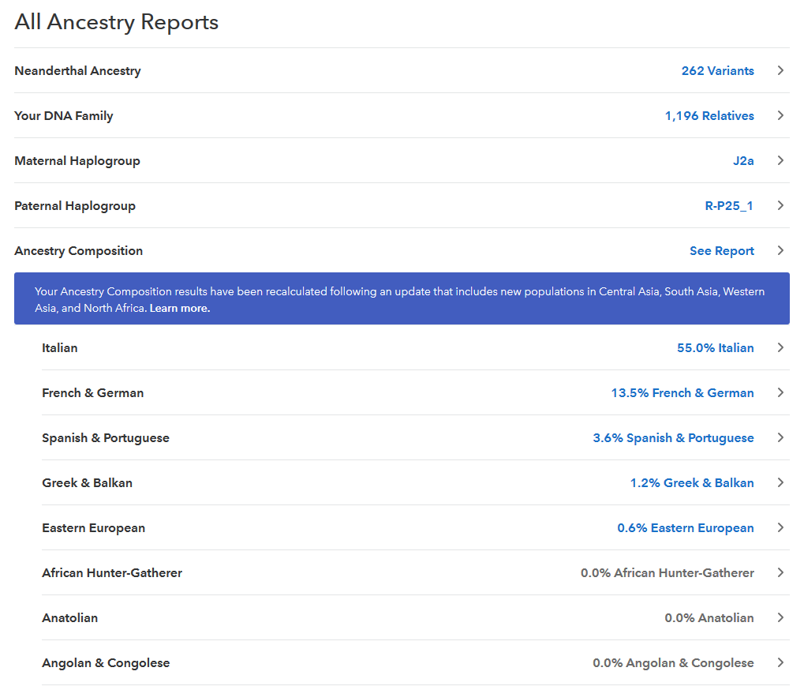

Slide 58
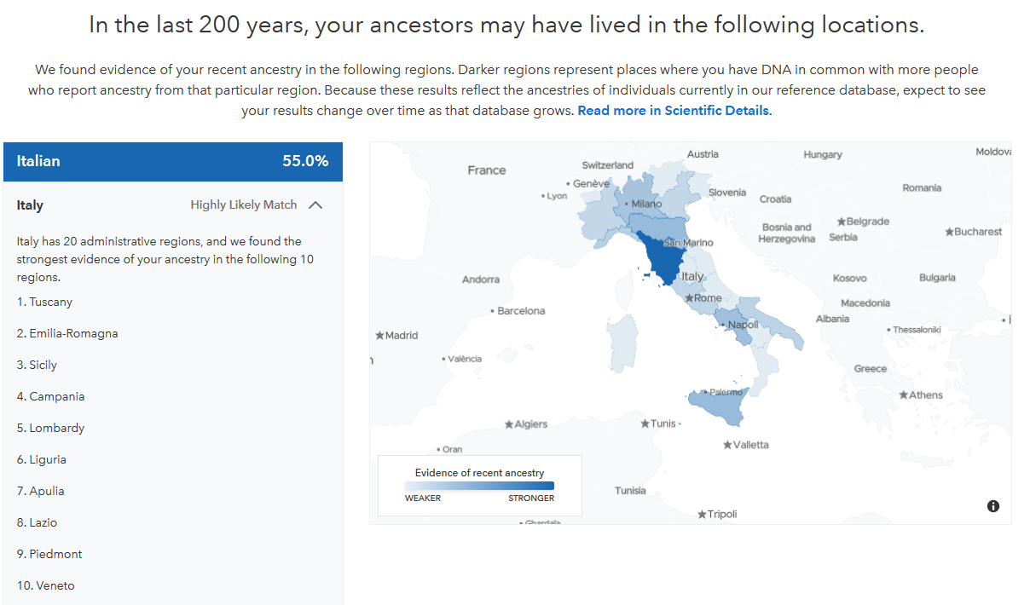

Slide 59
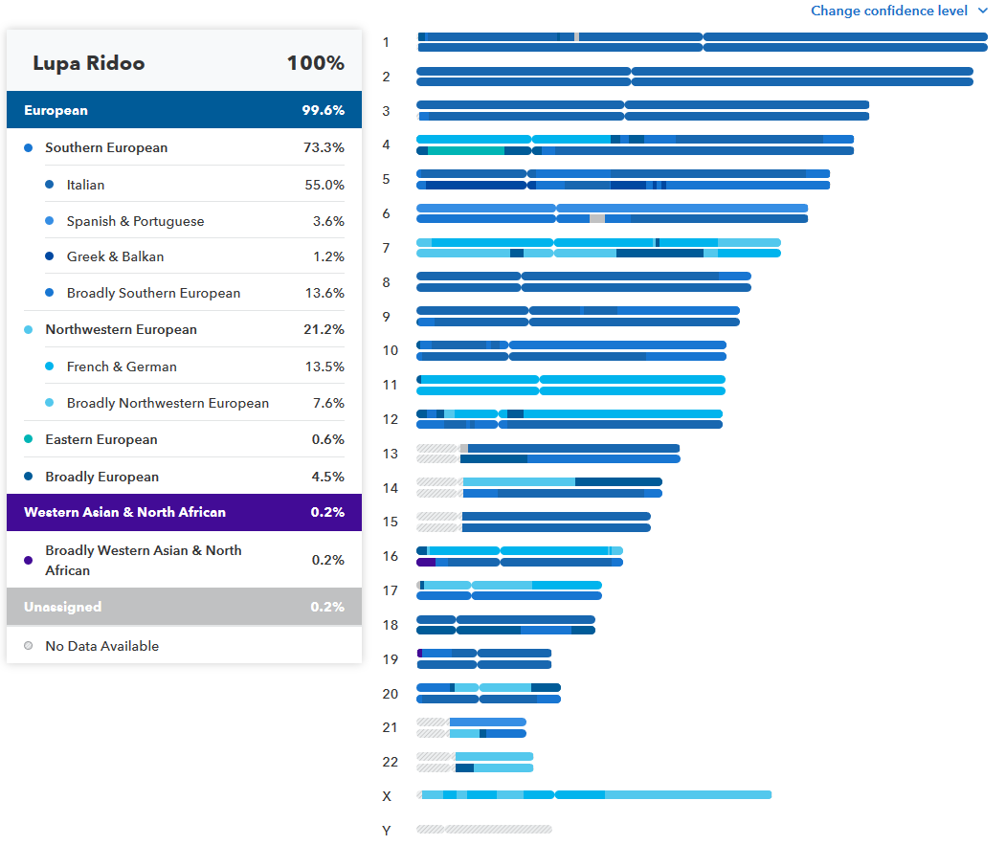

Slide 60



Slide 61
A peculiar case of increased similarity at certain loci: deliberate choice
Assortative mating is nonrandom mating based on phenotypes rather than between relatives. Positive-assortative mating or negative-assortative mating occurs if the mated pairs in a population are composed of individuals with the same phenotype more often, or less often, than expected by random mating, respectively.
An important difference between inbreeding and positive assortative mating is that inbreeding affects all loci, while assortative mating affects only those that play a role in the phenotype characteristics that are similar.

Slide 62

What about complex traits?
Yengo et al. 2018

Slide 63

What about complex traits?
Yengo et al. 2018

Slide 64


Assortative mating as a driver for natural selection (via increasing homozygosity)

Slide 65

Assortative mating as a driver for natural selection (via increasing homozygosity)

Slide 66
Thank you! luca.pagani@unipd.it

